Slide 1
Salt and sugar solution
By Ibrahim khouri

Slide 2
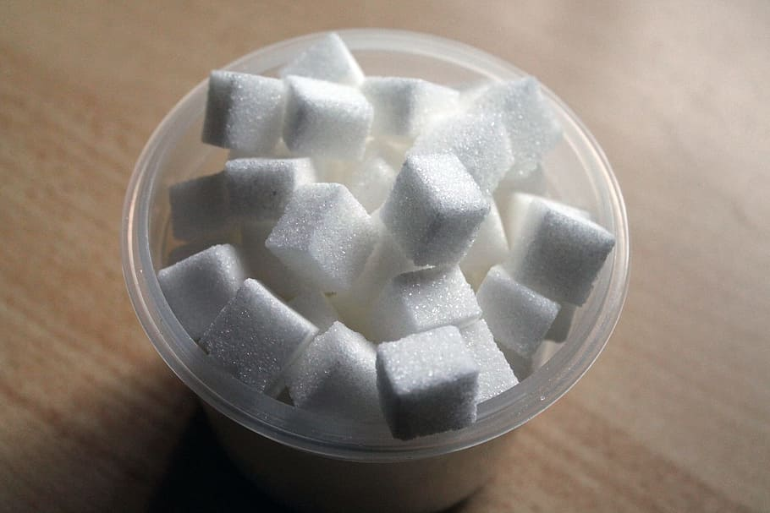
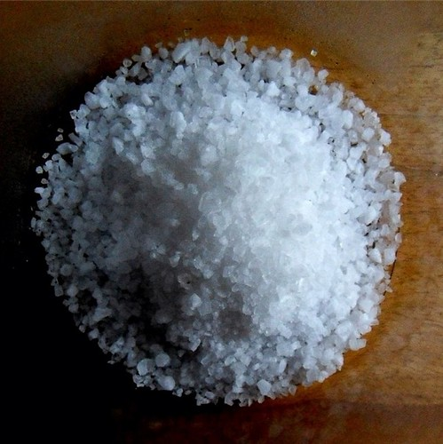
A salt and sugar solution is a mixture of salt, sugar, and water, most famously used as an oral rehydration solution (ORS) to treat dehydration from diarrheaA salt and sugar solution is a mixture of salt, sugar, and water, most famously used as an oral rehydration solution (ORS) to treat dehydration from diarrheaA salt and sugar solution is a mixture of salt, sugar, and water, most famously used as an oral rehydration solution (ORS) to treat dehydration from diarrheaA salt and sugar solution is a mixture of salt, sugar, and water, most famously used as an oral rehydration solution (ORS) to treat dehydration from diarrhea
This Photo by Unknown Author is licensed under CC BY

Slide 3
By dissolving the right proportions of salt and sugar in clean water, the solution helps to restore lost fluids and electrolytes, which can be a life-saving treatment. A common home recipe is one liter of water, six level teaspoons of sugar, and half a level teaspoon of salt, mixed until dissolved.

Slide 4
How to make a salt and sugar solution (ORS)
Ingredients:
1 liter of clean, safe water (boiled and cooled is best)
6 level teaspoons of sugar
1/2 level teaspoon of salt

Slide 5
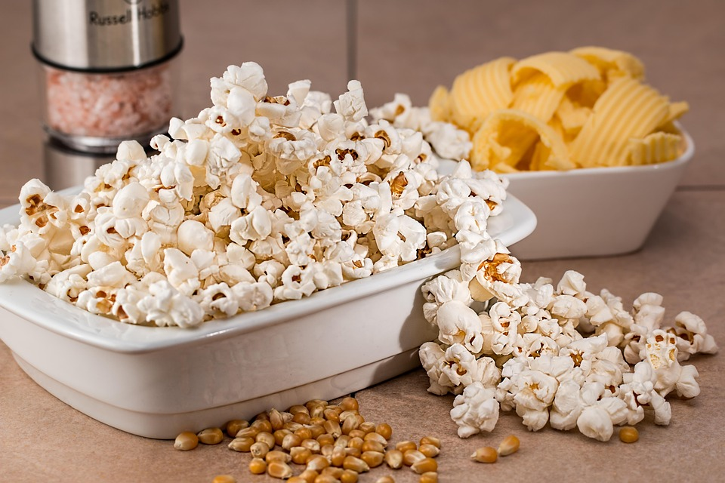
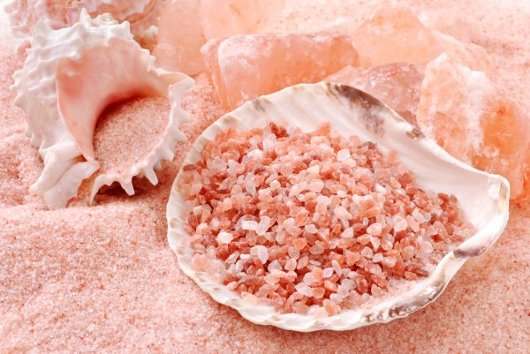
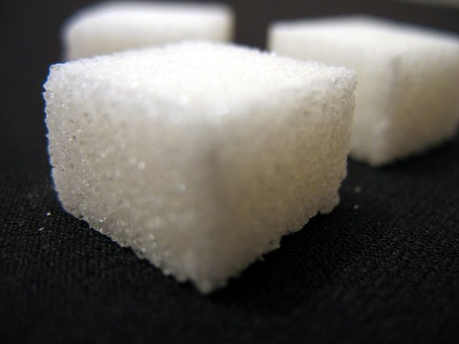
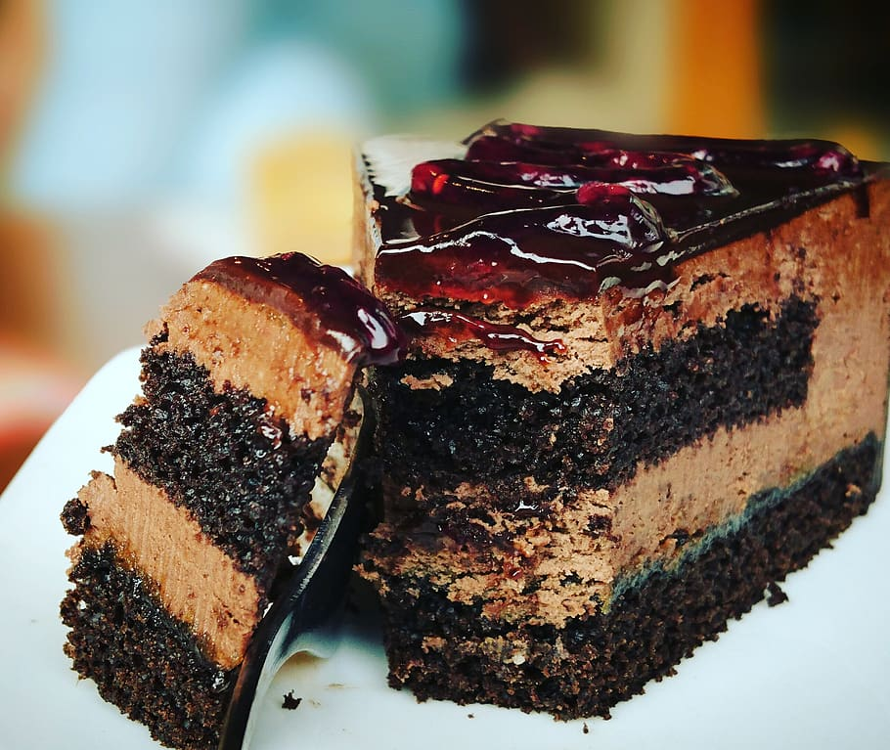
This Photo by Unknown Author is licensed under CC BY-SA
This Photo by Unknown Author is licensed under CC BY

