Slide 1
Opinion Essay

Slide 2
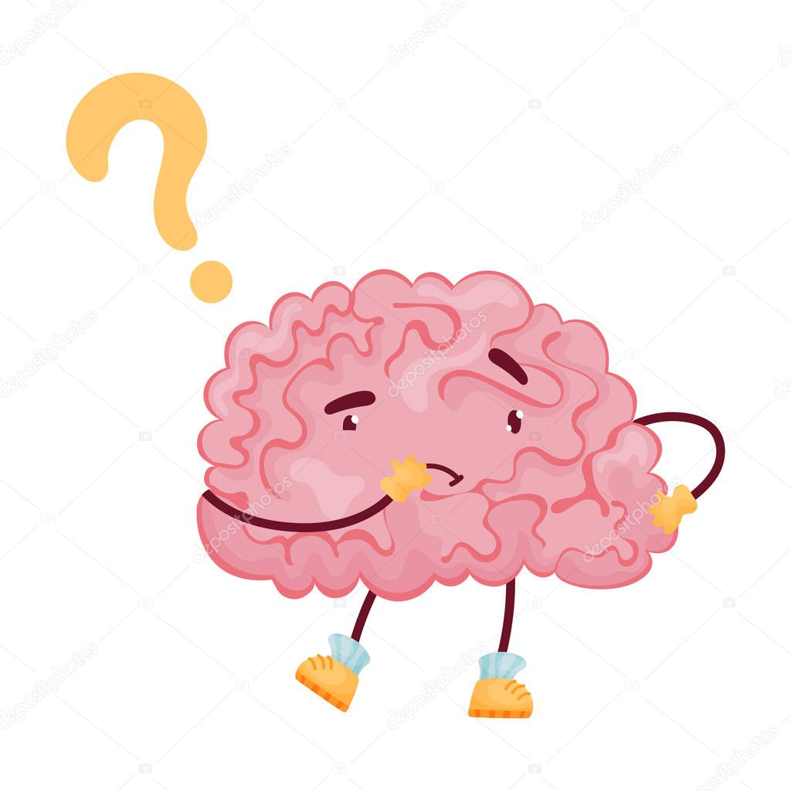
What is an opinion essay?
An opinion essay is a formal piece of writing that shows what a person thinks or feels about something or someone.

Slide 3
How to write an opinion essay?
To write an opinion essay we should use some words that we may write to show that we are stating an opinion

Slide 4

What are some words that we may write to show that we are stating an opinion?
I believe that
I think
I feel
My favourite
In my opinion

Slide 5
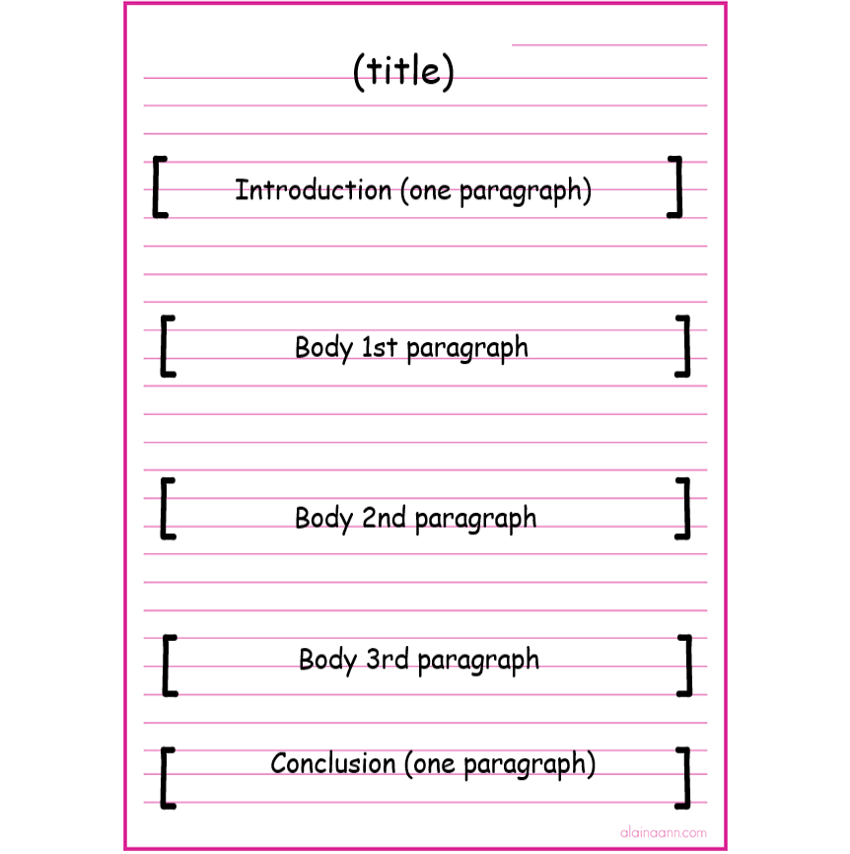
The structure of an opinion essay:
In the introduction (paragraph 1) you should mention:
-The topic/ problem
-Your opinion
In paragraphs (2+3) (body 1st and 2nd paragraphs) you should write:
-Your viewpoint + reasons/examples
In paragraph (4) (body 3rd paragraph) you should write:
- The opposing viewpoint + reasons/examples
In the conclusion (paragraph 5) you should :
-Restate your opinion

Slide 6

The structure of an opinion essay:
Introduction: (Paragraph 1)
↠The topic/ problem
↠Your opinion
2) The body (3 paragraphs):
Paragraph (2+3) ↠Your viewpoint + reasons/examples (2-3)
Paragraph (4) ↠The opposing viewpoint + reasons/examples
3) Conclusion: (Paragraph 5)
↠Restate your opinion

Slide 7
Introduction (You may start with a question)
To state the topic/problem. Example:
* There is no doubt that…
* Nowadays we are often told…
* There are various facts that support this opinion.
To express opinion. Example:
* In my opinion,... * I think...
* I believe that… * I feel that...
* It seems to me that… * In my view...

Slide 8
Main body : (each paragraph should present a separate viewpoint)
To list points. Example:
* First of all… * Secondly.../ Thirdly...
* In the first place… * Moreover/ Furthermore...
* To start/ begin with…
2) To introduce contrasting viewpoints. Example:
* As opposed to the above ideas... * There are people who oppose…
* People argue that… * Opponents to this view say…

Slide 9
Conclusion. (summaries what you’ve said + Restate your opinion using different words)
Example:
* To sum up…
* In conclusion…
* All in all, I still feel that…
* Taking everything into account…
* All things considered...

Slide 10
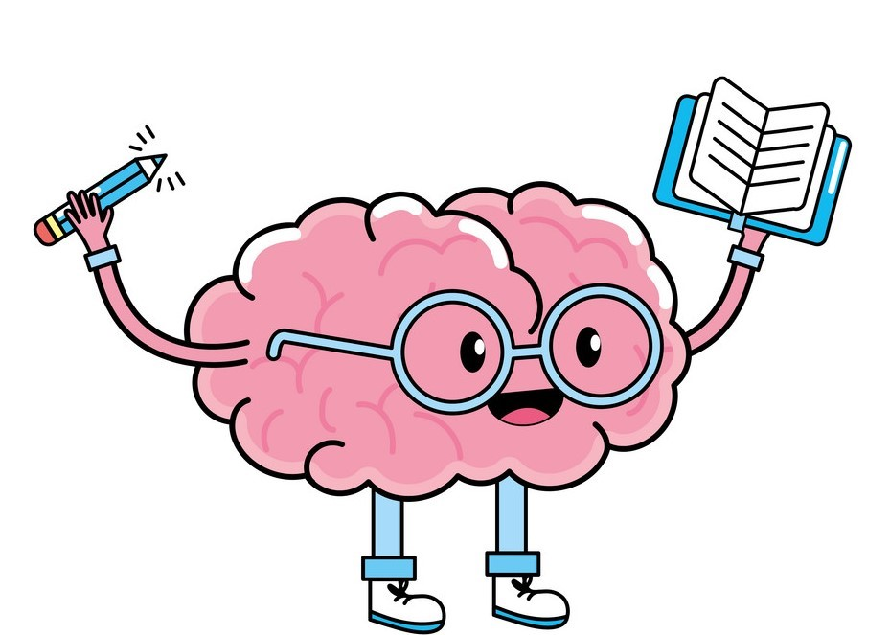
Let's practice

Slide 11
Computers are a necessity. Do you agree or disagree? Support your opinion with arguments and examples.

Slide 12
1- introduction ( state the topic and show your opinion clearly) :
Computers play an important role in the lives of most of us today, whether we realize it or not. Some people, however, are beginning to ask if we really need them. In my opinion, computers have become a necessary part of modern life.

Slide 13
2- Body 1st paragraph (mention reasons and examples) :
To begin with, computers can save a lot of storage space. Storing information on computer disks is one of the most efficient ways of keeping data. For example, one computer disk can hold the same amount of information as several books.

Slide 14
3- Body 2nd paragraph (mention more reasons and examples)
Furthermore, computers save everyone a lot of valuable time. Stored information can be found at the touch of a button, whereas searching for it manually takes much longer. For instance, nowadays we do not have to go to the shop to do the shopping when we can do it online using our computers.

Slide 15
4- Body 3rd paragraph ( Add the opposing viewpoint)
Nevertheless, there are those who claim that computers are unnecessary and make our lives more complicated. They argue that in the past we managed very well using other methods and that we have become too dependent on computers. I completely disagree with them especially that they fail to consider that the time saved by using computers for repetitive tasks, enables us to use our own time more creatively and productively.

Slide 16
5- Conclusion ( Sum up your opinion) :
All in all, I strongly believe that computers are a useful tool. They have changed our lives for the better and there is no reason why we should not make them work to our advantage.

Slide 17
Computers play an important role in the lives of most of us today, whether we realize it or not. Some people, however, are beginning to ask if we really need them. In my opinion, computers have become a necessary part of modern life.
To begin with, computers can save a lot of storage space. Storing information on computer disks is one of the most efficient ways of keeping data. For example, one computer disk can hold the same amount of information as several books.
Furthermore, computers save everyone a lot of valuable time. Stored information can be found at the touch of a button, whereas searching for it manually takes much longer. For instance, nowadays we do not have to go to the bank to do the shopping when we can do it online using our computers.
Nevertheless, there are those who claim that computers are unnecessary and make our lives more complicated. They argue that in the past we managed very well using other methods and that we have become too dependent on computers. I completely disagree with them especially that they fail to consider that the time saved by using computers for repetitive tasks enables us to use our own time more creatively and productively.
All in all, I strongly believe that computers are a useful tool. They have changed our lives for the better and there is no reason why we should not make them work to our advantage.

