Slide 1



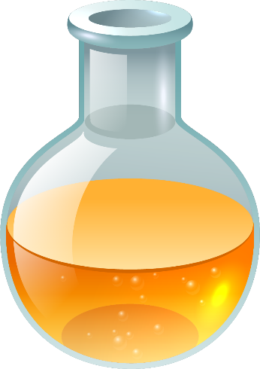

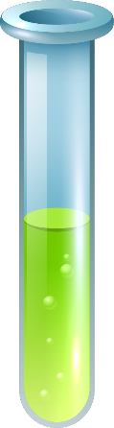
Making and separating solution

Slide 2
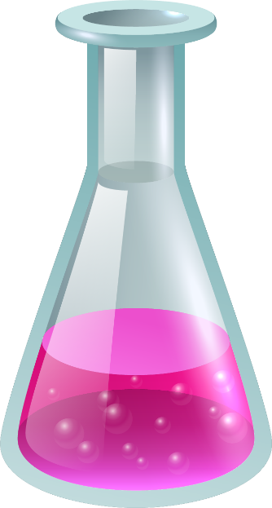
In this section, I am learning:
1- The meaning of mixtures, dissolve, solution, solvent and solute.
2- The difference between soluble or insoluble.
3- How to separate a mixture by sieving, filtering, evaporation or hands .

Slide 3
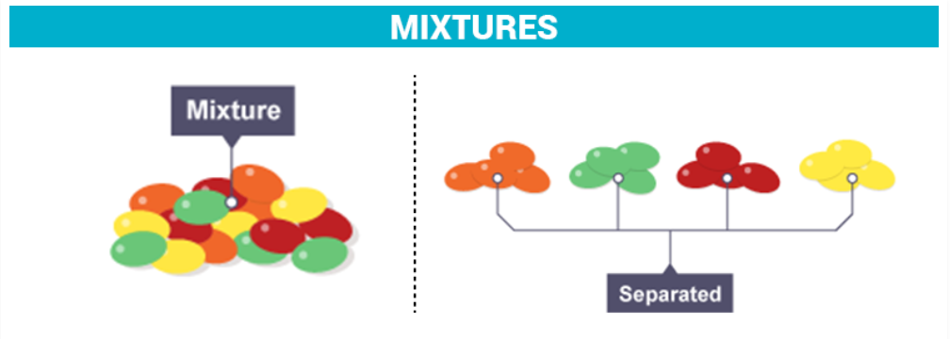
01
Mixtures
A mixture contains two or more solids mixed together.
The substances in a mixture of two solids can be separated.

Slide 4
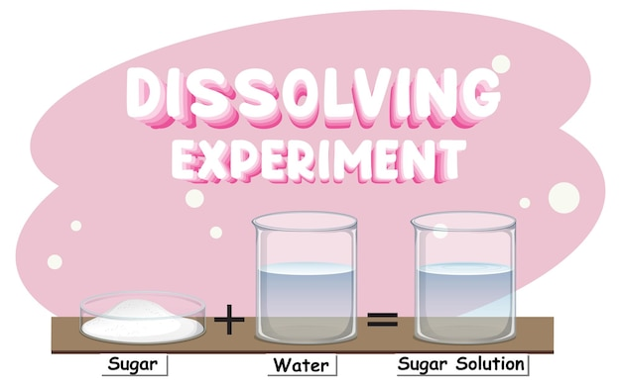
Dissolving
02
When some solids with small particles mix with a liquid like water, they dissolve and form a mixture called solution.

Slide 5
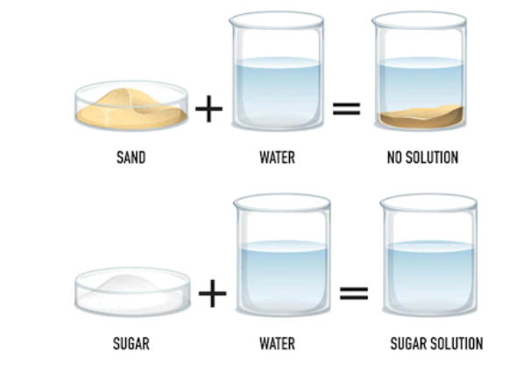
When the particles of the solid dissolve, the solution is clear. The particles do not settle at the bottom of the container and you cannot see any of them as they are invisible.

Slide 6
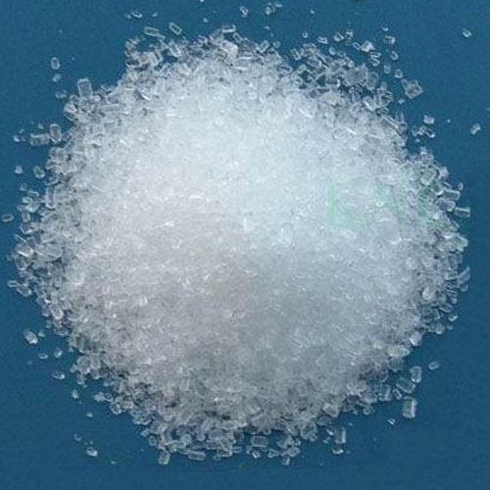
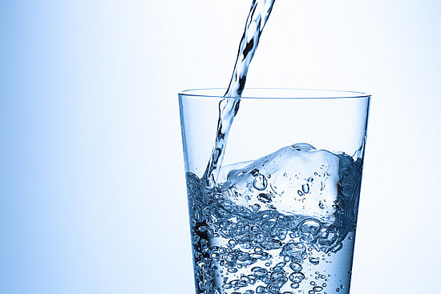
Soluble ,solvent and solute
Solute
Solvent
Solution
A solid that dissolves in solvent is called solute.
Salt is a solute.
A liquid in which particles of solute dissolve in.
Water is a solvent .
A mixture of solute and solvent.
+

Slide 7
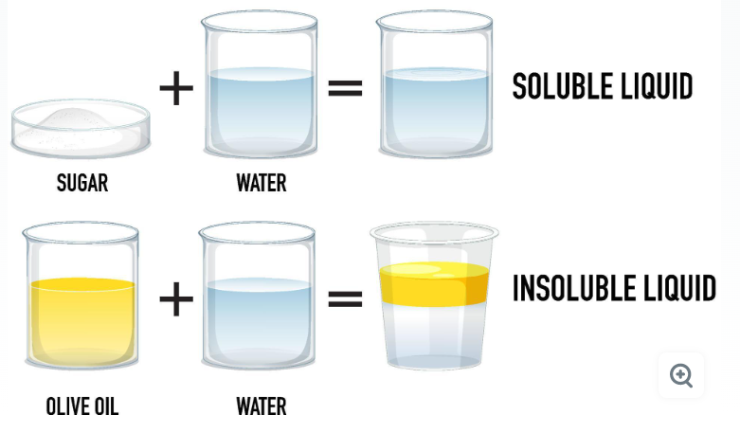
If a solid doesn’t dissolve in a liquid but drops to the bottom, it is called insoluble

Slide 8
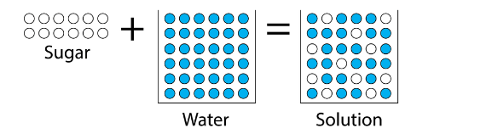
Remember
Some materials dissolve in water but others do not.
The materials that dissolve in water are described as soluble.
The mixture of the dissolved material and water is called solution.
Materials that do not dissolve in water are described as insoluble.
When a material dissolves in water, it seems to disappear, but it doesn't. The material particles mix completely with the water particles but the particles of the solid are still in the solution.

Slide 9
You can separate mixtures in different ways:
Hands
Filtering
Evaporation
Sieving

Slide 10
How to separate a mixture by sieving or filtering?
03
Substances in mixtures of two solids can be separated so that they are no longer mixed up.
You can separate the substances in a solution. This means you can separate the solute and the solvent .
This means that dissolving is reversible. It is a change that can be undone; it can be reversed.

Slide 11
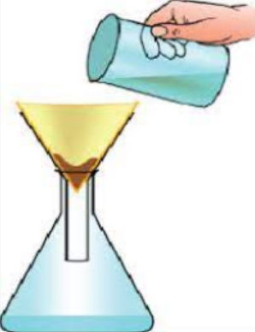
Filtering ground-up coffee
When coffee beans are roasted, they can be ground up to make coffee powder which dissolves in hot water.
The soluble pass through filter paper in the filter funnel .
The insoluble bits of ground –up coffee beans are left in the filter paper.
Filter paper
Coffee
Filter funnel
Coffee solution

Slide 12
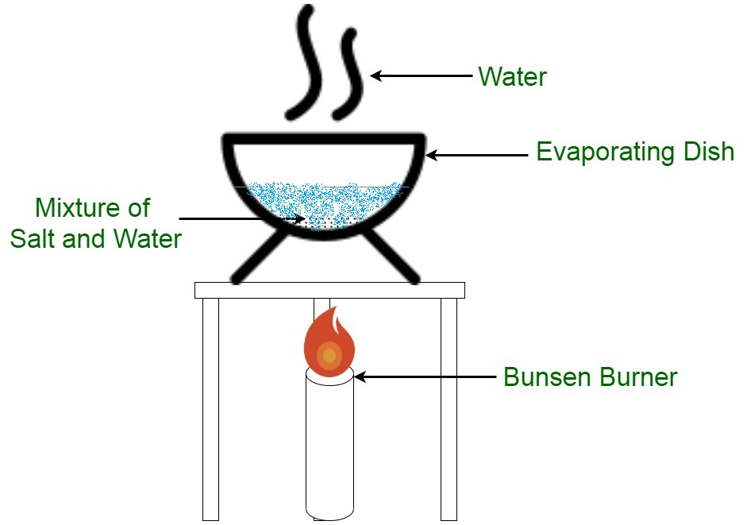
Evaporating solutions
Salt dissolves in water.
It becomes a salt solution.
To get the solid salt back from the solution, we need to evaporate the water off.
When the water evaporates from the salt solution, the salt is left behind.

Slide 13
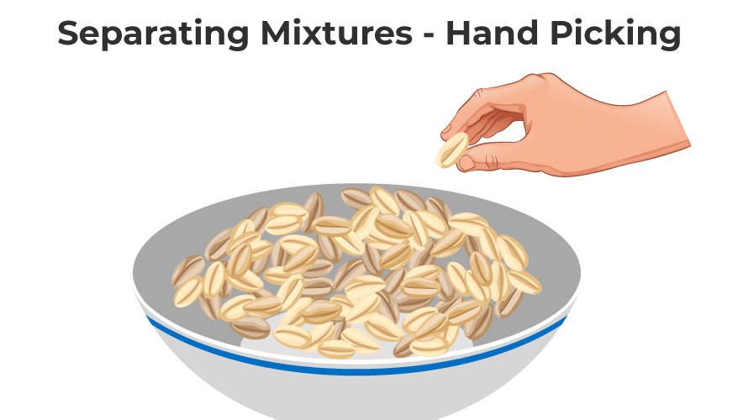
Separating mixtures by using your hands
In this way the substances in a mixture can be separated by just picking them out with the help of the hand from the mixture

Slide 14
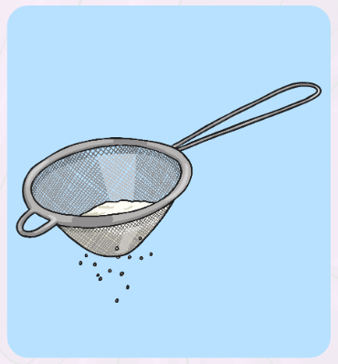
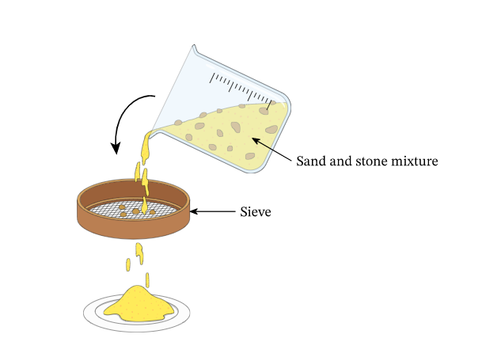
Separating mixtures by using a sieve
Sieving is the process of parting a mixture using a sieve. Sieving is used to separate solid mixtures that contain components of different sizes.

