Slide 1




Types of Sentences

Slide 2
Objectives
1.Identify different types of sentences (statements, command, question , and exclamatory)
2. Write different types of sentences using the correct punctuation marks.

Slide 3
There are 4 types of sentences
1. A statement
2. A command
3. A question
4. An exclamatory

Slide 4
A statement :
1.Tells us some information about something.
2. Starts with a capital letter.
3. Ends with a full stop.

Slide 5

Example:
Leaves fall in Autumn.

Slide 6
A question:
Asks about something.
Starts with a question word such as:
Who/ When / Where / Why / What / which.
3. Ends with a question mark (?)

Slide 7
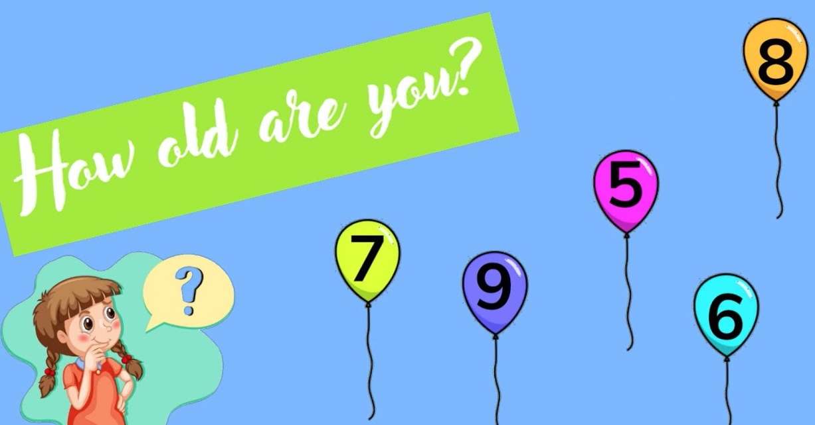
Example:
How old are you ?

Slide 8
A command:
Tells us to do something.
Starts with a verb.
Ends with a full stop. (.)

Slide 9
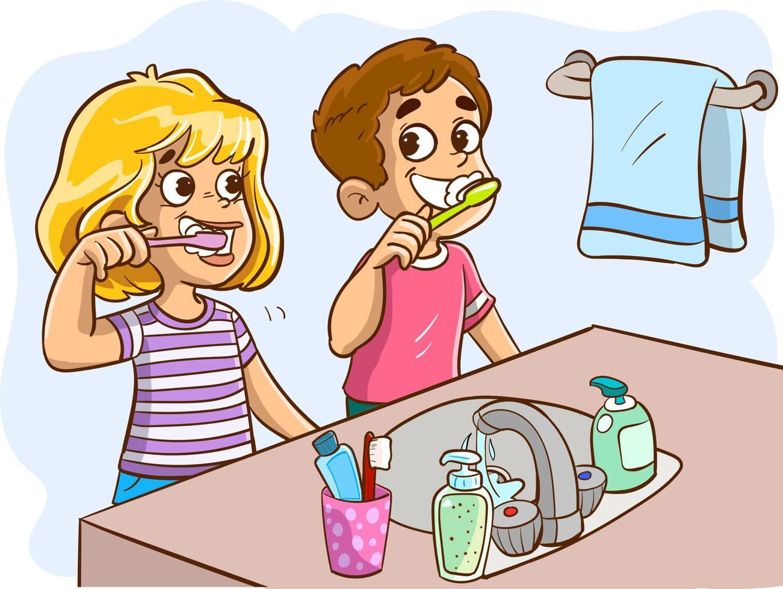
Example:
Brush your teeth.

Slide 10
An exclamatory:
1. Expresses strong feelings
2. Ends with an exclamation marks ( ! ).

Slide 11
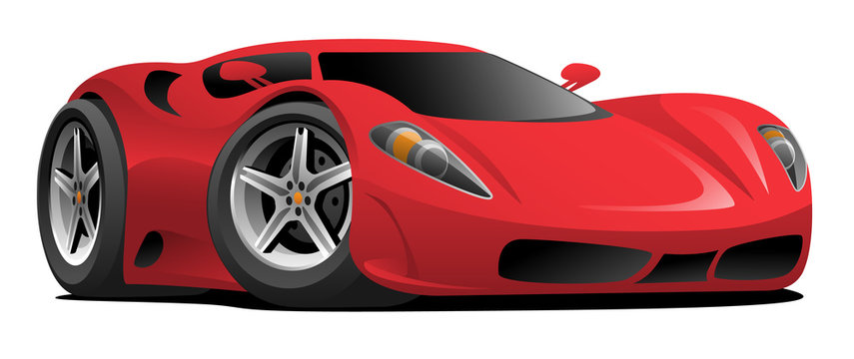
Example:
Wow ! It is a beautiful car !

Slide 12
Identify whether each of the following sentences is a question, a statement , a command or exclamatory.
1. Watch out! The dog is coming!
2. What is your favourite pet?
3. Wash your hands.
4. I like pizza.

Slide 13
Identify whether each of the following sentences is a question, a statement , a command or exclamatory.
1. Watch out! The dog is coming! (e)
2. What is your favourite pet? (q)
3. Wash your hands.(c)
4. I like pizza. (s)

Slide 14
Identify whether each of the following sentences is a question, a statement , a command or exclamatory.
5. Listen carefully.
6. Why are you sad?
7. I can read Arabic .
8. Oh no! I lost my bag !

Slide 15
Identify whether each of the following sentences is a question, a statement , a command or exclamatory.
5. Listen carefully.(c)
6. Why are you sad? (q)
7. I can read Arabic. (s)
8. Oh no! I lost my bag! (e)

Slide 16

Read the sentences ,then choose the correct answers.

Slide 17



Where do you live?
statement
command
question
exclamatory

Slide 18

Open your book.
statement
command
question
exclamatory
exclamatory

Slide 19
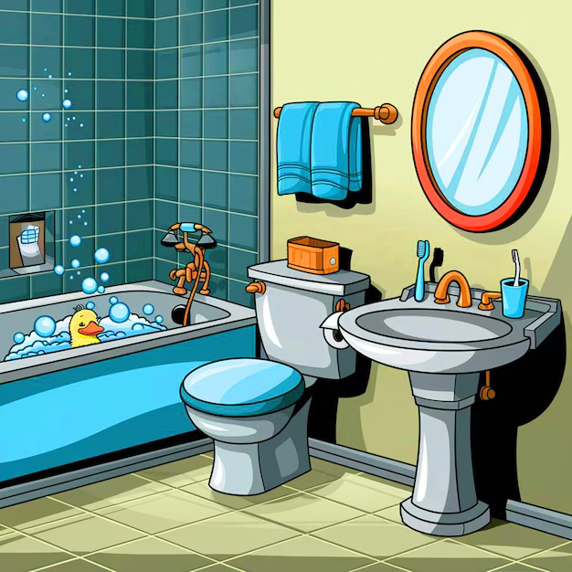
Where is the bathroom?
statement
command
question
exclamatory

Slide 20

My friend speaks many languages .
statement
command
question
exclamatory

Slide 21

Drink your milk.
statement
commarnd
question
exclamatory
exclamatory

Slide 22

We won the game!
statement
command
question
exclamatory

Slide 23

I have five pencils.
statement
command
question
exclamatory

Slide 24
I’m so proud of you!
Statement
command
question
exclamatory

Slide 25

I like to drink tea.
statement
command
question
exclamatory

Slide 26
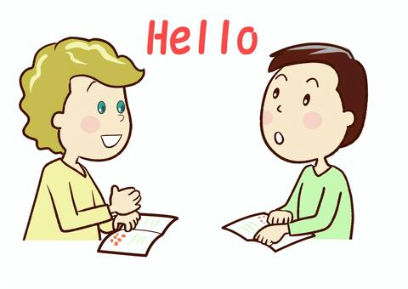
Your Engish is great !
statement
command
question
exclamatory

Slide 27

What is your name?
statement
command
question
exclamatory

Slide 28

Teacher: Maram Moien Dayoub

