Slide 1
Our Amazing Organs Human Internal Organs
Grade 2 Science Unit 4

Slide 2
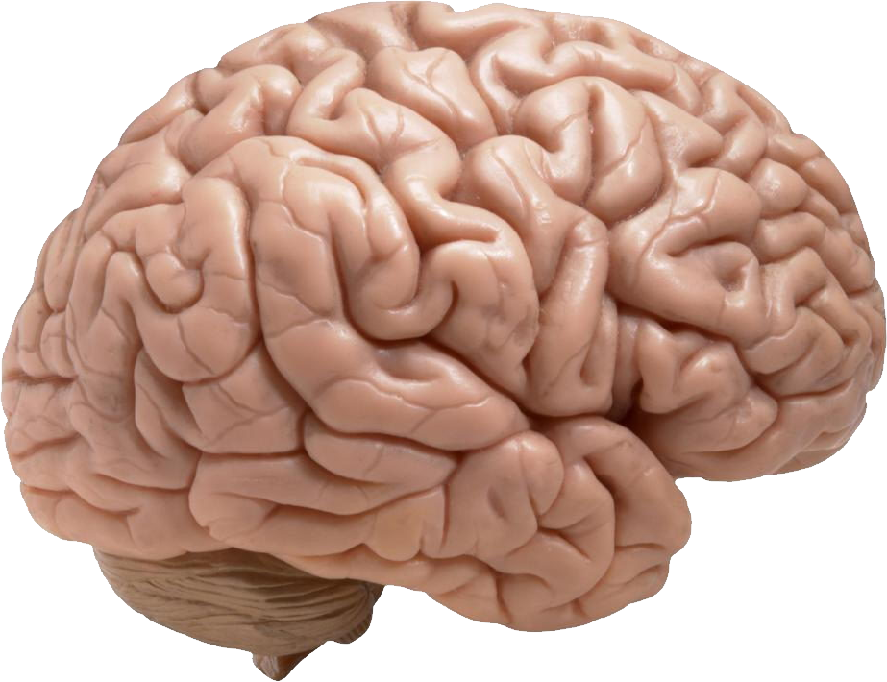
The Brain 🧠
• The brain helps us think and learn.
• It controls our body and feelings.

Slide 3
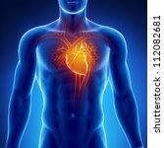
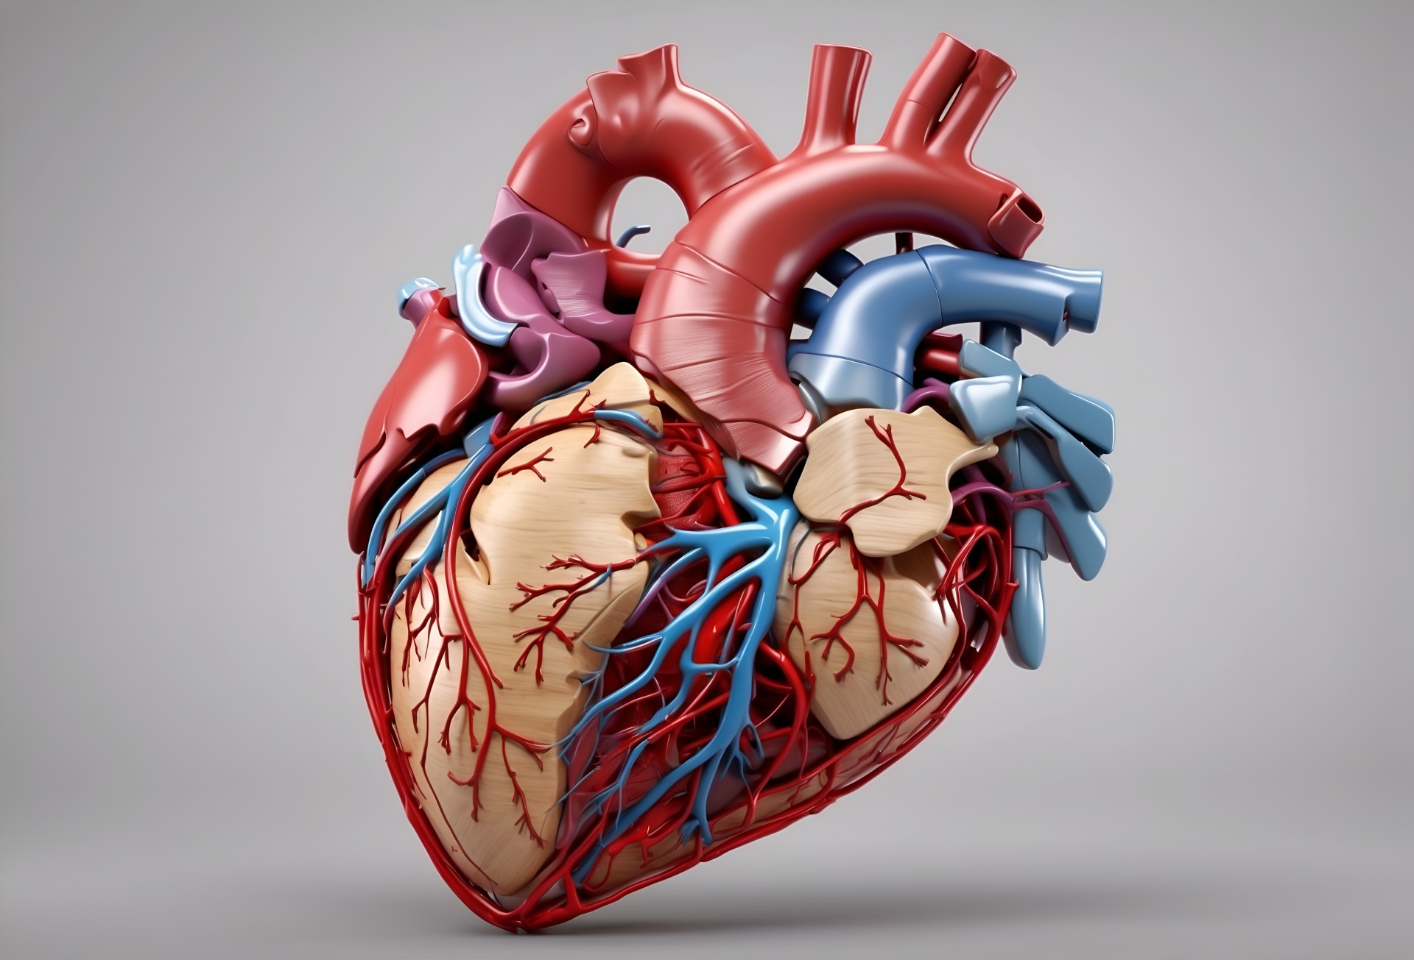
The Heart ❤️
• The heart pumps blood all around the body.
• It beats all the time, even when we sleep!

Slide 4
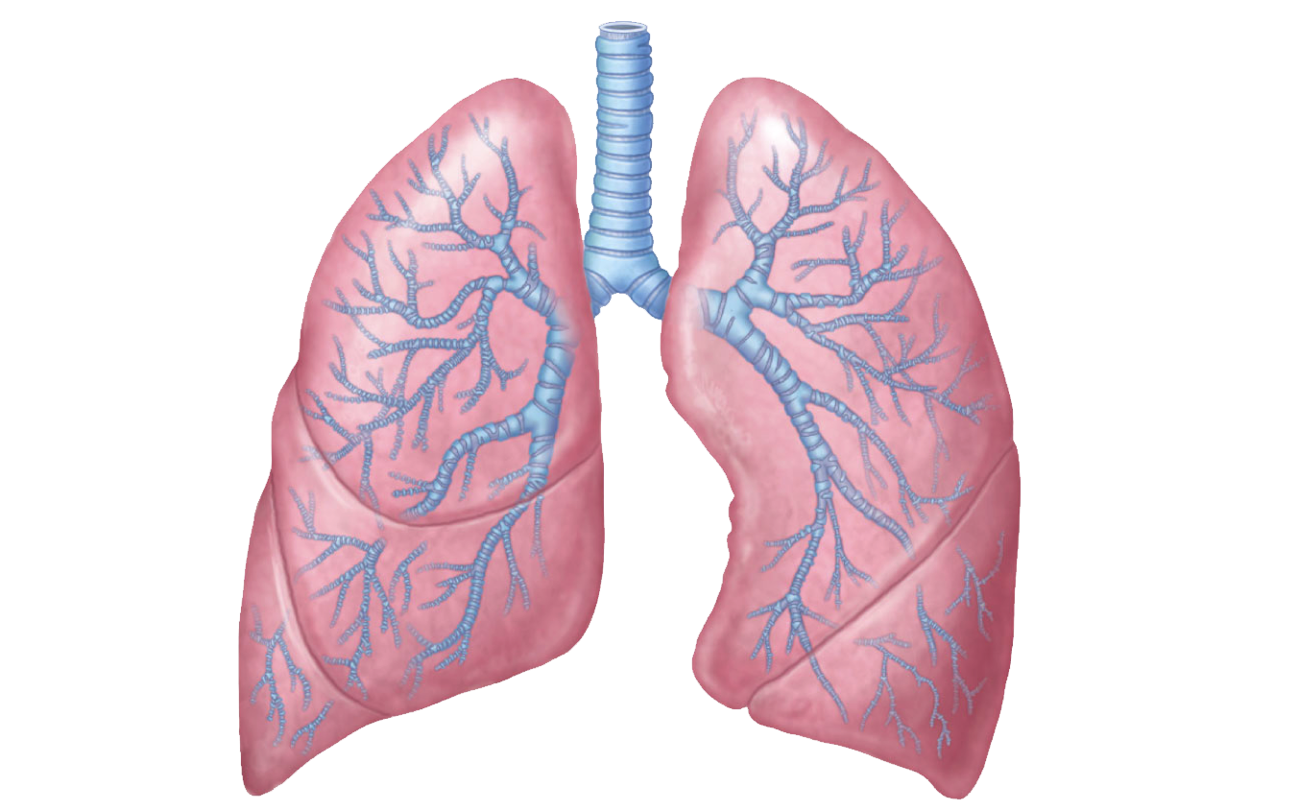
The Lungs 🫁
• The lungs help us breathe in air.
• They take in oxygen and send it to the blood.

Slide 5

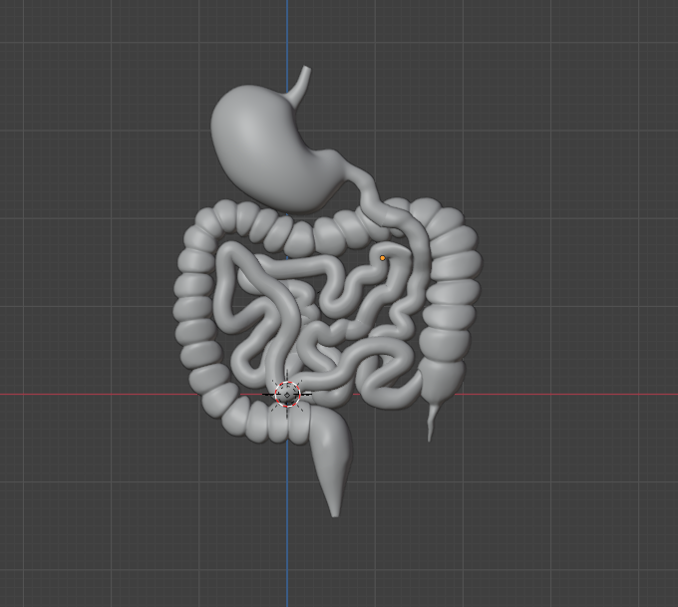
The Stomach 🍽️
• The stomach helps digest food.
• It breaks food into small pieces.

Slide 6
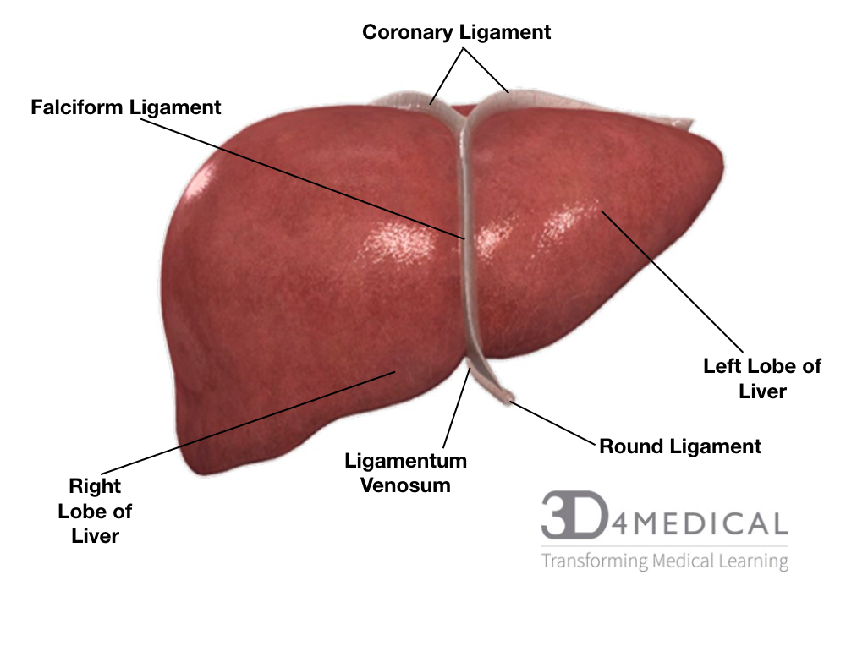
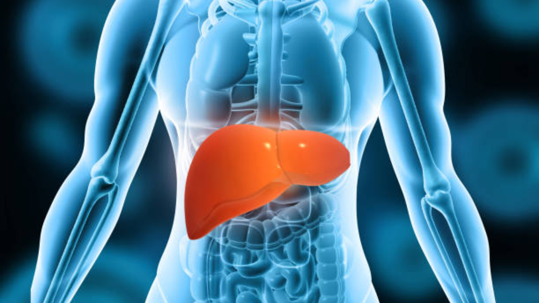
The Liver 🍏
• The liver cleans our blood.
• It helps our body digest food.

Slide 7

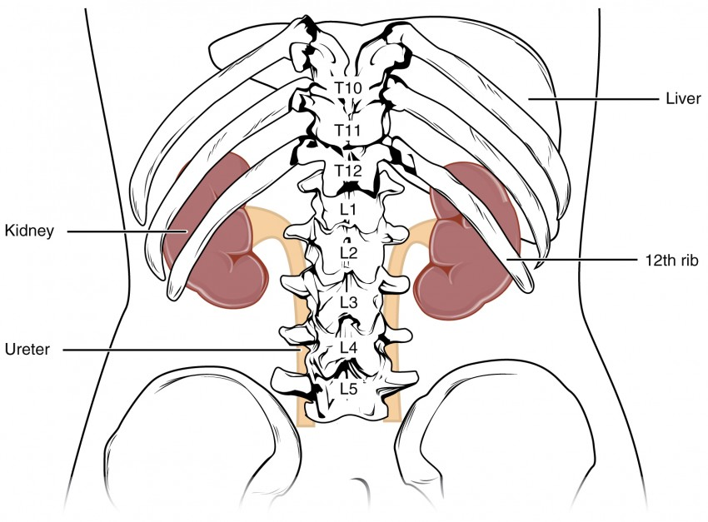
The Kidneys 💧
• The kidneys clean our blood.
• They help make urine to remove waste.

Slide 8
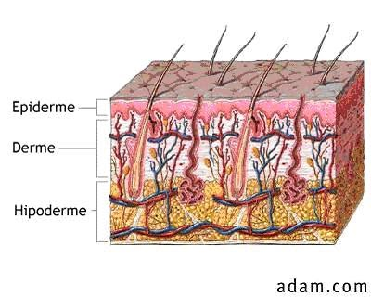
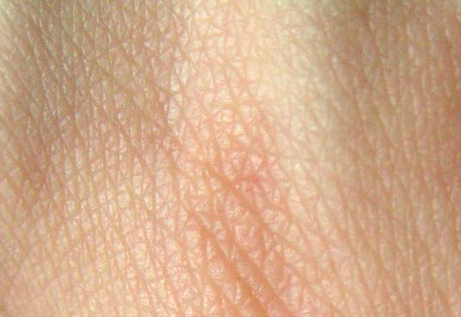
The Skin 🦴
• The skin covers and protects our body.
• It keeps germs out and keeps us safe.

Slide 9
Let’s Remember!
Our organs help us:
🧠 Think ❤️ Pump blood 🫁 Breathe 🍽️ Digest 💧 Clean 🦴 Protect

