Slide 1
Materials and their structure Compound
6th Grade

Slide 2
TABLE OF CONTENTS
01
02
What is a compound?
Properties of elements and compounds
03
04
Particle diagrams
Using formula

Slide 3
Remember!
An elements is made up of only one type of atoms.

Slide 4
What is a compound?
Different types of atoms joined tightly together.

Slide 5
Elements are made up of only one type of atoms.
Element1
Element2
Each element has its own properties

Slide 6
Compounds are made of different types of atoms joined tightyly together.
+
Element1
Element2
Compound

Slide 7
Once the elements are bonded, they lose the properties, and the compound has a new properties.
The chemical term for two atoms joining together is bonding.

Slide 8
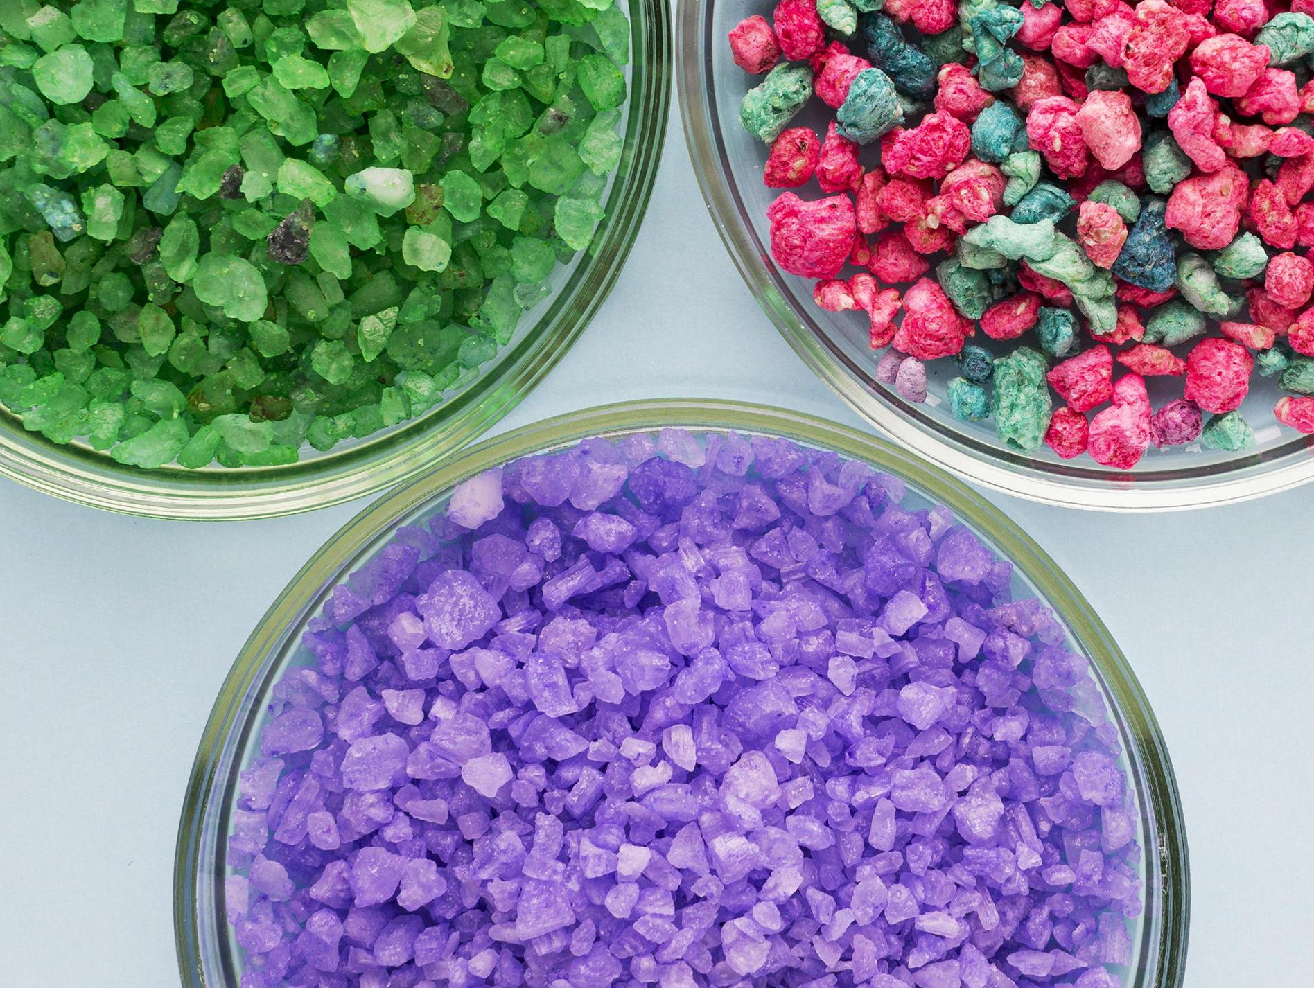
Example on compounds
If you combined
sodium with chlorine
+
Sodium chloride (salt)

Slide 9
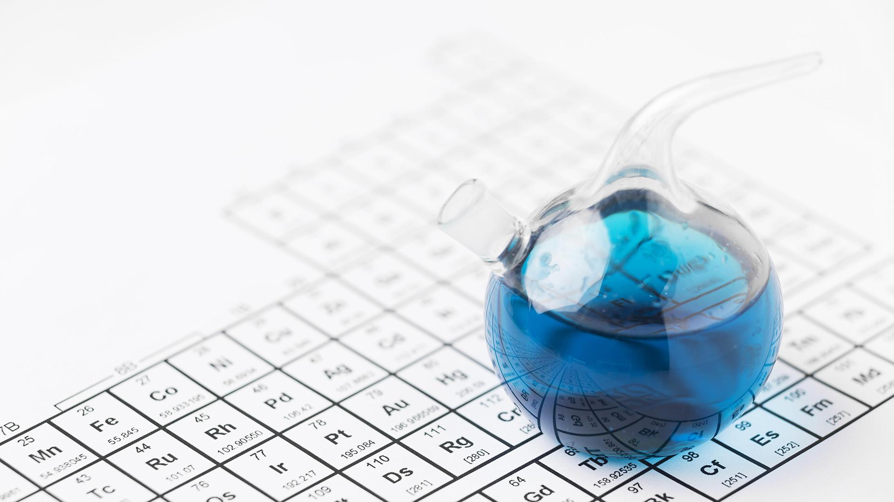
How can you tell that this is a compound by looking at the particle diagram ?

Slide 10
If there are different kinds of atoms bonded together then it is a compound.

Slide 11
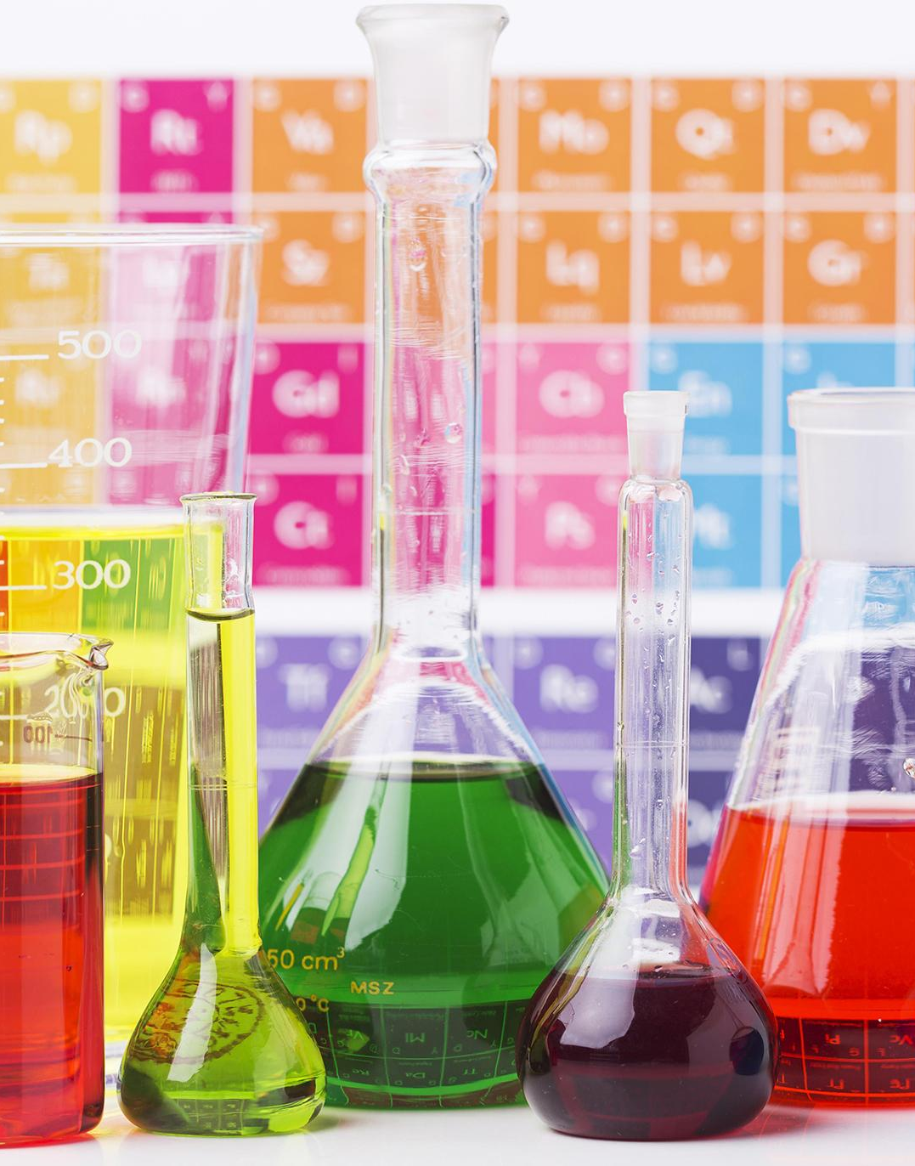
Every compound has a chemical name for example the compound of sodium and chlorine is sodium chloride
Every compound has a formulae .
The formula contains the symbols of elements that are bonded together in the compound.

Slide 12



Here are some examples on formula
CaCo3
NaOH
H2O
CaCo3
CH4
O2 ???

