Slide 1
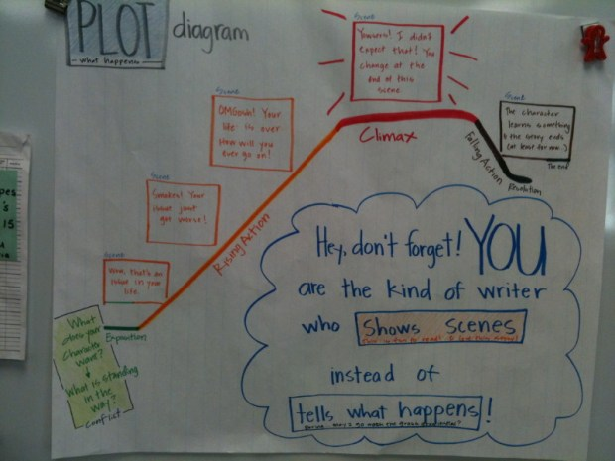
Story Elements: The Plot
The plot is the sequence of events that tell what happens in a story — the beginning, middle, and end!

Slide 2
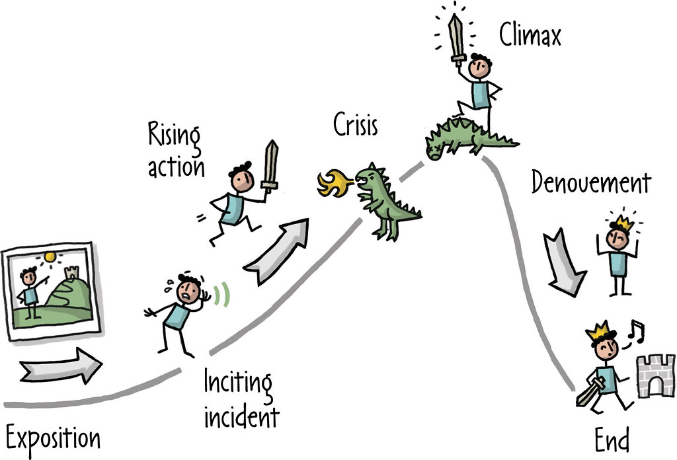
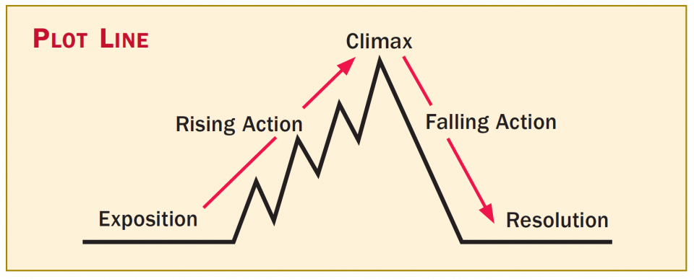
Parts of a Plot
✨ Beginning: The story starts and characters are introduced. 🌈 Middle: The problem or main event happens. 🏆 End: The problem is solved and the story ends happily!

Slide 3
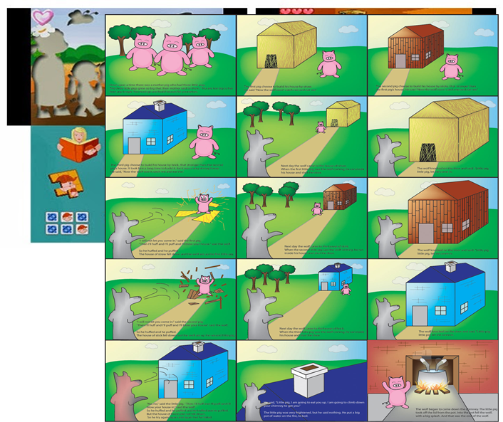
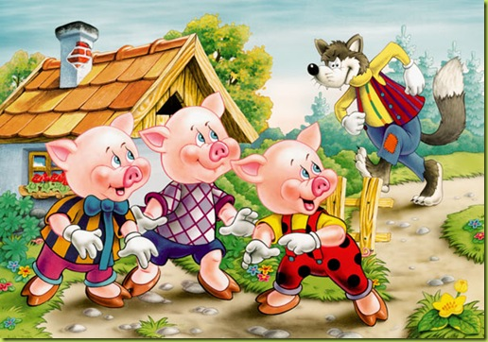
Example Story:
The Three Little Pigs
🐷 Beginning: The pigs build their houses. 🐺 Middle: The wolf blows the houses down! 🏡 End: The pigs are safe in the brick house.

Slide 4
Activity Time!
Create your own story! Draw or write what happens in the Beginning, Middle, and End. Be creative and use colorful drawings!

