Slide 1
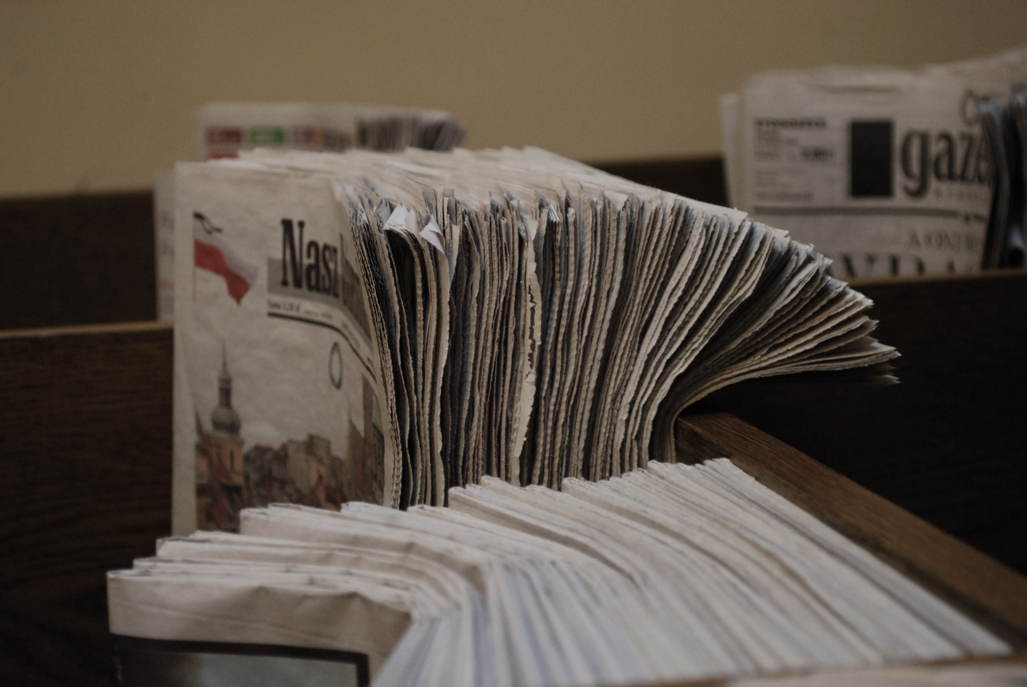
Features of Magazine & Newspaper Articles
Nataly Hamarneh

Slide 2
What Are Magazine and Newspaper Articles?
Both are forms of factual writing, to inform, entertain, or persuade readers.
Magazine articles are often longer, detailed, and expressive, while newspaper articles are shorter, direct, and focused on certain events.

Slide 3

The art of building an article
1. Catchy title/headline
2. Engaging introduction
3. Subheadings (optional)
4. Varied sentence structures
5. Formal tone
6. Personal opinions and anecdotes (Quotations in direct speech)
7. Conclusion or reflection
8. Third person
9. Past tense

Slide 4

Features
Lead paragraph – who, what, when, where
Body – supporting details in order of importance (why, how)
Quotes from people involved
Conclusion – summary or future outlook
Objective and formal tone

