Slide 2

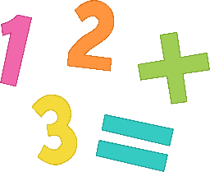

A number pattern is a sequence of numbers that follow a certain rule.
This is a number pattern:
1, 2, 3, 4, 5, 6
The rule is add 1 each time
Click here to see how this works.

Slide 3
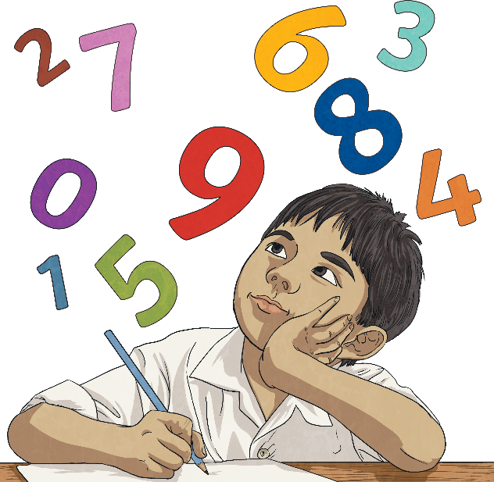
What would the next number be in this pattern?
1, 2, 3, 4, 5,
+1
2
+1
+1
+1
+1
3
4
5
6
1 + 1 = 2
2 + 1 = 3
3 + 1 = 4
4 + 1 = 5
5 + 1 = 6

Slide 4


What is happening each time?
5, 10, 15, 20, , ,
+5
+5
+5
25
30
35
Can you figure out what the next numbers in this sequence would be?
35 + 5 = 40

Slide 5
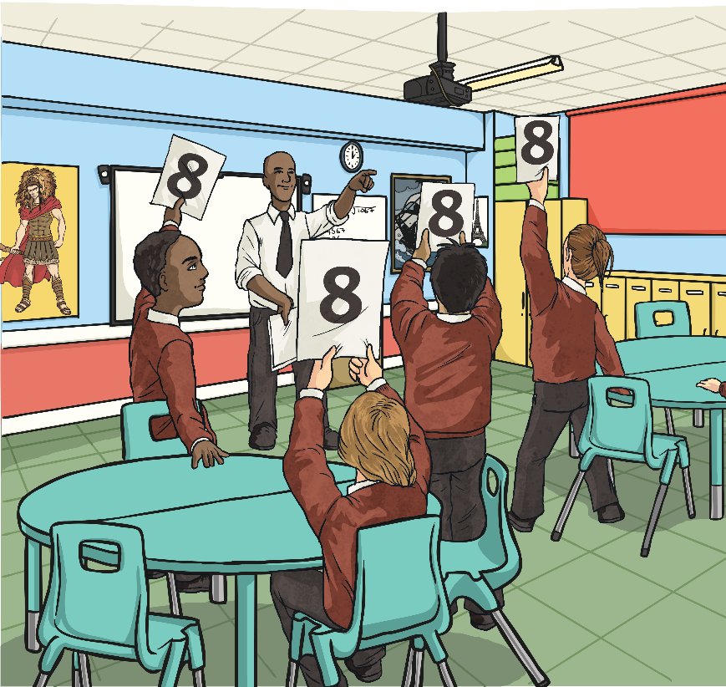
Number sequences can use addition, subtraction, multiplication or division.
Each rule can include whole numbers or decimal numbers.
+
-
Let’s look at some trickier sequences!

Slide 6

Can you finish this number sequence?
48, 45, 42, 39,___, ___.
-3
-3
-3
-3
-3
36
33
What is the term to term rule?

Slide 7
Now, can you figure out the missing numbers and the rule in these sequences?
13, 17, 21,___, ___
25
29
rule = add 4
95,___, 75, ___, 55, 45, ___
85
65
35
rule = subtract 10
10.1, 11.2, 12.3,___, ___, 15.6
13.4
14.5
rule = add 1.1

Slide 8
Let’s look at these even trickier number patterns. Can you figure out the missing numbers and the rule in these sequences?
10, 8, 6, 4, ___, 0, ___
2
-2
rule = -2
15, ___, 5 , 0, -5, ___
10
-10
rule = -5
7, 14, 21, 28, 35, ___, ___
42
49
rule = add 7

Slide 9

Think Reversely
Here is a part of a sequence
3, 6, 9, 12 ……….
Which of the following numbers will not be in the sequence
15 24 30 16 18

Slide 10




Shape patterns
Pattern number | Number of shapes
1
2
3
4
Pattern number | Number of shapes
1 | 6
2 | 8
3 | 10
4 | 12

