Slide 1
Light and Shadow
Grade 2 Science
Unit 3

Slide 2
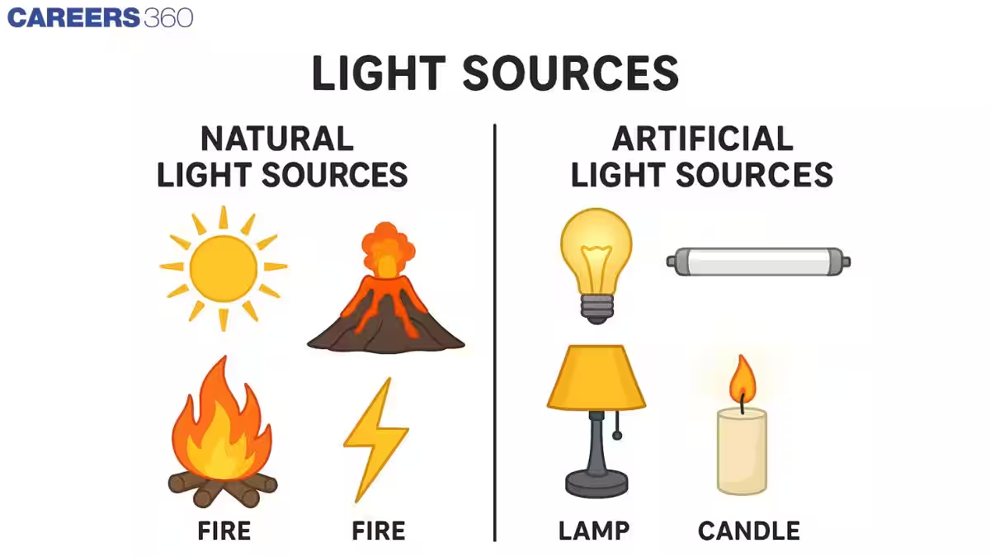
What is Light?
Light helps us see things around us.
The Sun is our main source of light.
Other sources: lamp, flashlight, candle.

Slide 3
Sources of Light
Natural Sources: Sun, fire, stars
Man-made Sources: Bulb, torch, candle
Activity: Point to things in the classroom that give light.

Slide 4
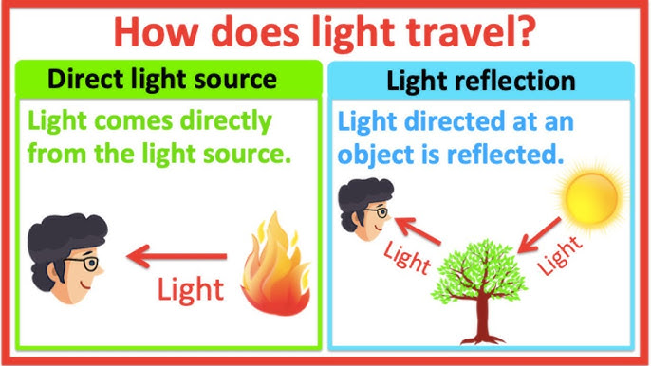
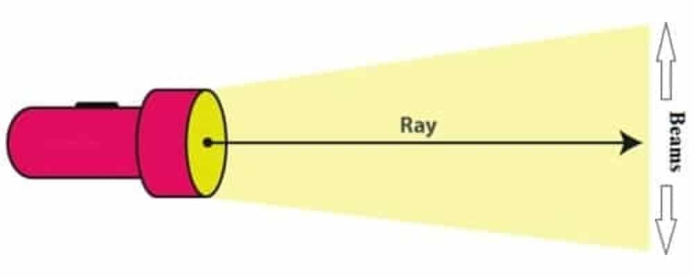
How Light Travels
Light travels in a straight line.
It can bounce off shiny surfaces.

Slide 5
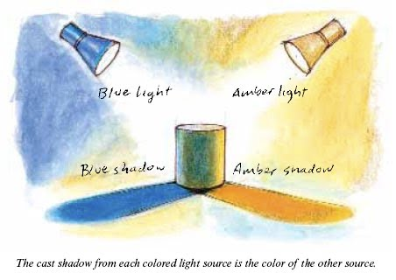
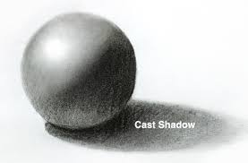
What is a Shadow?
A shadow is made when light is blocked by an object.
Shadows are dark shapes.

Slide 6
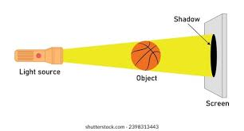
How Shadows are Formed
1. Light shines on an object.
2. The object blocks the light.
3. A shadow appears behind the object.

Slide 7
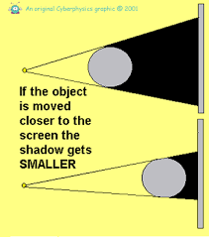
Changing Shadows
Shadows change size and shape during the day.
When the sun is high → short shadow
When the sun is low → long shadow.

Slide 8
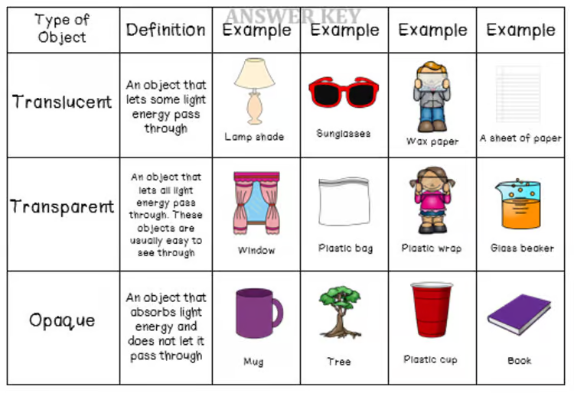
Transparent, Translucent, Opaque
Transparent: Glass → Light passes through
Translucent: Paper → Some light passes
Opaque: Book → No light passes.

Slide 9
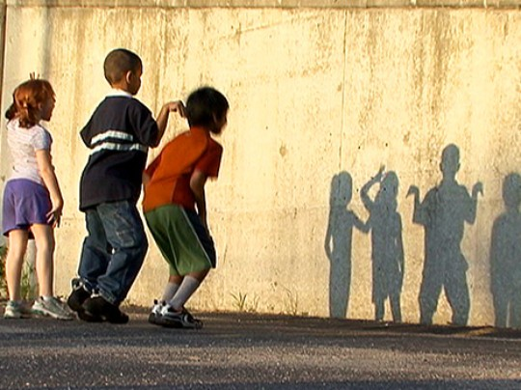
Fun Activity: Shadow Play!
Use a flashlight and toys to make shadows on the wall.
Move the toy closer or farther from the light to see what happens!

Slide 10
Summary
✅ Light helps us see.
✅ Light travels in straight lines.
✅ Shadows form when light is blocked.
✅ Shadow size changes with the sun.

Slide 11
Let's Review!
1. What is the main source of light?
2. What happens when light is blocked?
3. Name one opaque object.

Slide 12
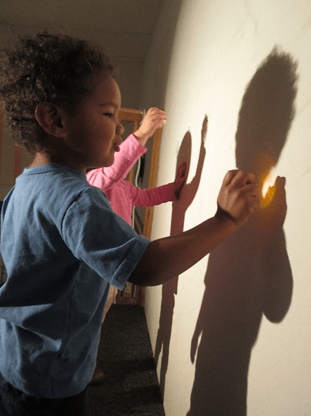
Thank You!
Great Job, Scientists! 🌞

