Slide 1
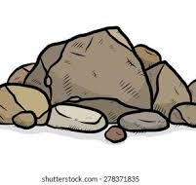
Rocks
How to get started with 3D in PowerPoint

Slide 2

Rocks are hard, natural materials that are found on the ground.

Slide 3
We have different types of rocks that we use .
Granite
Marble
Chalk
Slate
Coal

Slide 4
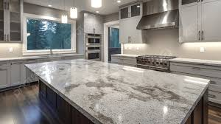
Granite Granite is a hard rock People use granite to make buildings, floors, and countertops because it is very strong.

Slide 5

Marble Marble is a smooth, shiny rock, it is used to make beautiful things like statues.

Slide 6
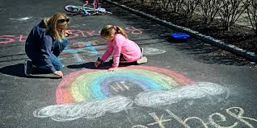
Chalk
Chalk is a soft white rock that can be used for writing or drawing on a board.

Slide 7
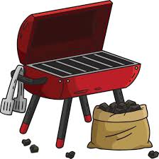
Coal
Coal is a black rock that people burn to make heat

Slide 8

Slate
Slate is a flat, gray rock. It’s used to make roofs , and it is waterproof

Slide 9
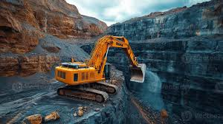
Extracting rocks
Extracting rocks means digging or collecting rocks from the earth to use them for building or making things.

Slide 10
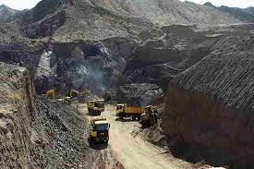
Ways of extracting rocks
Quarry
A quarry is like a big open hole in
the ground where workers take out rocks to use for building

Slide 11
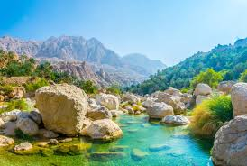
River bed
A river bed is the part of the river where the water runs.

Slide 12
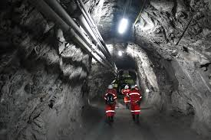
Mine
A mine is a hole or tunnel in the ground where people dig to find rocks like coal.

Slide 13
Which rock we use for making statues ?
Marble
Chalk
Coal

Slide 14
Which one we use for writing ?
Granite
Coal
Chalk

Slide 15
What do we see in a river bed?
a) Fish and rocks b) Cars and buses c) Tables and chairs

Slide 16
Why is a quarry big?
a) So workers can take many rocks b) To play games c) To grow trees

Slide 17
Where is a mine found?
a) Under the ground b) On top of trees c) In the sky

Slide 18
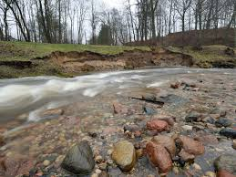
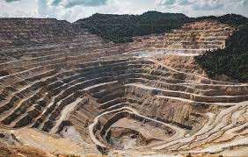
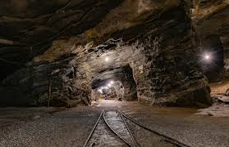
Which of these is a mine ?

Slide 19


