Slide 1

Writing an Informal Letter: Tips & Layout for O Level Success
Master the art of informal letter writing with confidence and clarity for your O Level examinations.

Slide 2

What is an Informal Letter?
Personal Connection
Friendly Tone
Written to someone you know well: friends, family members, or close acquaintances
Conversational and personal whilst maintaining clear structure and proper English
Purpose
Share news, offer advice, respond to prompts, or maintain relationships through correspondence

Slide 3
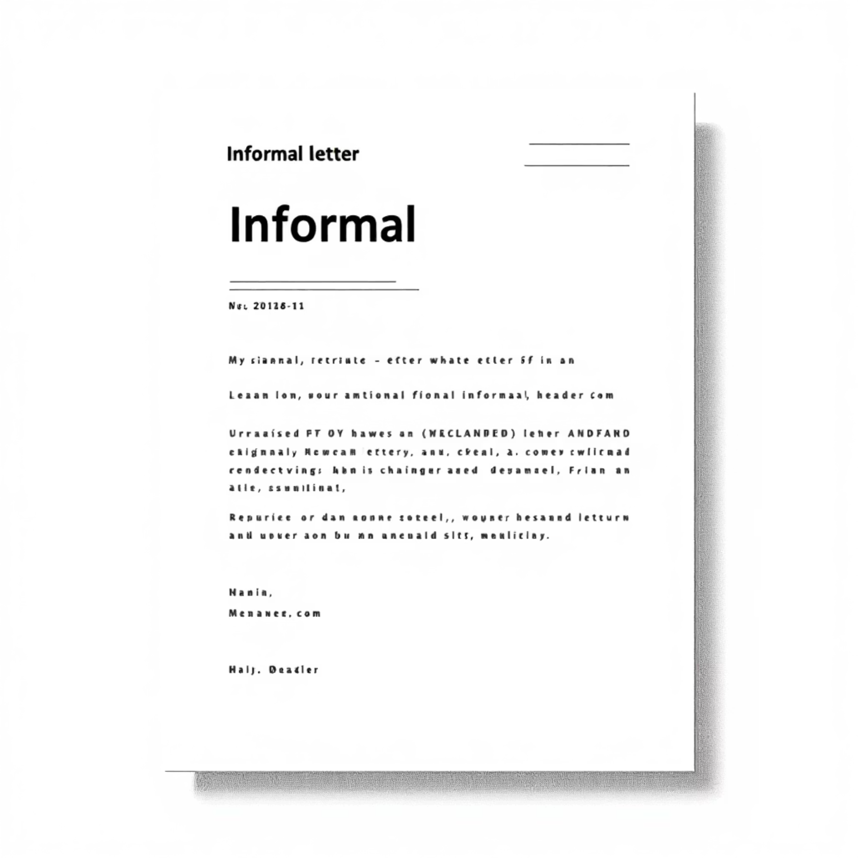

Essential Layout: Start Strong
Address & Date
Place your address in the top right corner, followed by the date written in full (e.g., 24th September 2025)
Greeting
Begin with "Dear" followed by the recipient's first name and a comma
(e.g., Dear Sarah,)
Top Tip: A warm opening line like "It was lovely to hear from you" or "Sorry for the delayed reply" immediately sets a friendly tone.

Slide 4
Structuring the Body: Clear & Focused
01
02
Paragraph Planning
Topic Sentences
Dedicate each paragraph to one main point or idea for maximum clarity and impact
Open paragraphs with clear topic sentences that introduce your main point
03
04
Develop Ideas
Link Smoothly
Support points with specific details, personal examples, or engaging stories
Use connectives like "Also," "However," "For instance" to create flow between ideas

Slide 5

Language & Tone: Friendly but Polished
Natural Contractions
Avoid Extremes
Use contractions like "don't" and "I'm" sparingly to maintain a conversational feel without being overly casual
Steer clear of text speak, slang, or abbreviations like "OMG" or "u" - remember, this is still an examination
Accuracy Matters
Maintain correct spelling, grammar, and punctuation throughout - accuracy shows respect for your reader

Slide 6
Example Opening & Closing Phrases
Engaging Openings
Memorable Closings
"I hope you're doing well. I wanted to tell you about..."
"Looking forward to hearing from you soon."
"Thanks for your letter - it really brightened my day!"
"Take care and write back soon!"
"I've been meaning to write for ages..."
"Can't wait to catch up properly."
These phrases demonstrate genuine interest and maintain the personal connection essential to informal correspondence.

Slide 7

Exam Tips for O Level Informal Letters
Plan Before You Write
Spend 5 minutes creating bullet points to organise your thoughts and ensure you address all requirements
Follow Instructions
Stick religiously to the task instructions and address every bullet point provided in the question
Direct Address
Engage your reader throughout by addressing them directly and maintaining the conversational feel
Vary Your Style
Mix sentence lengths and punctuation types to create rhythm and maintain reader interest

