Slide 1
Science
Answer key for
learner’s book

Slide 2
Learner’s book page 5
Questions
Q1)A ) The heart pumps blood around the body.
B) To supply all parts of the body with food and oxygen and to remove waste products from different parts of the body.
Q2) The heart muscle contracting as it pumps the blood.
Q3)To pick up oxygen that is carried in the blood to the rest of the body

Slide 3
Learner’s book page 5
Q4) 1-to ensure that all parts of the body get food and oxygen
2-Waste products are removed from different parts of the body.
3-Arteries carry blood containing oxygen and food to all parts of the body.
4-Veins carry blood from different parts of the body back to the heart.
5-Capillaries bring oxygen and food to the body cells and take away waste.

Slide 4
Learner’s book page 7
Think like a scientist 1
Step1-4
Answers will vary because the number of heartbeats counted will probably vary slightly when the pulse is taken again.
Time | Pulse rate in bpm
1
2
3

Slide 5
Learner’s book page 8
Think like a scientist 1
Q1) Heartbeat is the contraction of the heart muscle as it pumps blood. Pulse is caused by the pressure of the blood as it is pumped by the heart.
Q2) No. Learners may not have measured their pulse rates accurately.

Slide 6
Learner’s book page 8
Think like a scientist 1
Q3) Add the measured pulse rates together then divide the total by the number of measurements taken.
Q4) Observing over time

Slide 7
Learner’s book page 9
Think like a scientist 2
Q1)a-Exercise will increase the pulse rate. Because our bodies need more oxygen when we are active, which means the heart has to pump faster to supply the extra oxygen.
B-Measure pulse rate before and after exercise.

Slide 8
Learner’s book page 9
Q2)
*Variable to measure – pulse rate.
*Variable to change – amount of exercise/body activity.
*Variables to keep the same – the method and equipment used to measure pulse rate, the person whose pulse rate is measured.

Slide 9
Learner’s book page 9
Think like a scientist 2
Q3) Timer or stopwatch .
Q4+5) Results can be recorded in a table and presented in a bar graph.

Slide 10
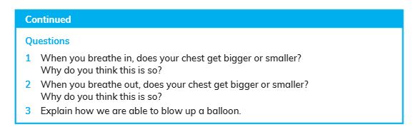
Learner’s book page 14
Activity 1
Q1) The chest gets bigger because the lungs fill with air.
Q2) The chest gets smaller because the lungs push air out.
Q3) Air leaves our body when we breathe out. The air fills the balloon and the balloon inflates/becomes blown up.

Slide 11
Learner’s book page 15
Think like a scientist 1
Questions
Q1)a Balloon inside the bottle
b The bottle
c The straw
d The balloon around the cut-off base of the bottle
Q2)The ribs

Slide 12
Learner’s book page 15
Q3) When you pull down on the balloon diaphragm, air is pulled into the bottle. This makes the balloon inside the bottle inflate as it f ills with air. This shows breathing in. When you let go, the balloon diaphragm moves upwards and air is pushed out of the balloon inside the bottle. This shows breathing out.
Q4) The model lung is hollow and not spongy like a real lung.

Slide 13
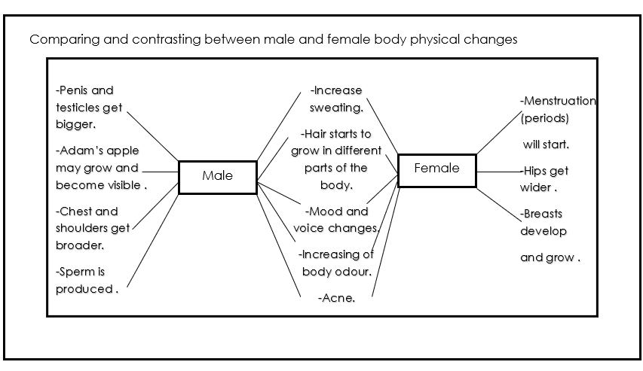

Slide 14
Learner’s book page 25
Questions
Q1) a- Any living thing that lives on or in the body of another living thing.
b- They grow and reproduce in the bodies of other living things

Slide 15
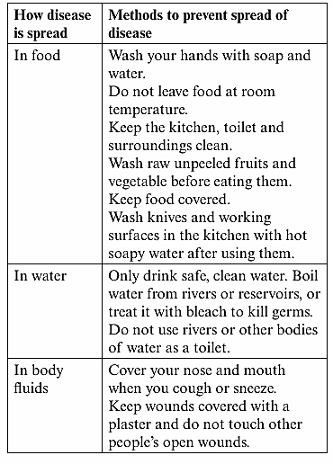
Learner’s book page 28
Activity #2

Slide 16
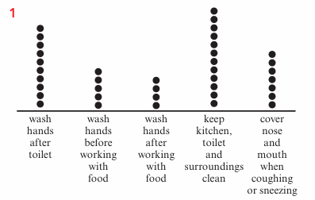
Learner’s book page 28
Think like a scientist

Slide 17
Learner’s book page 28
Think like a scientist
2-a-Keep the kitchen, toilet and surroundings clean.
b Wash hands after working with food.
3-The soap helps to kill germs.
4-So they don’t spread germs.
5-To stop germs from our bodies spreading through the air to other people.
6-Germs live and grow better in moist conditions; a dirty towel may have germs on it which rub off onto our hands.

Slide 18
Science
Answer key for
Workbook

Slide 19
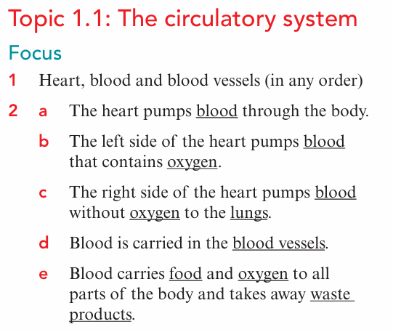
Workbook page 2

Slide 20

Workbook page 3

Slide 21
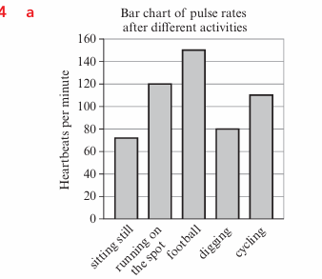
Workbook page 4

Slide 22
Workbook page 5
B- Marcus’s pulse rate was lowest when he was sitting still because the body needs less nutrients and oxygen when it is still or inactive,
C- Playing football

Slide 23
Workbook page 5
D-Yes. The measurement for digging. The pulse rate measured is low although he is doing a physical activity
E- He should do all the activities for the same length of time, then measure his pulse rate. He should also start each activity after sitting still to allow his heartbeat to return to normal.
F-Body activity/exercise makes the pulse rate increase.

Slide 24
Workbook page 6
g -Marcus’s pulse rate would increase. The more active you are, the more often your heart must beat to carry enough nutrients and oxygen from the blood to your muscles.

Slide 25
Workbook page 6
We breathe in air through our nose or mouth. The air we breathe in contains oxygen gas. The air moves down the windpipe and into our lungs. The oxygen in the air then moves from the lungs into the blood. We breathe out air that contains carbon dioxide gas. The ribs protect our respiratory system.

Slide 26
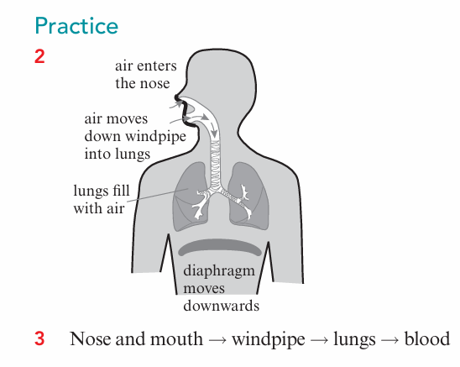
Workbook page 7

Slide 27
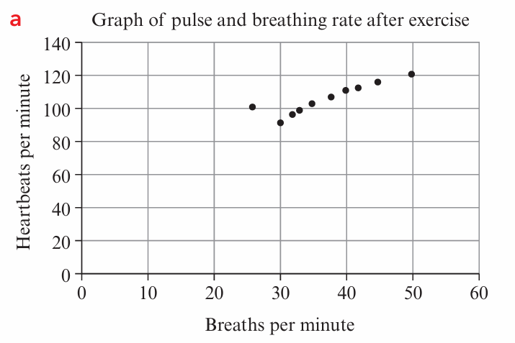
Workbook page 8+9

Slide 28
Workbook page 9
b -As the pulse rate increase, the breathing rate also increases during exercise.
C-i -The person with a pulse rate of 100 heartbeats per minute and a breathing rate of 26 breaths per minute.
Ii- the breathing rate was not accurately measured, or the person had a very large lung capacity.

Slide 29
Workbook page 10
D- Accept answers of between 116 and 124 heartbeats per minute.
E- After jogging on the spot for three minutes, a person with a high breathing rate has a higher pulse rate than a person with a low breathing rate

Slide 30
Workbook page 12
3
a- Any three from: period starts , breasts develop , hips get wider
b-i 12 years
ii 35
C-i 11
ii 7
D- i Puberty starts when girls have an average mass of 45 to 47 kg.
ii Body mass
iii Types of food

