Slide 1
Rocks and environment

Slide 2
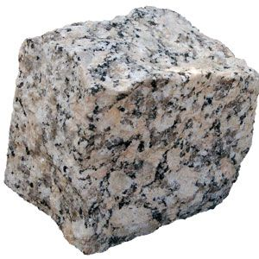
Granite : very strong rock used to make bridges and buildings , its has gray bits color

Slide 3
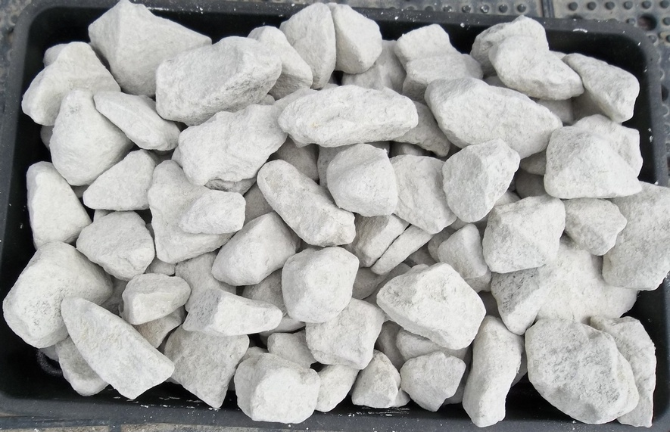
White chalk rocks : very soft rocks used to make sticks for writing

Slide 4
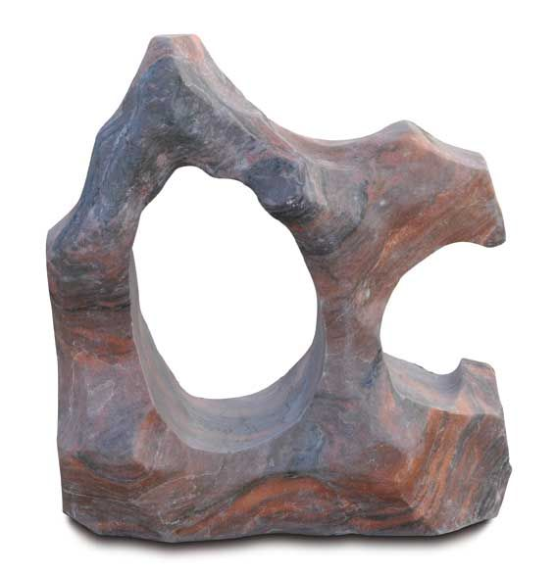
Marble : a hard , strong rock used in wall tiles and to make statues / shapes

Slide 5
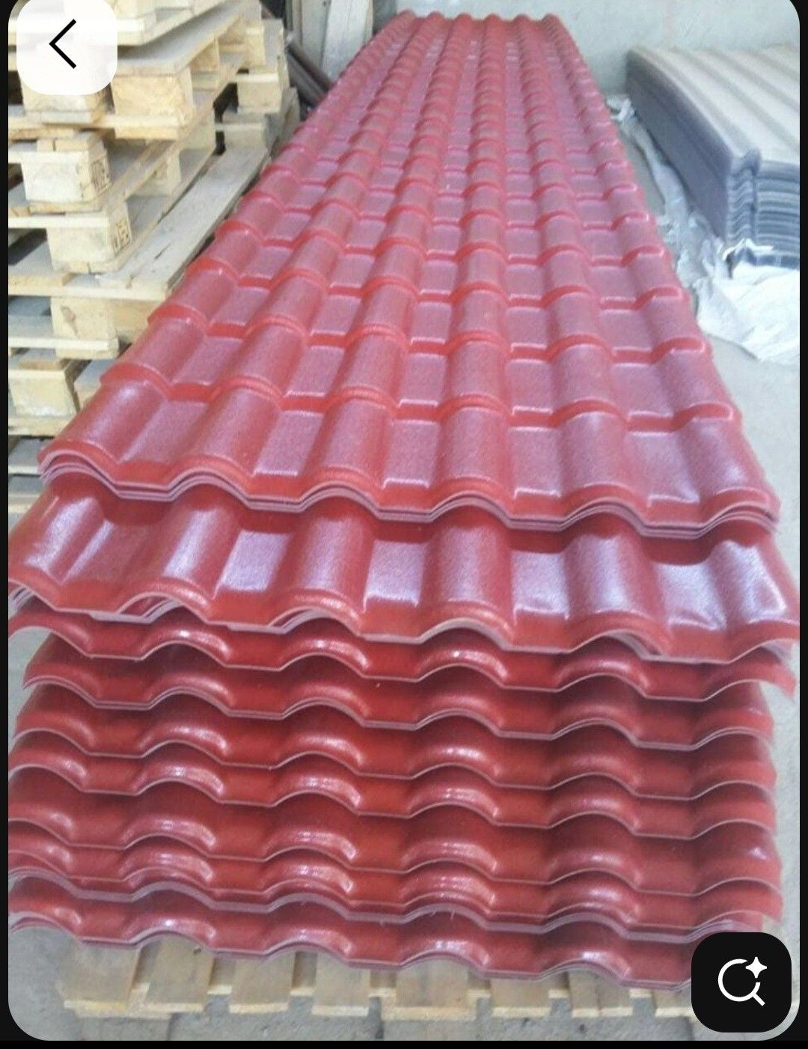
Slate rocks: can be blue , purple or gray , it waterproof and used in roof tiles

Slide 6
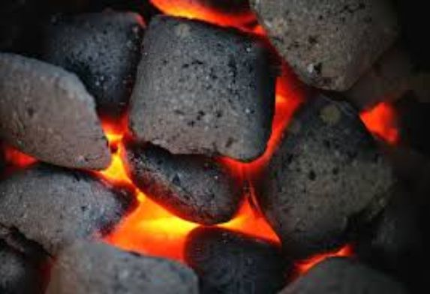
Coal : a black rock which we can burn to keep us warm

