Slide 1

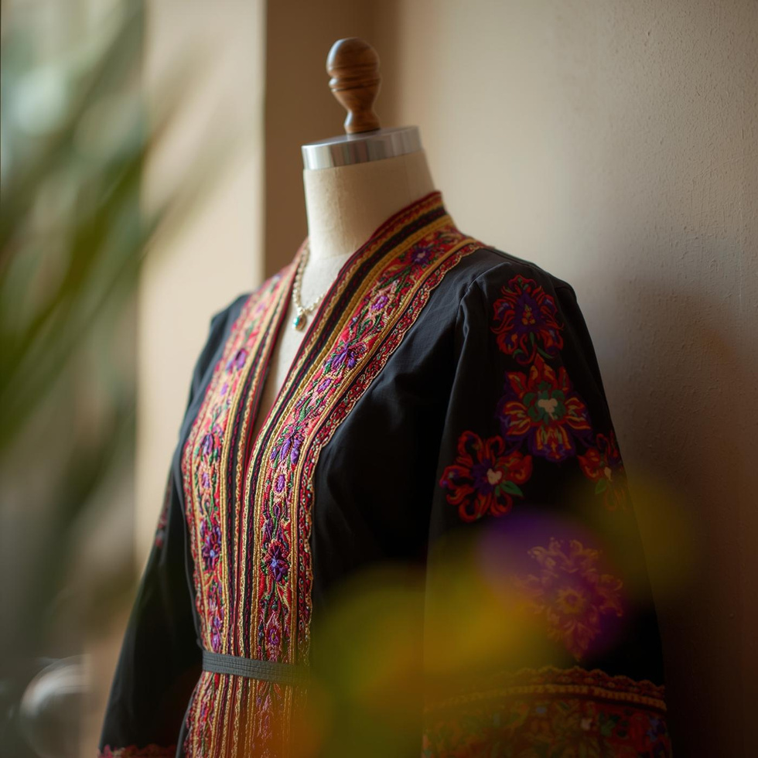
CULTURAL HERITAGE PRESERVATION SOCIETY
Jordanian Costumes
Presented by [Haneen Mazahreh ], Jordanian culture enthusiast and researcher

Slide 2
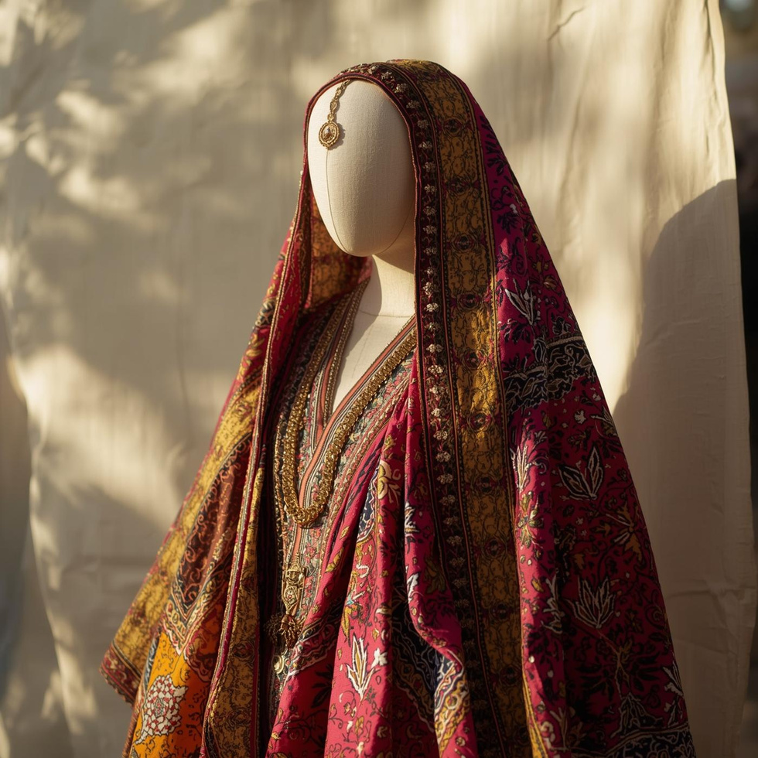
Essence of Attire
Traditional Jordanian costumes are vibrant expressions of cultural identity. They encompass a rich history, reflecting the diverse influences of the region. Each garment tells a story, symbolizing social status and community ties. In modern times, preserving these exquisite designs is essential, as they connect generations and reinforce the importance of cultural heritage in an ever-evolving world.

Slide 3
Evolution
Ottoman Influence
Modern Adaptation
Global Recognition
Ancient Roots
Traditional costumes trace back to ancient Jordanian tribes and cultures.
Ottoman rule introduced new styles and fabrics to Jordanian clothing.
Contemporary designs blend heritage with modern fashion trends and preferences.
Jordanian costumes gain international appreciation through cultural festivals and exhibitions.

Slide 4
Cultural Significance
01
Colors
02
Patterns
Colors in Jordanian costumes often symbolize social status, cultural beliefs, and regional identity, enhancing their significance.
Intricate patterns and designs in costumes convey history and stories, reflecting the artistic expressions of various communities.
03
Embroidery
04
Social Status
Traditional embroidery techniques showcase craftsmanship, each stitch narrating personal and cultural tales unique to families.
Costumes can indicate social status, with specific garments reserved for the elite, while others are common for daily wear.
05
Tribal Affiliation
06
Occasions
Clothing styles often signify tribal affiliations, showcasing pride in lineage and belonging within the diverse Jordanian society.
Different costumes are worn for special occasions, such as weddings and festivals, highlighting their cultural roles and traditions.

Slide 5
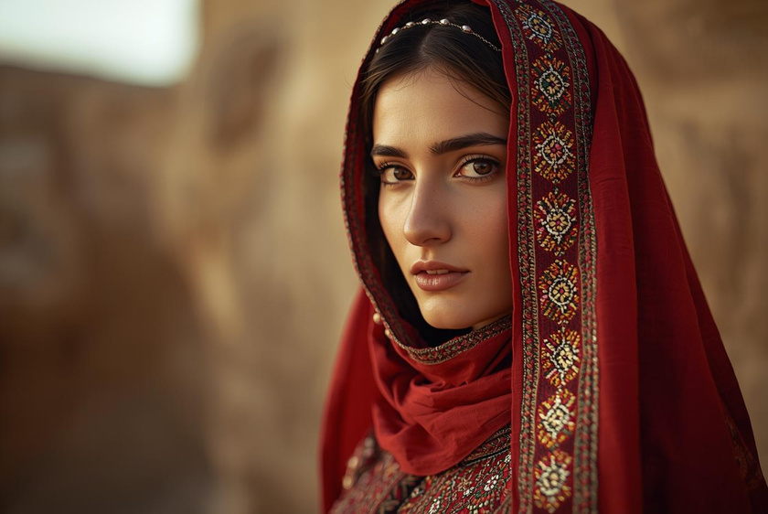
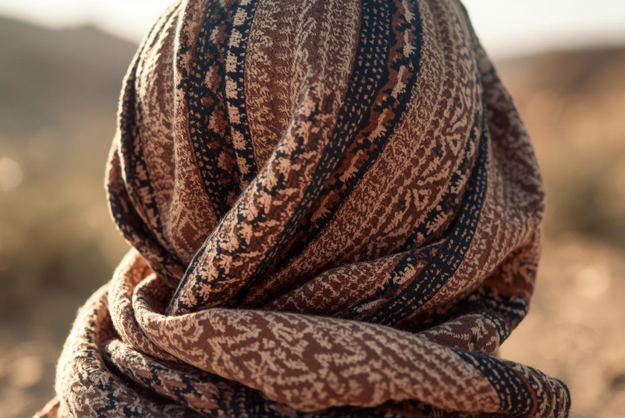
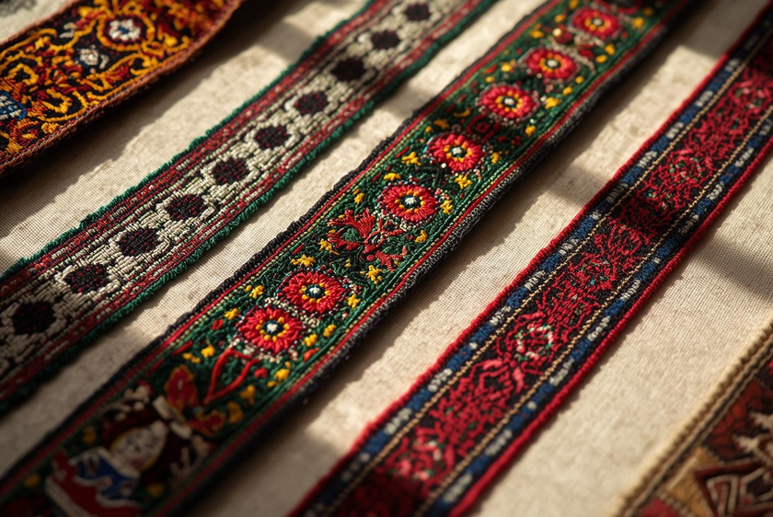
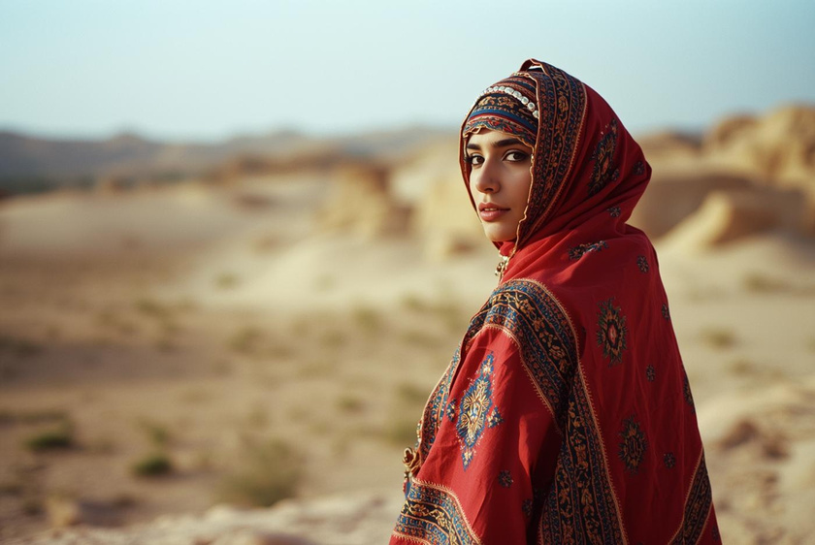
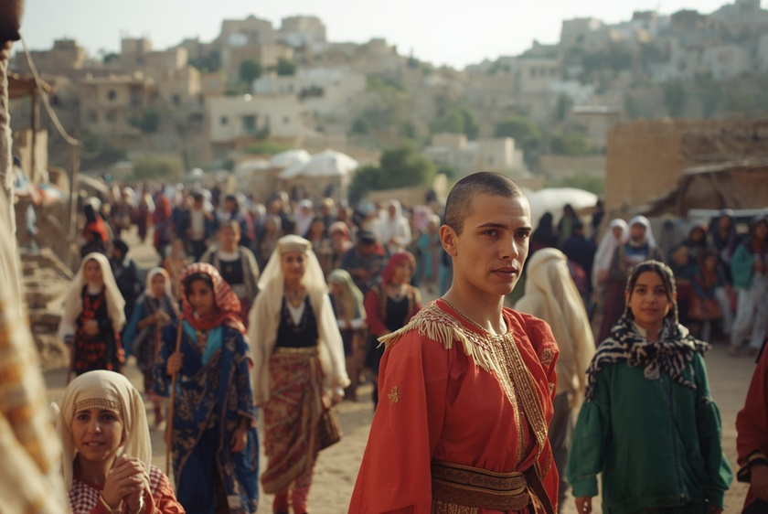
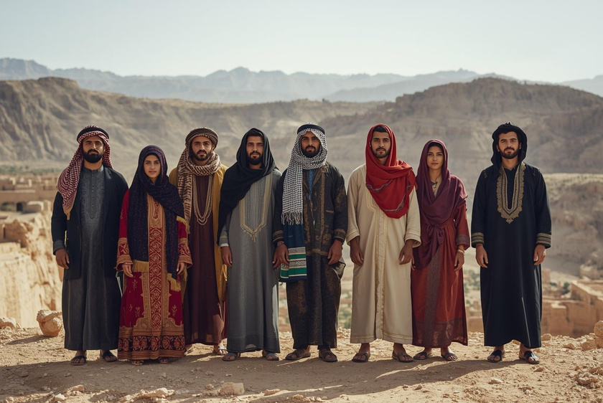

Thob
Ghutrah
Belts
The thob is a signature Jordanian dress embodying elegance.
The ghutrah is an essential part of Bedouin attire.
Traditional embroidered belts add character to outfits.
Accessories
Regional Styles
Modern Integration
Accessories complement traditional outfits, enhancing cultural identity.
Diverse regional styles showcase Jordan's rich heritage beautifully.
Modern fashion integrates traditional elements in creative ways.

Slide 6
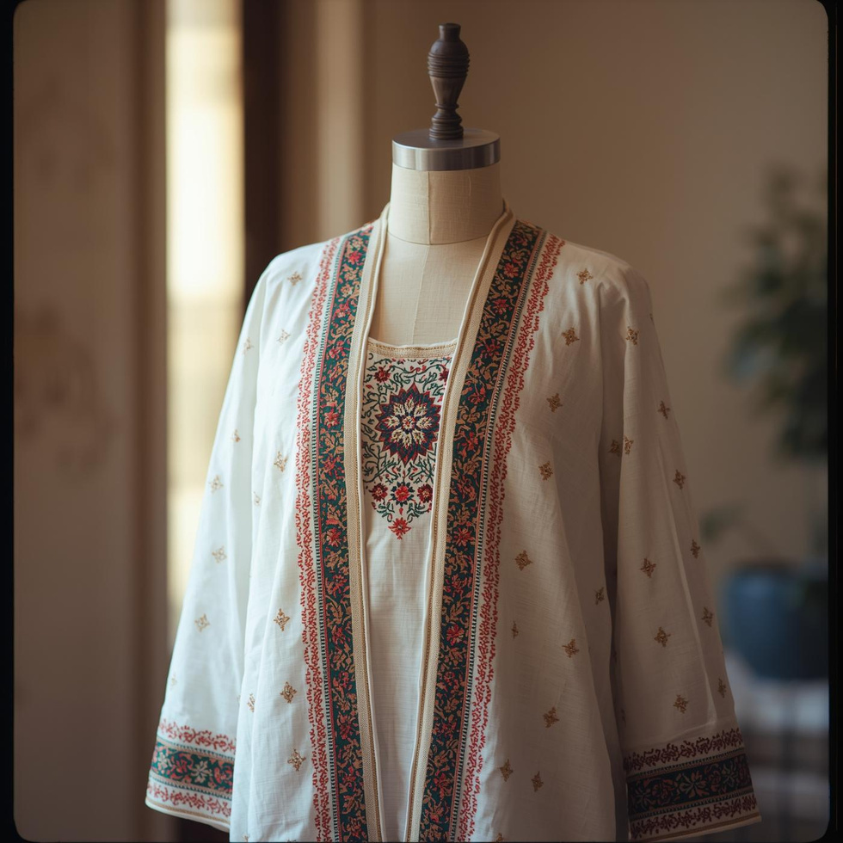
Key Garment Pieces
The thob is a traditional garment worn by both men and women in Jordan, distinguished by its vibrant colors and intricate embroidery. Accompanied by beautifully embroidered belts and unique headscarves, these pieces not only enhance the wearer’s appearance but also symbolize cultural identity. Each region boasts its own variations, showcasing the diversity and richness of Jordan's traditional attire.

