Slide 1
Disclaimer/s
We hope you find the information on our website and resources useful.
Animations
This resource has been designed with animations to make it as fun and engaging as possible. To view the content in the correct formatting, please view the PowerPoint in ‘slide show mode’. This takes you from desktop to presentation mode. If you view the slides out of ‘slide show mode’, you may find that some of the text and images overlap each other and/or are difficult to read.
To enter slide show mode, go to the slide show menu tab and select either from beginning or from current slide.
You may wish to delete this slide before beginning the presentation.

Slide 3
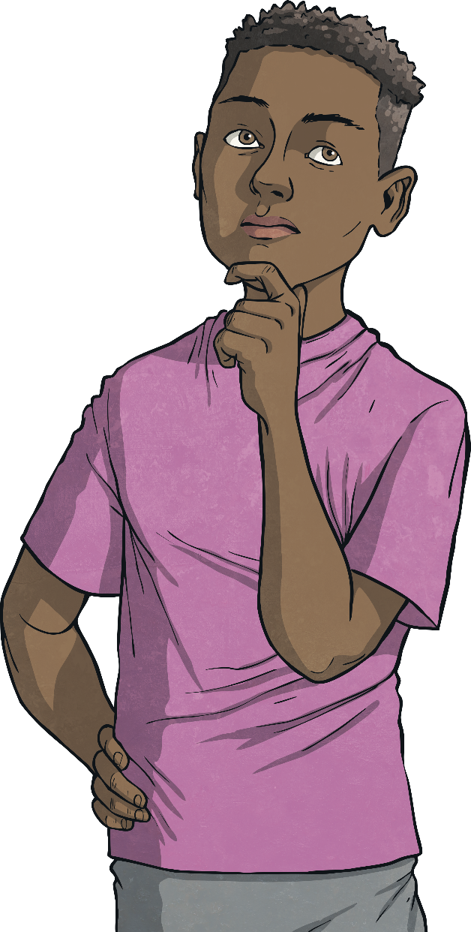
What Is a Decimal?
A decimal is the number that comes after the decimal point in a number. It represents part of a whole number.
Decimals have a close relationship with fractions and percentages and can be converted between them quite easily.

Slide 4
Decimal Value Place Chart
Millions | Hundred Thousands | Ten Thousands | Thousands | Hundreds | Tens | Ones | tenths | hundredths | thousandths | ten thousandths | hundred thousandths | millionths
M | HTh | TTh | Th | H | T | O | t | h | th | tth | hth | m
You might be familiar with the place value house. Decimals are a part of this too. You can find them on the right of the decimal point.
The decimal point is always a part of a number but often when a whole number is expressed, eg. 100, we don’t use a decimal point as we assume it would be 100.00

Slide 5
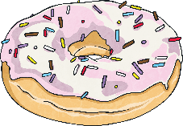
Whole Numbers and Decimal Numbers
When we look at a decimal number it will have two parts to it:
The whole number
The decimal (part of a whole)
12.5 is made up of 12 wholes and .5
For example:

Slide 6

What Is a Decimal Made up Of?
A decimal can be made up of:
Tenths
Hundredths
Thousandths
Ten thousandths
Hundred thousandths
Millionths
          What do you notice about the name of these compared to those on the other side of the place value house?

Slide 7
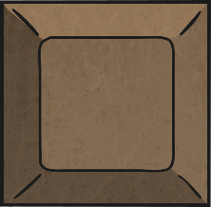
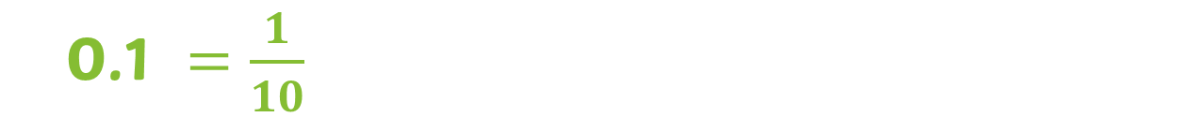
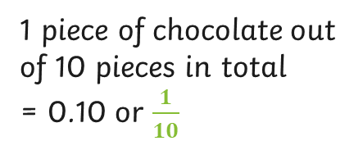
What Is a Tenth?
A tenth is the largest part of a decimal.
Ten tenths make up 1 whole or ten parts of something will make a whole.
A tenth can look like:
0.1 $=\frac{1}{10}$
What things can you think of that would represent 0.1?
1 piece of chocolate out of 10 pieces in total
= 0.10 or $\frac{1}{10}$

Slide 8
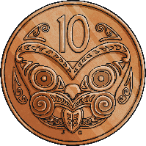


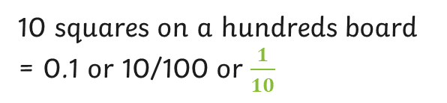
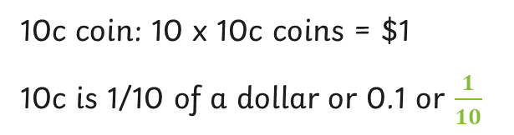
What Is a Tenth?
10c coin: 10 x 10c coins = $1
10c is 1/10 of a dollar or 0.1 or $\frac{1}{10}$
10 squares on a hundreds board
= 0.1 or 10/100 or $\frac{1}{10}$

Slide 9
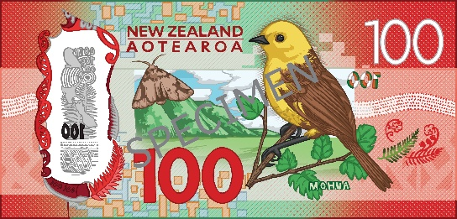
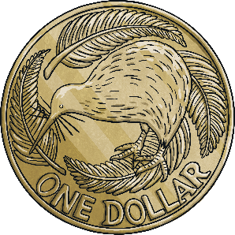

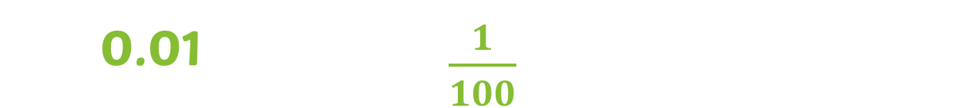
What Is a Hundredth?
A hundredth is the next largest part of a decimal after a tenth.
A hundred hundredths make up 1 whole or one hundred parts of something will make a whole.
A hundredth can look like:
0.01
$\frac{1}{100}$
What things can you think of that would represent 0.01?
$1 out of $100 = 0.01 or $\frac{1}{10}$

Slide 10
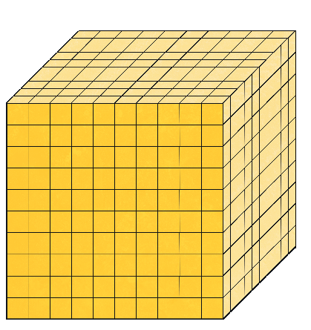

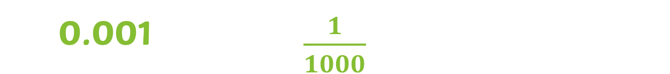
What Is a Thousandth?
A thousandth is starting to get into smaller pieces of a decimal number.
One thousand thousandths make up 1 whole or a thousand parts of something will make a whole.
A thousandth can look like:
0.001
$\frac{1}{1000}$
What things can you think of that would represent 0.001?
Not many things come in thousandths because the pieces are so tiny!

Slide 11
So What Does It Mean to Read Numbers to 3 Decimal Places?
To read a decimal number, first read the whole number part to the left of the decimal point as you would any whole number. Then, say "and" for the decimal point. Finally, read the numbers to the right of the decimal point as a whole number, followed by the place value of the last digit (tenths, hundredths, thousandths, etc.)
3.14
62.348
7.7
0.3
0.62
8.88

Slide 12
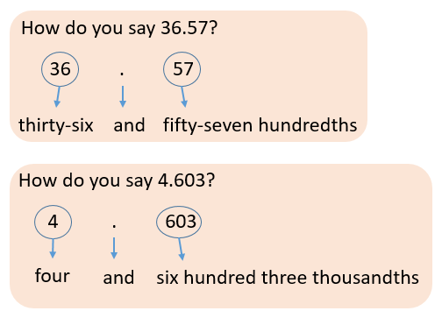
Reading decimal numbers

Slide 13
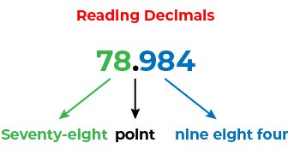
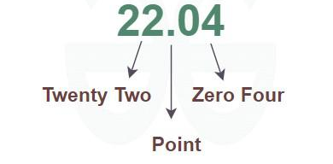
Or…..

Slide 14
How Do You Say Decimal Numbers?
When we say decimal numbers, we do it in two different ways.
Take this number for example:
45.768
We would read it as ‘’ forty-five and seven hundred and sixty- eight thousandths’’
Or ‘’ forty-five point seven six eight’’

Slide 15
Try These Examples Yourself
How would you say these numbers:
99.4
Ninety-nine and 4 tenths
72.18
Seventy-two and eighteen hundredths
246.879
Two hundred forty-six and eight hundred seventy-nine thousandths

