Slide 1
Disclaimer/s
We hope you find the information on our website and resources useful.
Animations
This resource has been designed with animations to make it as fun and engaging as possible. To view the content in the correct formatting, please view the PowerPoint in ‘slide show mode’. This takes you from desktop to presentation mode. If you view the slides out of ‘slide show mode’, you may find that some of the text and images overlap each other and/or are difficult to read.
To enter slide show mode, go to the slide show menu tab and select either from beginning or from current slide.
You may wish to delete this slide before beginning the presentation.

Slide 2


Mathematics
Number
Year One
Mathematics | Year 4 | Number | Decimal Equivalents for Tenths and Hundredths | Tenths and Hundredths | Lesson 1 of 1

Slide 3
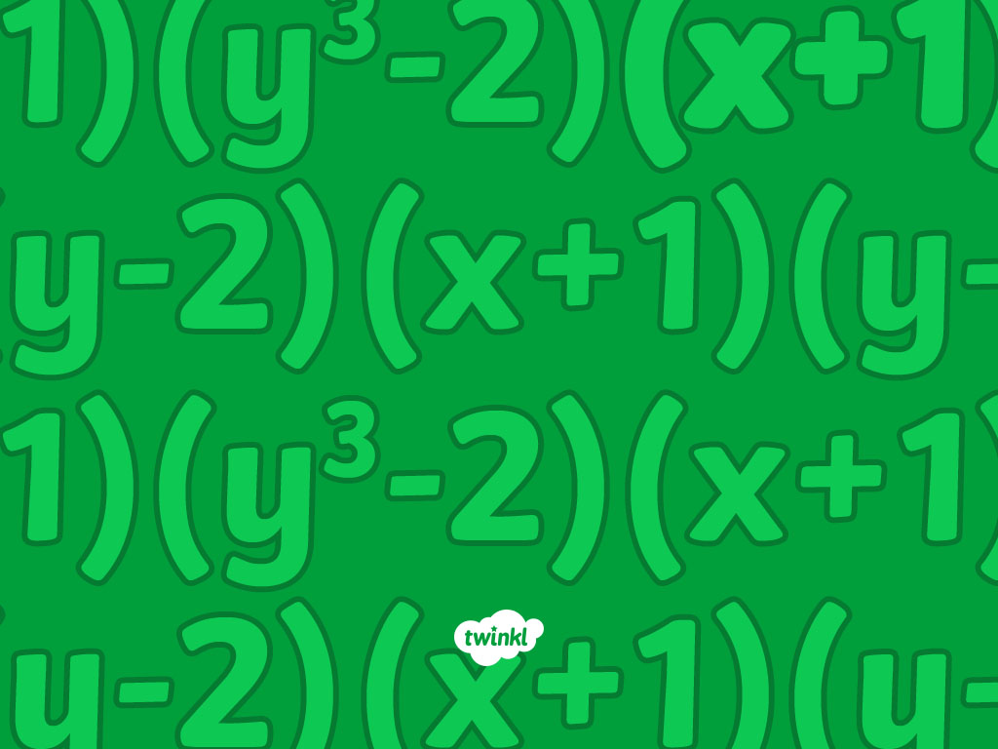

Tenths and Hundredths

Slide 4
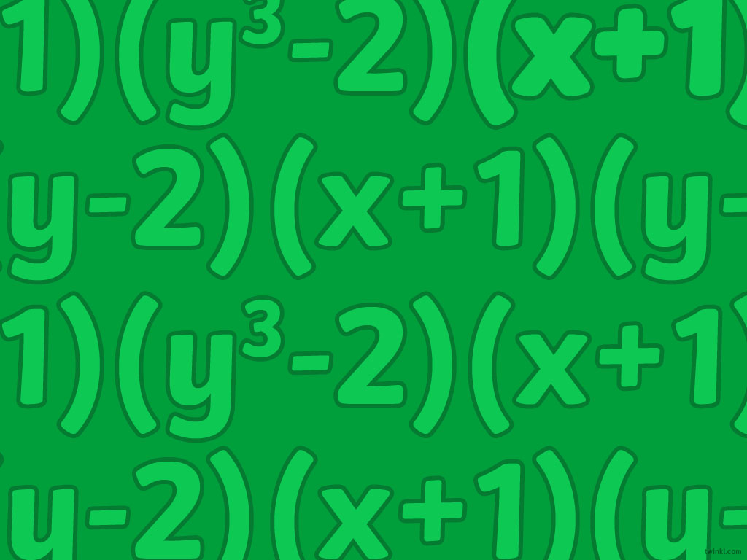
Aim
To recognise decimal equivalents for tenths and hundredths.
Success Criteria
I can identify decimal and fraction equivalents for tenths.
I can identify decimal and fraction equivalents for hundredths.

Slide 5

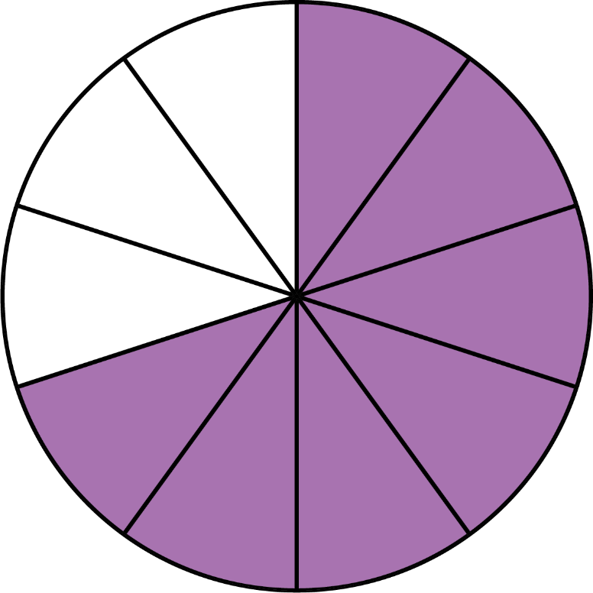
Tenths and Hundredths
What fraction is represented by…
7
because the whole circle has been divided into 10 equal pieces and 7 of them are coloured in.
10

Slide 6

Tenths and Hundredths
What fraction is represented by…
because the whole square has been divided in to 100 equal pieces and 65 of them are coloured in.

Slide 7

Tenths and Hundredths
What fraction is represented by…
5
because there are 10 objects, and 5 of them have been selected.
10

Slide 8
Tenths and Hundredths
What fraction is represented by…
40
because the whole square has been divided in to 100 equal pieces and 40 of them are coloured in.
100
Or
because the whole group of 100 squares could be divided into equal groups of 10 squares each and 4 of those groups are coloured in.
4
10

Slide 9
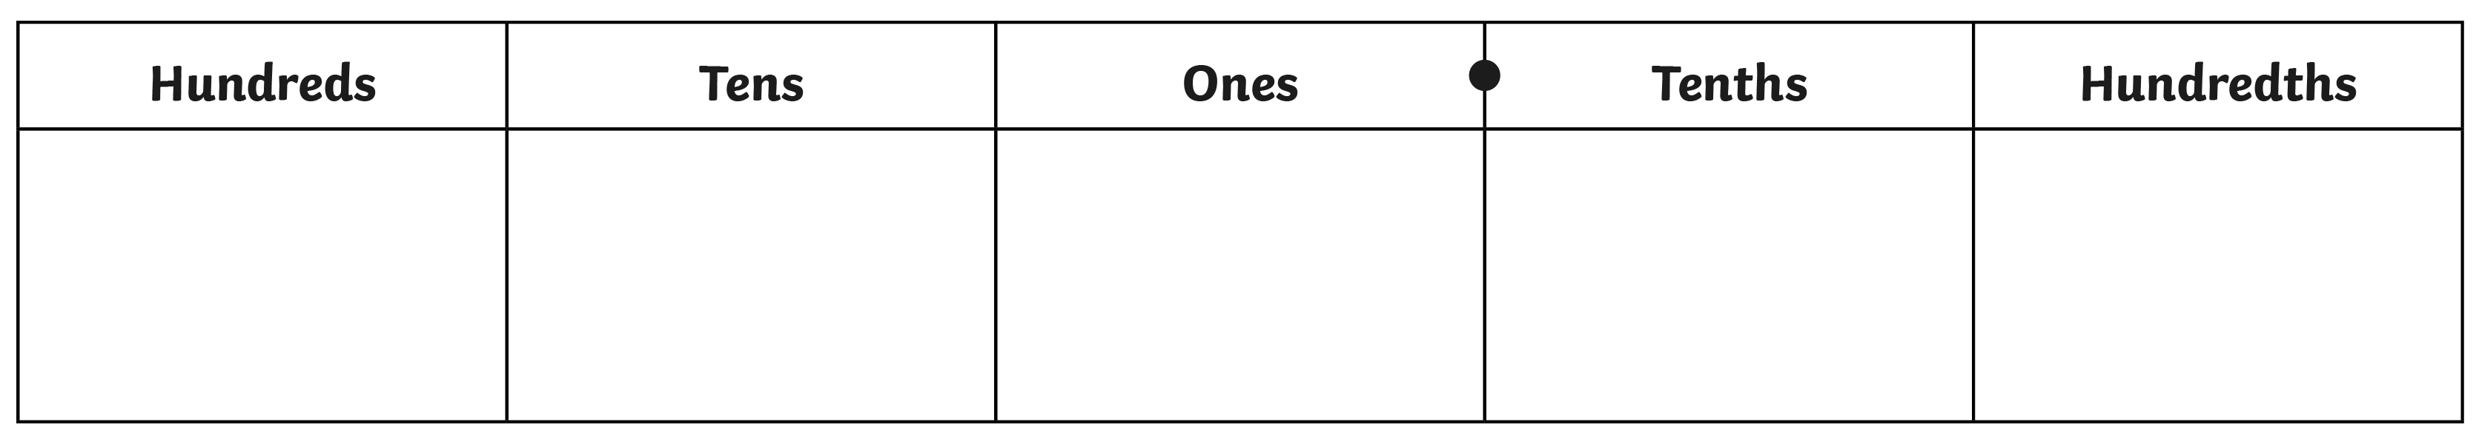
Place Value
How do
you know?
what does
this column
represent?
what does
this column
represent?
what does
this column
represent?
what does
this column
represent?
How do
you know?
× 10
× 10
× 10
× 10
tenths
hundredths
Hundreds
Tens
Ones
tenths
hundredths
?
?
?
?
÷ 10
÷ 10
÷ 10
÷ 10
What happens as we move to the left across the columns?
What happens as we move to the right across the columns?
If this column
represents tens,
If this column
represents ones,

Slide 10

Fractions to Decimals
Hundreds
Tens
Ones
tenths
hundredths
0
0
0
0
1
3
7
1
9
Place holder
Place holder
Place holder
Place holder
3 tenths
7 tenths
1 tenth
9 tenths

Slide 11
Fractions to Decimals
Hundreds
Tens
Ones
tenths
hundredths
0
0
0
0
0
0
4
2
8
Place holders
Place holders
Place holders
4 hundredths
2 hundredths
8 hundredths

Slide 12
Fractions to Decimals
Hundreds
Tens
Ones
tenths
hundredths
0
1
10

Slide 13
Fractions to Decimals
Hundreds
Tens
Ones
tenths
hundredths
0
3
30

Slide 14
Fractions to Decimals
Hundreds
Tens
Ones
tenths
hundredths
0
9
90

Slide 15
Fractions to Decimals
Hundreds
Tens
Ones
tenths
hundredths
0
6
60

Slide 16
Fractions to Decimals
Hundreds
Tens
Ones
tenths
hundredths
0
2
5

Slide 17
Fractions to Decimals
Hundreds
Tens
Ones
tenths
hundredths
0
4
8

Slide 18
Fractions to Decimals
Hundreds
Tens
Ones
tenths
hundredths
0
7
2

Slide 19
Fractions to Decimals
Hundreds
Tens
Ones
tenths
hundredths
0
9
1

Slide 20

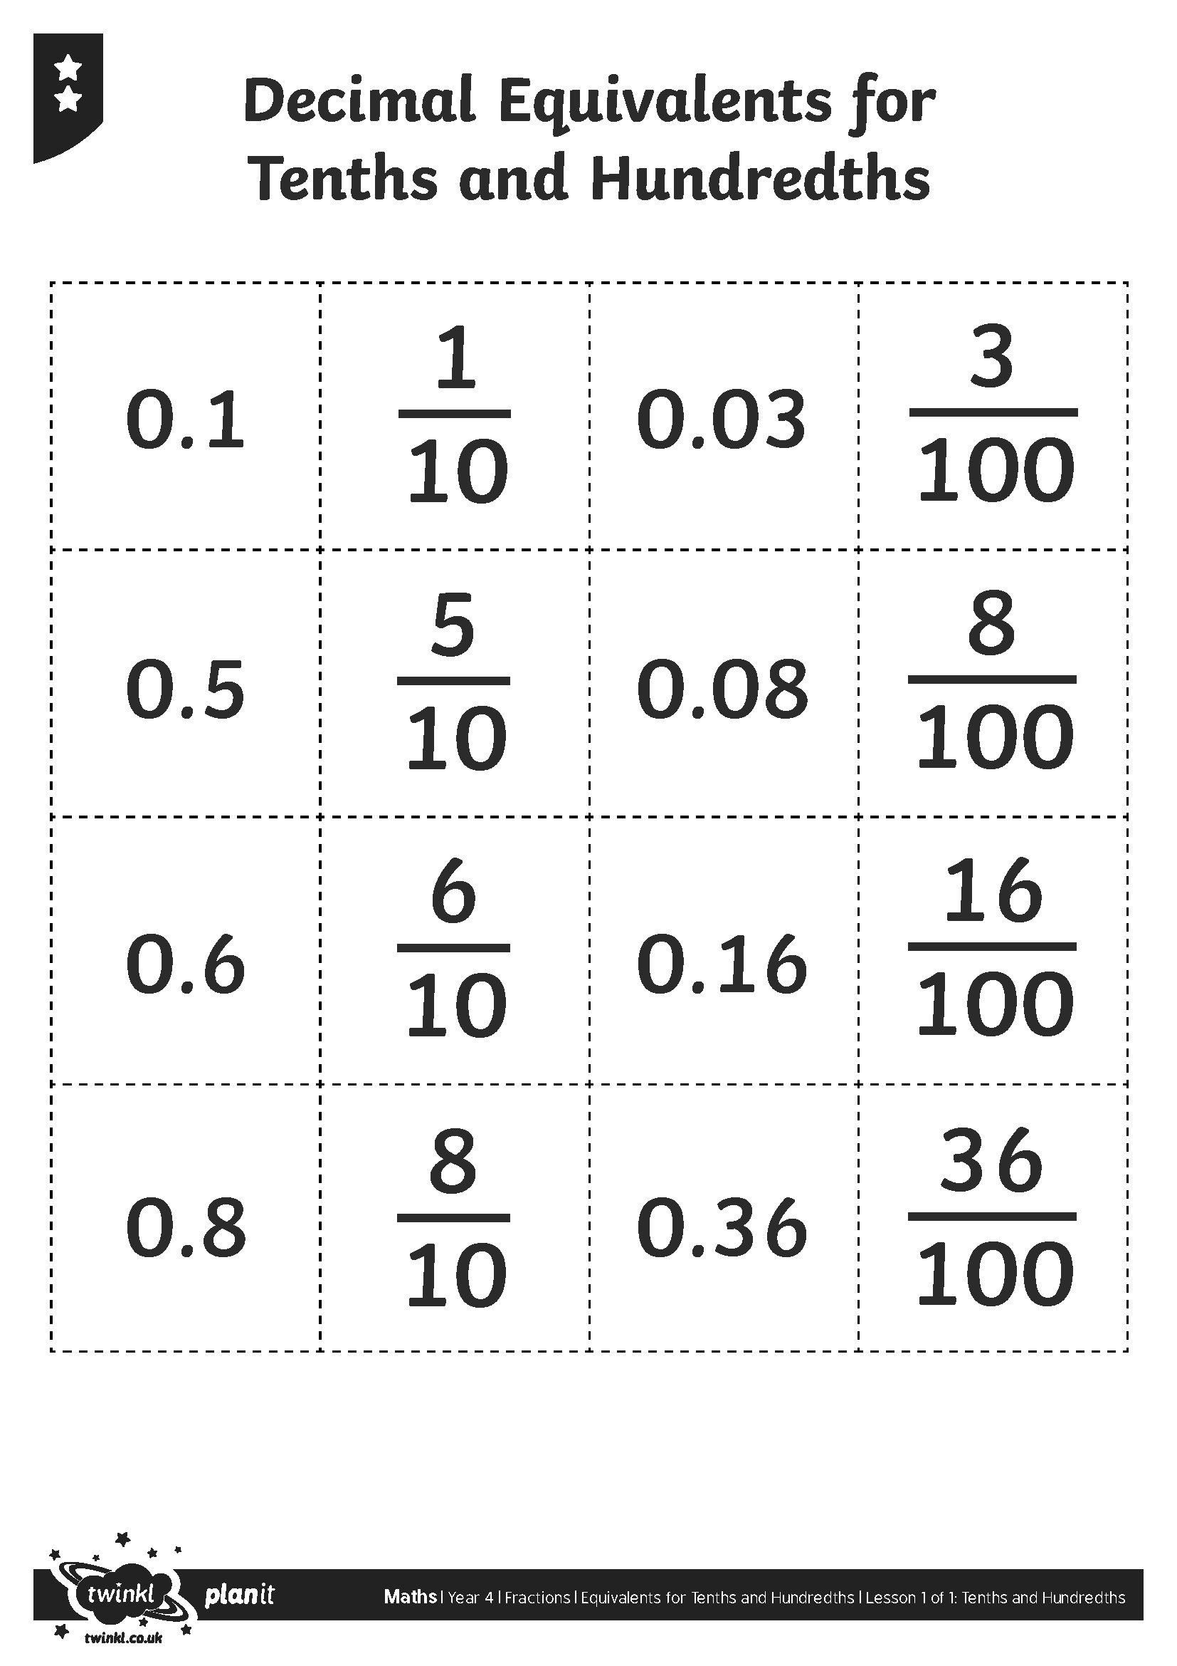
Pairs

Slide 21

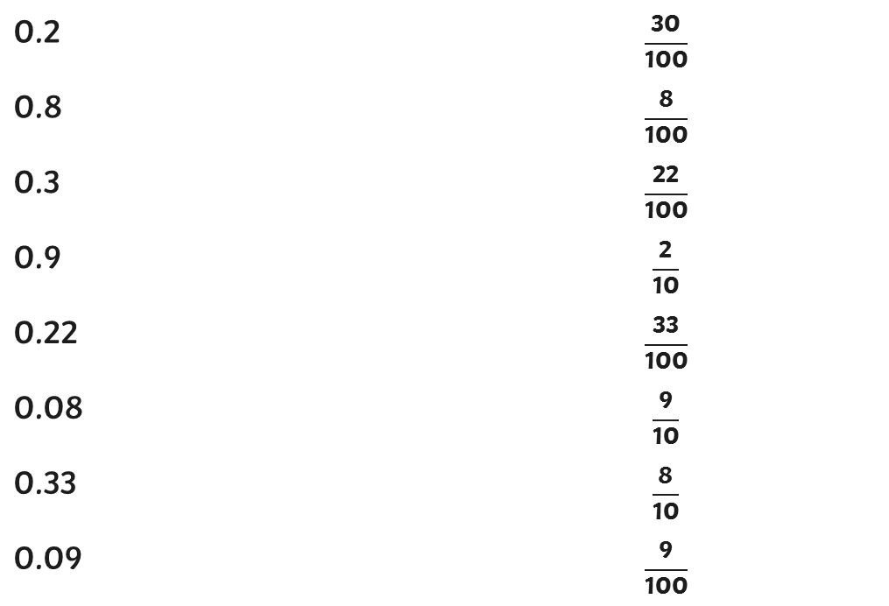
Match It
Match the decimal numbers to the equivalent fractions.
3
0.2
0.8
0.3
0.9
0.22
0.08
0.33
0.09
10

Slide 22
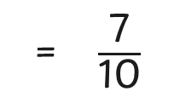
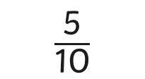


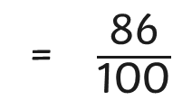
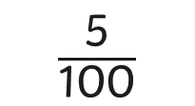
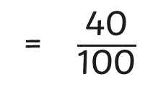
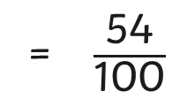
Match It
Complete the equivalent pairs of fractions and decimals.
5
0.7
0.5 =
0.01 =
0.07 =
60
0.86
0.6 =
0.4
0.54

Slide 23

Aim
To recognise decimal equivalents for tenths and hundredths.
Success Criteria
I can identify decimal and fraction equivalents for tenths.
I can identify decimal and fraction equivalents for hundredths.

Slide 24
