Slide 1
Disclaimer/s
We hope you find the information on our website and resources useful.
Editable
This resource is editable and can be adapted to meet the needs of different children. Twinkl cannot be held responsible for any changes made once a resource has been downloaded. Please be aware that this content may have been edited and therefore may no longer reflect our values.
Animations
This resource has been designed with animations on each slide to make it as fun and engaging as possible. To view the content in the correct formatting, please view the slideshow in ‘presentation mode’. If you view the slides without selecting ‘presentation mode’, you may find that some of the text and images overlap each other or are difficult to read.

Slide 2
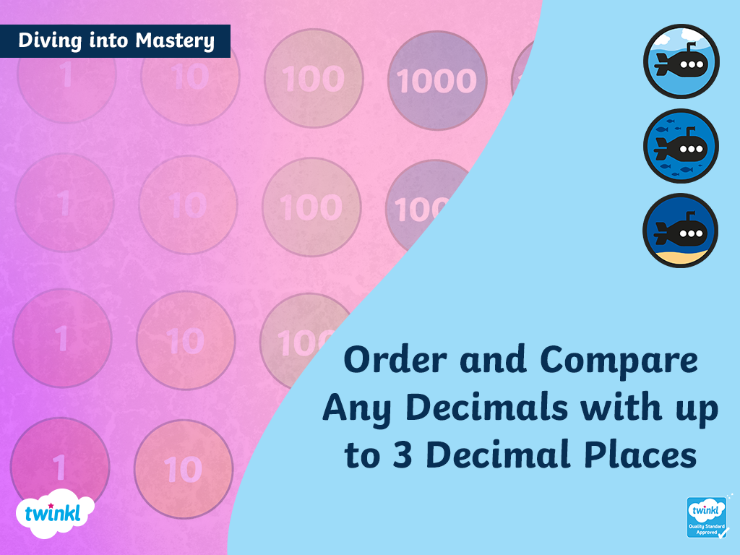

Slide 3
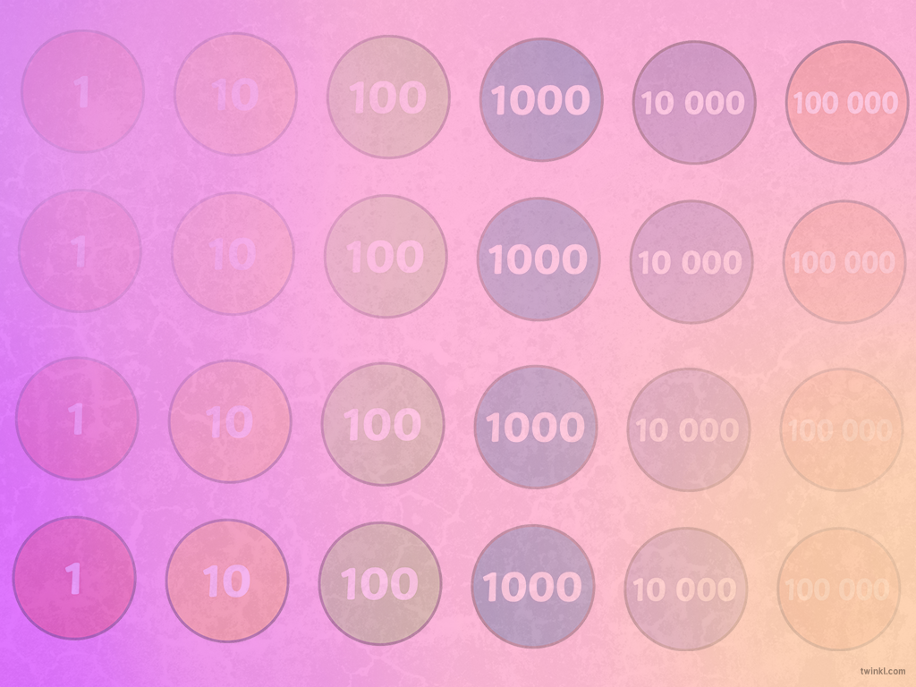



Diving into Mastery Guidance for Educators
Each activity sheet is split into three sections, diving, deeper and deepest, which are represented by the following icons:
These carefully designed activities take your children through a learning journey, initially ensuring they are fluent with the key concept being taught; then applying this to a range of reasoning and problem-solving activities.
These sheets might not necessarily be used in a linear way. Some children might begin at the ‘Deeper’ section and in fact, others may ‘dive straight in’ to the ‘Deepest’ section if they have already mastered the skill and are applying this to show their depth of understanding.
Diving
Deeper
Deepest

Slide 4
National Curriculum Aim
Read, write, order and compare numbers with up to 3 decimal places

Slide 5

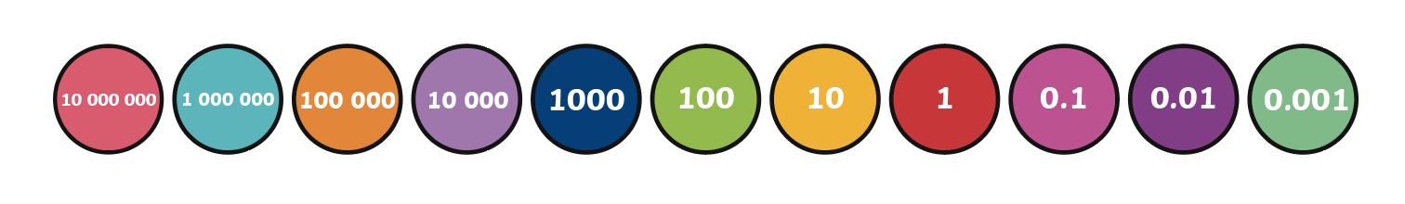
Order and Compare Any Decimals with up to 3 Decimal Places
Diving
Jia makes the number 0.725 on this place value chart.
O | t | h | th
Use the chart to help you decide if each of the comparisons shown below are true or false.
0.725 < 0.890
0.81 < 0.725
true
false
0.725 > 0.9
0.801 > 0.725
false
true

Slide 6
Order and Compare Any Decimals with up to 3 Decimal Places
Diving
Copy and complete this place value chart by writing the numbers shown in descending order. The first one has been done for you.
6.875
6.1
6.01
6.021
6.201
O | t | h | th
6 | 8 | 7 | 5
6 | 2 | 0 | 1
6 | 1
6 | 0 | 2 | 1
6 | 0 | 1

Slide 7

Order and Compare Any Decimals with up to 3 Decimal Places
Deeper
Priya is comparing the numbers represented in these place value charts. Is Priya's statement correct? Explain how you know.
A
O | t | h | th
B
O | t | h | th
The decimal number represented in place value chart A is greater than B as it has more counters in the thousands column.
Priya
Priya’s statement is incorrect as the place value column she is looking at is the thousandths column, not the thousands column. The number represented in place value chart B is actually greater than A as, although the ones and tenths are equal, it has one more hundredth when compared to A. 1.426 < 1.432

Slide 8
Order and Compare Any Decimals with up to 3 Decimal Places
Deeper
Elena is thinking about how to order these decimal numbers.
0.2
0.01
0.101
0.2 must be the smallest number as it has the fewest digits after the decimal point and 0.101 must be the greatest number as it has the most digits after the decimal point.
Elena
Do you agree with Elena’s reasoning?
Explain your answer fully.
Elena’s reasoning is incorrect as it is not the number of decimal places that is most important when ordering decimal numbers. To order these numbers, Elena needs to compare the value of the digit in the column that has the highest value, moving on to compare the next column if the value of the digits is the same.
The correct order, from smallest to greatest, is: 0.01, 0.101, 0.2

Slide 9

Order and Compare Any Decimals with up to 3 Decimal Places
Deepest
Use each digit card only once to complete the statement.
5
7
7
8
3
4. 5
<
4.
Find five different solutions.
Your answers may vary. For example:
4.575 < 4.837
4.375 < 4.578
4.753 < 4.873
4.585 < 4.773
4.755 < 4.837

Slide 10
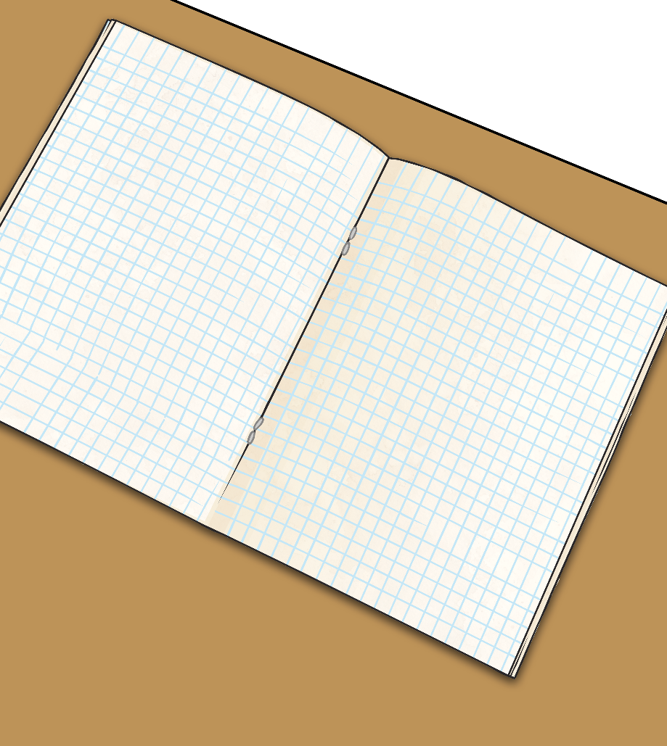
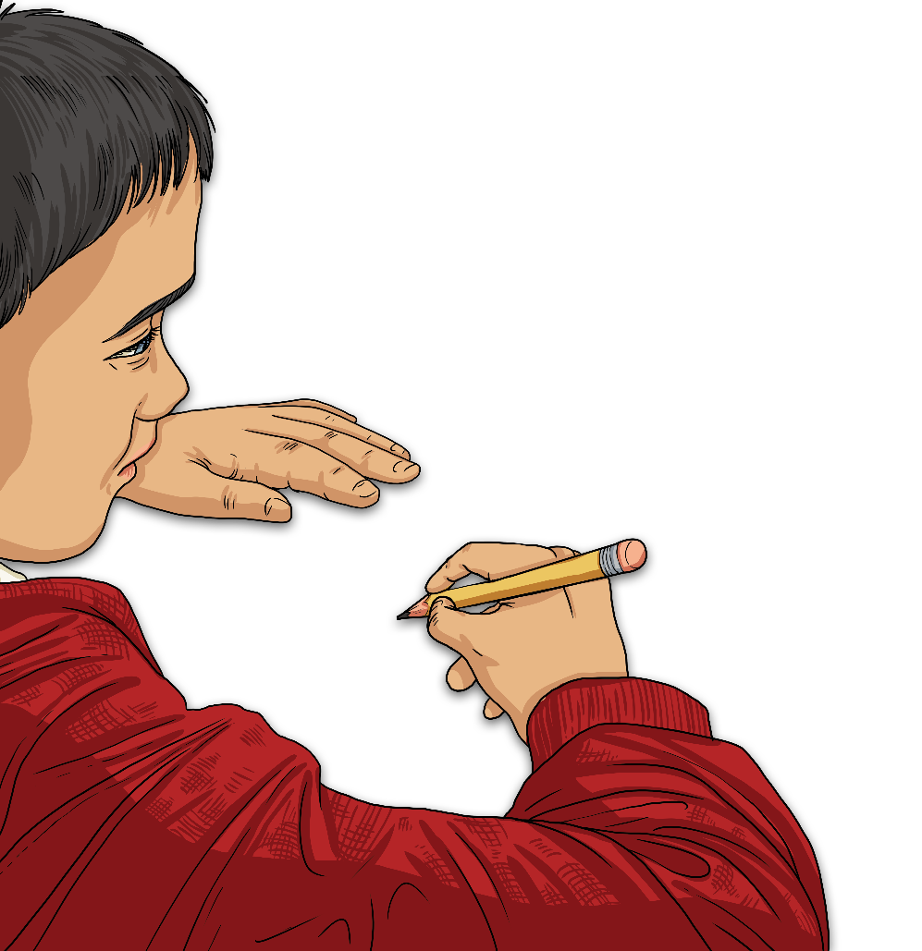
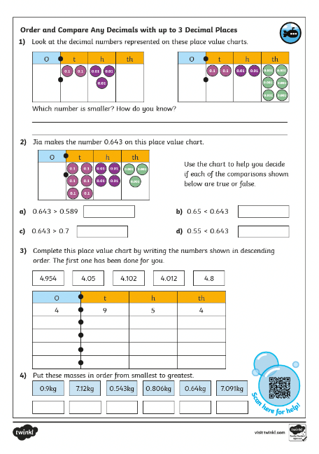
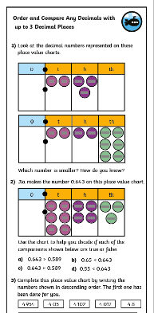
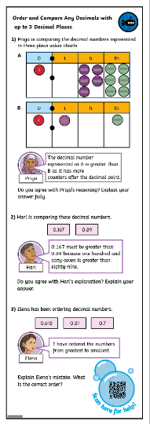
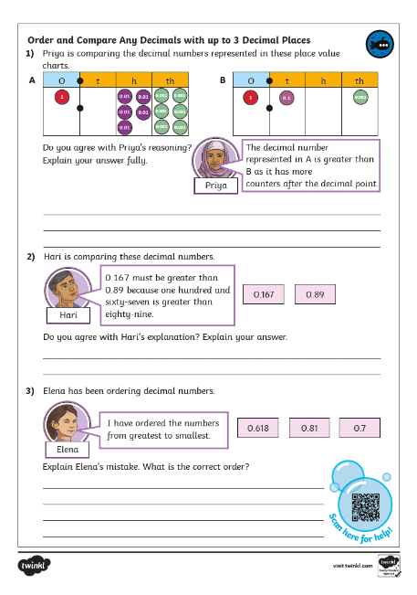
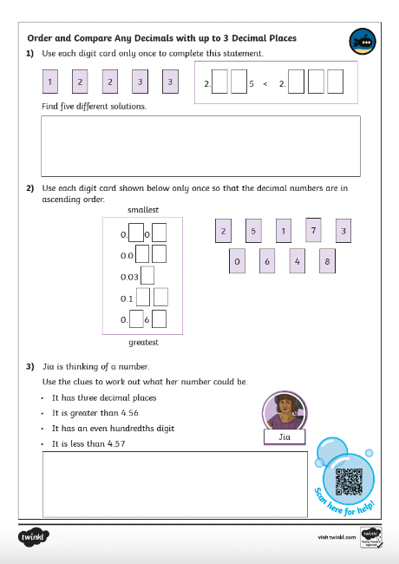
Order and Compare Any Decimals with up to 3 Decimal Places
Dive in by completing your own activity!

Slide 11
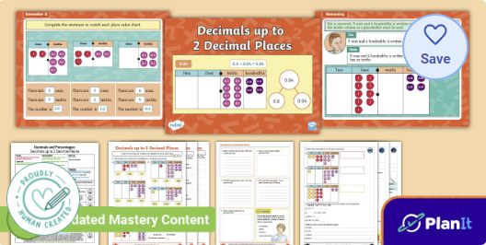
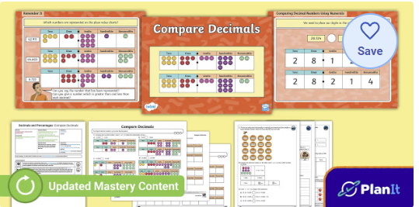

Need Planning to Complement this Resource?
National Curriculum Aim
Read, write, order and compare numbers with up to 3 decimal places
For more planning resources to support this aim, click here.
Twinkl PlanIt is our award-winning scheme of work with over 4000 resources.

Slide 12
