Slide 1
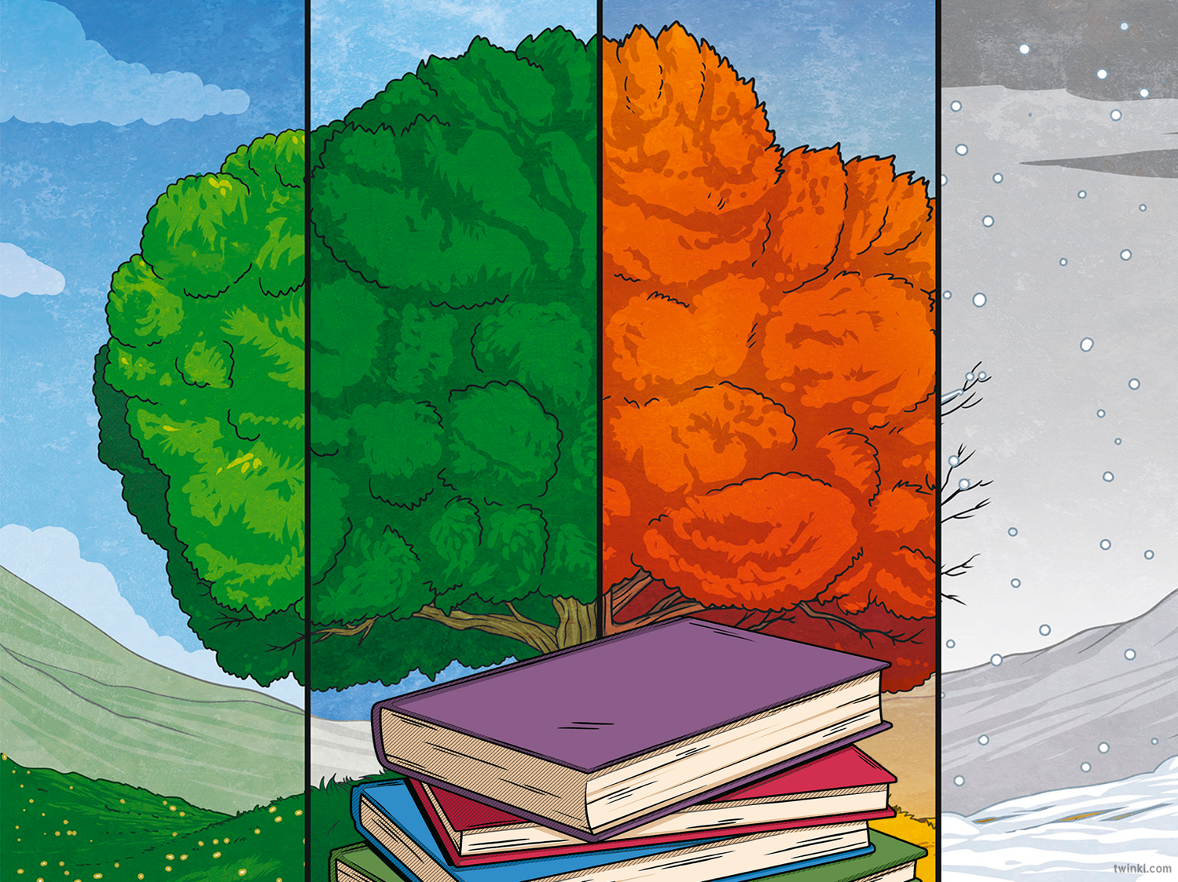
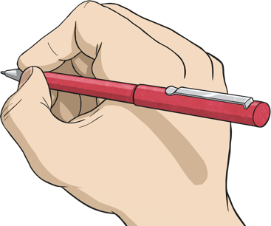
What is a clause?
The subject of a sentence is the person or thing that is carrying out the main action of that sentence.
Verbs can describe an action (e.g. sing, climb), emotion (e.g. loves, hates), thought (e.g. thinks), opinion (e.g. believes) or state of being (e.g. am, is, are, was, were).
A clause is a group of words that contains a verb and a subject.
There are two types of clauses: dependent and independent.

Slide 2

Independent Clause
An independent clause is the key part of a sentence. Every sentence has a main independent clause. A main clause can form a complete sentence; it makes sense on its own.
Independent
clause

Slide 3
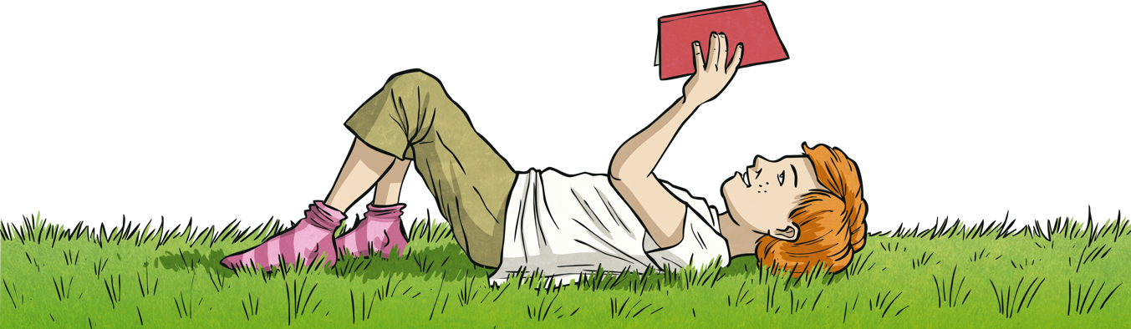
Dependent Clause
A dependent clause gives us more information about the main clause. If we removed the main clause, a dependent clause would not make sense on its own, it is not a ‘full’ sentence.

Slide 4
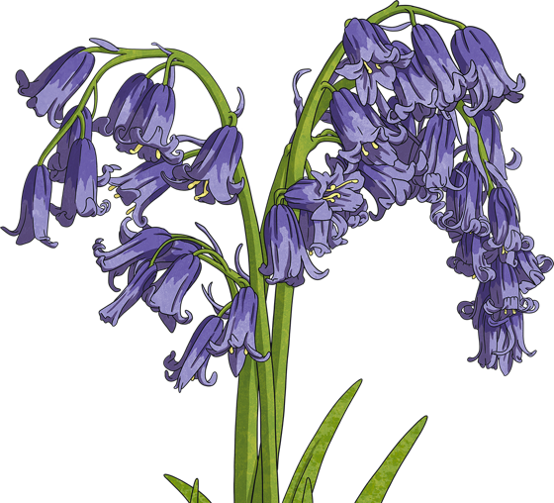
Simple Sentences
A simple sentence has just one main clause.
For example:
Bluebells are protected flowers.

Slide 5
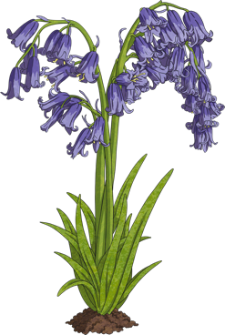
Compound Sentences
A compound sentence will include two independent clauses (they will both make sense on their own and have equal importance in the sentence).
The main clauses will be linked together by a type of word called a ‘coordinating conjunction’: and; so; but; or; for; yet; nor.
For example:
Bluebells are protected flowers, and uprooting wildflowers without permission is not allowed in Northern Ireland.
Main clause: Bluebells are protected flowers.
Main clause: Uprooting wildflowers without permission is not allowed in Northern Ireland.
Coordinating conjunction: and

Slide 6

Complex Sentences
Complex sentences will include an independent clause and a dependent clause or clauses. The dependent clause will add more detail to the main clause, but will not make sense on its own. Wherever it appears in the sentence, a dependent clause will usually begin with a type of word called a ‘subordinating conjunction’. This word or words will explain how the information is linked to the main clause.
For example:
It is illegal to intentionally pick, uproot, or destroy bluebells because they are protected flowers.
Main clause: It is illegal to intentionally pick, uproot or destroy bluebells.
Dependent clause: they are protected flowers.
Subordinating conjunction: because

Slide 7
Activity 1
Read the sentence and decide if it is a simple, compound, or complex sentence.
Roses are red, and violets are blue.
Compound

Slide 8
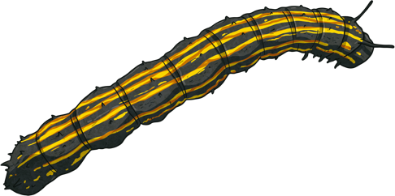
Activity 2
Activity 2
Read the sentence and decide if it is a simple, compound, or complex sentence.
I can search for minibeasts, now that I’ve
finished my homework.
Complex

Slide 9
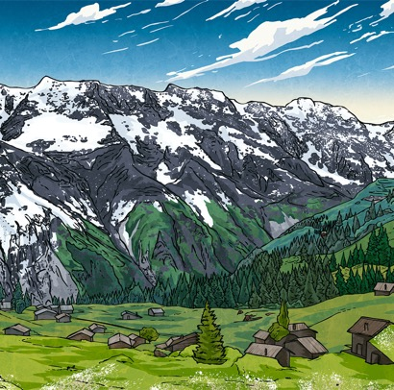
Activity 3
Read the sentence and decide if it is a simple, compound, or complex sentence.
Wintry weather might include frost, hail, sleet, and snow.
Simple

Slide 10
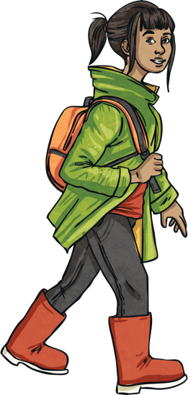
Activity 4
Read the sentence and decide if it is a simple, compound, or complex sentence.
Even though it was about to rain, I wanted to go for a walk.
Complex

Slide 11
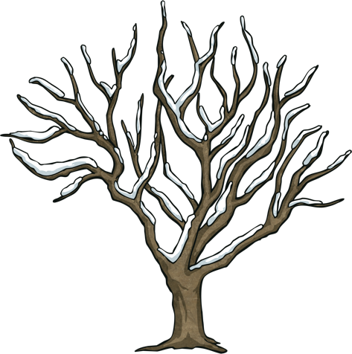
Activity 5
Read the sentence and decide if it is a simple, compound, or complex sentence.
Many trees are bare in winter, but evergreen trees do not lose their leaves.
Compound

Slide 12
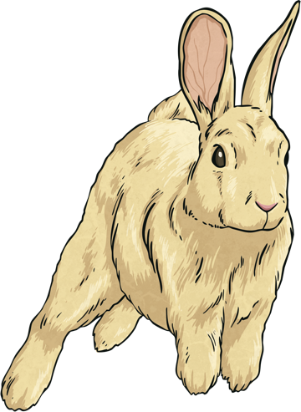
Activity 6
Read the sentence and decide if it is a simple, compound, or complex sentence.
During spring, rabbits can be spotted ‘boxing’ one another, as the females will sometimes fight off the attention of the males.
Complex

Slide 13
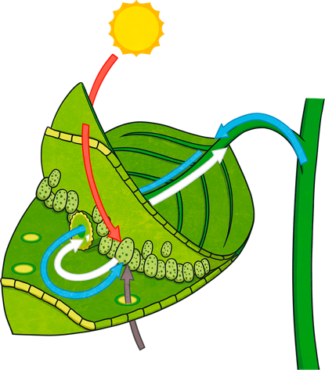
Activity 7
Read the sentence and decide if it is a simple, compound, or complex sentence.
Photosynthesis is the name for the process in which green plants make their own food.
Simple

Slide 14
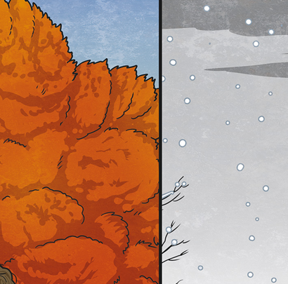
Activity 8
Read the sentence and decide if it is a simple, compound, or complex sentence.
The winter solstice occurs in December, and the summer solstice takes place in June.
Compound

Slide 15
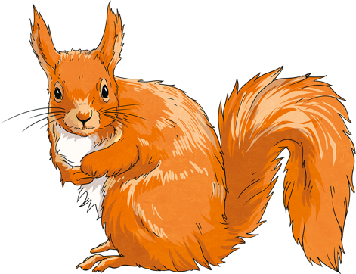
Activity 9
Read the sentence and decide if it is a simple, compound, or complex sentence.
Although they may be much less active in winter, red squirrels do not hibernate.
Complex

Slide 16
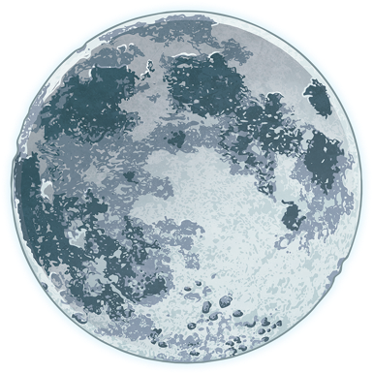
Activity 10
Read the sentence and decide if it is a simple, compound, or complex sentence.
The full moon that occurs closest to the autumn equinox is known as the Harvest Moon.
Simple

Slide 17

Activity 11
Read the sentence and decide if it is a simple, compound, or complex sentence.
Once the rain had stopped, the bees began buzzing around the flowers again.
Complex

Slide 18
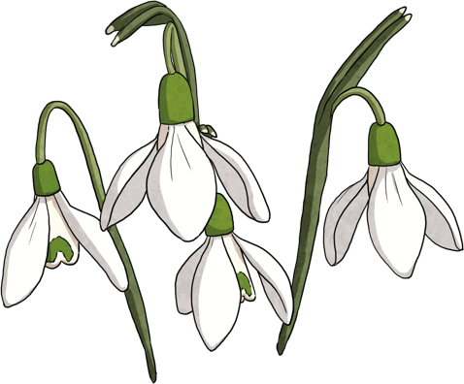
Activity 12
Read the sentence and decide if it is a simple, compound, or complex sentence.
Snowdrops are one of the first flowers that appear each year, even blooming in frost or snow.
Simple

