Slide 1


JORDAN WILDLIFE CONSERVATION SOCIETY
Endangered Wildlife of Jordan
A Critical Study of Species at Risk

Slide 2


Endangered Species of Jordan: An Overview
Jordan's biodiversity faces significant threats, with many species on the brink of extinction. Understanding the critical status of these animals is essential for effective conservation efforts and to preserve the region's unique ecological heritage.

Slide 3


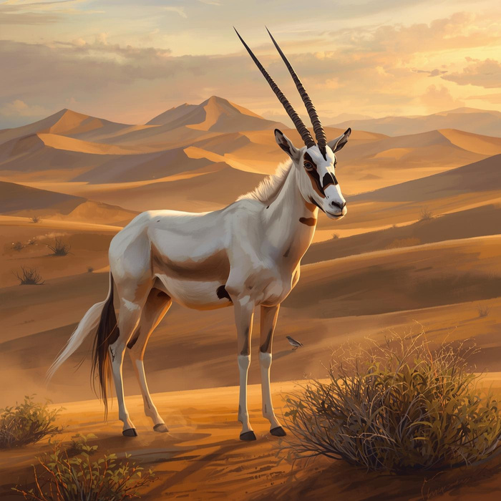
The Arabian Oryx: A Success Story
Reintroduction efforts and habitat restoration initiatives
The Arabian Oryx (Oryx leucoryx) was once extinct in the wild but has been successfully reintroduced through dedicated conservation efforts. Habitat restoration programs have increased its population and raised awareness about the importance of preserving this iconic species and its desert ecosystem.

Slide 4
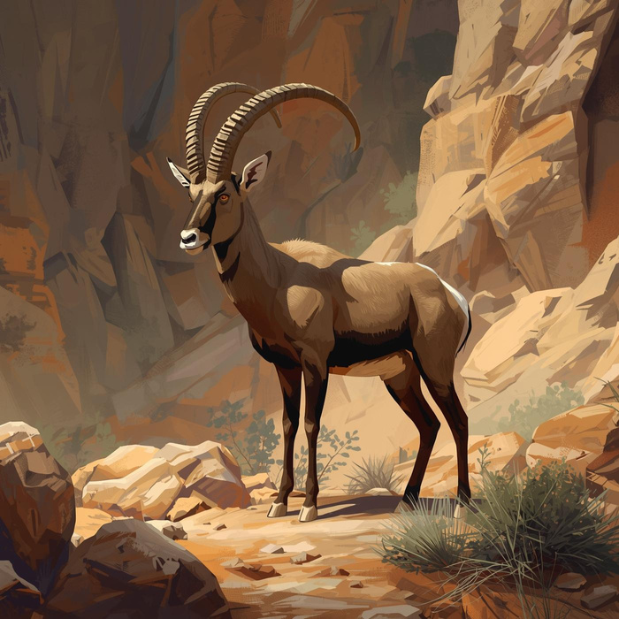
The Nubian Ibex: Conservation Status
Understanding its population decline and protection efforts
The Nubian Ibex (Capra nubiana) has faced significant population decline due to habitat loss and hunting. Conservation measures, including protected areas and breeding programs, aim to stabilize and increase its numbers, ensuring the survival of this remarkable species in Jordan's unique ecosystems.

Slide 5
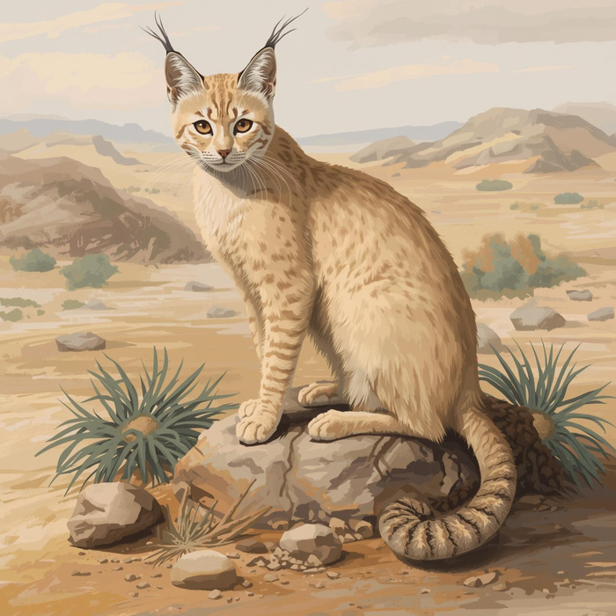
The Sand Cat's Habitat
Understanding its environment and conservation needs
The Sand Cat (Felis margarita) thrives in arid regions, primarily desert ecosystems. Habitat loss due to human encroachment and climate change poses significant threats. Conservation initiatives focus on habitat protection and awareness, ensuring the survival of this elusive species in its natural environment.

Slide 6
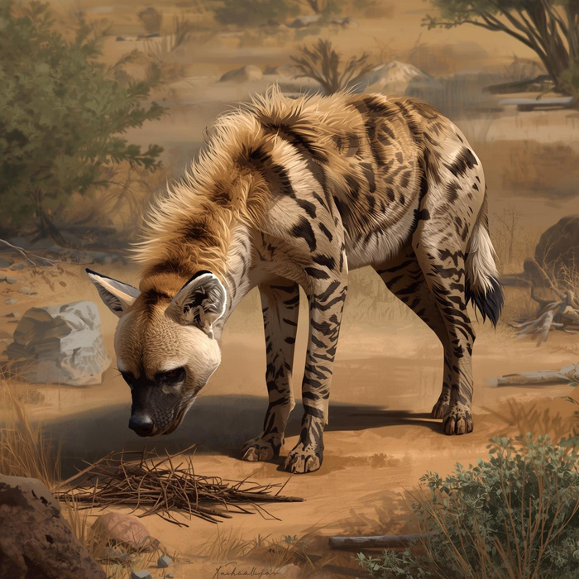
The Striped Hyena: Conservation Status
Understanding threats and efforts for survival
The Striped Hyena (Hyaena hyaena) faces significant threats from habitat loss and human-wildlife conflict. Conservation efforts focus on habitat preservation and educating local communities about its ecological role, as these scavengers contribute to the health of their ecosystems.

Slide 7
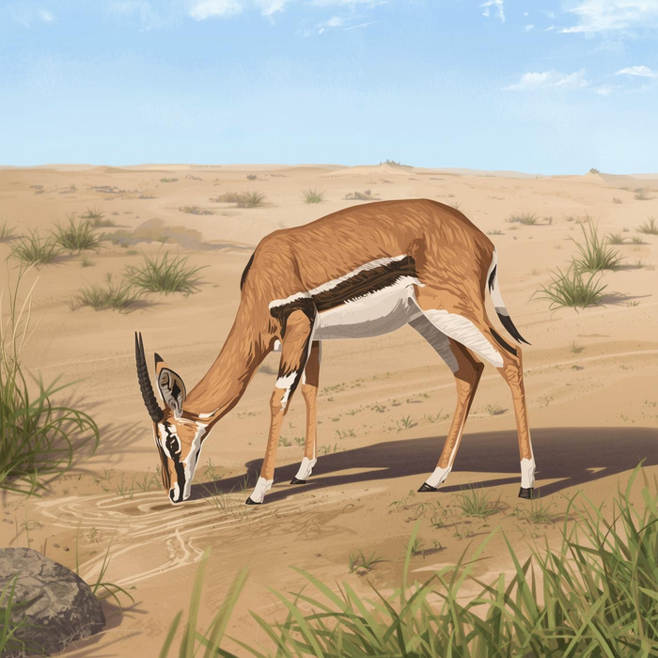
The Dorcas Gazelle's Habitat
Understanding its environment and conservation needs
The Dorcas Gazelle (Gazella dorcas) faces significant population decline due to habitat loss and hunting. Protecting its habitat in arid regions is essential. Conservation strategies include habitat restoration, anti-poaching efforts, and local community engagement to ensure the species' survival in Jordan.

Slide 8
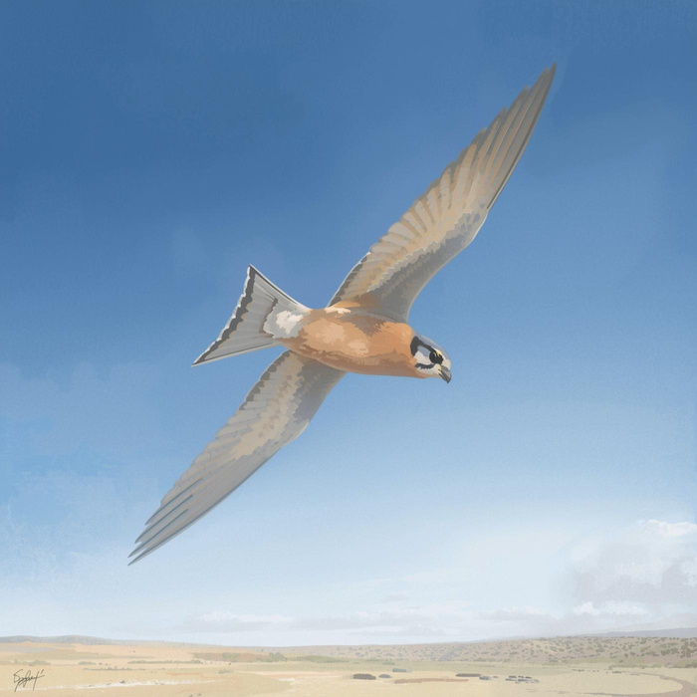
The Lesser Kestrel (Falco naumanni)
Migration patterns and habitat preservation efforts
The Lesser Kestrel is a migratory bird known for its seasonal movements between Europe and Africa. Habitat preservation is crucial as these birds rely on open landscapes for nesting and feeding, making conservation initiatives essential to their survival in Jordanian ecosystems.

Slide 9

Habitat Loss
Conservation Challenges and Solutions
Destruction of natural habitats leads to declining wildlife populations.
Poaching
Illegal hunting threatens many species, pushing them closer to extinction.
Addressing key issues impacting wildlife in Jordan's ecosystems
Climate Change
Shifting climates disrupt ecosystems and affect species survival rates.

Slide 10

How will you take action?

