Slide 1
Separating Mixtures
Science – Grade 2

Slide 2
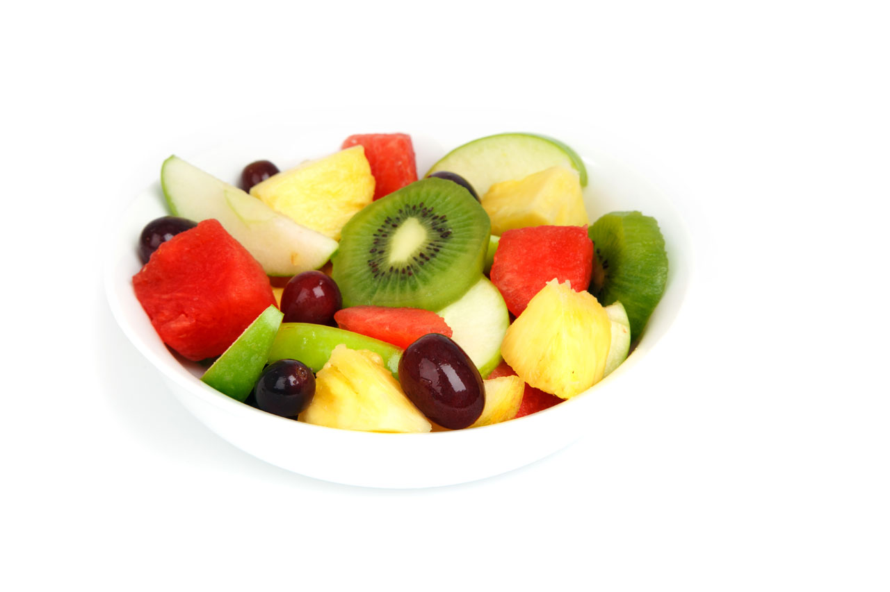
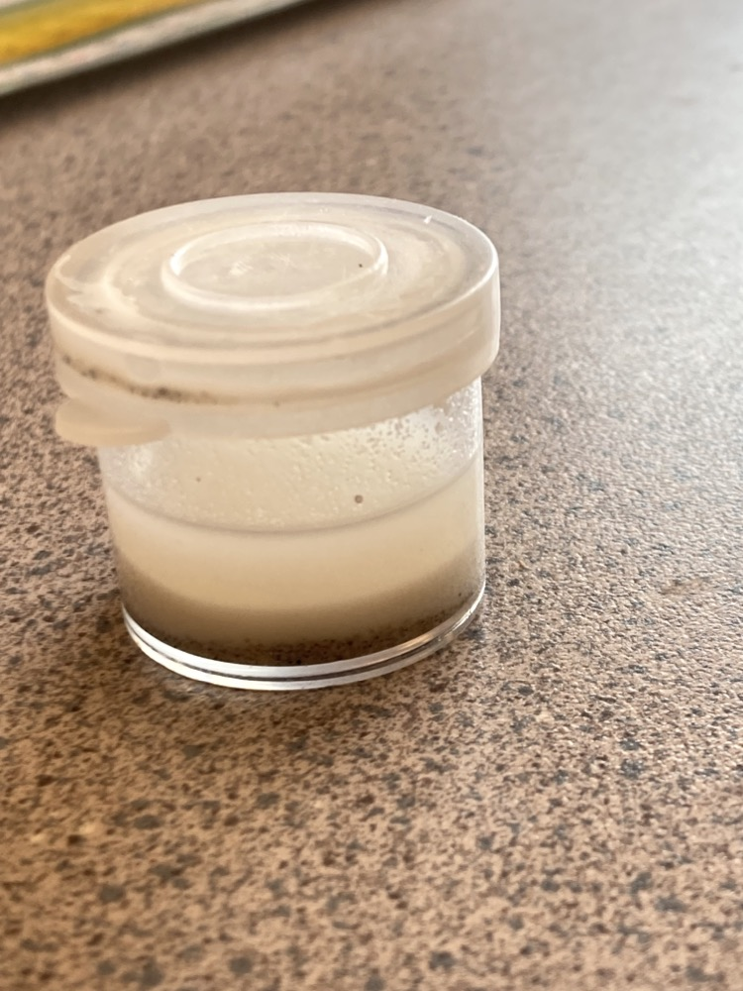
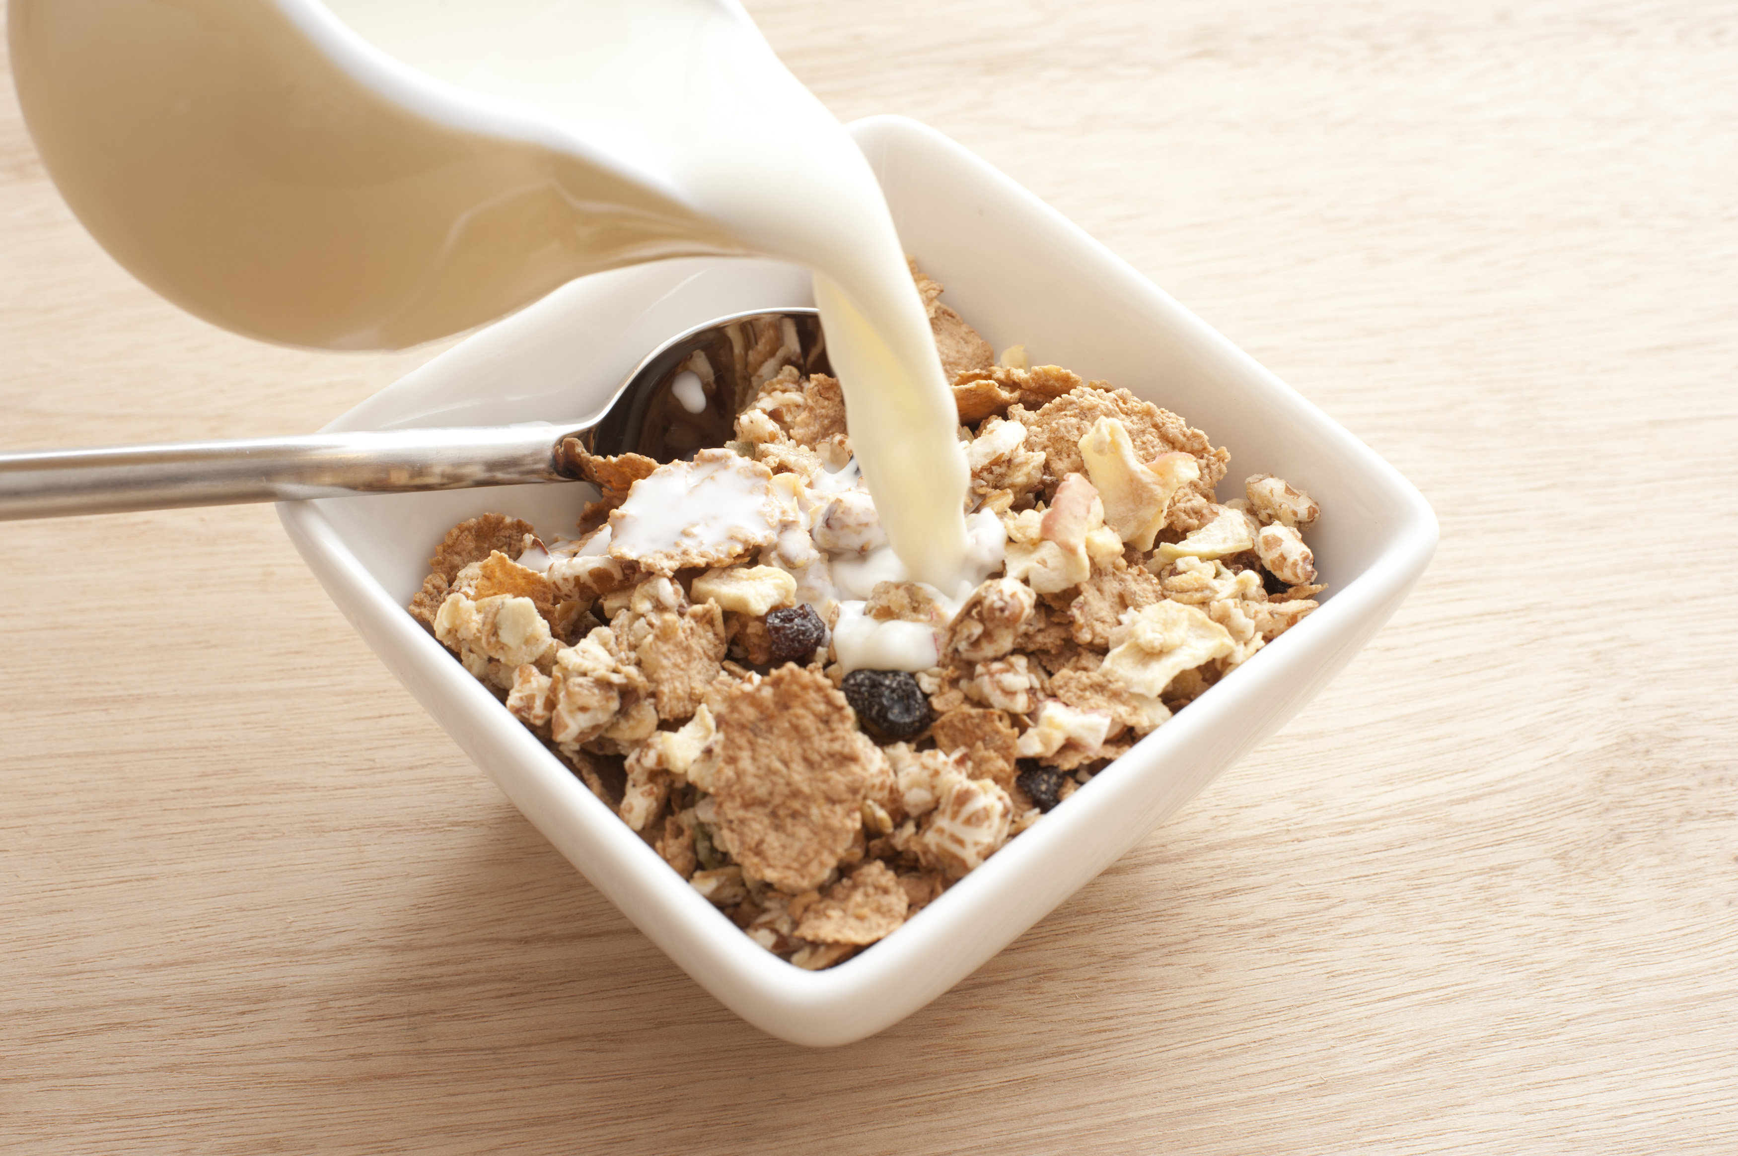
What is a Mixture?
A mixture is when two or more things are put together.
Examples: sand and water, fruit salad, cereal and milk.

Slide 3
Why Do We Separate Mixtures?
We separate mixtures to:
• Get clean water.
• Collect useful things.
• Keep things tidy and safe.

Slide 4
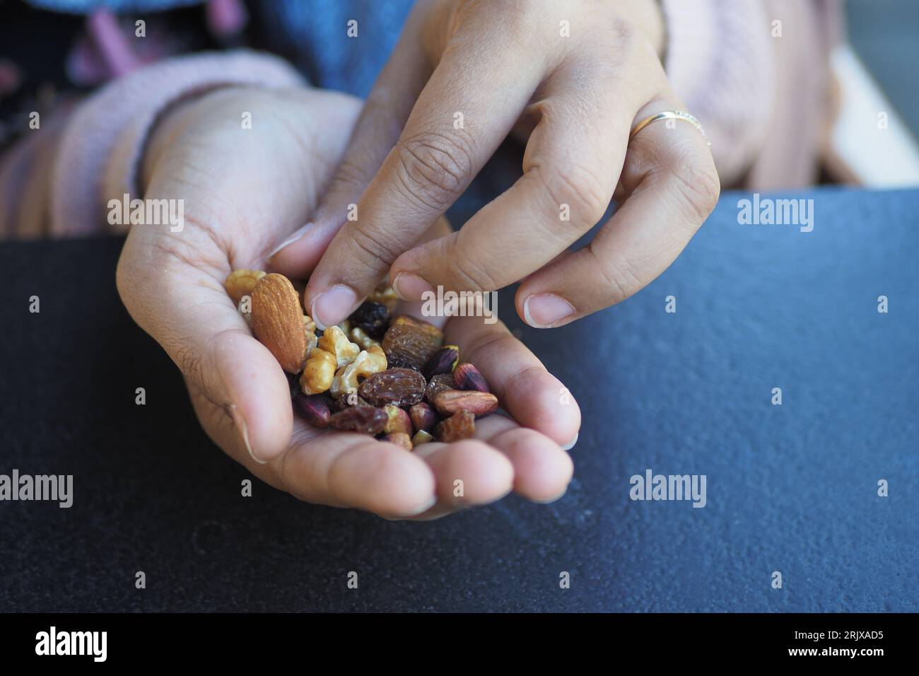
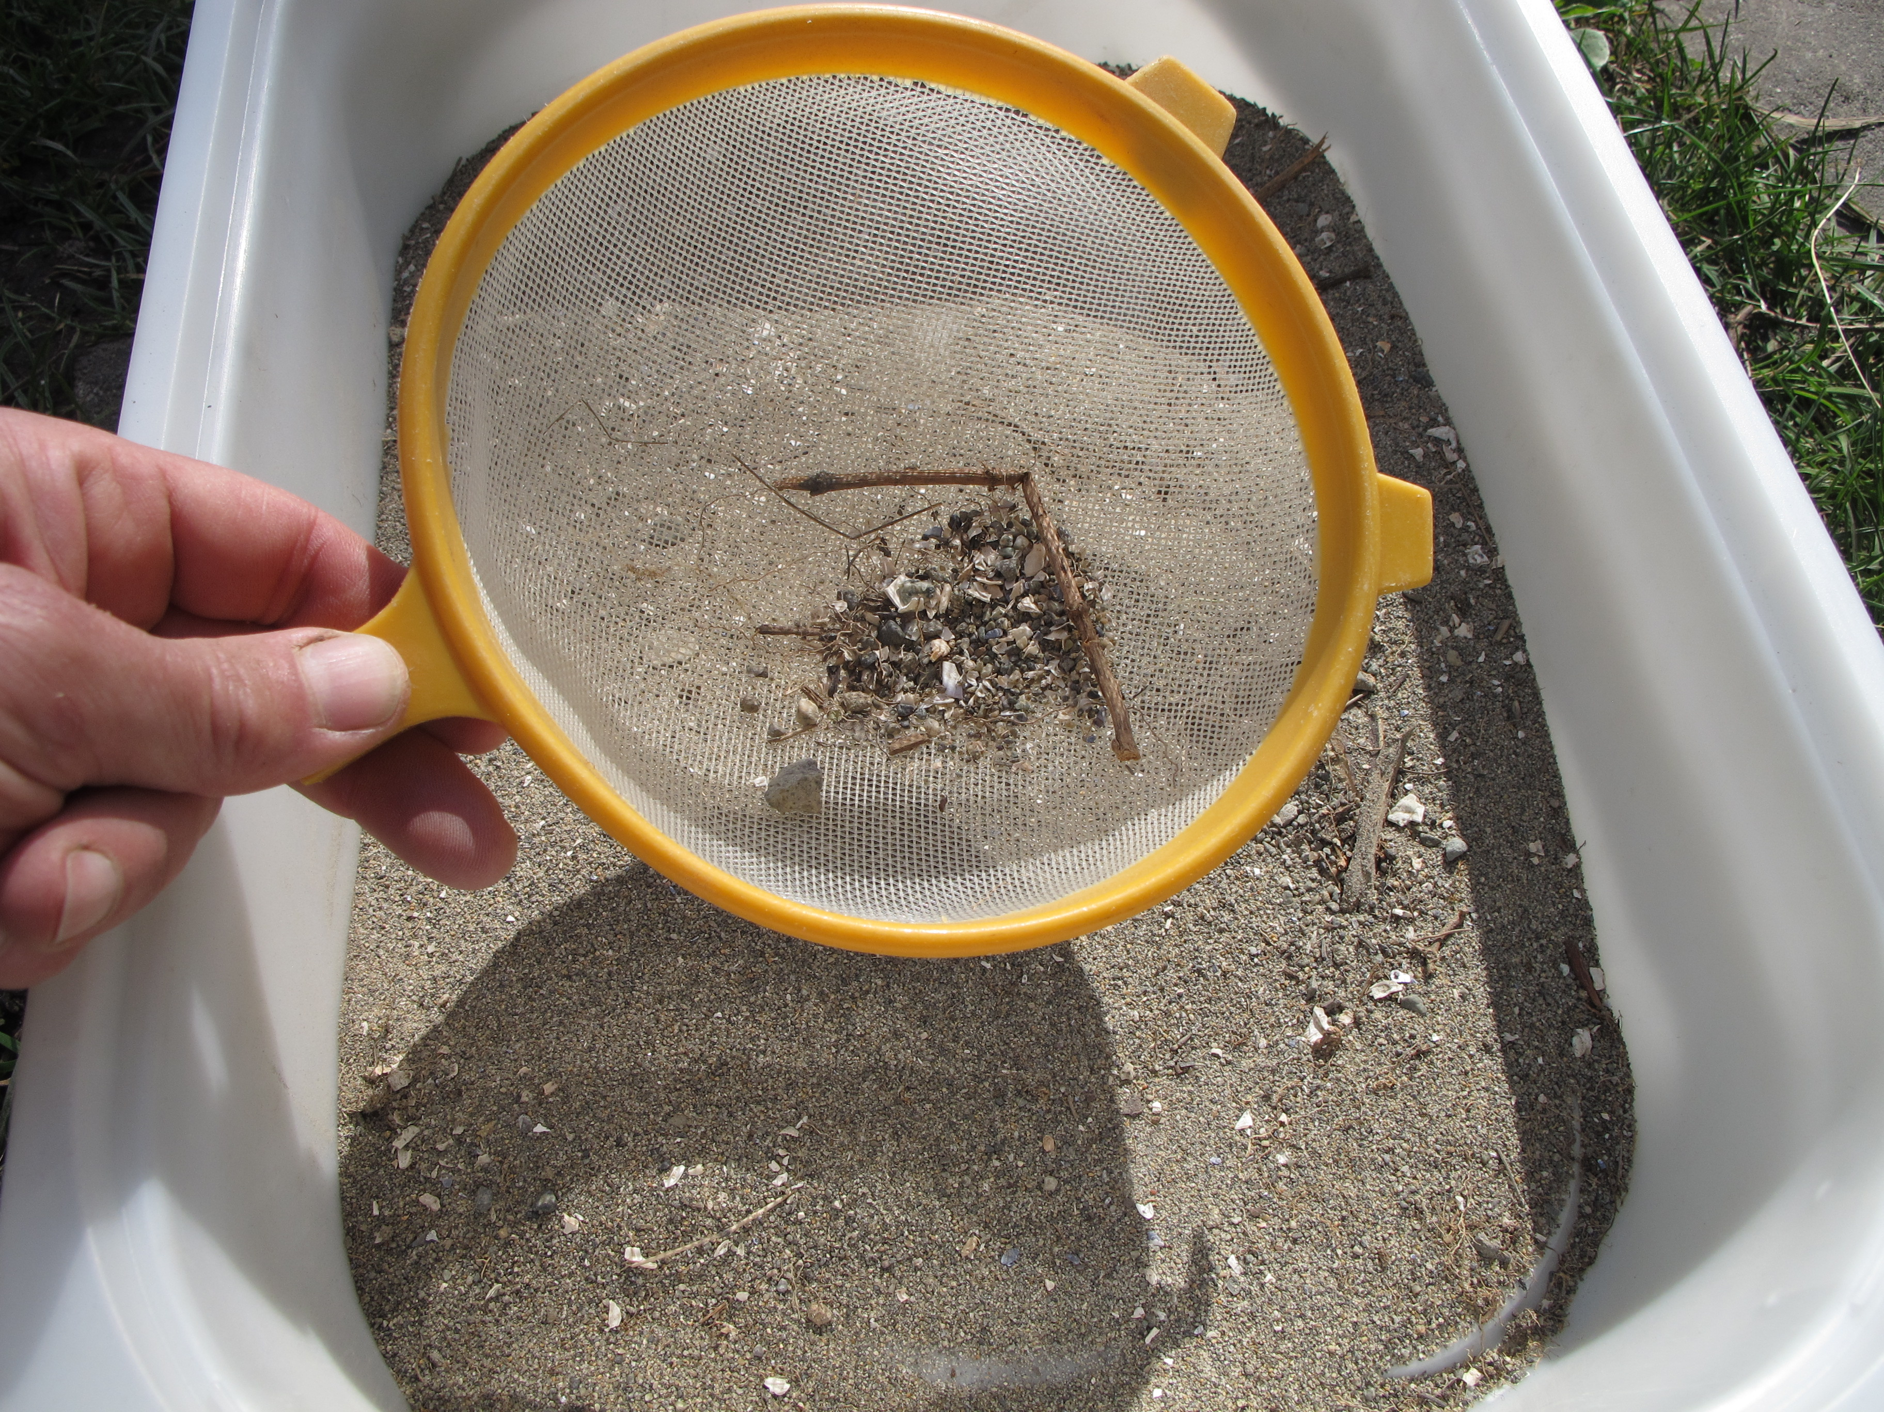
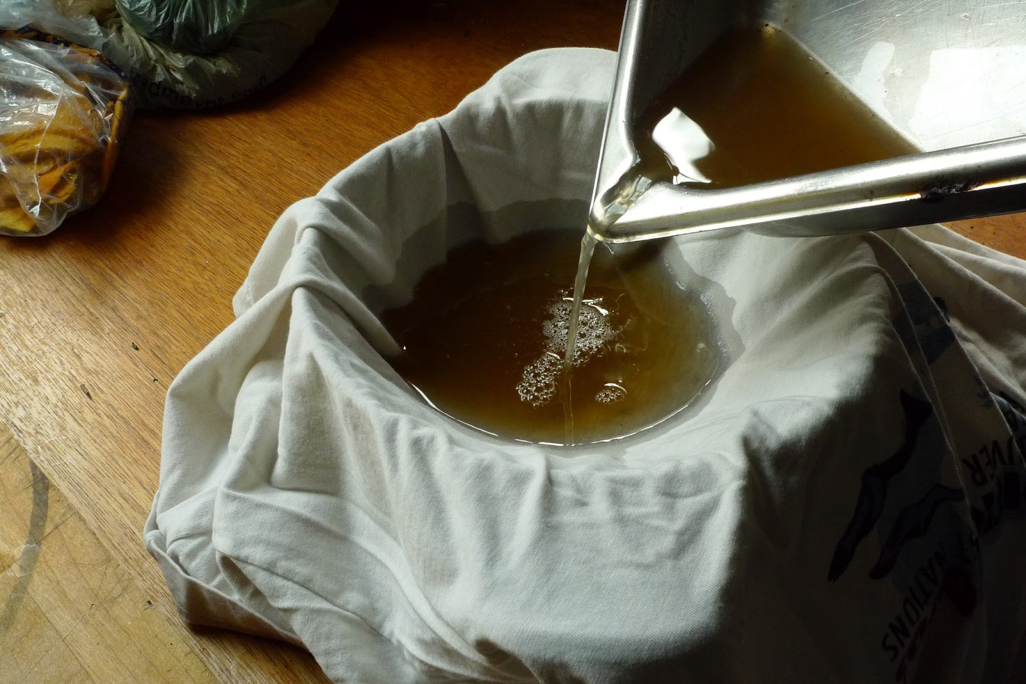
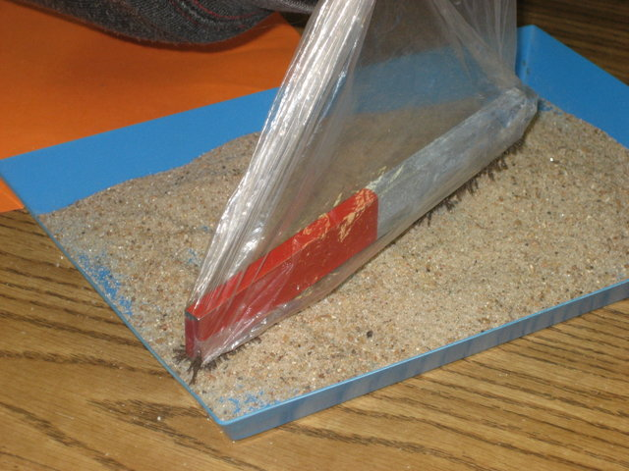
Ways to Separate Mixtures
1. Handpicking – picking big pieces by hand
2. Sieving – using a sieve to separate big and small parts
3. Filtering – using a filter or cloth to separate solids from liquids
4. Using a Magnet – to pick up things made of iron

Slide 5
Handpicking
We use our hands to take out one part of a mixture.
Example: Picking your favorite nuts.

Slide 6
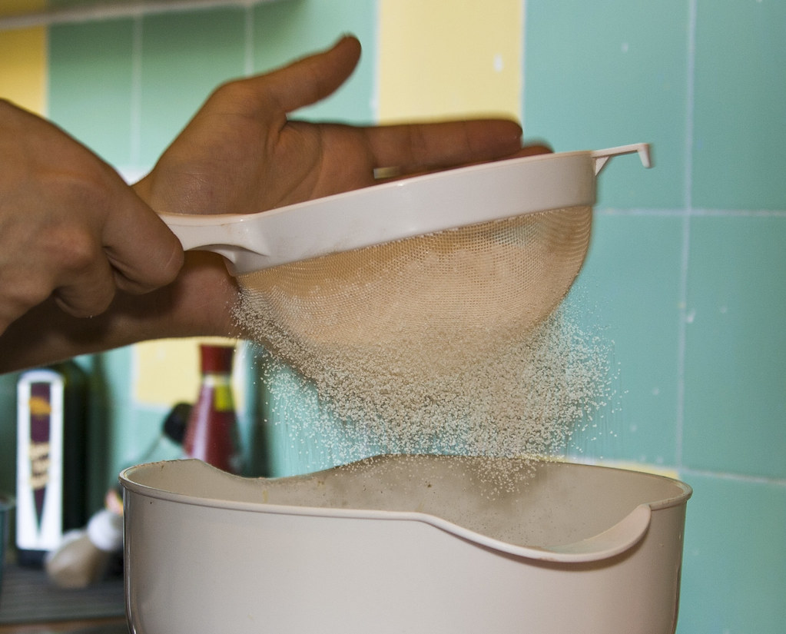
Sieving
A sieve has holes that let small things pass through.
Example: sieving from flour or sand.

Slide 7
Filtering
Filtering is used to separate solids from liquids.
Example: filtering sand from water using filter paper or cloth.

Slide 8
Using a Magnet
A magnet attracts things made of iron or steel.
Example: separating iron nails from sand.

Slide 9
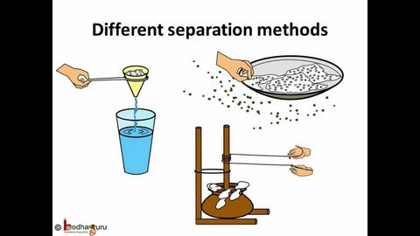
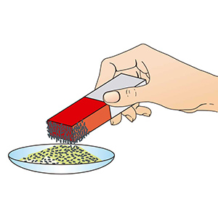
Let’s Try!
What method would you use to separate:
1. Sand and stones?
2. Water and sand?
3. Iron nails and rice?

Slide 10
Summary
• Mixtures are things mixed together.
• We can separate them using:
- Handpicking
- Sieving
- Filtering
- Magnet

Slide 11

Activity Time
Draw or bring a mixture from home.
Show how to separate it in class!

