Slide 1
Fiction vs. Nonfiction Unit 2
Grade 2 English

Slide 2
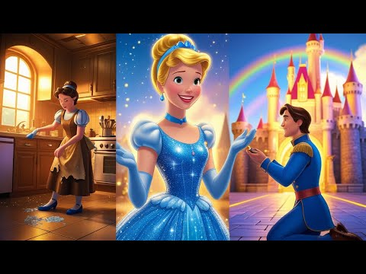
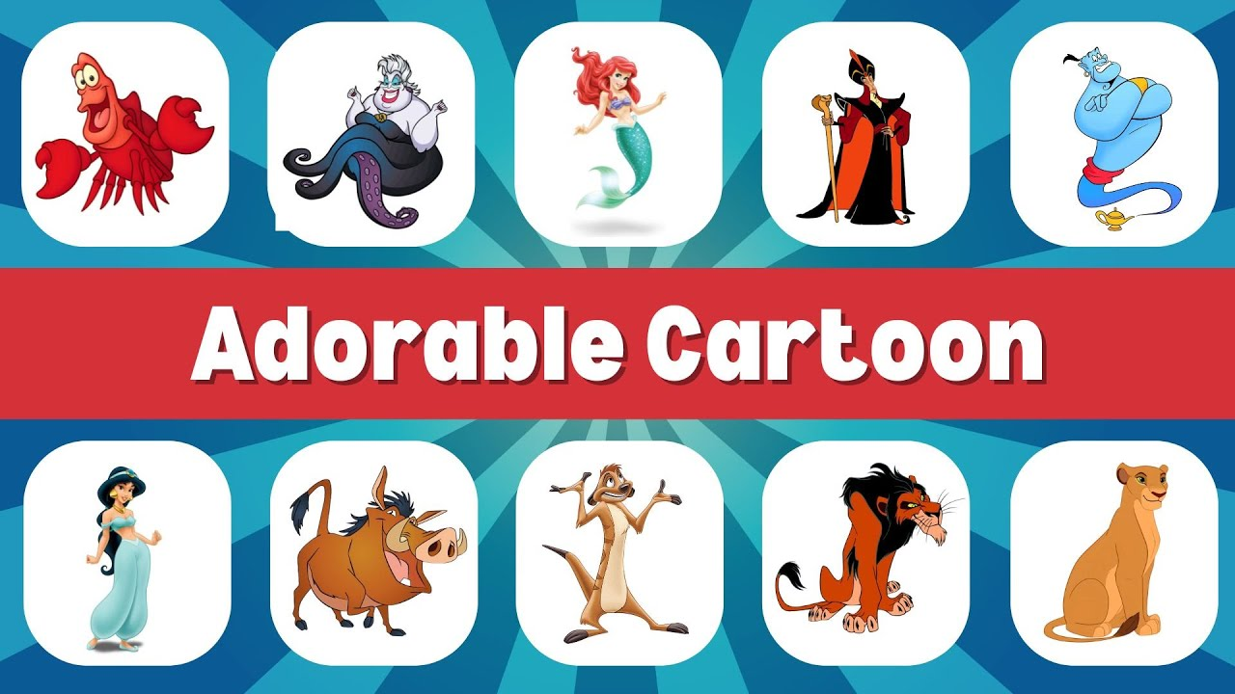

What is Fiction?
• Fiction is made-up or imaginary.
• It tells a story that may not be real.
• Includes characters, settings, and events.
• Examples: Fairy tales, cartoons, storybooks.

Slide 3



What is Nonfiction?
• Nonfiction is true and real.
• It gives us facts and information.
• It teaches us about the world.
• Examples: Science books, history, newspapers.

Slide 4
Fiction vs. Nonfiction
Fiction:
- Imaginary
- Entertains
- Made-up characters
Nonfiction:
- Real facts
- Teaches
- Real people, places, events

Slide 5
Activity Time!
Let’s decide:
📖 Is 'Cinderella' fiction or nonfiction?
📖 Is 'A book about animals' fiction or nonfiction?
📖 Is 'A newspaper' fiction or nonfiction?
📖 Is 'Spiderman comic' fiction or nonfiction?

Slide 6
Remember!
✨ Fiction is fun and imaginary.
✨ Nonfiction is real and teaches us facts.
Now you know the difference!

