Slide 1
Articles
Unit 1 – Grammar

Slide 2
Objectives
¿?
01
Identify and explain the differences between definite (the) and indefinite articles (a, an), as well as recognize when no article is needed.
03
Choose appropriate articles by engaging actively in peer correction activities and collaborative sentence-building exercises.
02
04
Apply the correct articles in sentences.
Reflect on their learning by reviewing their work

Slide 3
Table of contents
01
02
03
Overview on the rule
Tasks
Answer the book’s questions

Slide 4
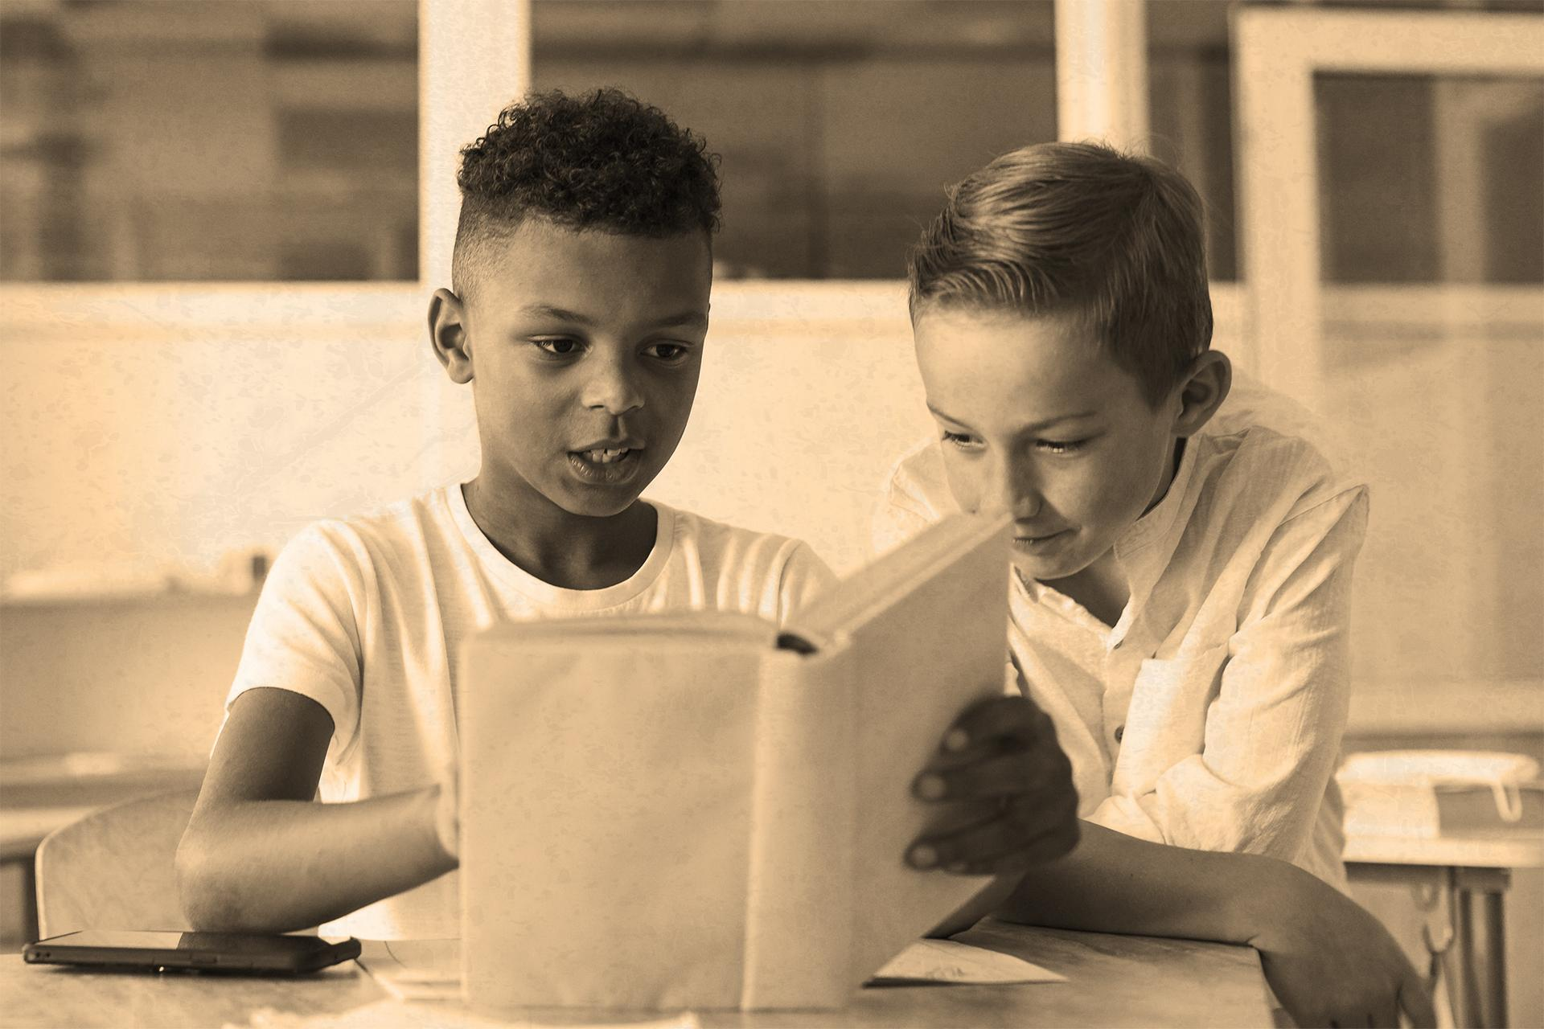
Types of Articles Definite Article: "the"
Important - Important - Important
Usage:
"The" is used when referring to a specific noun that is already known to the reader or listener. It can indicate uniqueness or specificity.
Examples:
The Eiffel Tower is in Paris. (There is only one Eiffel Tower.)
Please close the door. (A specific door that both speaker and listener are aware of.)

Slide 5
Types of Articles Definite Article: "the"
Important - Important - Important
When to Use "the":
When there is only one of something: the sun, the president.
When the noun has been mentioned before: I saw a movie last night. The movie was thrilling.
With superlatives: She is the best student in the class.
With unique objects: the Earth, the universe.

Slide 6
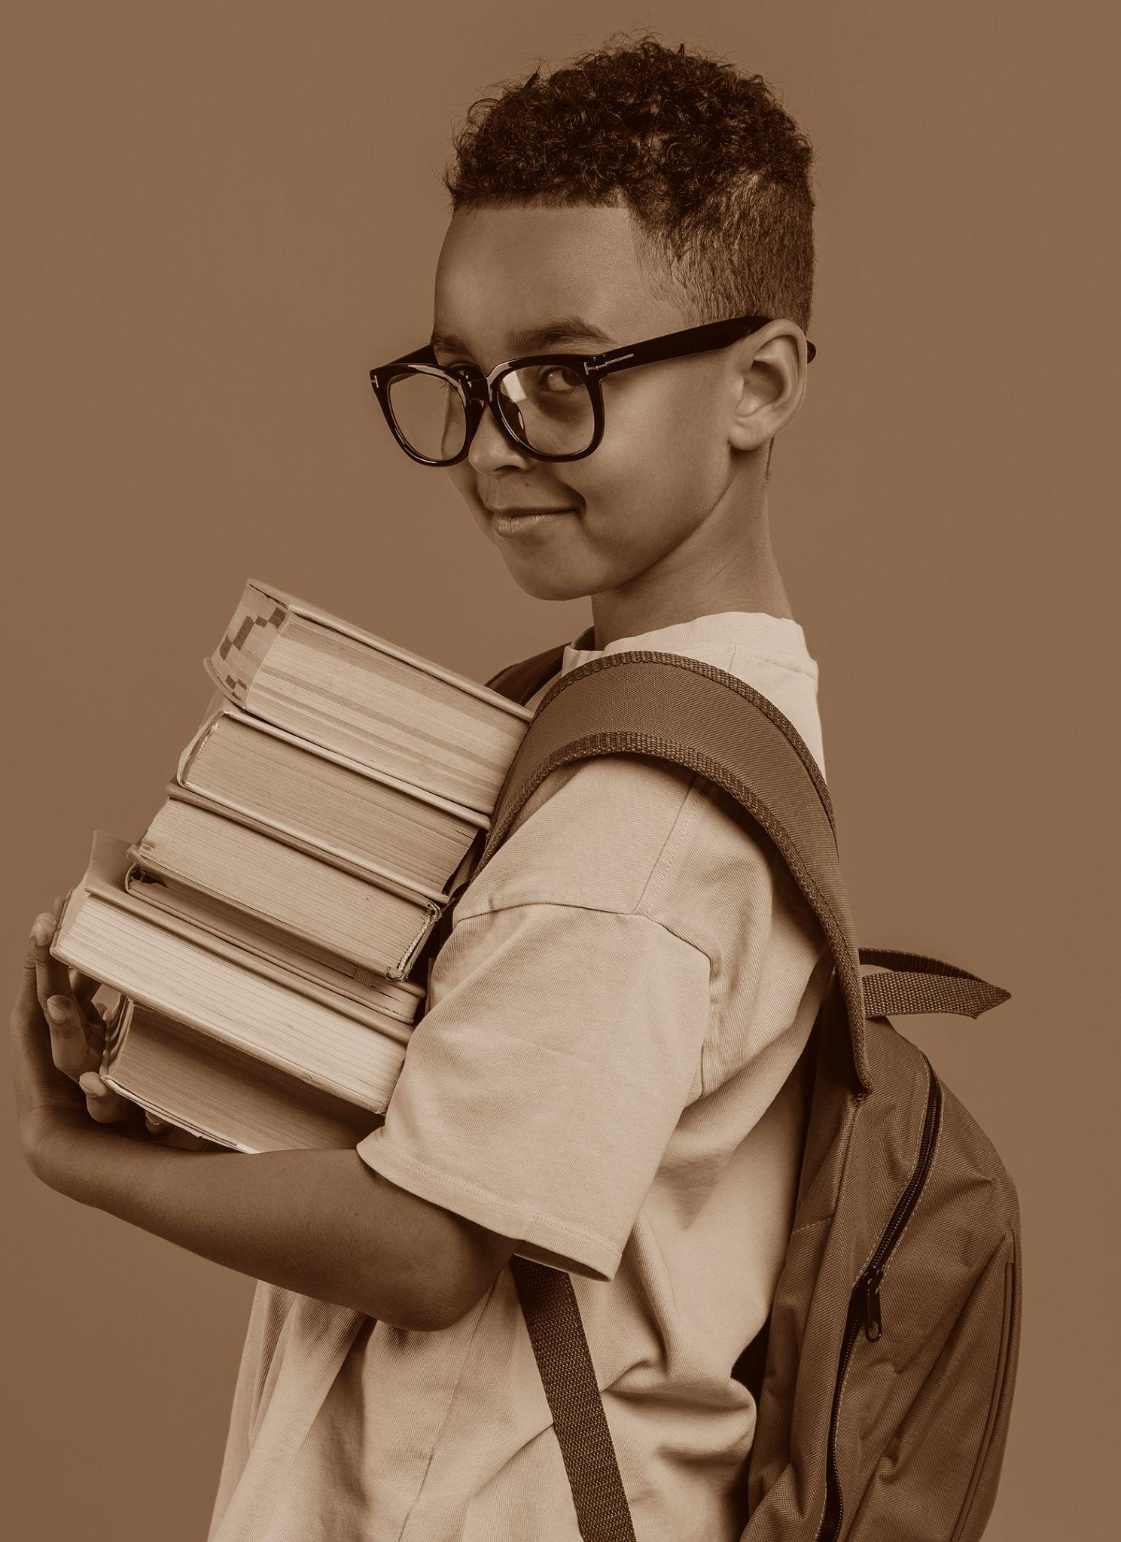
Indefinite Articles: "a" and "an"
Usage:
"A" is used before words that begin with a consonant sound, while "an" is used before words that begin with a vowel sound.
Examples:
I saw a bird in the garden. (Any bird)
He wants to be an astronaut. (Any astronaut)

Slide 7
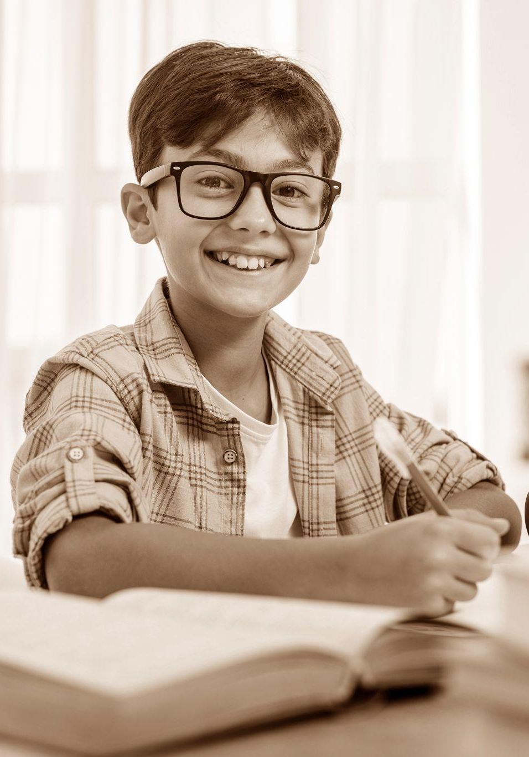
When to Use "a" and "an":
To refer to a non-specific item: I need a pen. (Any pen, not a specific one.)
When mentioning something for the first time: I met an interesting person yesterday.
With professions and descriptions: She is a doctor. He is an excellent player.

Slide 8
No Article
Generalizations:
Use no article when talking about things in general, especially plural nouns or uncountable nouns.
Examples:
Dogs are loyal animals. (General statement about all dogs.)
Water is essential for life. (Referring to water in general.)

Slide 9
Special Cases
Expressions and Idioms
Some phrases require articles for idiomatic expression:
In the morning
At the same time
Geographical Names
Use "the" with:
Rivers: the Nile
Oceans: the Atlantic
Mountain ranges: the Rockies
Group of Countries: the united states
Do not use "the" with:
Countries: Canada, Brazil
Cities: Paris, Tokyo

Slide 10
Common Errors to Avoid
Confusion Between "a" and "an":
Always focus on the sound: an hour, a university.
Using Articles with Abstract Nouns:
We usually don’t use an article when talking about abstract nouns in general: Example: Love is powerful. (not "the love")
Misuse with Countable and Uncountable Nouns: Use "a" or "an" with singular countable nouns (e.g., a book).
Do not use an article with
uncountable nouns when
speaking generally (e.g., milk, information).

Slide 11
Task 1
When Do We Use definite . Indefinite or No Article?

Slide 12
Task 2
Circle or underline all the articles "a," "an," and "the" in the text SB P 7.
Explain why did we use them ?

Slide 13
Task 3
sort the words into categories: **a, **an, or **zero article*.

Slide 14
1. Elephant 2. Problem 3. Apple 4. Doctor 5. Water 6. University 7. Ocean 8. Chair 9. Information 10. Actor 11. History 12. Umbrella 13. President 14. Coffee 15. Teacher 16. Energy 17. Engineer 18. Juice 19Advice. 20. Homework

Slide 15
An elephant /A problem /An apple /A doctor / No article (water is uncountable) /A university / an ocean /A chair /No article (information is uncountable) / An actor/ No article (history is uncountable) / An umbrella/ a president / No article (coffee is uncountable)/ A teacher/ No article (energy is uncountable)/An engineer /No article (juice is uncountable)/ No article (advice is uncountable)/ No article (homework is uncountable)

Slide 16
Task 4
Use the words below to create grammatically correct sentences using *a, **an, **the*, or no article.

Slide 17
1. Cat 2. Ice cream 3. Mountain 4. River 5. Teacher 6. Honest man 7. Lion 8. Cheese 9. Book 10. Ocean 11. President 12. Painting 13. Exam 14. Team 15. Star 16. Bird 17. Island 18. Idea 19. Computer 20. Movie 21. Telephone 22. Flower 23. Airport 24. King 25. Village 26. Dolphin 27. Garden 28. Article 29. Engineer 30. Salt

Slide 18
Listen
Now listen and find the articles .

Slide 19
Awesome work open SB P 12

