Slide 1
States of Matter
Grade 4

Slide 2
In this unit, I am learning:
1. Recognize solids, liquids and gases and the meaning of matter
2. Solids, liquids and gases are three states of matter
3. How the particles model describes each of these three states
4. How heating affects solids and liquids
5. How cooling affects liquids and solids
6. The difference between evaporation and condensation
7. The boiling, freezing and melting point of water

Slide 3


Everything around us is made of matter.
Matter takes up space and has weight.

Slide 4

Matter can exist in three forms:
Solid
Liquid
Gas

Slide 5
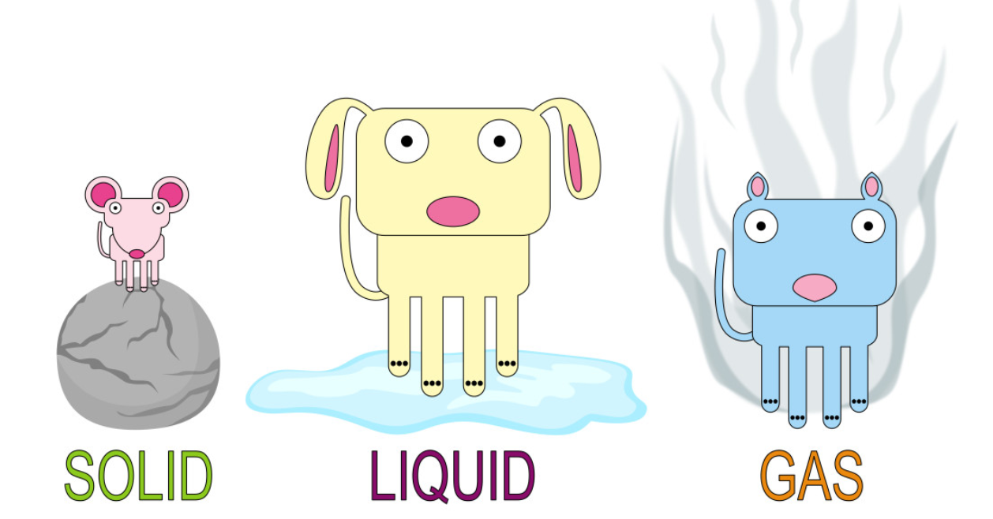
Matter is made up of small bits which are called particles.
03
Particles are too small to see except with very special microscopes.
We use a model to help us understand what the particles of matter are like in different states.

Slide 6
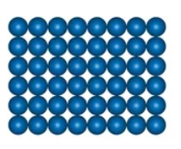

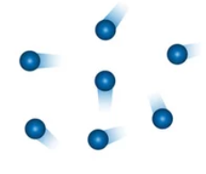
Shape of particles in each state of matter
Solid | Solid particles are packed tightly together. They stay in fixed position. The particles vibrate in their position.
Liquid | Liquid particles are closer together than gas, but not as close as in solids. Liquids don’t have a fixed shape; they can flow and take the shape of the container.
Gas | Gas particles are not close together; they move in different directions. Gas fills the container.

Slide 7
How does heating affect solids and liquids ?
04

Slide 8
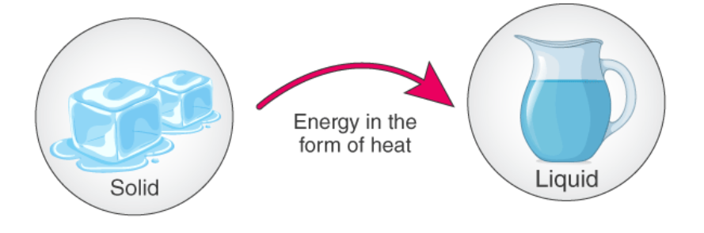
What is melting?
When a solid turns into a liquid, we say it melts.
Melting happens when we heat solids.

Slide 9
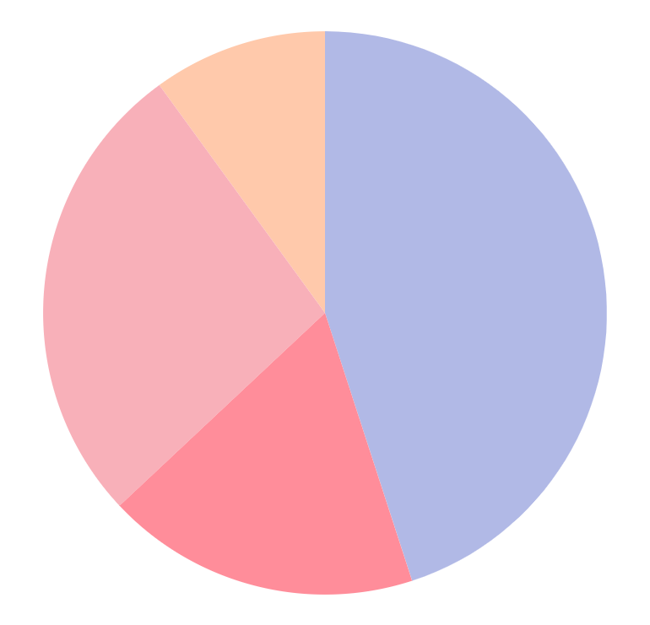

Did you know this?
Not all solids melt at the same temperature.
Some metals need to be heated to a very high temperature in a hot furnace before they melt.

Slide 10
How does cooling affect liquids and solids?
05

Slide 11

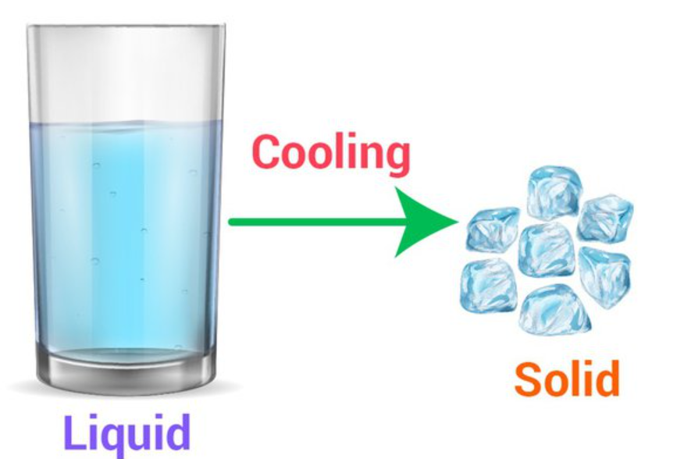
What is freezing?
When a liquid cools, it changes into a solid.

Slide 12
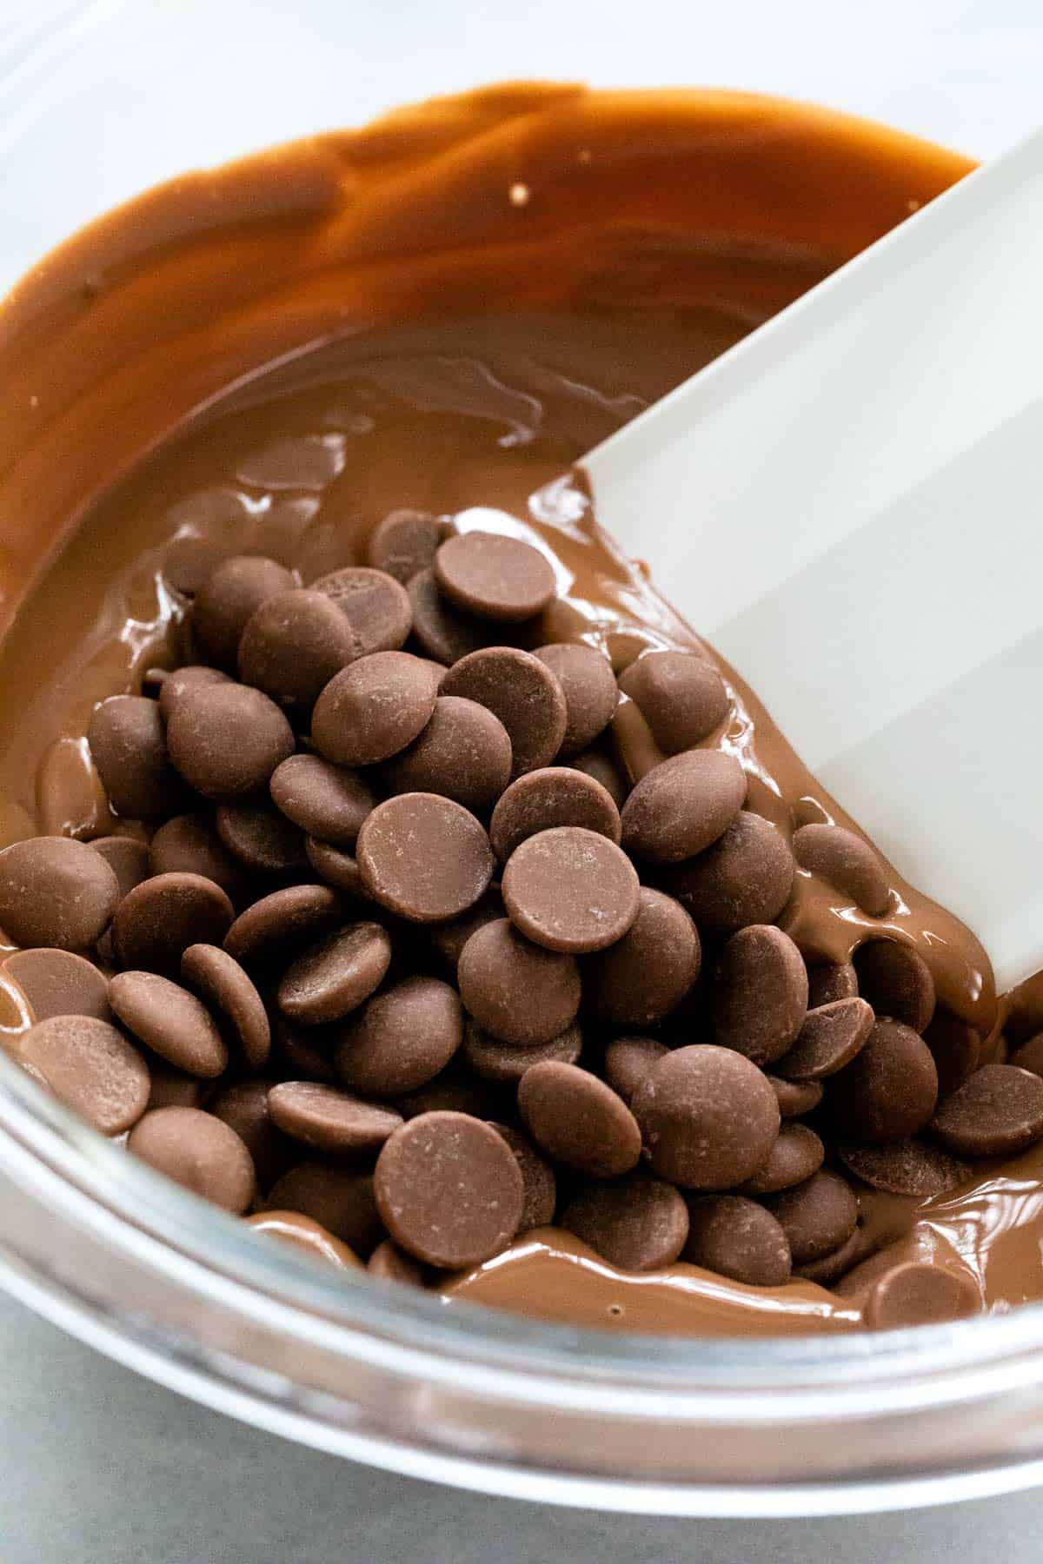
We often use melting and freezing when we cook.
Solid chocolate melts when it is heated; it becomes a liquid.
Melted chocolate turns back into solid when it is cooled.

Slide 13

The difference between evaporation and condensation
When a liquid is heated, it changes into gas. This process is called evaporation.
When a liquid is heated and we see many bubbles forming, we say it boils.
The bubbles are filled with gas. Once the gas touches a cold surface, it will change into liquid.

Slide 14
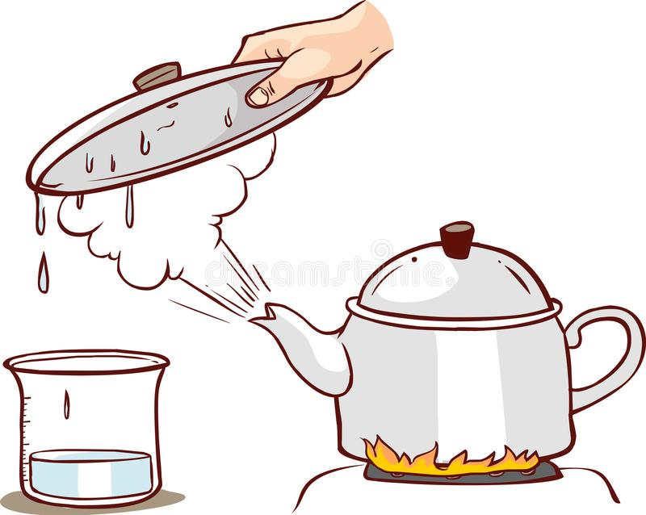
When gas particles meet a cold surface, it changes into a liquid.
We say the gas is condensed to become a liquid.

Slide 15
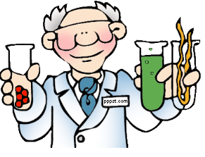
Remember
1.Melting and freezing are examples of changes of states.
2.During melting, a solid changes to a liquid.
3.During freezing, a liquid changes to a solid.
4.Evaporation and condensation are also changes of state.
5.When a liquid evaporates, it becomes a gas.
6.When a gas condenses, it becomes a liquid.

Slide 16


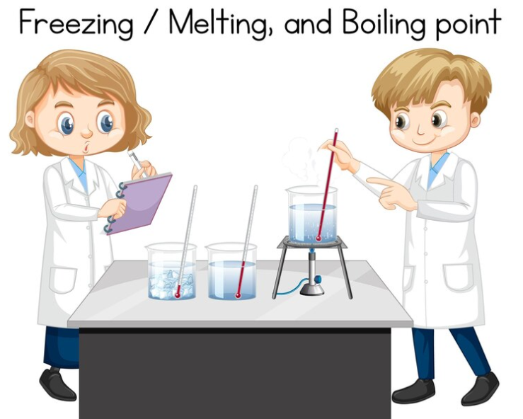

Slide 17
Boiling point
Freezing point
Melting point

