Slide 1
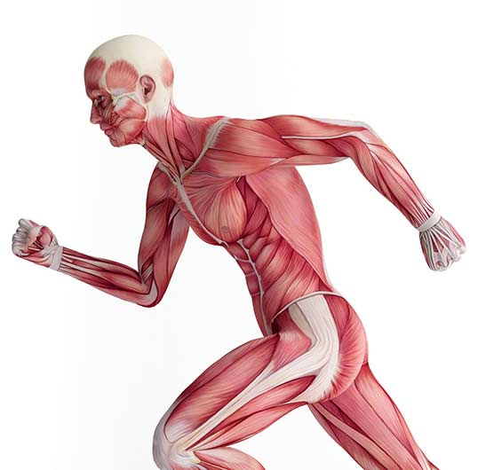
Muscles

Slide 2
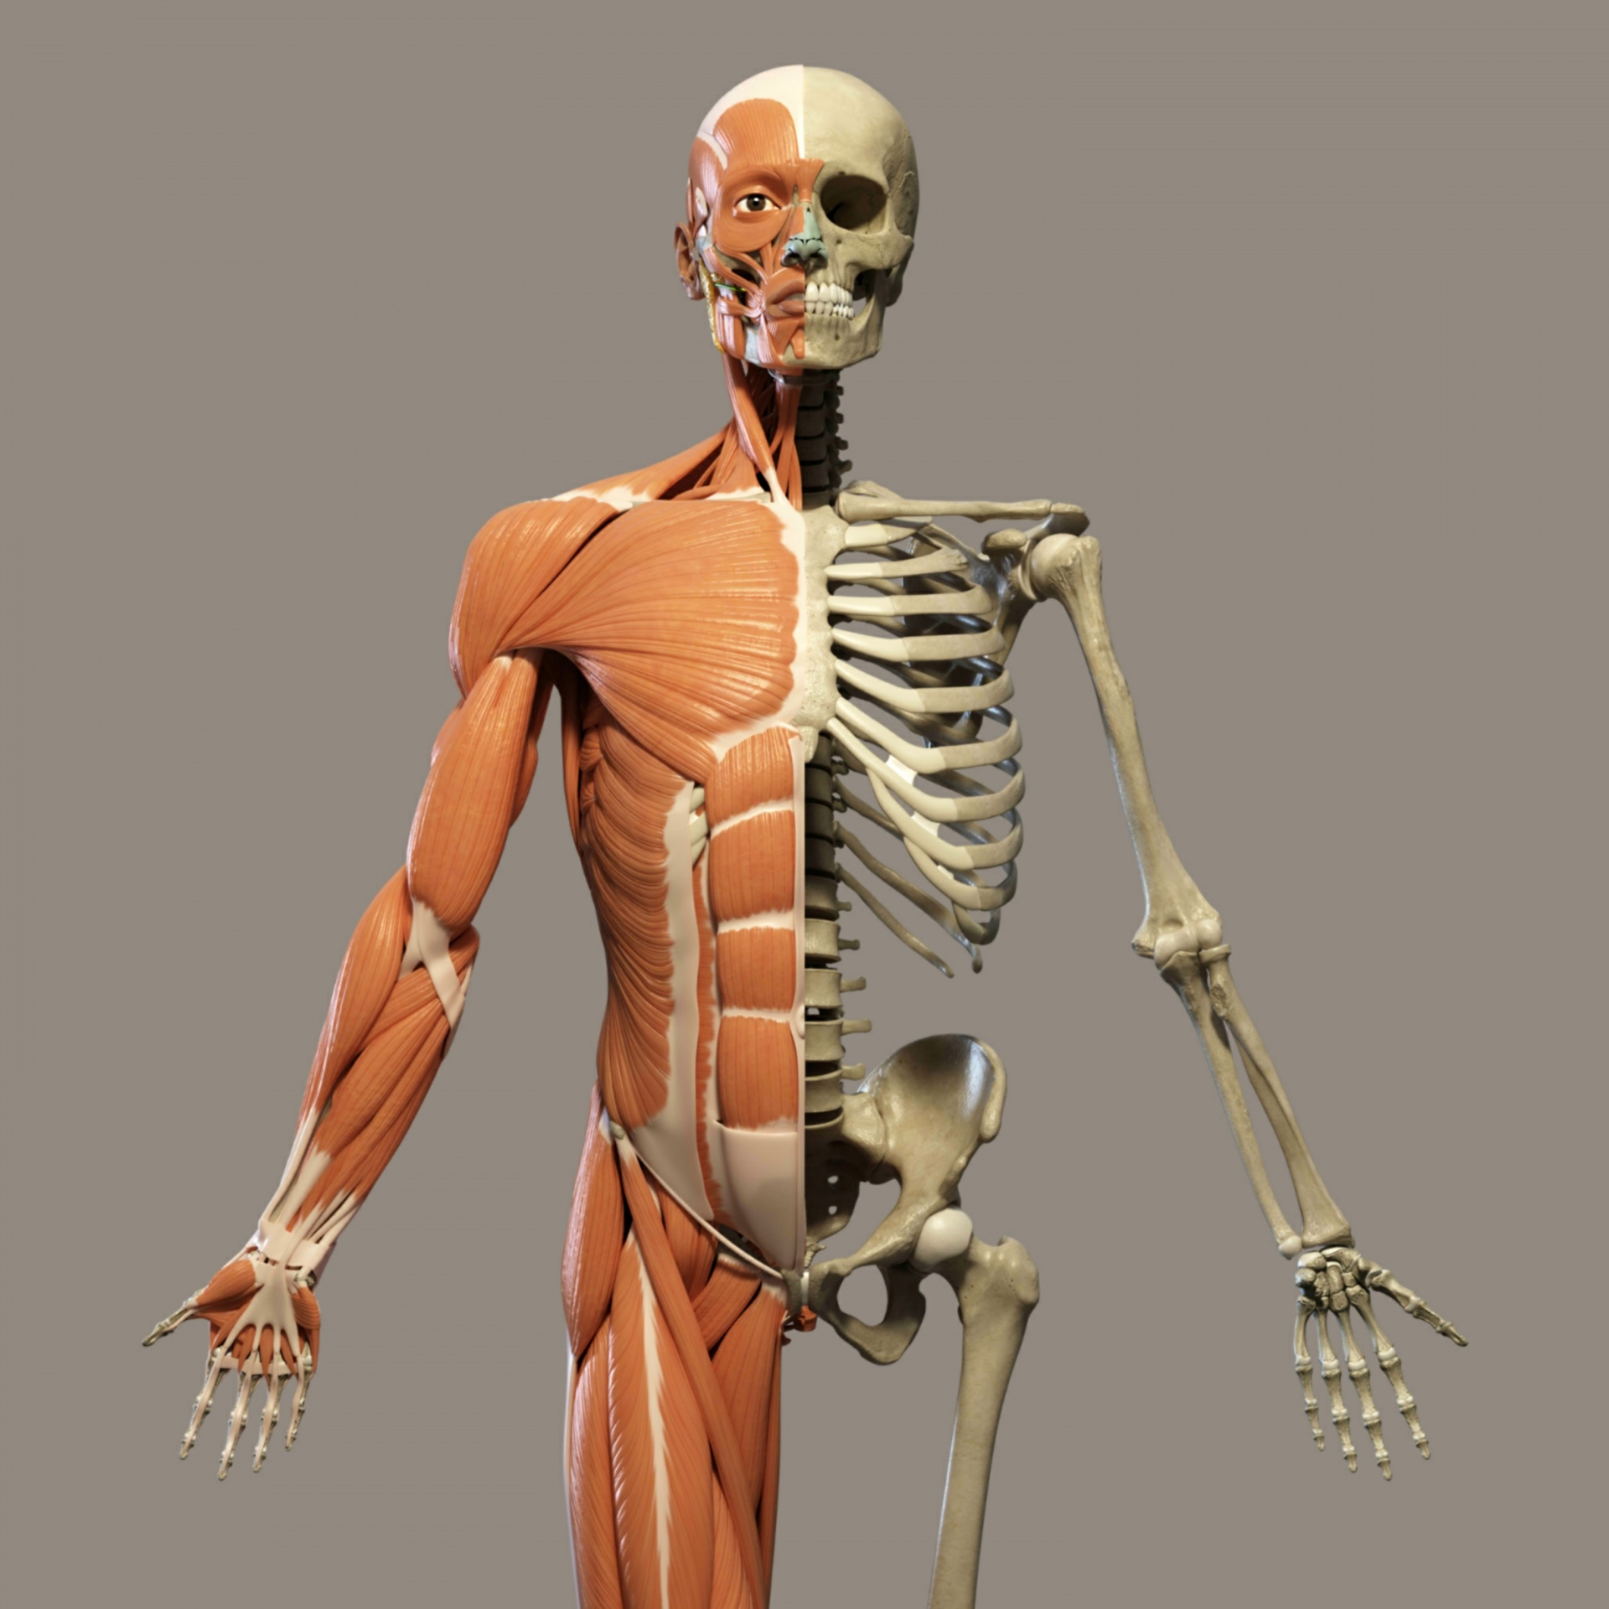
You can see your bones under your skin but if you could take off your skin, you would not see your skeleton. Do you know why?
This is because your bones are covered by muscles.
Muscles

Slide 3
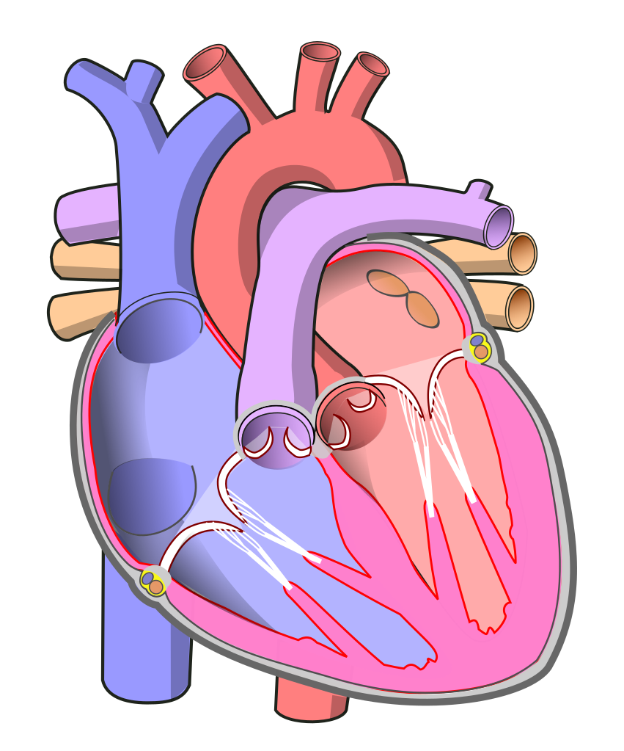
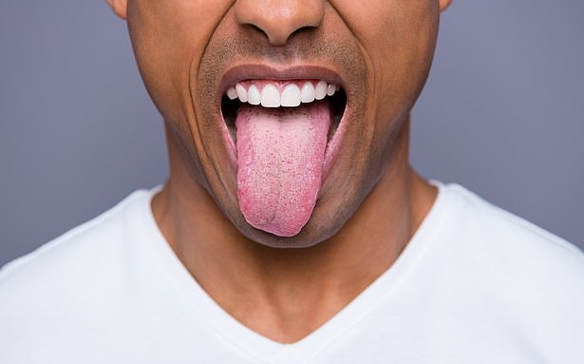
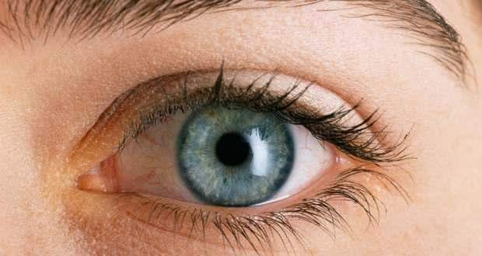
Why do you think muscles are important?
Because the skeleton and the muscles work together so that you can move.
Here are some examples on muscles in your body:
Tongue Heart Eye

Slide 4
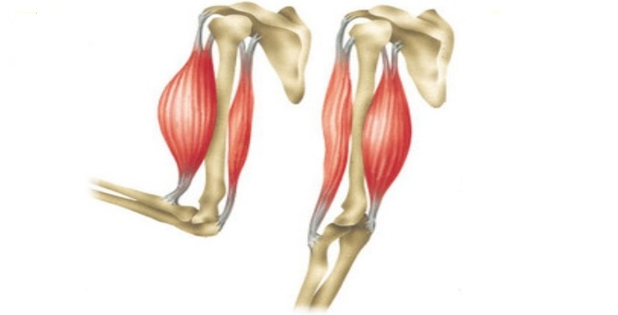
Muscles move the bones they are attached to by contracting.
Muscles have to shorten (contract)to make a bone move .
Contract muscle (Shorter)
Relaxed muscle
(Longer)

Slide 5
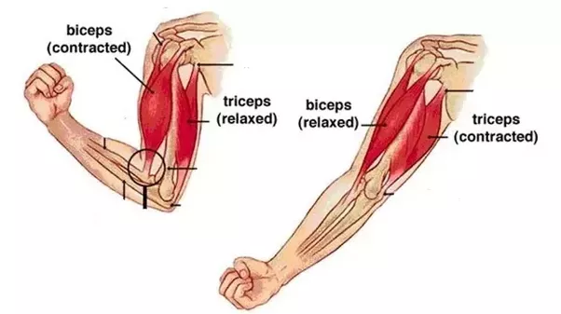
Muscles work in pairs. If you want to move your arm, two muscles work together.
One muscle contracts(gets smaller) while the other muscle relaxes and becomes longer.

Slide 6
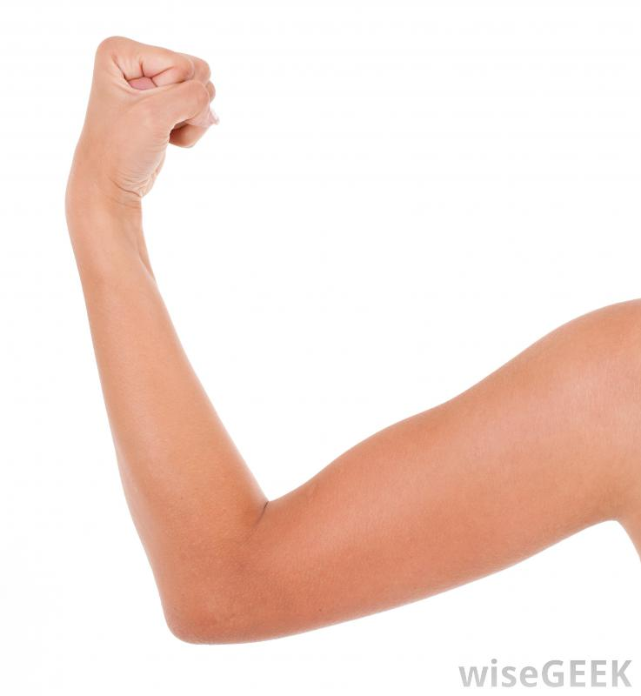
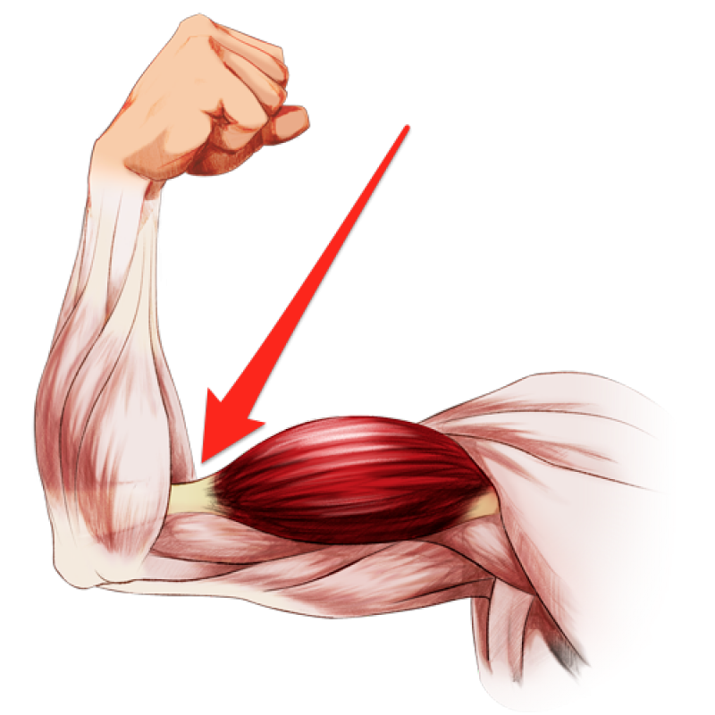
What do you think will happen when you bend your arm?

Slide 7
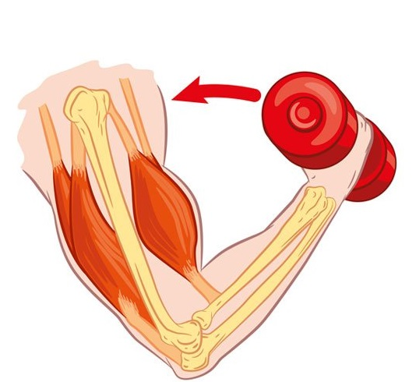
When you bend your arm, the muscle at the front of the upper arm gets fatter, harder and shorter.
Front muscle contracts.
The lower arm moves up.
Back muscle relaxes.
The muscle at the back of the upper arm gets thinner, softer and longer (relaxes).

Slide 8
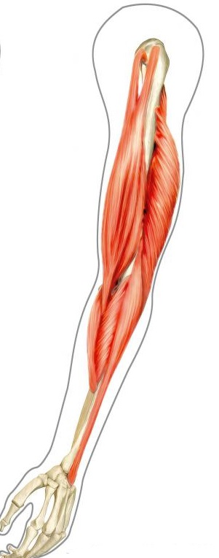
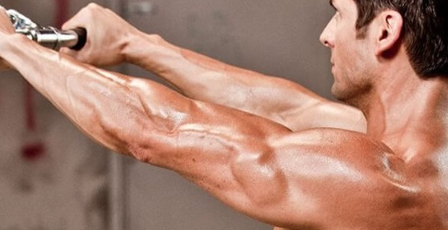
When you straighten your arm, what do you think will happen?

Slide 9
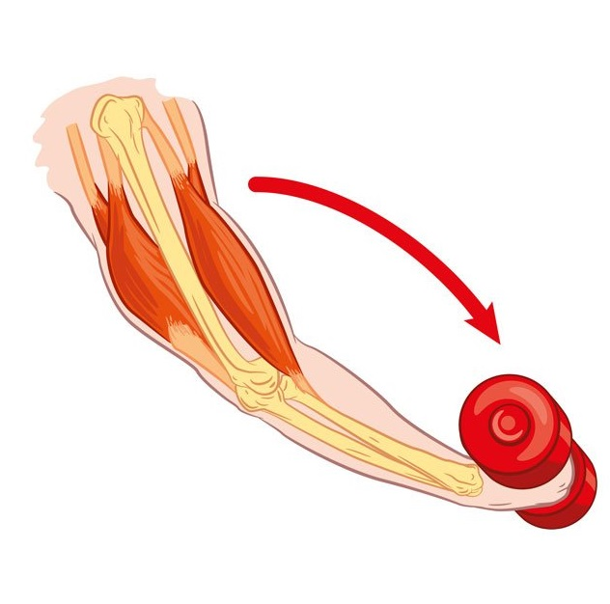
*The muscle at the front of the upper arm gets thinner, softer and longer (relaxes).
Front muscle relaxes.
Back muscle contracts.
The lower arm moves down.
*The muscle at the back of the upper arm gets fatter, harder and shorter.

Slide 10
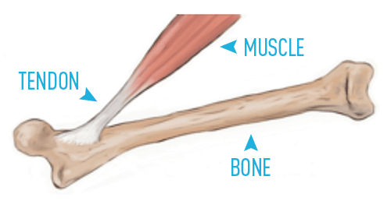
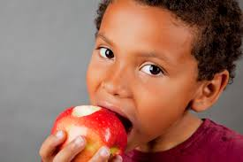
Here are some facts:
Our muscles are attached to our bones by tendons.
The strongest muscles are muscles you use to bite things and they are found on both sides of your mouth.

Slide 11
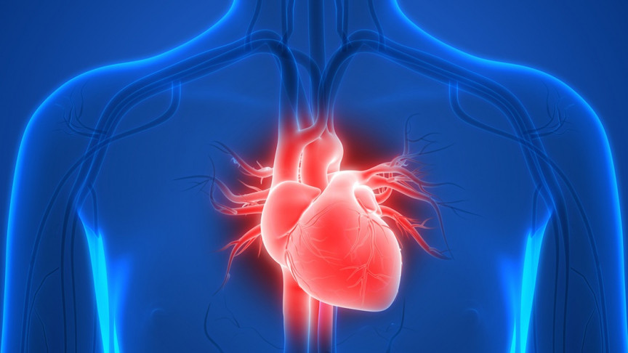
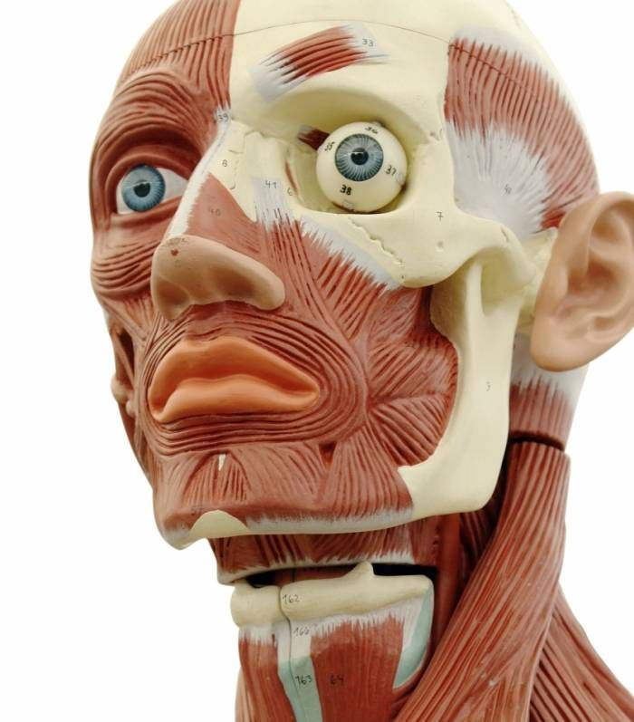
Your heart is a special muscle that never gets tired or stops beating.
The most active muscles are the six muscles that move the eye around in its socket.
Eye socket

