Slide 1
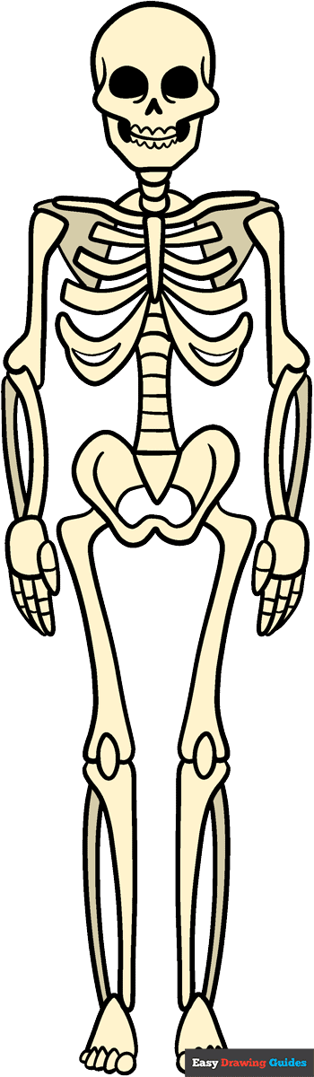
Skeletons

Slide 2
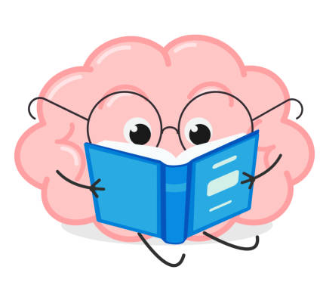
In this unit you will :
Identify some of the important bones in the human body.
Know that bones move because pairs of muscles that are attached to them contract and relax.
Describe some of the important functions of skeletons.
Know that some animals have exoskeleton.
Identify vertebrates as animals with a backbone and invertebrates as animals without a backbone.

Slide 3
Living things
All animals are alive. They are living things.
All animals (including humans) do certain things.
These are called life processes.

Slide 4
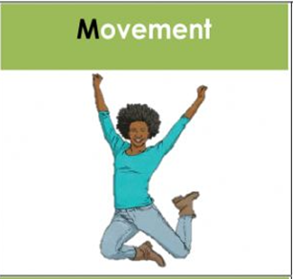
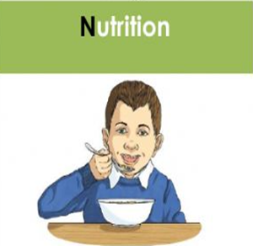
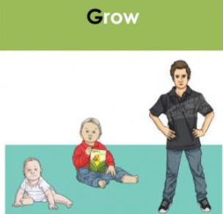
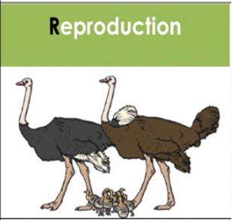
Let’s remember the life processes?
a. nutrition ( take in food )
b. growth ( increase in size )
c. movement ( go from one place to another )
d. reproduction ( produce new animals )
e. respiration ( needing air or oxygen )
f. excretion ( getting rid of waste )

Slide 5
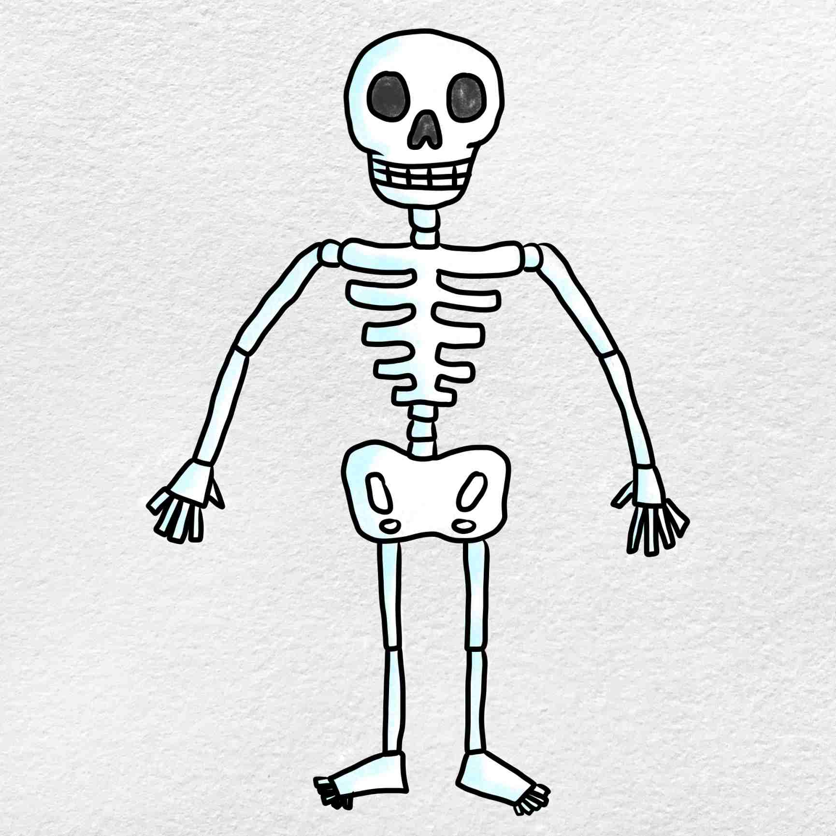
The Human Skeleton
What is a skeleton?
It is the structure inside our body that is made up of bones.

Slide 6
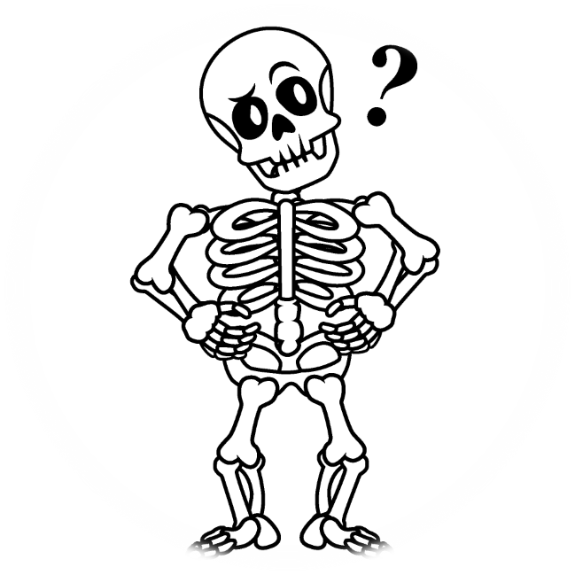
The skeleton is important. It has three main functions (jobs).
It supports your body.
It protects parts inside your body.
It helps you move.

Slide 7
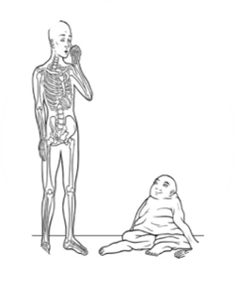
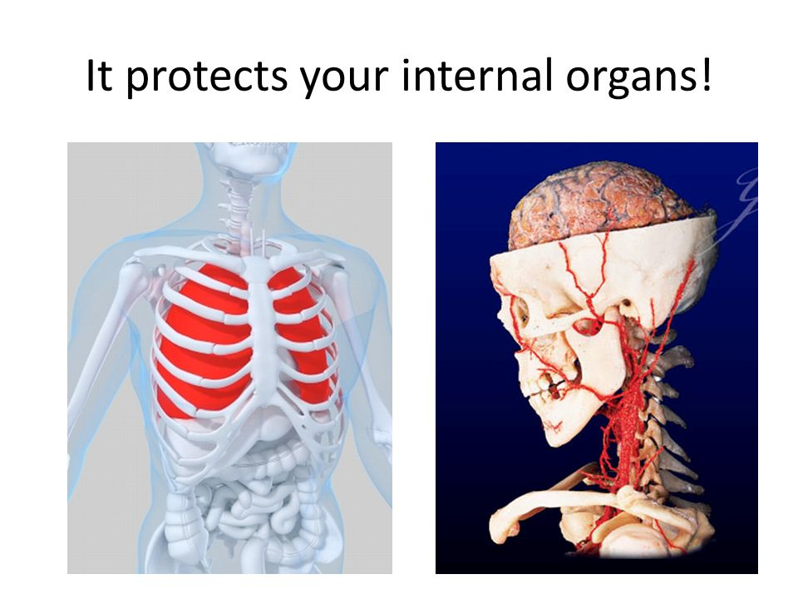
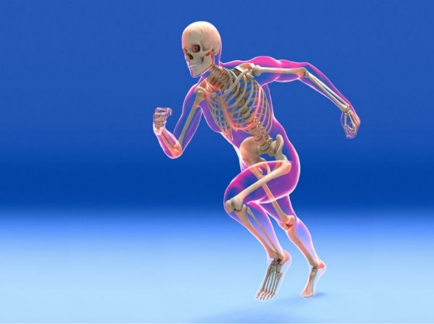
1- It supports your body. If you don’t have it, you will be floppy and wobbly .
2- It protects your inner organs such as the brain , the lungs and the heart.
3- It helps you move.

Slide 8
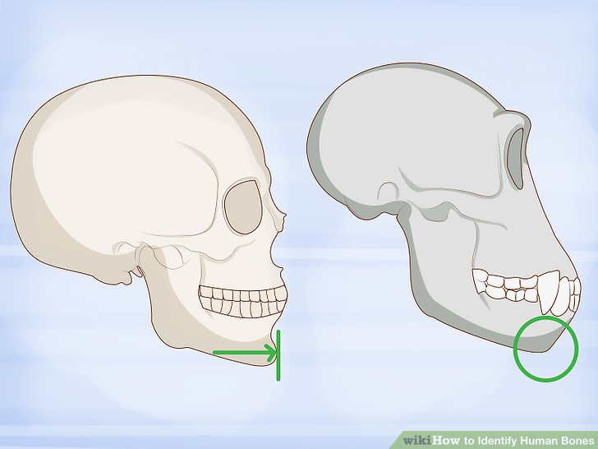
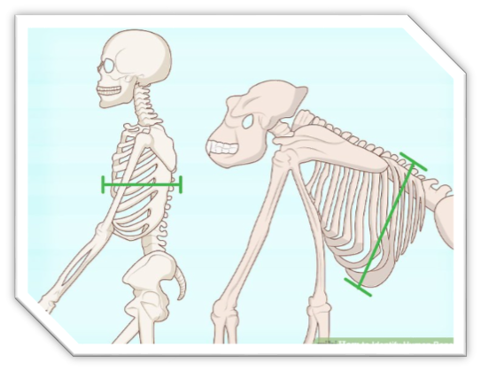
Many of the bones in our skeleton look similar to those of other animals although animal bones may be bigger or smaller than ours.
Unlike the skeletons of animals, the human skeleton stands upright.

Slide 9
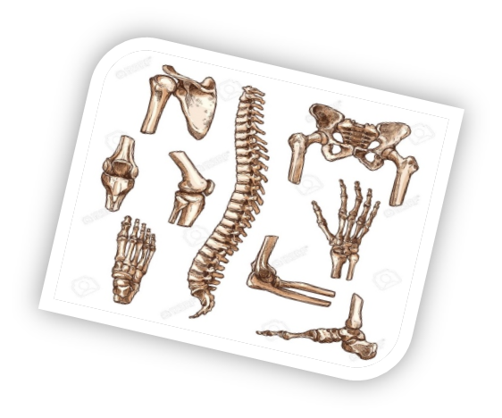
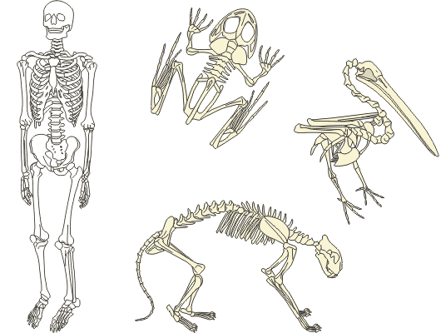
Many animals have bones inside their bodies. These animals are called vertebrates.
Bones are hard .They exist for a long time after their death.

Slide 10
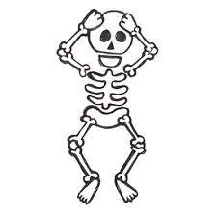
Babies are born with 300 bones . As they grow, their bones grow together. They have 206 bones as an adult.

Slide 11
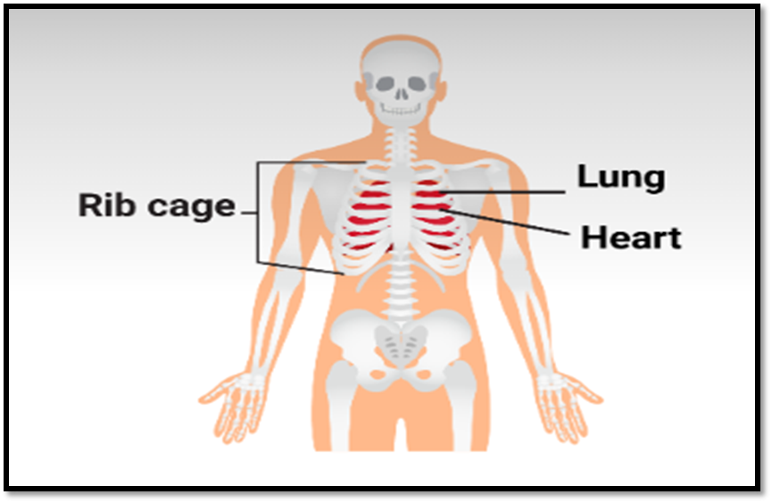
The skeleton protects our organs
Bones are hard and strong. The ribs and skull surround vital organs such as the heart, the lungs and the brain.

Slide 12
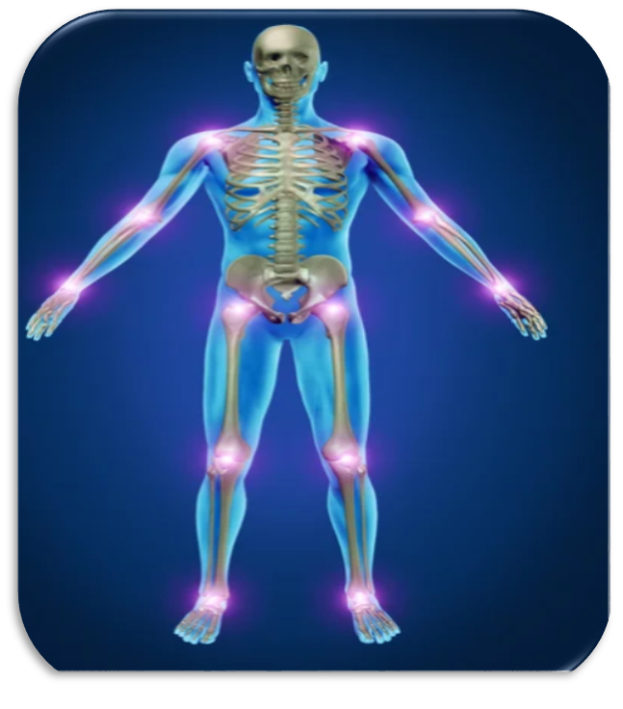
The skeleton protects our organs
The place where two bones connect (meet) is called a joint.
Joints allow us to move parts of our body.

Slide 13
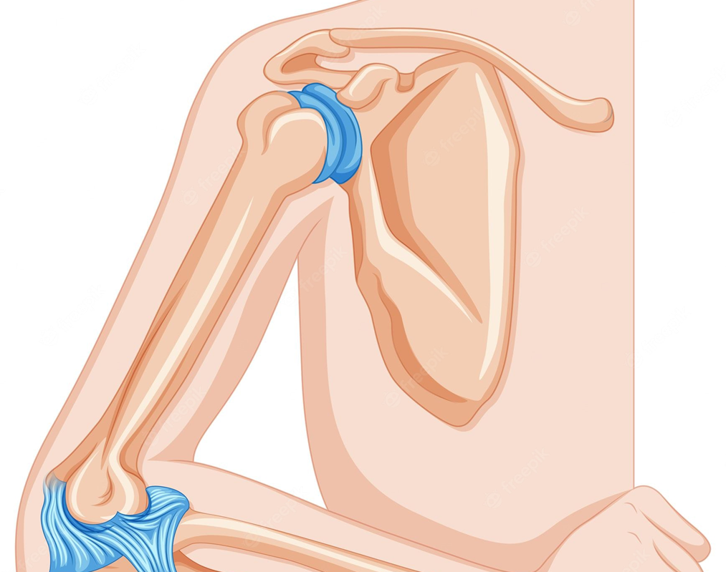
There is a joint between the bones in you upper and lower arm, which is called the elbow.

Slide 14
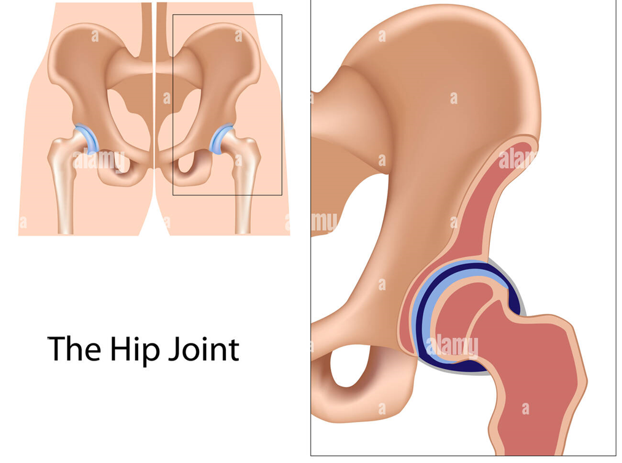
Your hip is also a type of joints. It connects the bone in your thigh to your upper body.

Slide 15
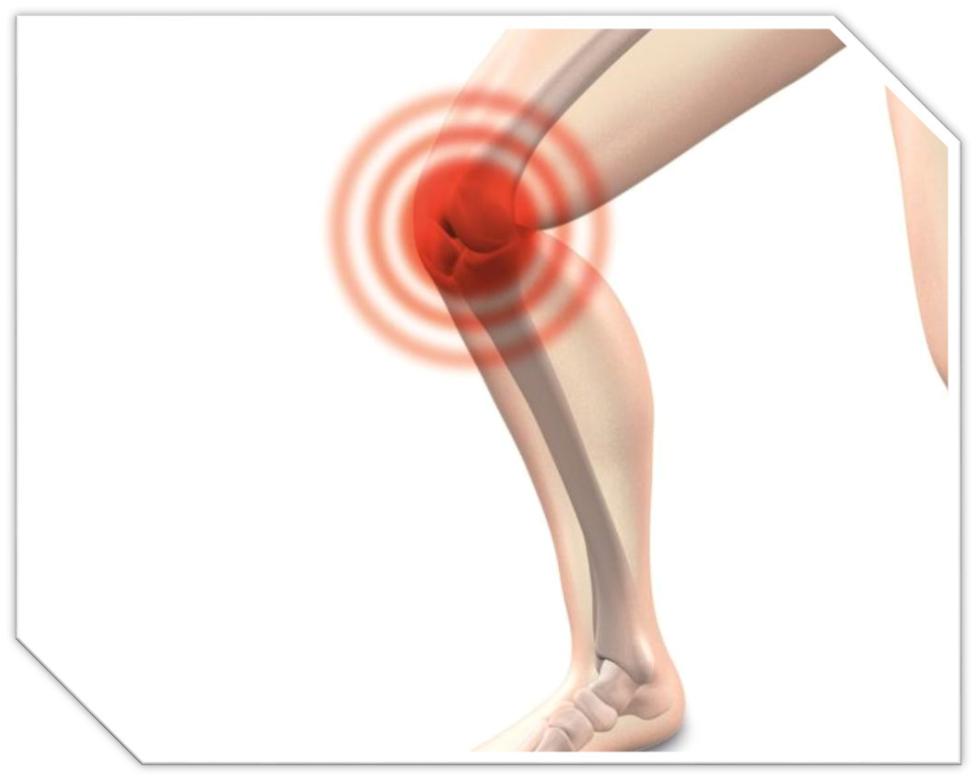
Your knee connects the thigh bone to the bones below your knee.
The knee is also a joint.

Slide 16
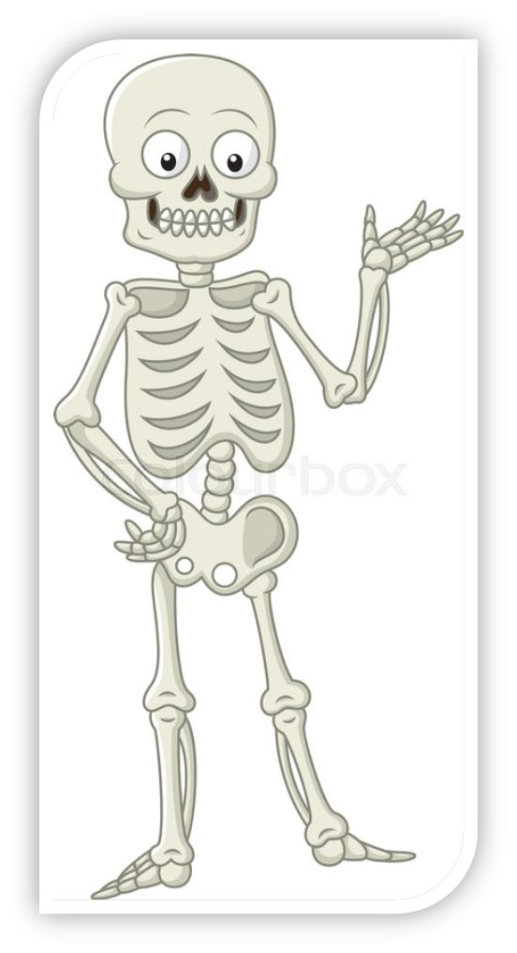
Now we need to know the name of the main bones in our skeleton.

Slide 17
Rib cage
Spine (backbone)
Skull
Jaw
Breastbone
Hip bone

Slide 18
Fingers
Thigh bone
Shoulder blade
Collarbone
Knee cap

Slide 19
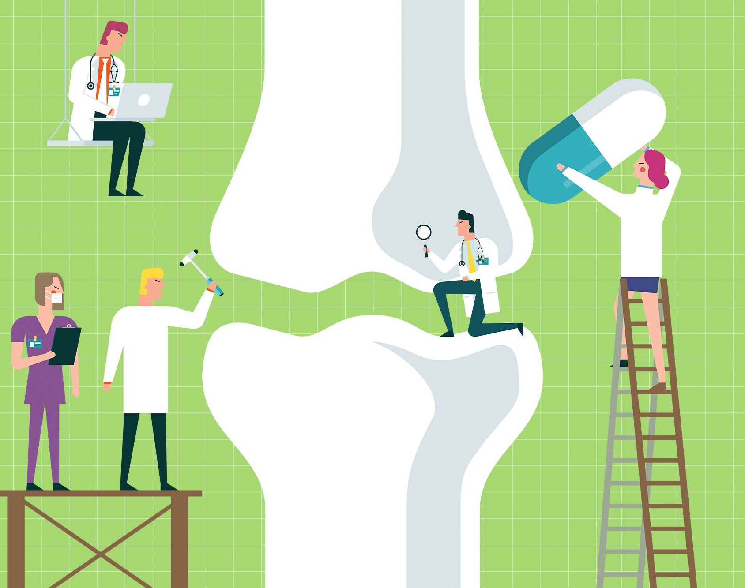
How can I keep my bones strong and healthy?

Slide 20
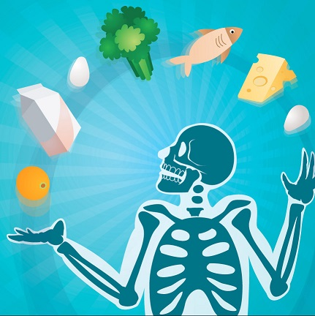
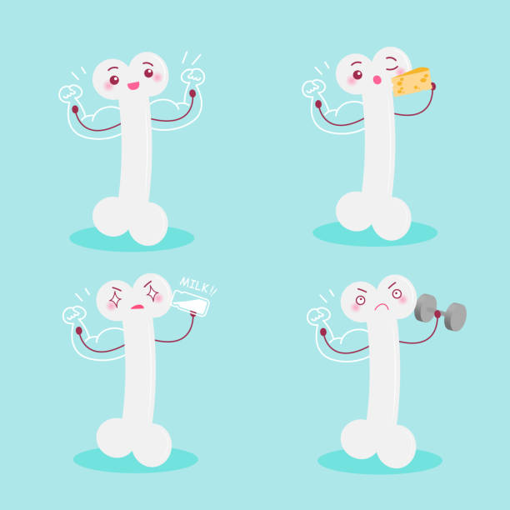
You need to eat healthy food and to do some exercises.

Slide 21
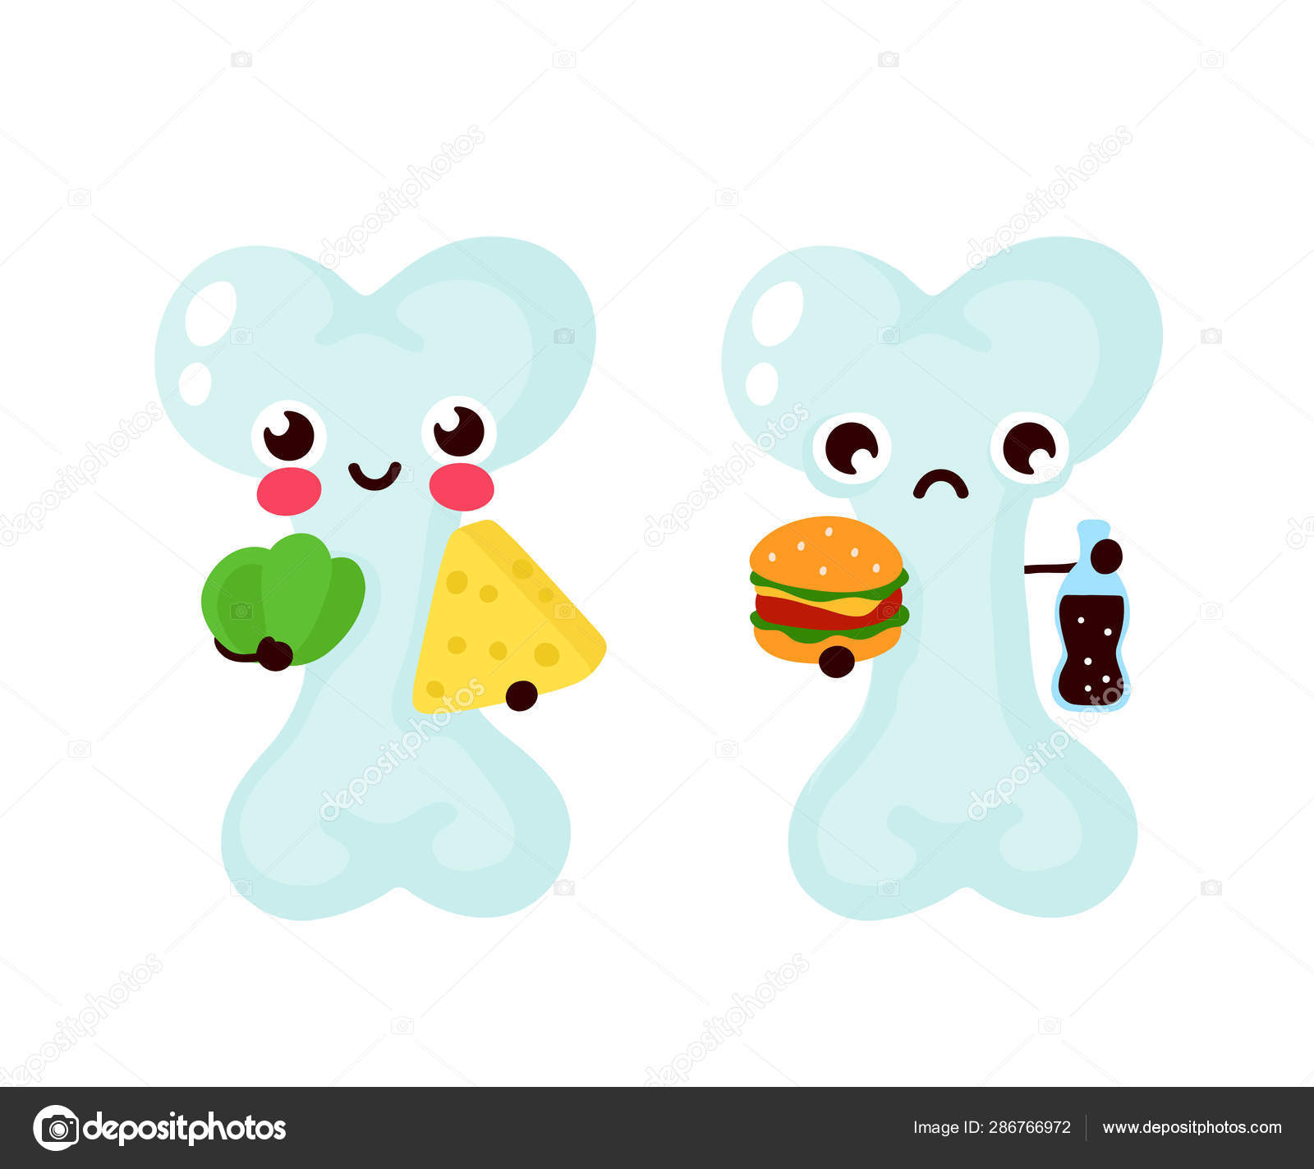
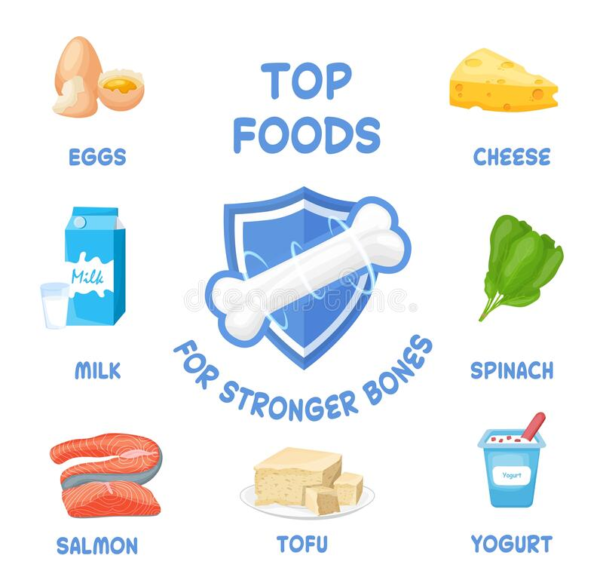
Here are some examples of top foods for healthy bones:

