Slide 1
All about
Digestion
Unit 4

Slide 2
In this unit, Iam learning about:
01
02
03
04
05
Digestion
Organs of the digestive sysytem
Thinking about balanced diets
Hidden sugar dangers
Food scientists

Slide 3
Introduction
Humans need to eat to provide the body with the food substances it needs for energy to grow and to repair itself.
The food we eat cannot be used by the body in the form that we eat it. Our bodies have to change the food into substances that dissolve and be transported around the body in the blood.

Slide 4

What is digestion?
Digestion is the process of breaking down food into smaller parts so it can be used by the body.
The digestive system contains a number of different organs.
Each organ has its own function but they all work together to help us digest the food we eat.

Slide 5

Organs of the digestive system
Mouth
Oesophagus
Stomach
We chew food with our teeth that break it up and then mix it with the saliva so we can swallow it.
The chewed food passes down the oesophagus to the stomach.
In the stomach ,food is crushed and mixed with acids to make it liquid.
Small intestine
Large intestine
In the small intestine, the food is mixed with other juices. The digested food is then absorbed into the blood through the walls of the small intestines.
Some parts of the food cannot be digested so the body cannot use them.These waste products pass into the large intestine where they form solid faeces that passes out of the body through the anus.

Slide 6
There are 4 steps to digestion:
Eating
Breakdown
Absorption
Disposal

Slide 7
3 functions of the digestive system:
It breaks down food.
It absorbs nutrients from food.
It gets rid of waste.

Slide 8
Thinking about balanced diets
03
All animals including humans need an adequate diet. They need to eat enough food to stay alive.
It is important to eat the right food to help our digestive system to work well.
A balanced diet is a diet in which we eat the right amount of food from each of the different food groups every day.

Slide 9
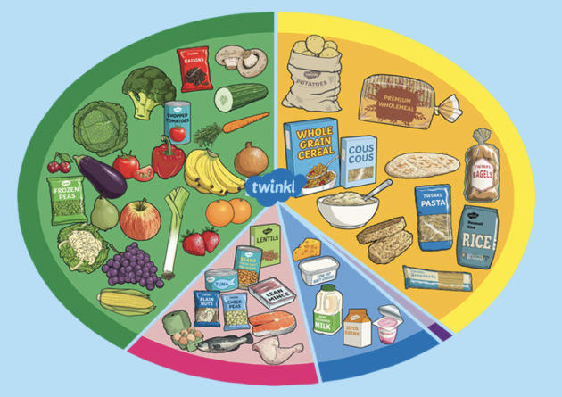
The balanced food plate shows what a balanced diet looks like.

Slide 10
What does each food group give us?
Group name | Gives us
Carbohydrates | Give us energy
Fruits and vegetables | These foods are full of vitamins and fibers
Fats | These foods help us to store energy in our bodies
Dairy products | These foods are needed for healthy bones and teeth
Protein | These foods help our bodies to grow and repair themselves
Foods high in sugar and fat | These foods should be eaten occasionally. It is important not to eat too many food from this group.

Slide 11
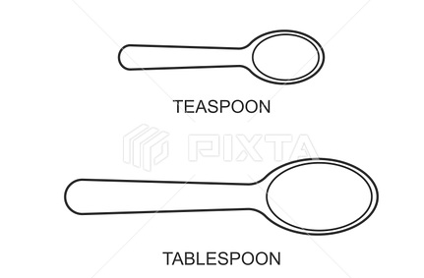


Hidden sugar dangers
04
The recommended maximum daily amount of sugar for a 7-10 year-old person is 6 teaspoons (24 grams).
$$✓$$
$$✗$$

Slide 12
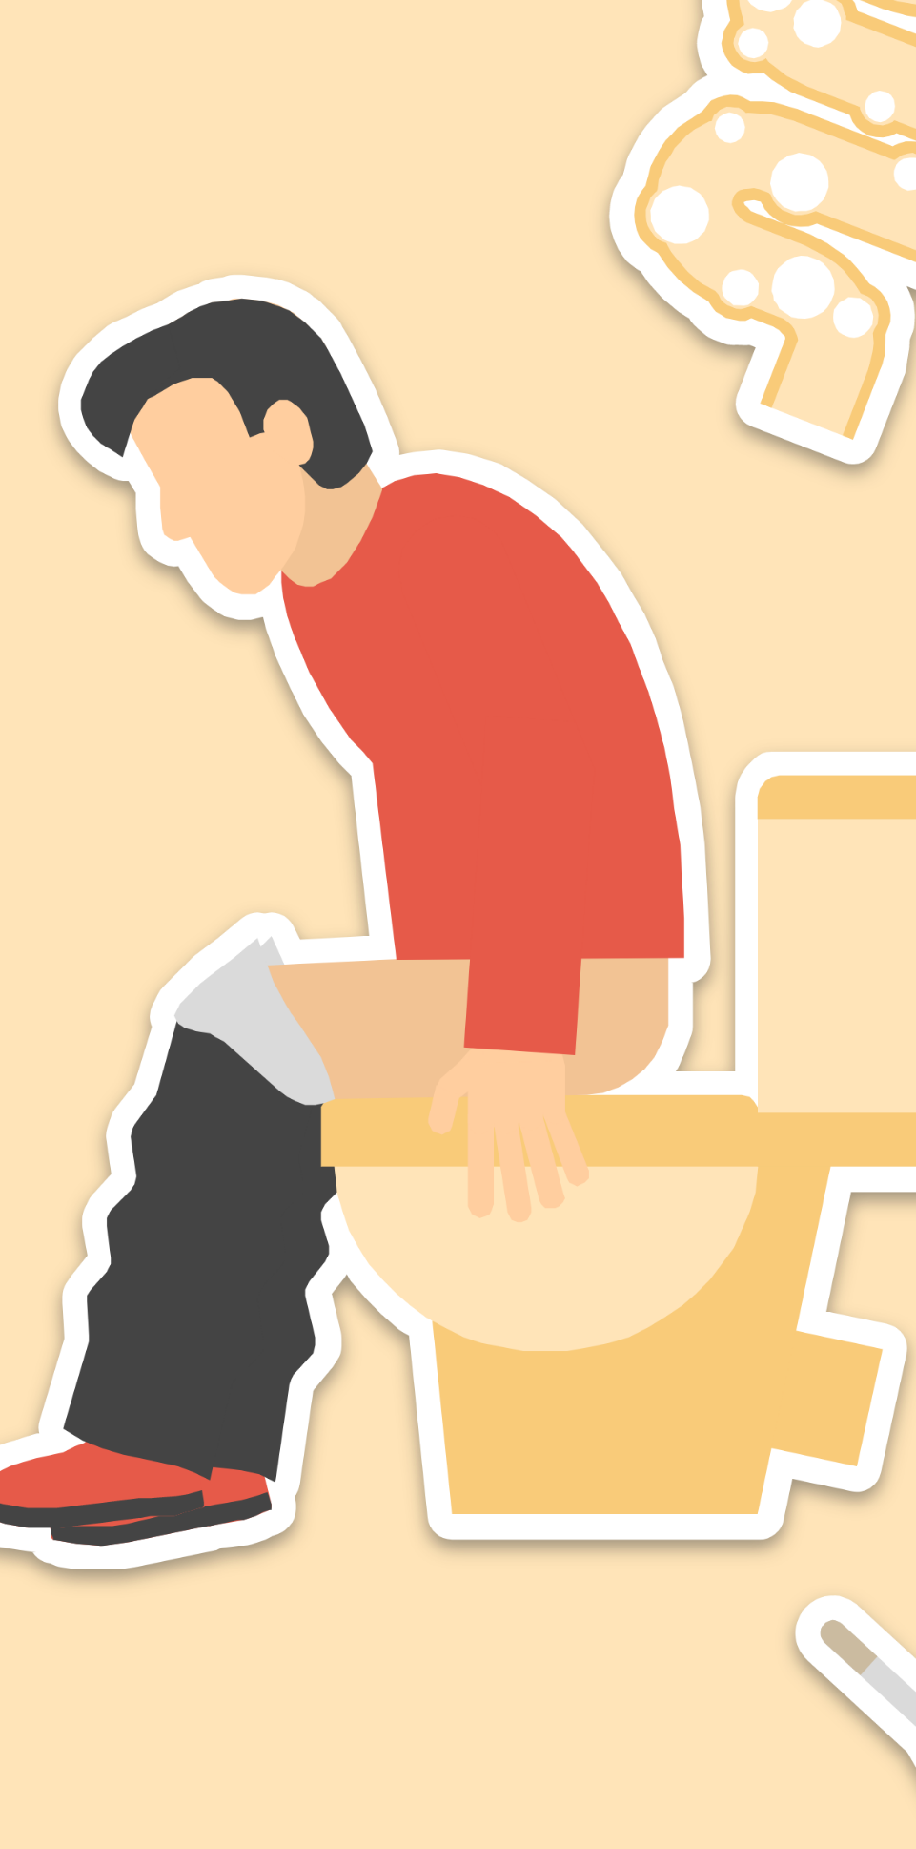
Food and drinks that are high in added sugar have extra calories and usually have few nutrients in them.

Slide 13

You are the one who is responsible for the health of your digesive system.

Slide 14

Eating too many calories can lead to many health issues such as:

Slide 15
1
3
5
Overweight and even obese
Problems with the joints such as the knees.
Tooth decay
2
4
Eating too much sugar can also lead, when a peson gets older,to Type 2 diabetes.
Heart disease

Slide 16
Food scientists
They study food under a microscope.
05
Much of the food you eat has been specially designed and made by the following food scientists:

Slide 17
Biologists
Biotechnologists
Biologists play a key role in producing food and drinks, and developing new products. They find new ways of growing crops that will withstand drought conditions due to climate change, develop plants that are resistant to pests and develop food that has more vitamins and minerals in it.
Biotechnologists design a system for producing food. For example, they design a system that turns milk into yoghurt.
Chemical engineers
Biochemists
Chemical engineers help to create food additives to make food taste better and look more attractive.
They also help design new foods and solve problems.
Biochemists find out about how living things are made. They help to develop nutritious food by finding out about different chemicals in food and inventing new chemicals.

Slide 18
Which digestive organ is correct?
Color the correct answer. Use the “fill color” option to do so
Heart
Kidney
Stomach
Lungs

Slide 19
Match the organs
Connect the organs with their corresponding names.
Stomach
Liver
Small Intestines
Large Intestine

Slide 20
The digestive system in 4 steps
Fill in the blanks below with the correct answers.
E | A | T
B |  | E |  | K |  | O | W | N
 | B | S |  |  | P |  | I |  | N
D |  | S |  | O |  | A

