Slide 1
Language Focus: Verbs – Past & Present Tense
Grade 2

Slide 2

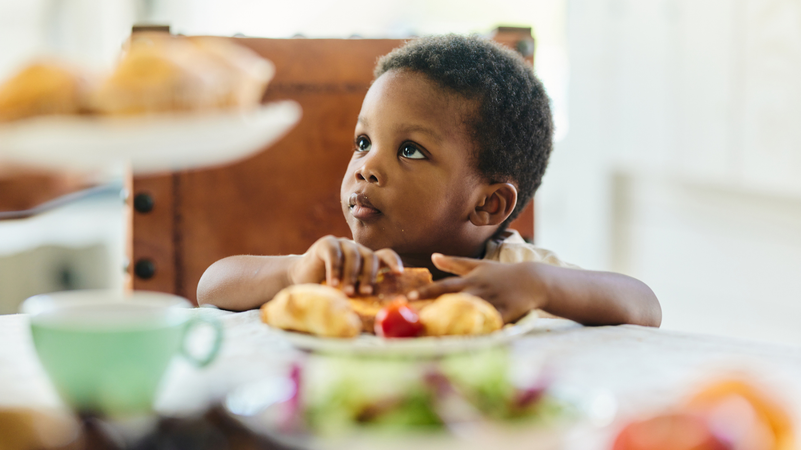
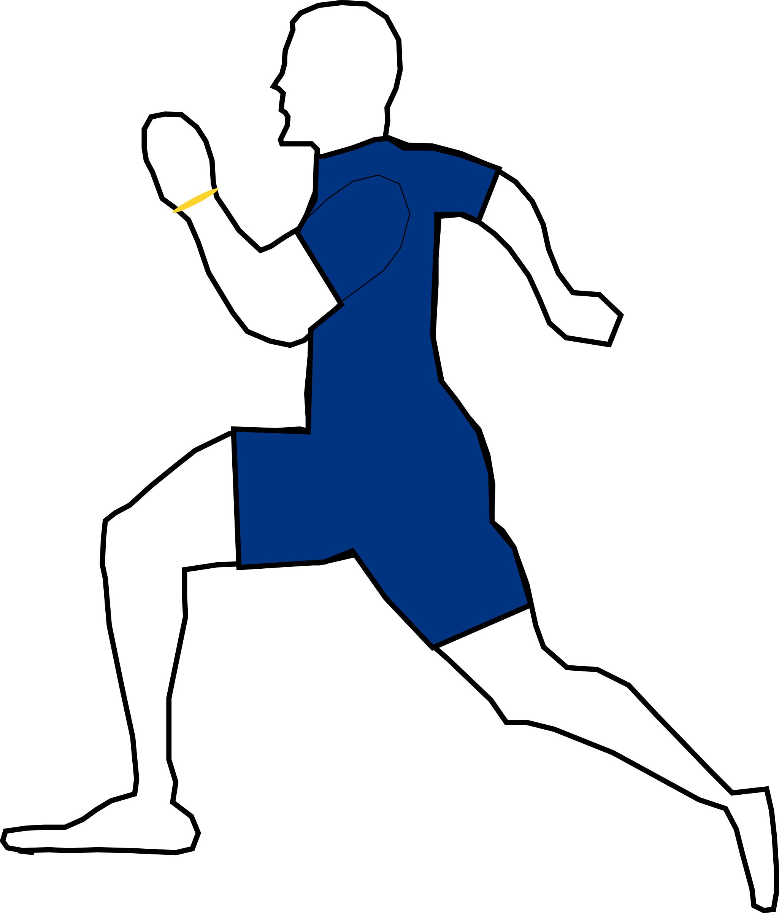
What is a Verb?
A verb is an action word. It tells what someone is doing.
Examples: run, eat, play, jump

Slide 3
Present Tense Verbs
Used when the action is happening NOW.
Examples:
- She runs.
- They play.
- He eats.

Slide 4
Past Tense Verbs
Used when the action already HAPPENED.
Examples:
- She ran.
- They played.
- He ate.

Slide 5
Regular Past Tense Verbs
Most verbs add -ed in the past.
Examples:
play → played
talk → talked
wash → washed

Slide 6
Irregular Past Tense Verbs
Some verbs change completely.
Examples:
go → went
eat → ate
run → ran
see → saw

Slide 7
Present vs Past
Present → Past ( add – ed or change the whole word )
jump ----- jumped
walk ---- walked
Play --- played
Cry ----- cried
bath ---- bathed
eat ---- ate
go ---- went
run ---- ran
sleep ----- slept

Slide 8
Practice Activity 1
Match the verbs:
run → ? Walked
go → ? Ate
walk → ? Ran
eat → ? Went

Slide 9
Practice Activity 2
Fill in the blanks:
- Yesterday I ___ (play) with my friend.
- Today I ___ (eat) pizza.
- Last night she ___ (read) a book.

Slide 10
Wrap-Up
✔ Present tense = happening NOW
✔ Past tense = already HAPPENED
✔ Regular verbs = add -ed
✔ Irregular verbs = change the word
Great Job!

