Slide 1
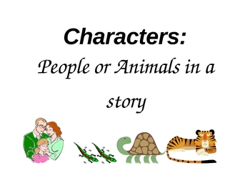
Story Elements: Characters
Grade 2 English

Slide 2

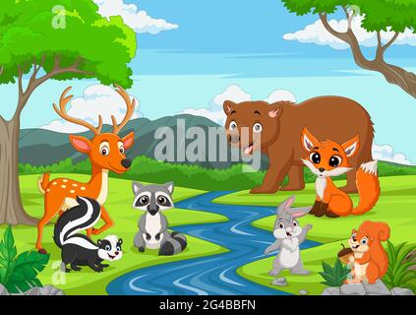
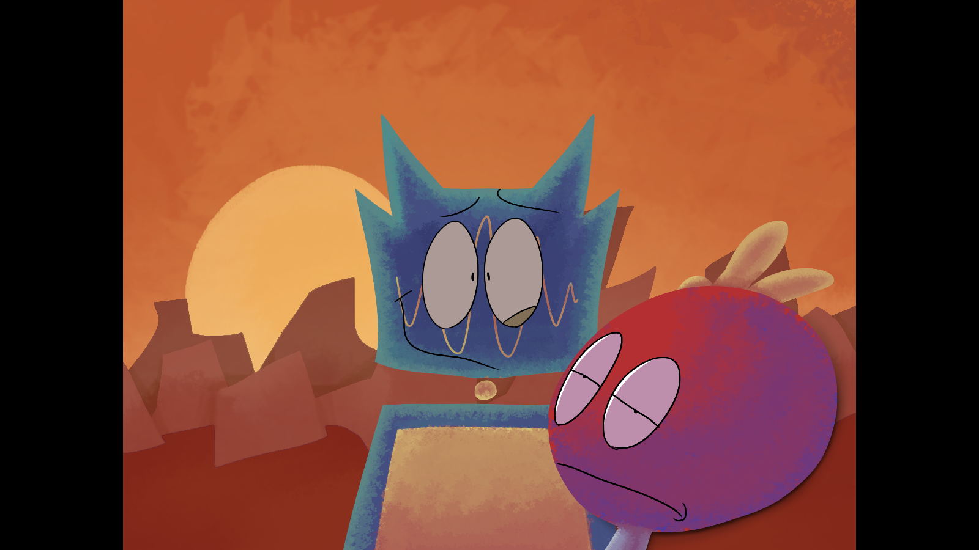
What are Characters?
Characters are the people, animals, or creatures in a story.

Slide 3
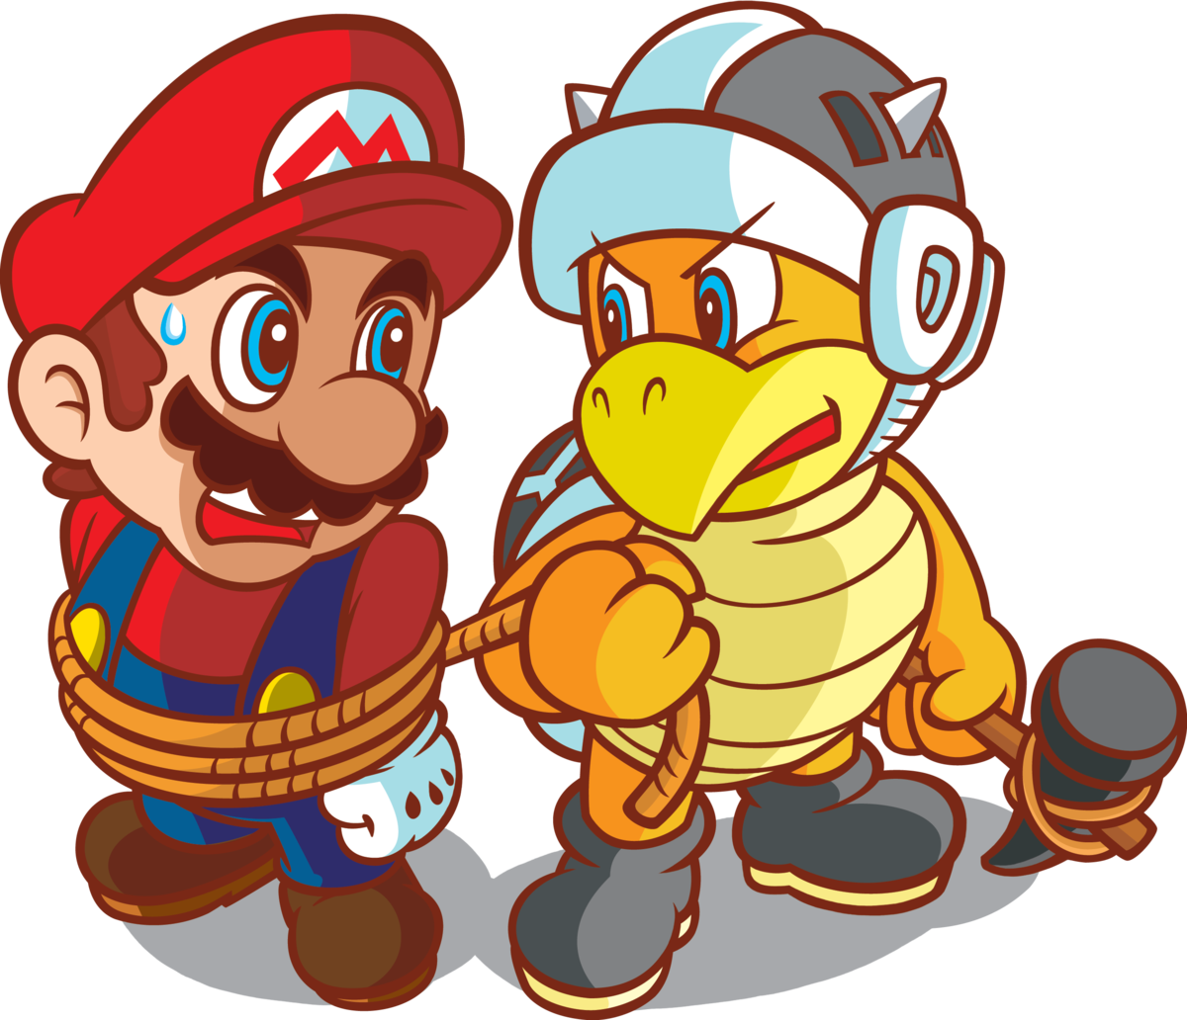
Main Characters
The main character is the most important one. The story is mostly about them.

Slide 4
Supporting Characters
Supporting characters help the main character or make the story more fun.

Slide 5
Good and Bad Characters
Good characters are heroes who help.
Bad characters are villains who cause problems.

Slide 6
Why are Characters Important?
⭐ They make the story exciting
⭐ They have adventures
⭐ They solve problems

Slide 7
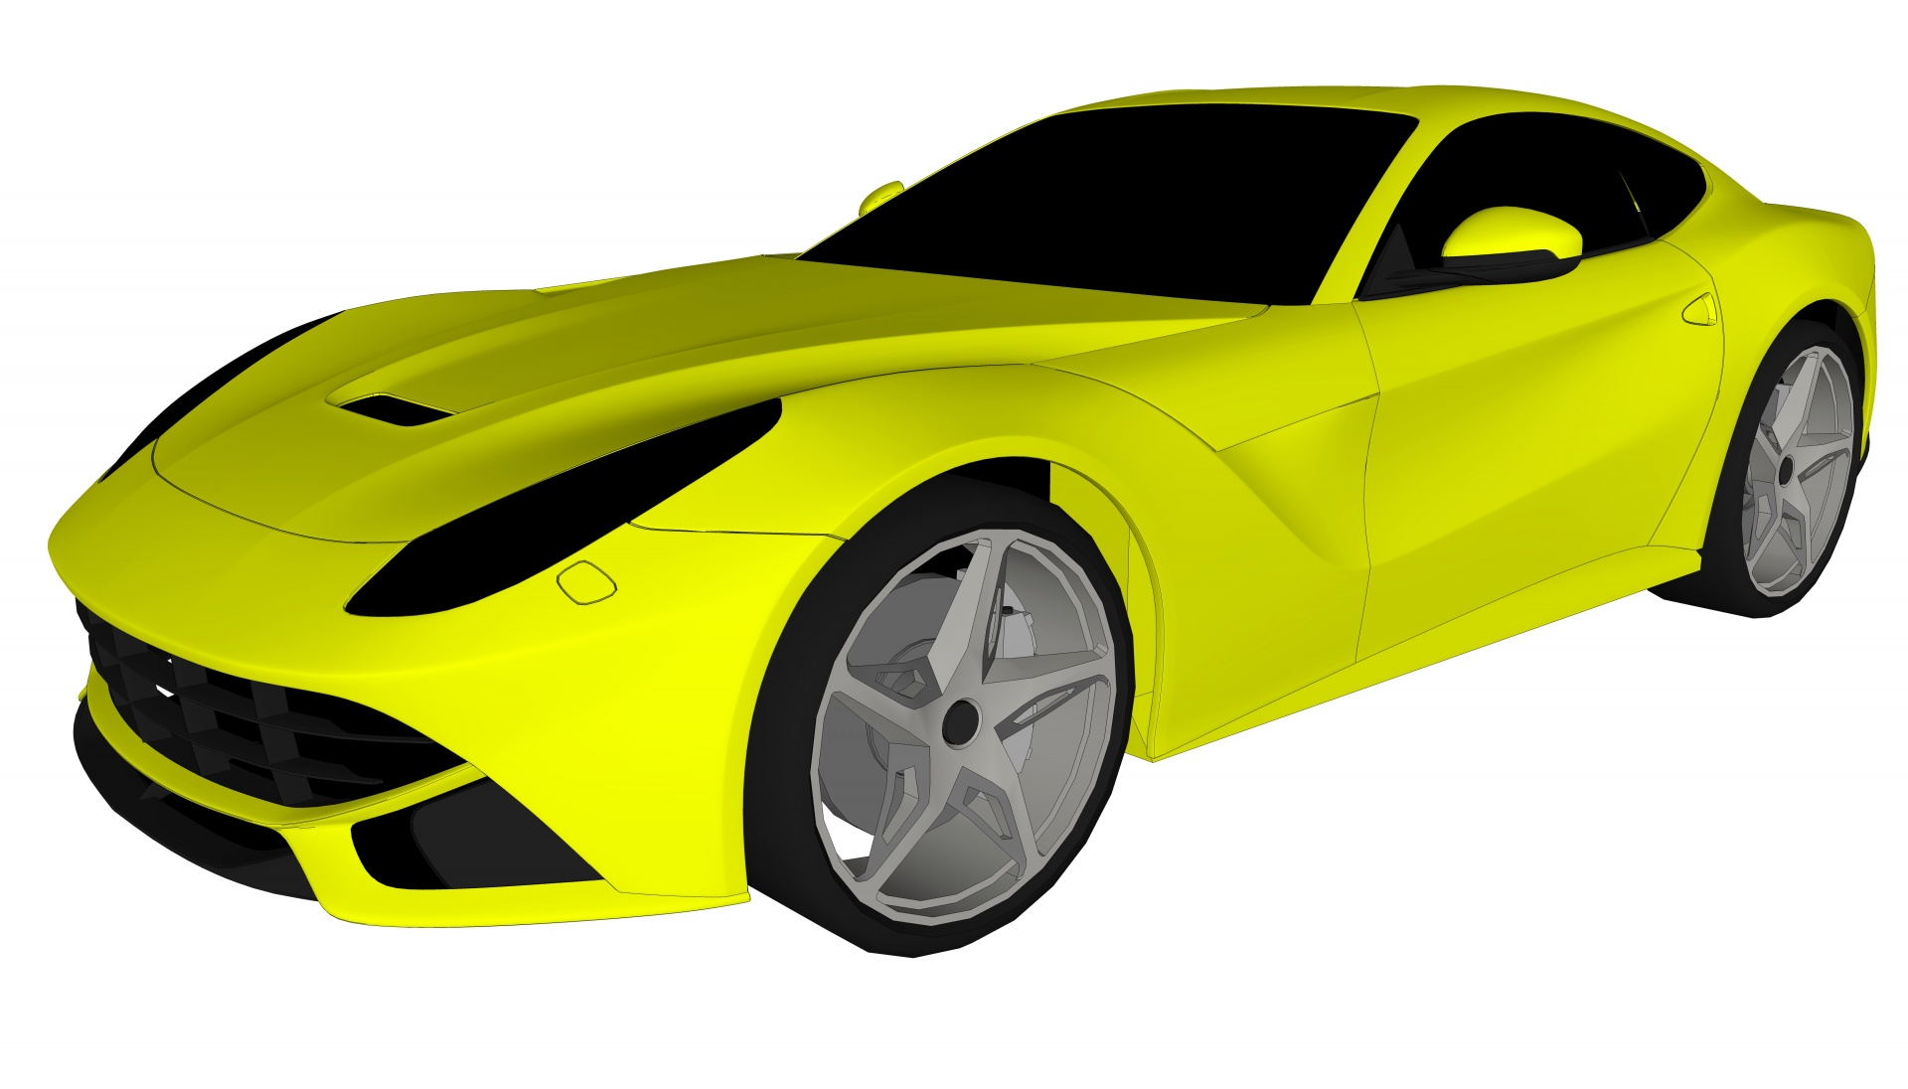
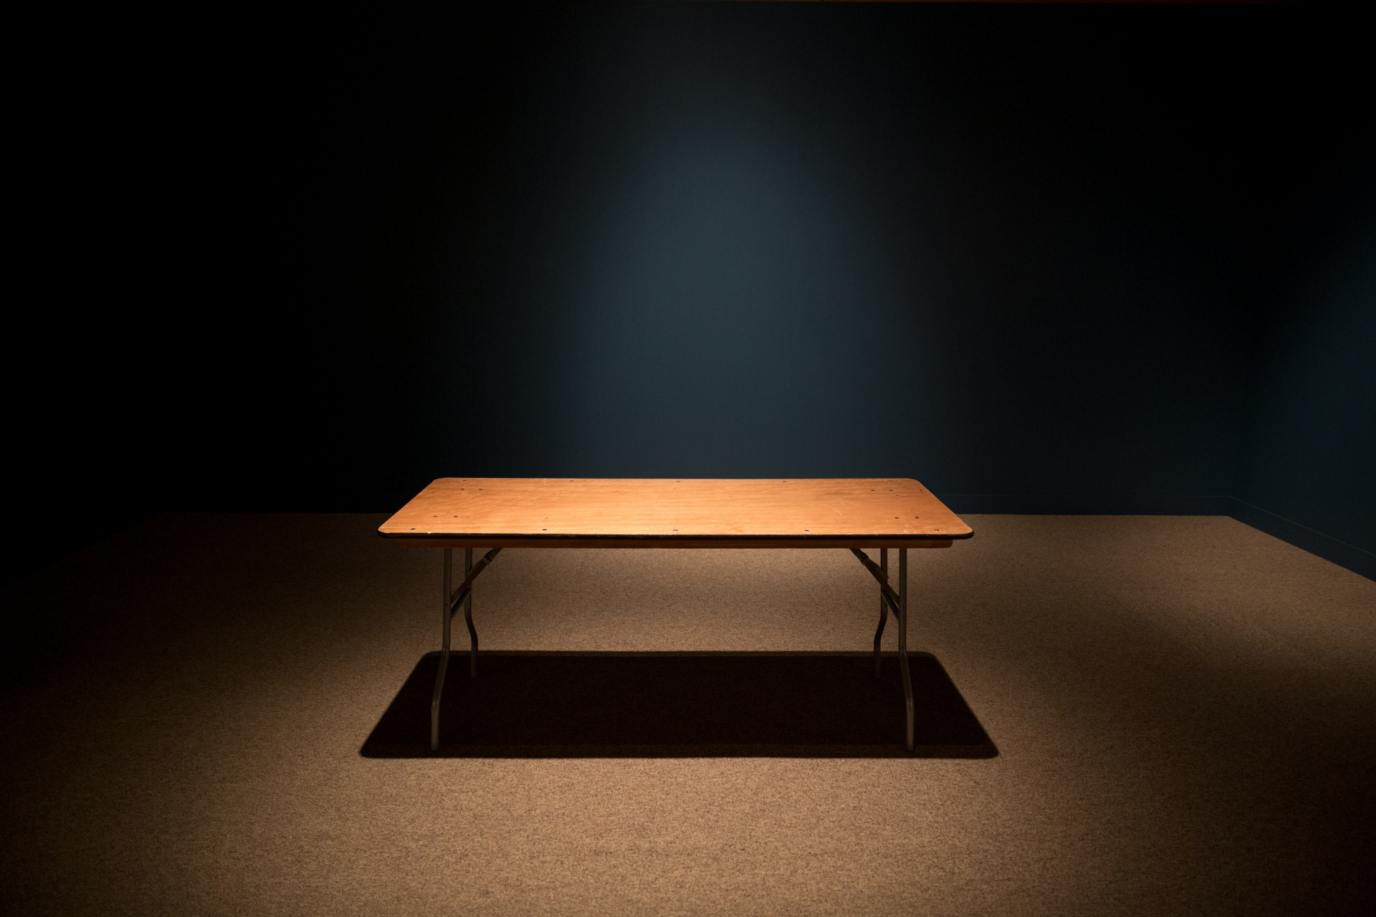
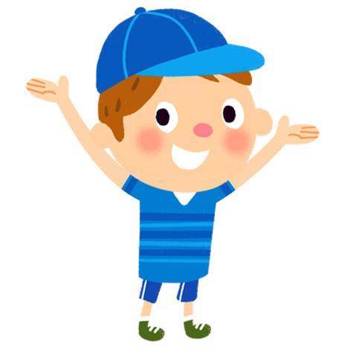
Quick Activity
Who is the Character?
Look at the pictures: A car , A table, a boy.
Which are story characters?

Slide 8
Review
• Characters are people, animals, or creatures in a story.
• They can be main or supporting, good or bad.

Slide 9

The End
Great job, Readers!

