Slide 1
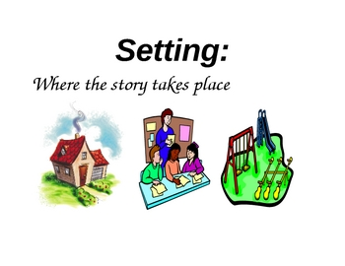
What is a Setting?
Learning about where and when a story happens

Slide 2
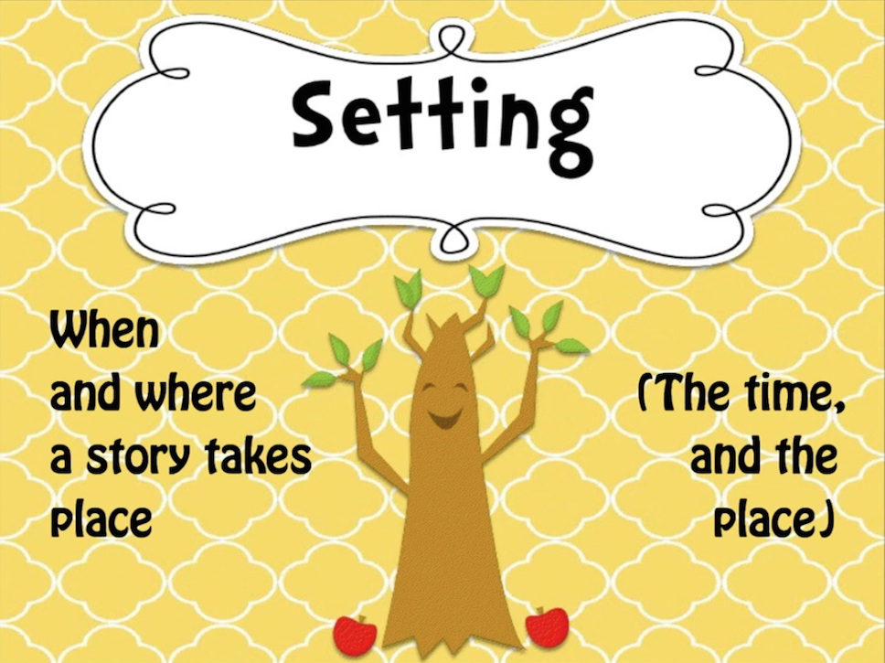
What is a Setting?

Slide 3
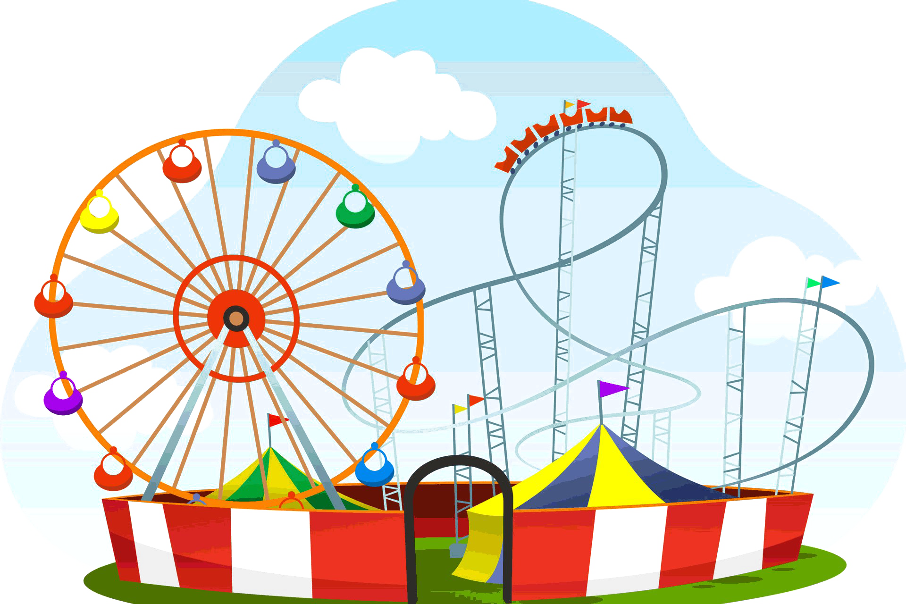
Where can a story happen?
( Place )
• At school
• In a forest
• At the beach
• In a city

Slide 4
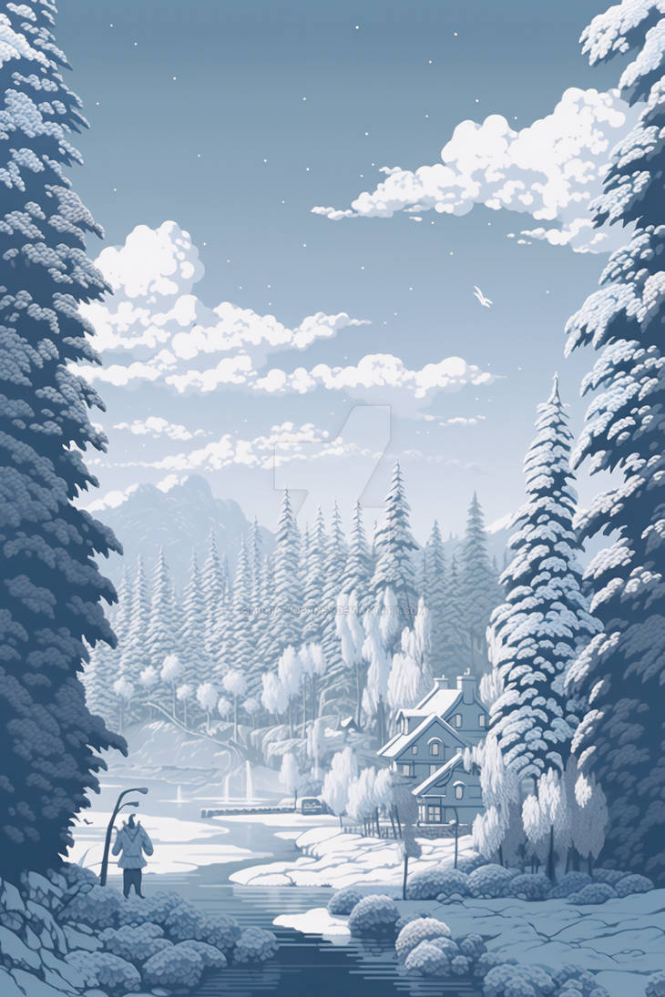
When can a story happen?
( Time )
• In the morning
• At night
• In the winter
• In the summer

Slide 5

Why is the Setting Important?
• Makes the story more interesting
• Helps us understand the characters
• Tells us what is happening

Slide 6
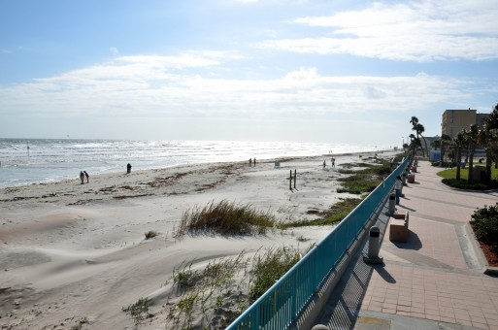
Practice Together
Maria went to the beach in the summer.
She played in the sand.
Question: Where is the setting? When is the setting?

Slide 7
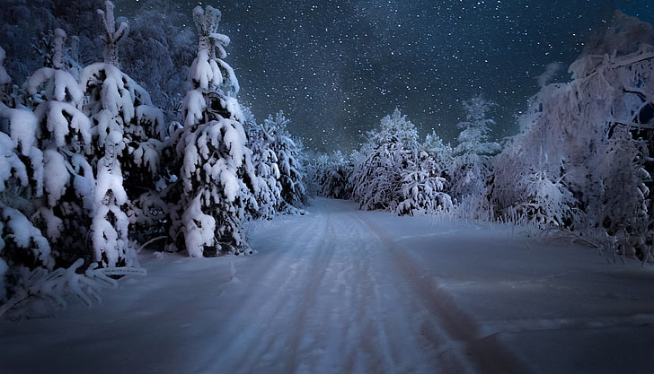
Try Another Example
Tom looked out the window at the falling snow.
It was a cold winter night.
Question: Where is the story? When is the story?

Slide 8
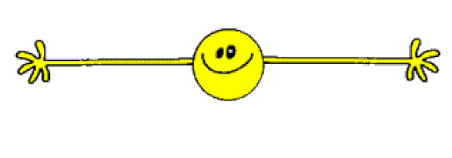
Your Turn!
Think of your favorite story.
What is the setting?

