Slide 1
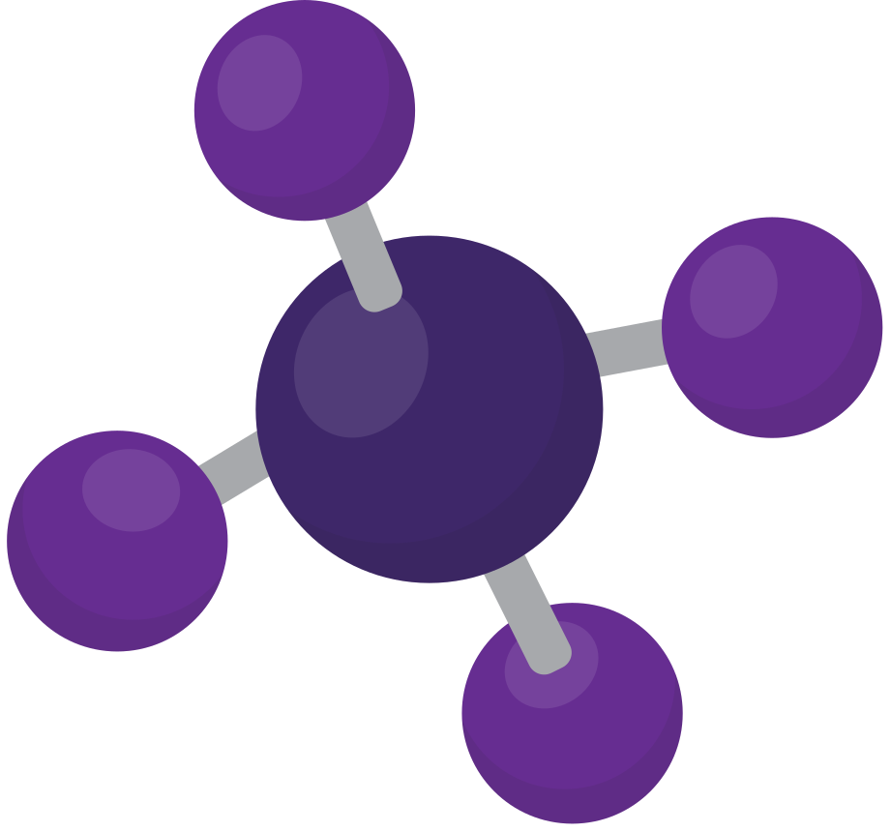

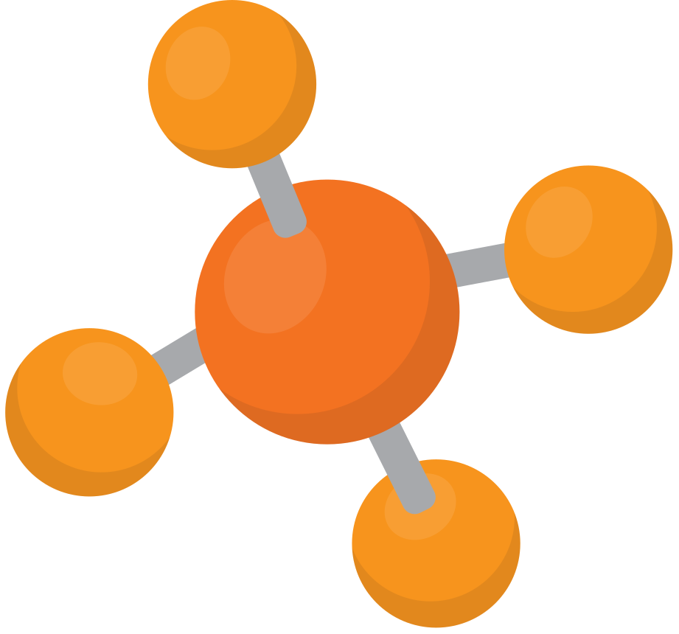

STATES
OF MATTER
BY
SHAHEM SAFADI

Slide 2

SOLID
has definite shape and volume
has particles that are packed closely together and usually arranged in a regular pattern

Slide 3




EXAMPLES OF SOLIDS
cup
shirt
book
eraser

Slide 4
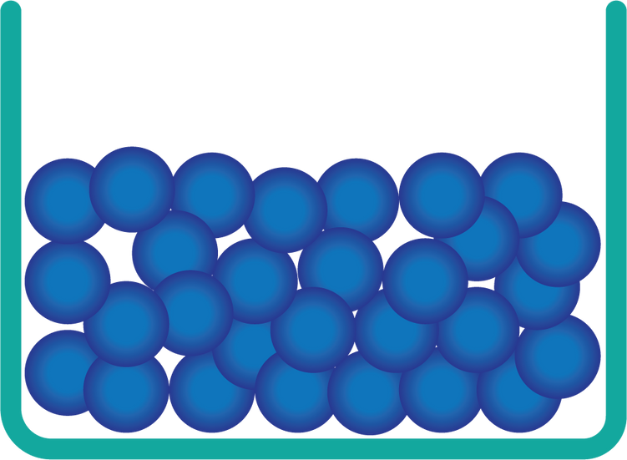
LIQUID
has definite volume, but has no fixed shape
has particles that can move and are in close contact

Slide 5




EXAMPLES OF LIQUIDS
shampoo
olive oil
orange juice

Slide 6

GAS
has no definite volume and shape
has particles that are widely separated

Slide 7


EXAMPLES OF GASES
helium in a balloon
steam from a kettle

Slide 8
SUMMARY
Solid
Liquid
Gas
has particles that are packed closely together
has particles that can move and are in close contact
has particles that are widely separated

Slide 9

THANK YOU FOR LISTENING
BY
SHAHEM SAFADI
GRADE 3-A

