Slide 1
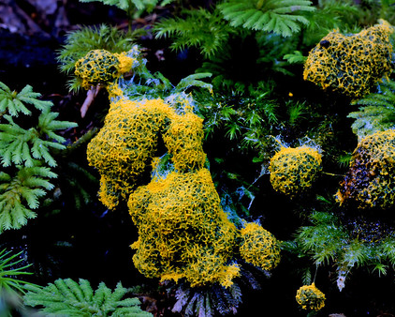
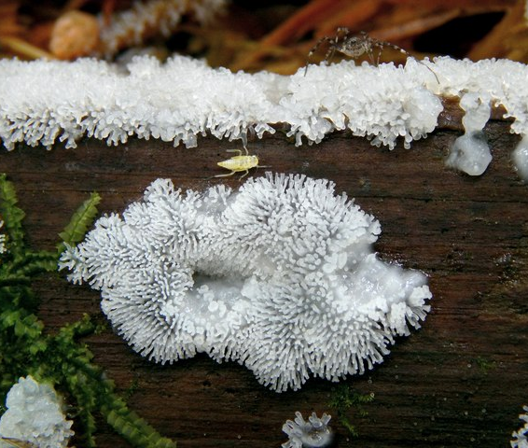
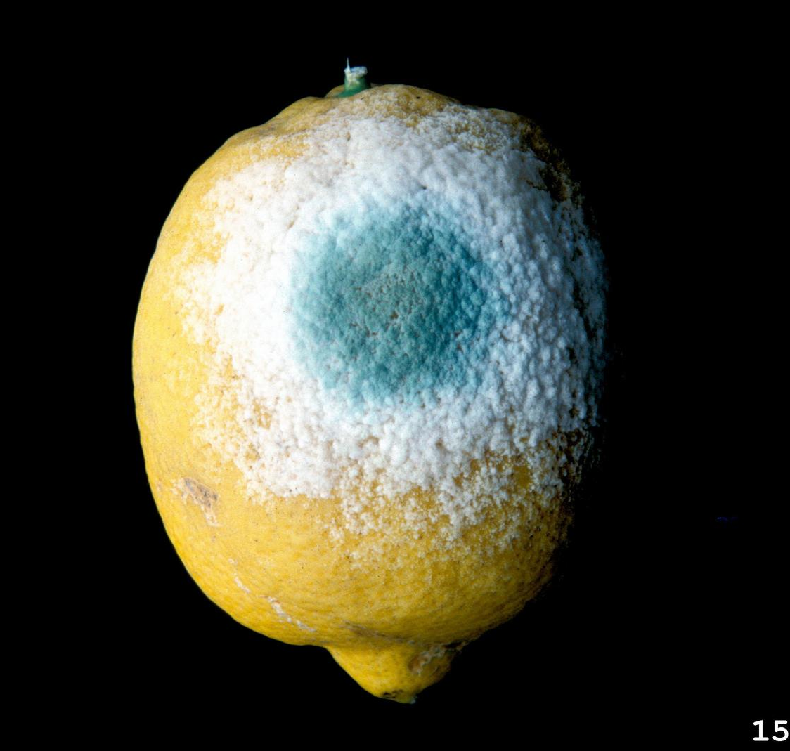
mold attack!!
Zain Zayed
This Photo by Unknown Author is licensed under CC BY-SA
This Photo by Unknown Author is licensed under CC BY-NC

Slide 2
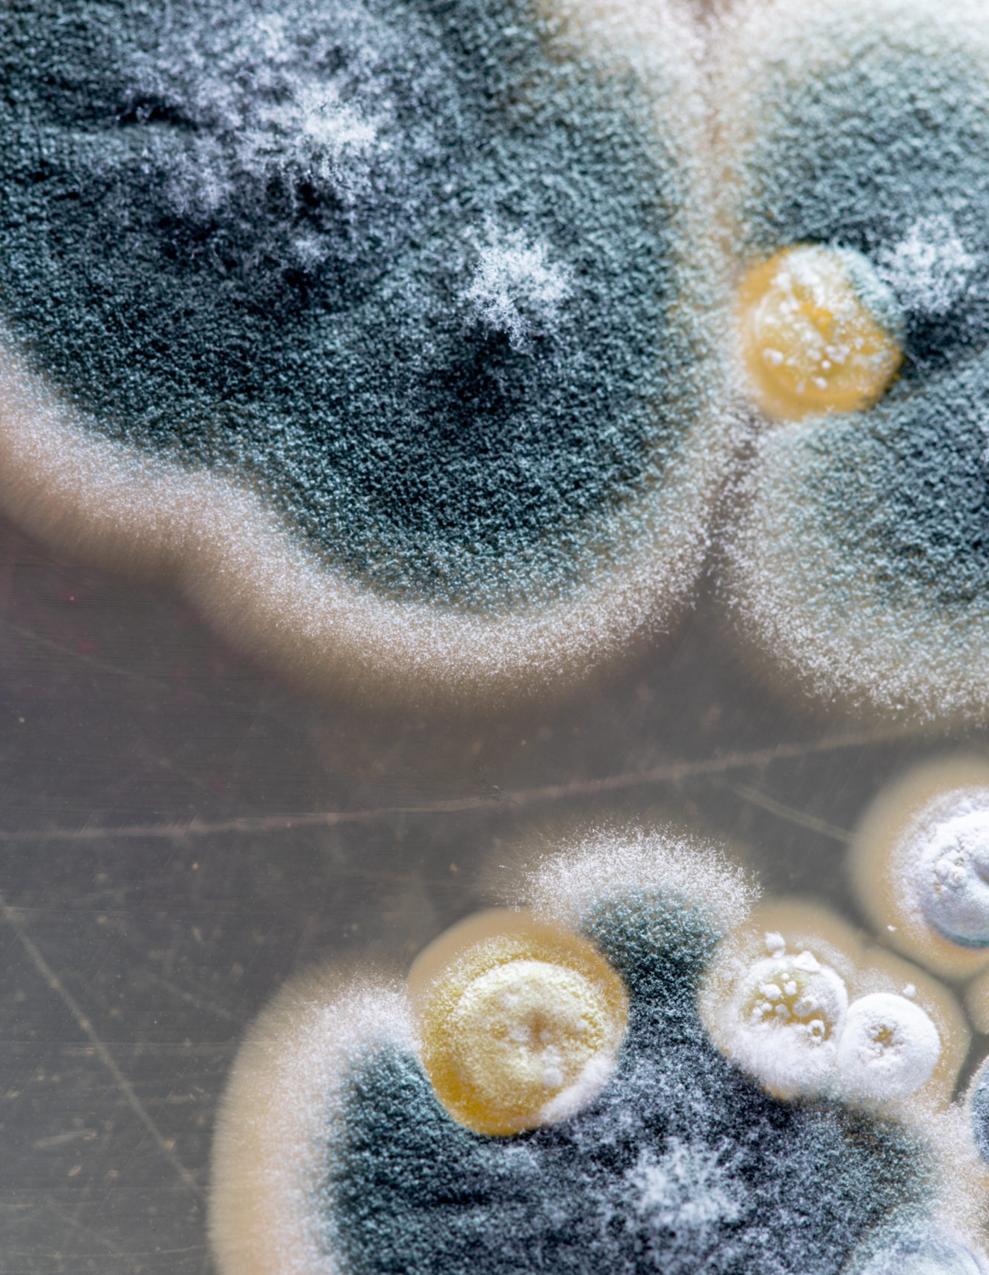
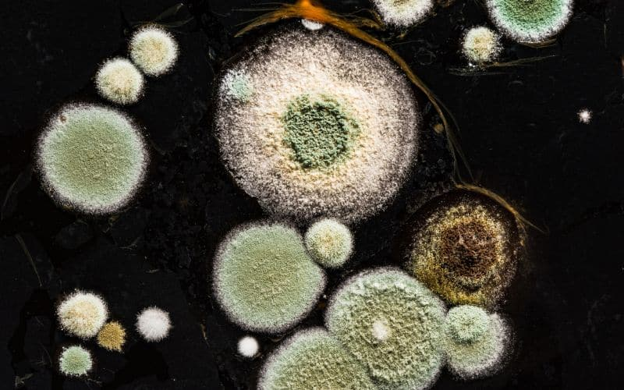
What is Mould attak
Mould attack happens when fungi begin to grow in damp environments. These organisms spread through tiny spores that float in the air and settle on surfaces, where they quickly multiply. They feed on organic materials such as wood, paper, and fabrics, and if left untreated, mould can cause serious damage to buildings and belongings. Moisture is the key factor that allows mould to survive and expand.

Slide 3
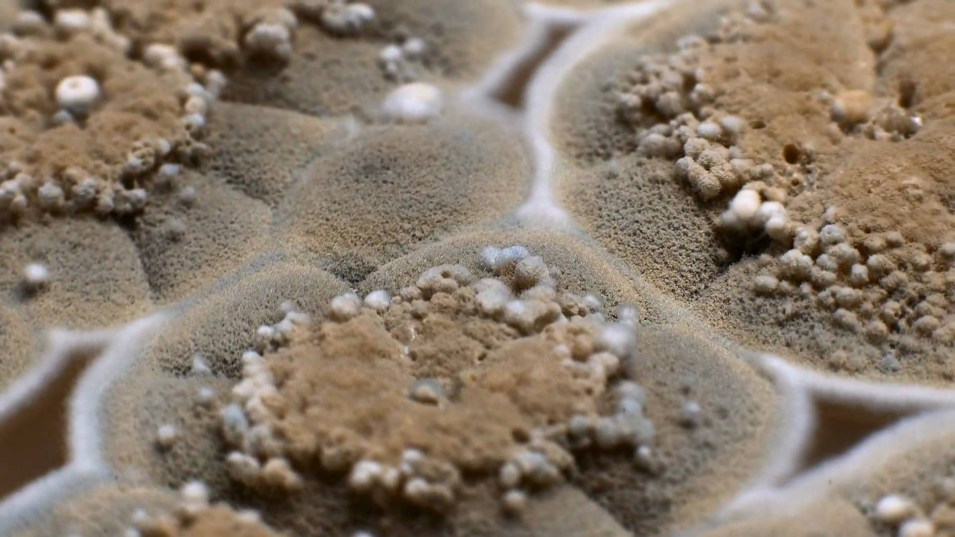
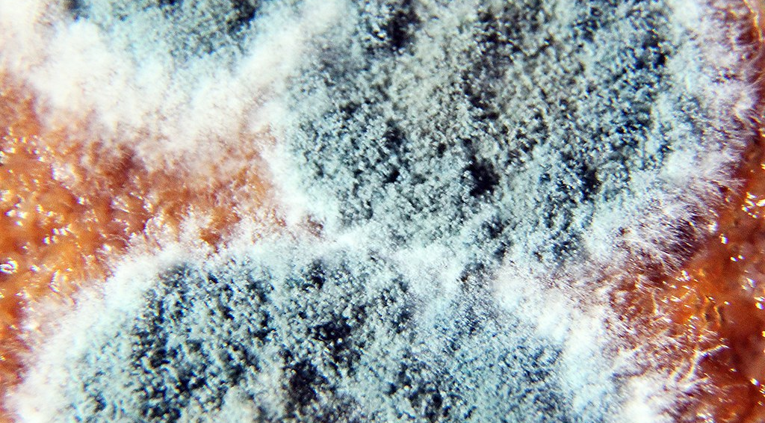
Causes of Mould Growth
Mould growth is usually caused by excess moisture. High indoor humidity, water leaks from roofs or pipes, and flooding that is not properly cleaned all create ideal conditions. Poor ventilation in bathrooms, kitchens, and basements allows damp air to linger, while condensation on cold walls and windows adds to the problem. Building materials that remain wet for long periods also encourage mould to spread.
This Photo by Unknown Author is licensed under CC BY-ND

Slide 4
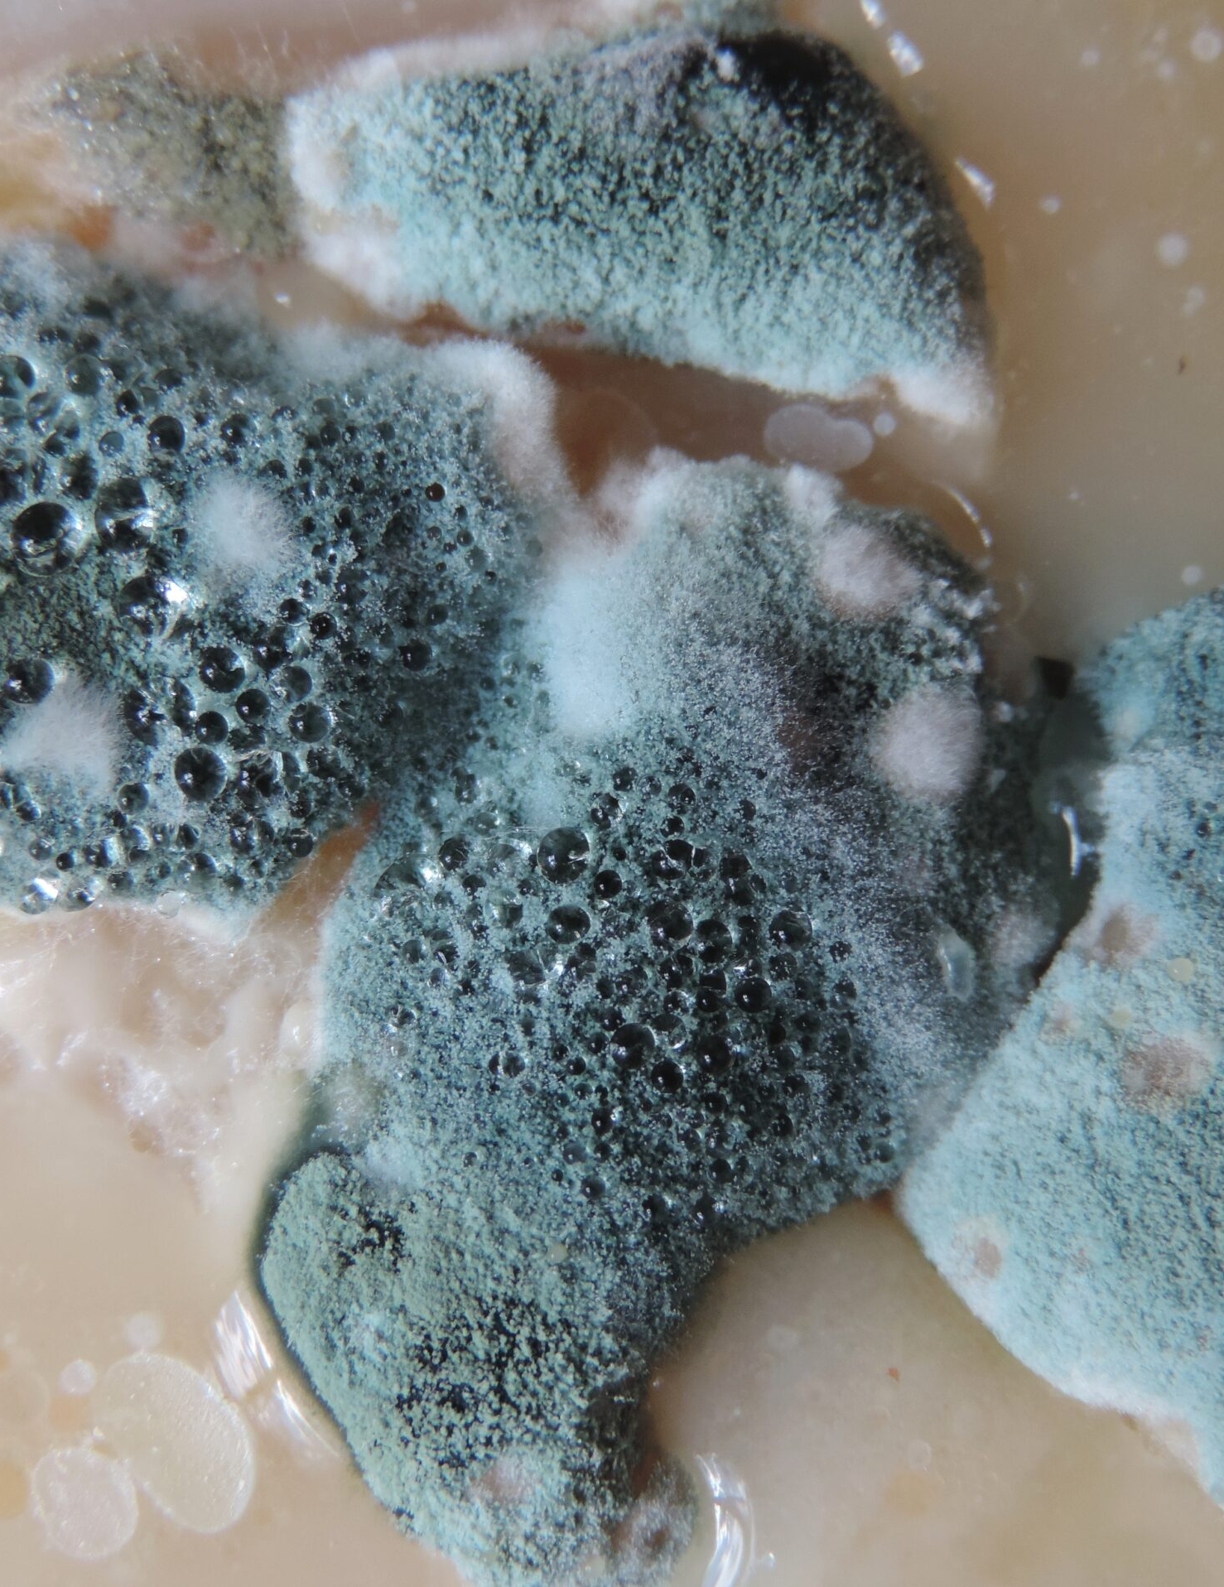
Common Places Affected
Mould can appear in many areas of a home or building. Bathrooms and kitchens are especially vulnerable because of steam and water use. Basements often suffer due to poor airflow and damp floors. It can also grow on carpets, curtains, and upholstered furniture, as well as wooden beams, drywall, and wallpaper. Even clothing stored in humid closets can be affected.

Slide 5
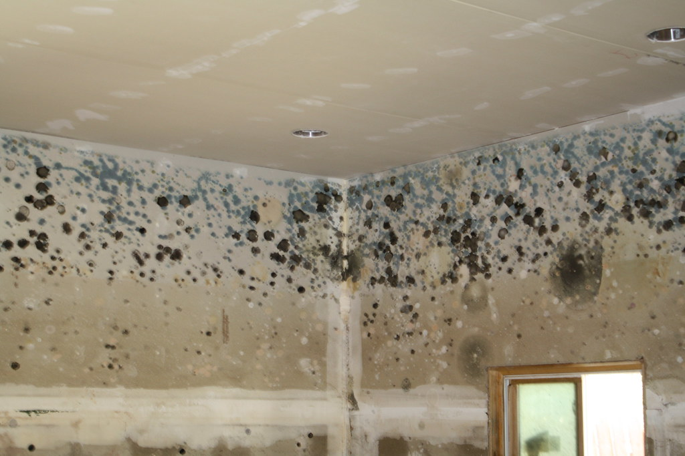
Signs of Mould Attack
There are several warning signs that mould is present. A musty, unpleasant odor is often the first clue. Discolored patches in shades of green, black, or white may appear on walls or ceilings. Paint and wallpaper can begin to peel, and surfaces may develop a fuzzy or slimy texture. People living in the space may notice increased allergy symptoms, and water stains or damp marks are often visible.

Slide 6
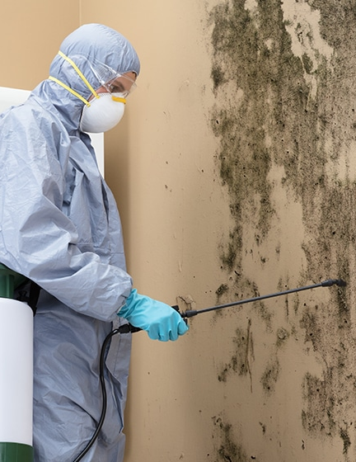
Treatment Methods
When mould does appear, small areas can be cleaned with vinegar or antifungal sprays. Protective gloves and masks should be worn during cleaning to avoid exposure. Severely damaged materials may need to be removed and replaced. After cleaning, the area must be dried completely, and surfaces can be sealed to prevent regrowth. For large infestations or toxic moulds, professional help is often necessary.

Slide 7
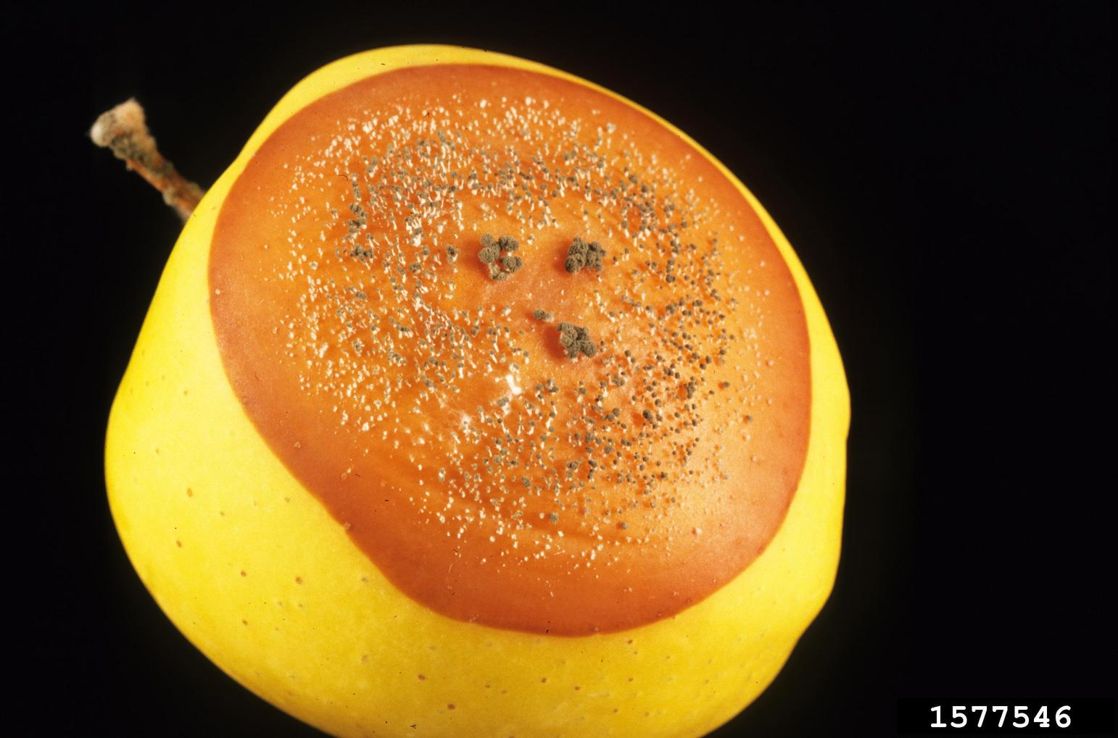
Why Prevention Matters
Preventing mould attack is important for both health and property. It reduces allergies and respiratory problems, keeps homes safe and structurally sound, and saves money on repairs and medical bills. Furniture and belongings are protected from damage, and the overall environment becomes cleaner and healthier. By stopping mould before it spreads,
This Photo by Unknown Author is licensed under CC BY-NC

Slide 8
Thankyou for listning
Zian Zayed

