Slide 1
Respiratory system
Nardeen Abu Joudeh
Gr.5A

Slide 2
What is a respiratory system?
It is the body system that help us breath
It brings oxygen into our body
It removes carbon dioxide ( a waste gas)
Every cell in our body needs oxygen to work

Slide 3
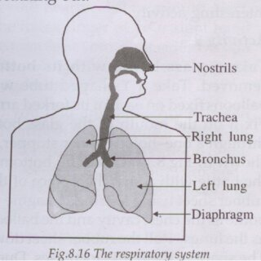
Main Organs of the Respiratory System

Slide 4
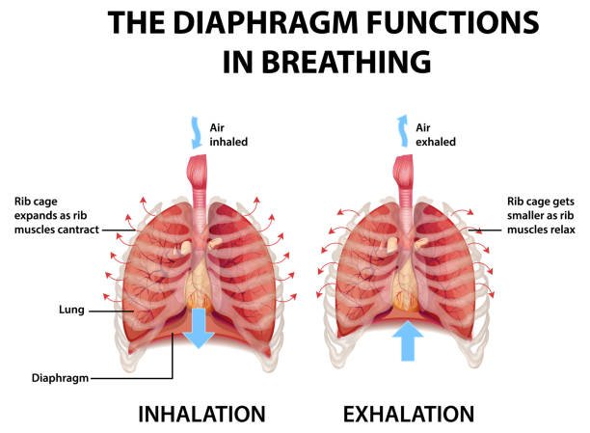
Breathing
We need oxygen to live, when we breath IN, oxygen gas from the air moves into the blood vessels in the lungs. Blood carries the oxygen to the heart & then to the other parts of the body.
As your body uses up oxygen, it makes carbon dioxide. The blood carries the carbon dioxide back to the lungs. We get rid of Carbon dioxide in the air we breath OUT.

Slide 5
Fun Facts!
You breath about 20,000 times a day
Your lungs are not the same size –the right lung is bigger
Your lungs are like ballons that fill with air
The diaphragm is a strong muscle that moves every time u breath

