Slide 1


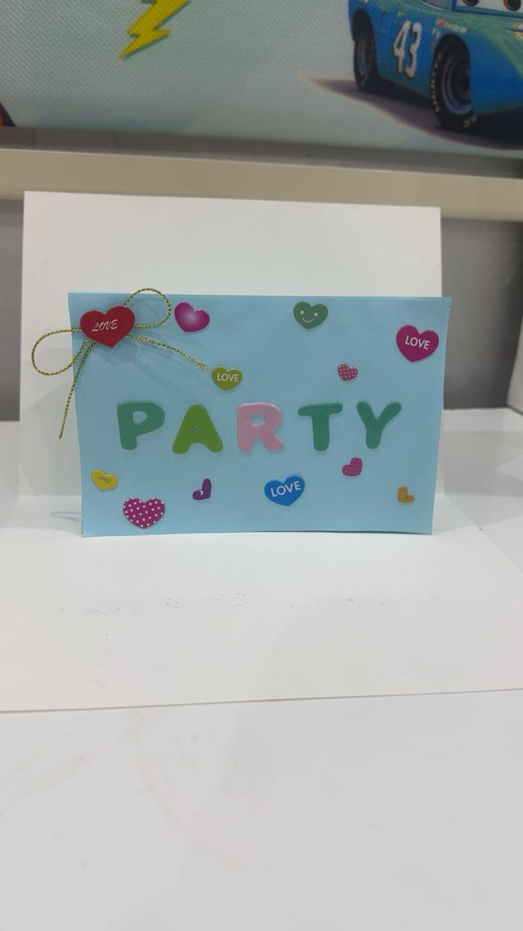
October 22, 2025
HOW TO MAKE
POP UP CARD
Abdulhafeeth

Slide 2



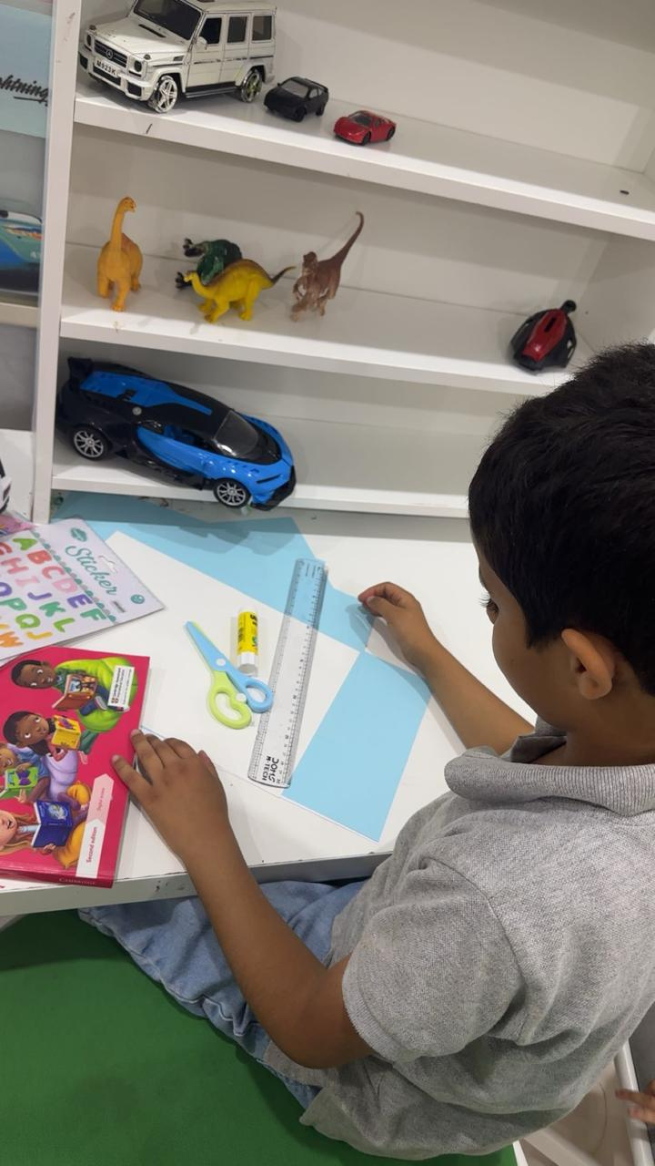
I NEED

Slide 3


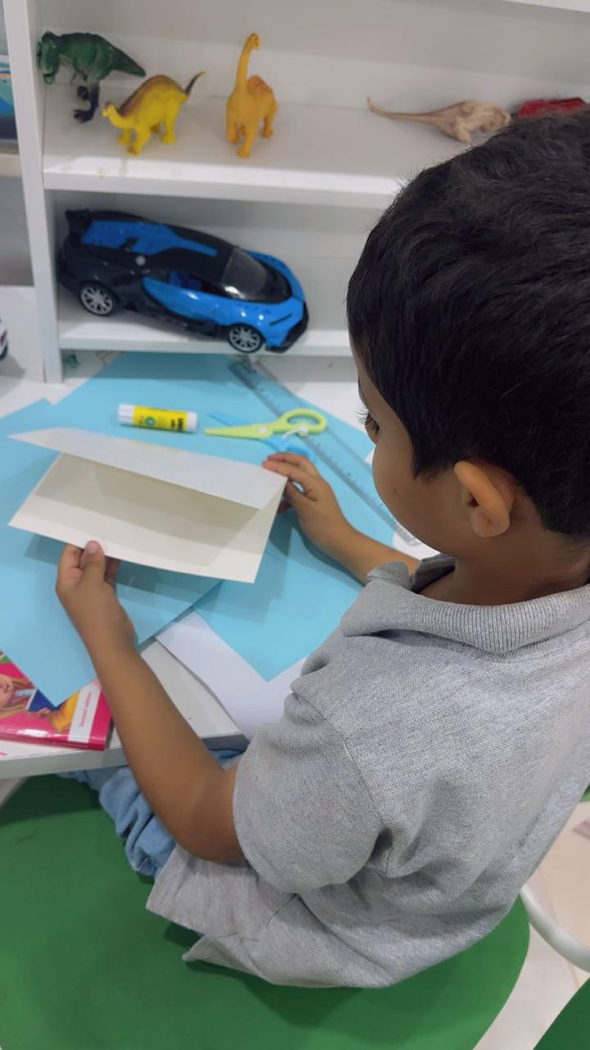


INSTRUCTIONS

Slide 4
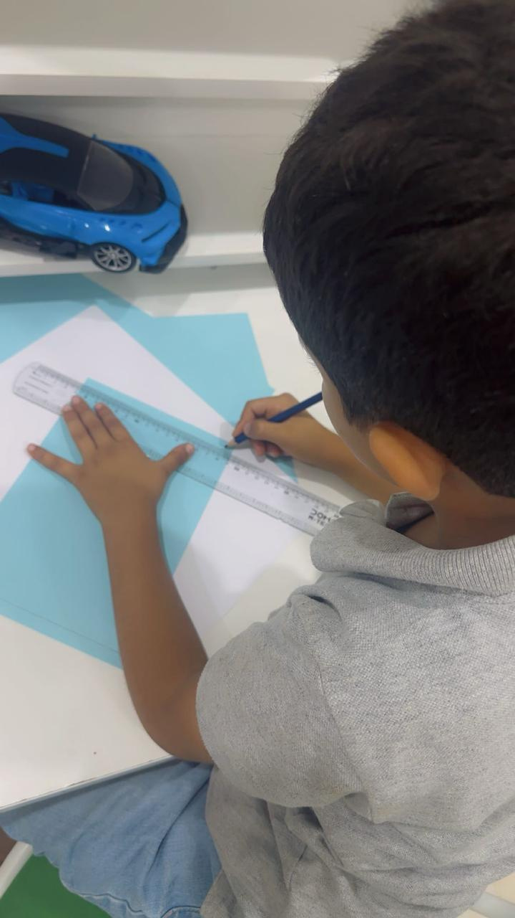
INSTRUCTIONS

Slide 5

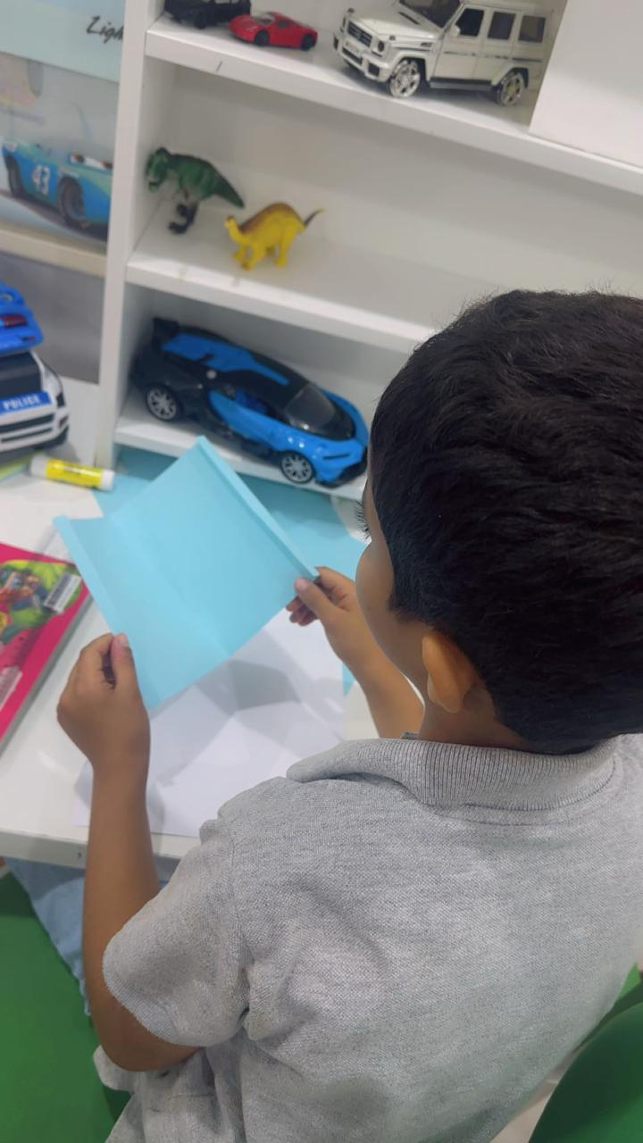
INSTRUCTIONS

Slide 6
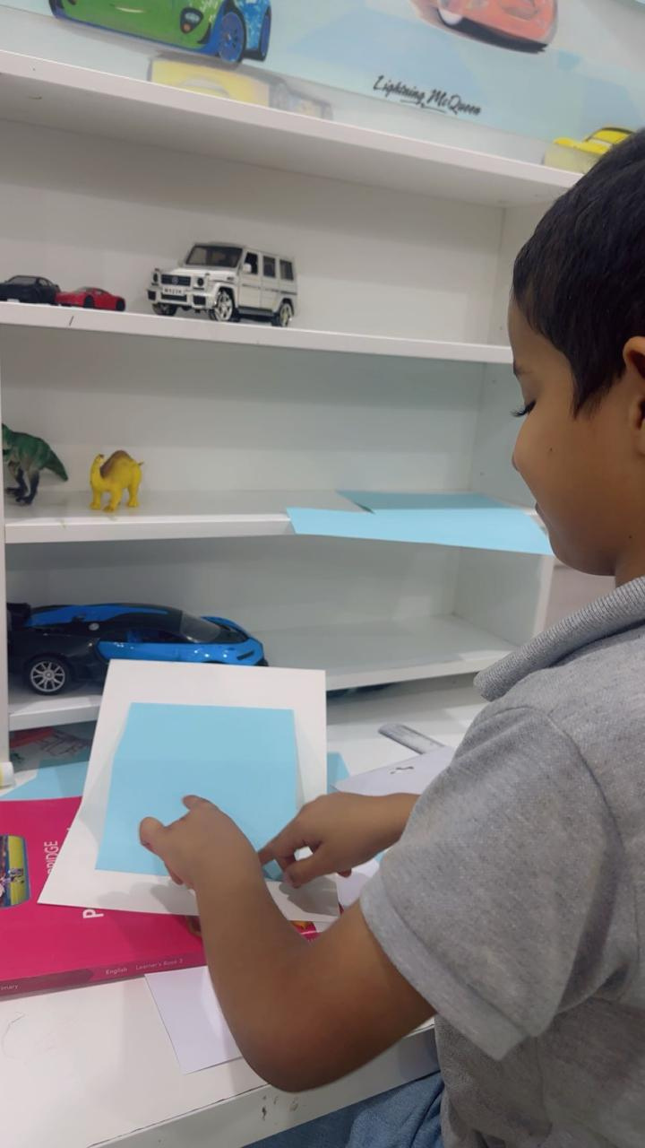
INSTRUCTIONS

Slide 7

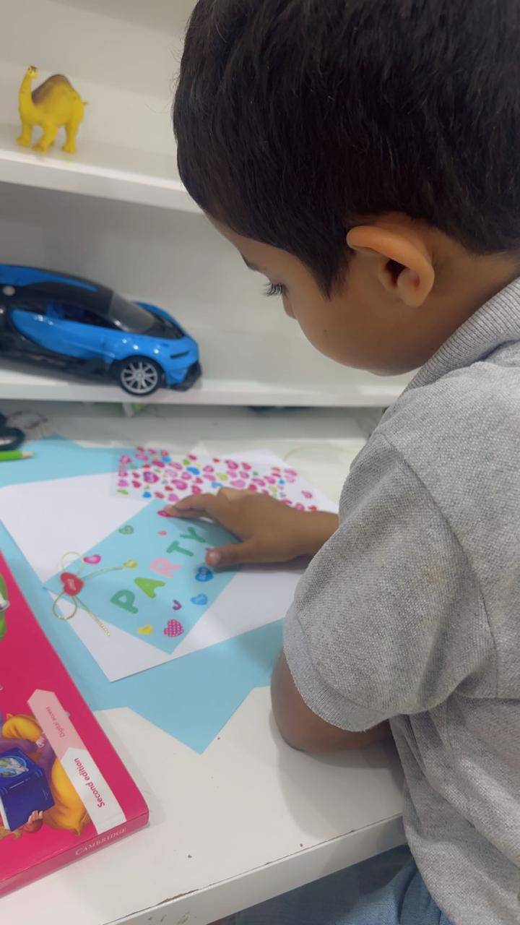
INSTRUCTIONS

Slide 8
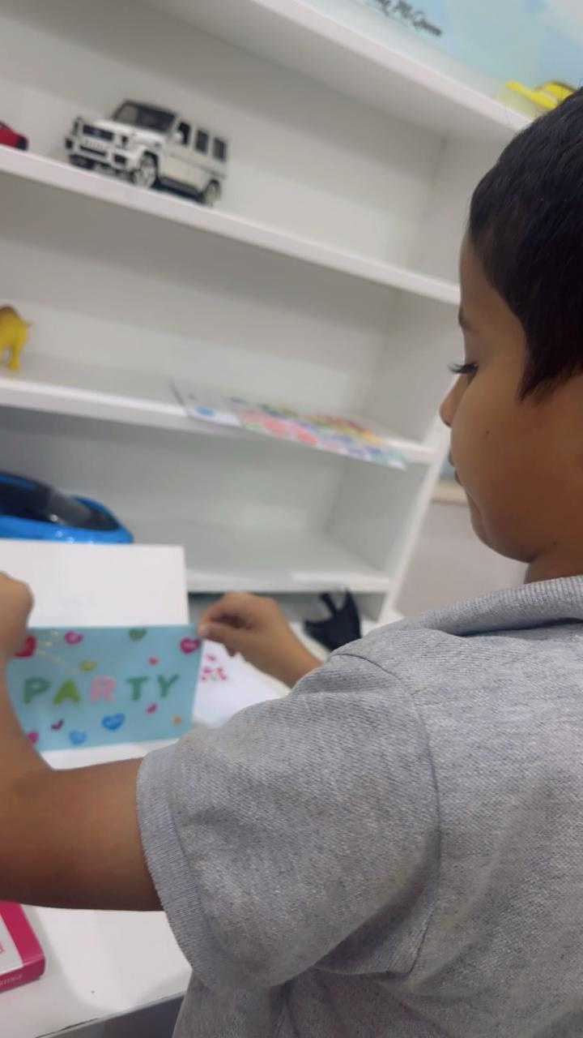

INSTRUCTIONS

Slide 9
POP UP CARD
  I really injoy making it
  thank you for listening

