Slide 1
JORDAN ROMERO JOURNEY
Done by: ADAM HJAZEEN

Slide 2
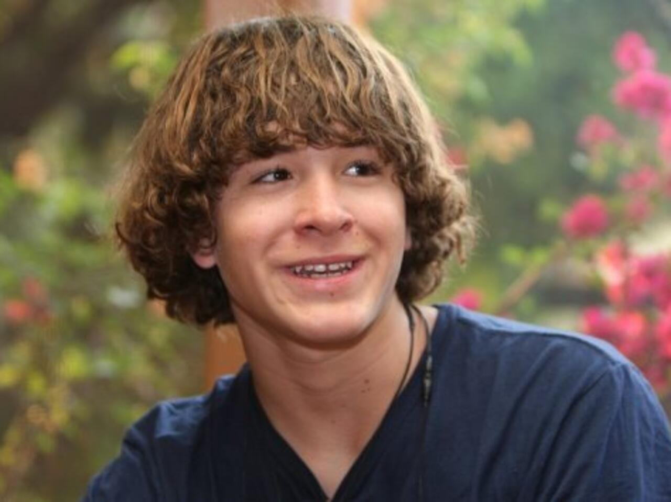
HE LIVES IN AMEIRECA
HE IS BORN IN ( JULY/12/1996)
HE REACHED THE SUMMIT OF MOUNT EVEREST IN (22/MAY/2010) WHEN HE WAS 13 YEARS OLD
The previous record for youngest to climb Everest was held by Ming Kipa of Nepal who was 15 years old when she reached the summit on May 22, 2003.

Slide 3
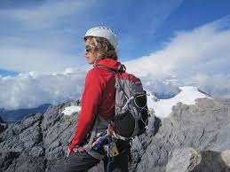
HIS TEAM INCLUDED: HIS FATHER PAUL ROMERO,STEP MOTHER KAREN,AND THREE GUIDES: PASANG SHERPA, LAMA DAWA SHIRPS,LAMA CARMA SHERPA.
HIS ROUTE:CHINEES ROUTE ( TIBETAN ).

Slide 4
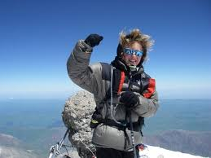
HIS GOAL WAS TO COMPLETE THE SEVEN SUMMITS ( THE HIGHEST MOUNTAINS )
AND HE COMPLETED HIS GOAL AT AGE OF 15 ON ( DEC.2011).

