Slide 1
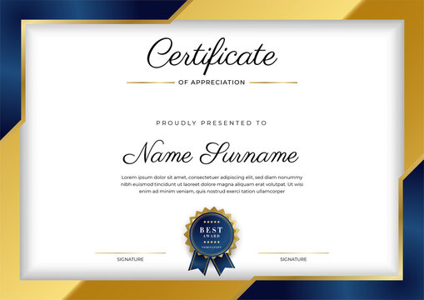

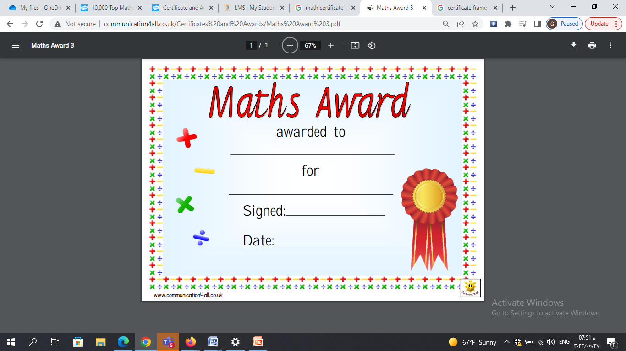

This Certificate is awarded to
William Qubain
For your OUTSTANDING ACHEIVEMENT
In English
Teacher
Nour Hanania
School Coordinator
Jumana Masarweh
Date : 10/6/2025

