Slide 1
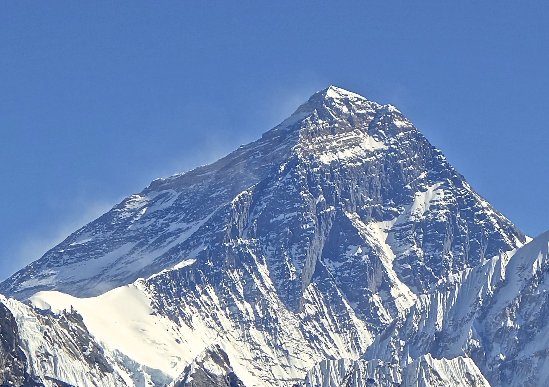
Jordan Romero-Everest(2010)
This Photo by Unknown Author is licensed under CC BY-SA

Slide 2
Quick Facts
Age at summit the mount Everest :13 years old (born July 12,1996).
Summit date: May 22, 2010.
Team: Father Paul Romero, step-mother Karen Lundgren , and three Sherpas(Ang pasang, Lama Dawa, Lama Karma).
In December 2011 at the age of 15 years, 5 months, 12 days, Romero became the youngest person in the world to complete the Seven Summits
This Photo by Unknown Author is licensed under CC BY-SA

Slide 3
Jordan Romero Mount Everest Expedition
Before starting his expedition towards Mount Everest, Jordan Romero
and his team had spent over a year preparing and researching
every scenario that they could face during their climb.
Furthermore, to avoid any risk, Jordan and his team spent about 50 days
in the Himalayas to acclimatize and prepare for their journey.
This Photo by Unknown Author is licensed under CC BY-SA

Slide 4
How did he get the funding?
It is not an unknown fact that climbing Everest can be quite expensive.
But to make his dream come true, Jordan was awarded a Polartec Grant,
to produce low impact and cost-effective
expedition that is both culturally and environmentally friendly.
Furthermore, Jordan also sold t-shirts to raise more funds for his trip.
This Photo by Unknown Author is licensed under CC BY-SA

Slide 5
Challenges on the mountain
To reach the top of Everest is an extraordinary challenge for any mountain climber.
At such high-altitude sickness, the air is thin, making breathing difficult.
Jordan and his team had to use oxygen tanks.
They also endured freezing temperatures, strong winds, and the risk of avalanches.
This Photo by Unknown Author is licensed under CC BY-SA

Slide 6
His achievement and Legacy
Learn about his inspiring journey, preparation, and record-breaking achievement here.
He made history when he became the youngest man to climb Mount Everest at only 13 years of age.
His incredible achievement inspired people all around the world.
This Photo by Unknown Author is licensed under CC BY-SA

Slide 7
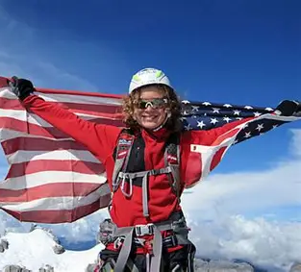
“Dream big, climb higher, Age doesn`t define your limits” by Jordan Romero Done by: Saif Madaeen

