Slide 1


Hi my friends!
today I will talk about materials

Slide 2
Materials
Are what things are made of. Objects can be made of different types of materials.

Slide 3
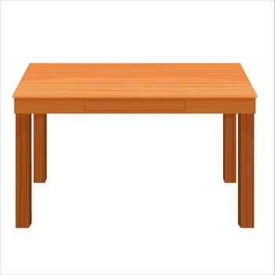


wood
Table
pencil
Tree

Slide 4
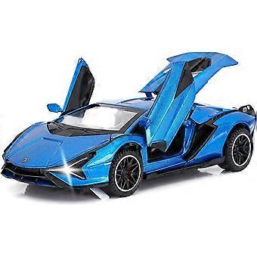
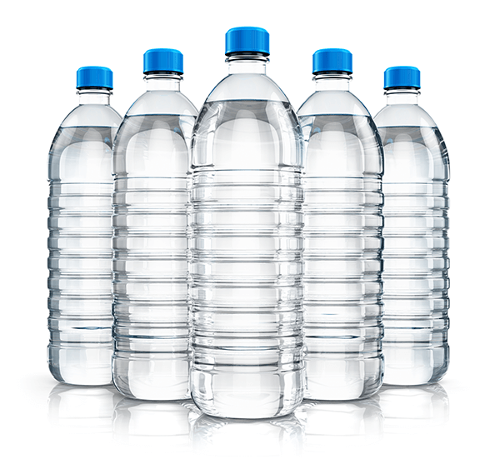
Plastic
water bottle
Toy car

Slide 5
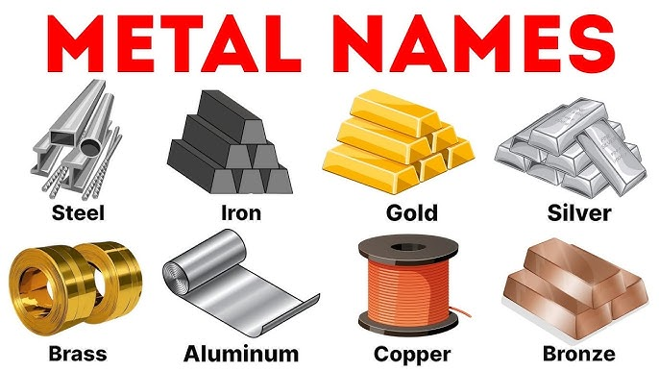
Metal

Slide 6
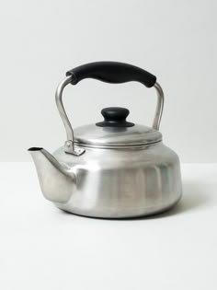
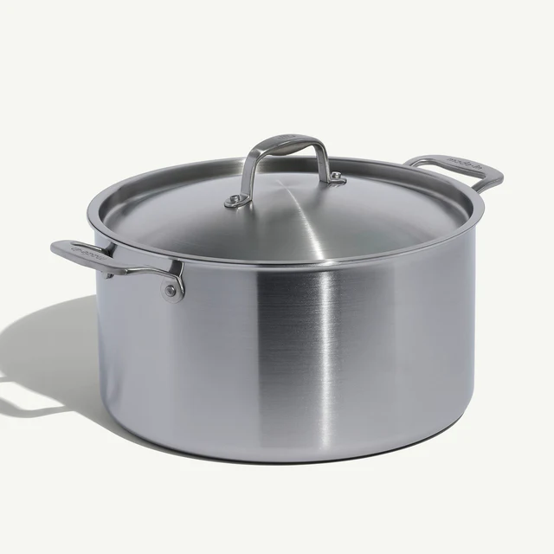
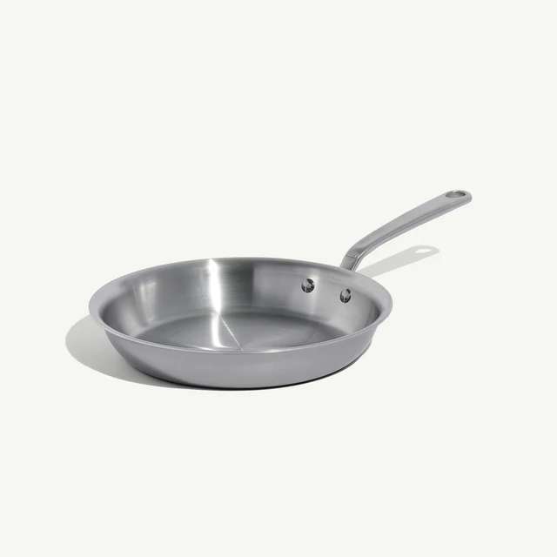
Metal
Luster
Pot
Pan

Slide 7
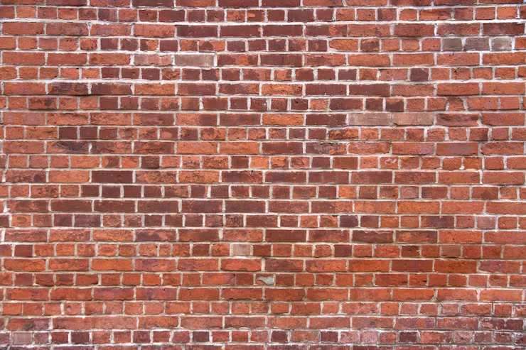
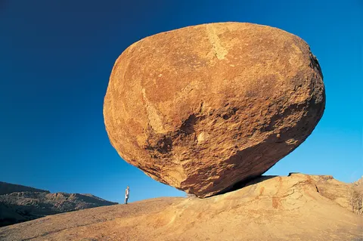
Rock
Solids have fixed shapes and volumes (like a rock), liquids have fixed volumes but take container shapes (like water), and gases have no fixed shape or volume, expanding to fill everything (like air). Sentences illustrating this include: "The ice cube (solid) kept its shape," "The water (liquid) poured into the glass," and "The steam (gas) disappeared into the air".
Solids have fixed shapes and volumes (like a rock), liquids have fixed volumes but take container shapes (like water), and gases have no fixed shape or volume, expanding to fill everything (like air). Sentences illustrating this include: "The ice cube (solid) kept its shape," "The water (liquid) poured into the glass," and "The steam (gas) disappeared into the air".
Solids have fixed shapes and volumes (like a rock), liquids have fixed volumes but take container shapes (like water), and gases have no fixed shape or volume, expanding to fill everything (like air). Sentences illustrating this include: "The ice cube (solid) kept its shape," "The water (liquid) poured into the glass," and "The steam (gas) disappeared into the air".
Solids have fixed shapes and volumes (like a rock), liquids have fixed volumes but take container shapes (like water), and gases have no fixed shape or volume, expanding to fill everything (like air). Sentences illustrating this include: "The ice cube (solid) kept its shape," "The water (liquid) poured into the glass," and "The steam (gas) disappeared into the air".
Solids have fixed shapes and volumes (like a rock), liquids have fixed volumes but take container shapes (like water), and gases have no fixed shape or volume, expanding to fill everything (like air). Sentences illustrating this include: "The ice cube (solid) kept its shape," "The water (liquid) poured into the glass," and "The steam (gas) disappeared into the air".
Solids have fixed shapes and volumes (like a rock), liquids have fixed volumes but take container shapes (like water), and gases have no fixed shape or volume, expanding to fill everything (like air). Sentences illustrating this include: "The ice cube (solid) kept its shape," "The water (liquid) poured into the glass," and "The steam (gas) disappeared into the air".
Solids have fixed shapes and volumes (like a rock), liquids have fixed volumes but take container shapes (like water), and gases have no fixed shape or volume, expanding to fill everything (like air). Sentences illustrating this include: "The ice cube (solid) kept its shape," "The water (liquid) poured into the glass," and "The steam (gas) disappeared into the air".
Solids have fixed shapes and volumes (like a rock), liquids have fixed volumes but take container shapes (like water), and gases have no fixed shape or volume, expanding to fill everything (like air). Sentences illustrating this include: "The ice cube (solid) kept its shape," "The water (liquid) poured into the glass," and "The steam (gas) disappeared into the air".
Solids have fixed shapes and volumes (like a rock), liquids have fixed volumes but take container shapes (like water), and gases have no fixed shape or volume, expanding to fill everything (like air). Sentences illustrating this include: "The ice cube (solid) kept its shape," "The water (liquid) poured into the glass," and "The steam (gas) disappeared into the air".
Solids have fixed shapes and volumes (like a rock), liquids have fixed volumes but take container shapes (like water), and gases have no fixed shape or volume, expanding to fill everything (like air). Sentences illustrating this include: "The ice cube (solid) kept its shape," "The water (liquid) poured into the glass," and "The steam (gas) disappeared into the air".
Solids have fixed shapes and volumes (like a rock), liquids have fixed volumes but take container shapes (like water), and gases have no fixed shape or volume, expanding to fill everything (like air). Sentences illustrating this include: "The ice cube (solid) kept its shape," "The water (liquid) poured into the glass," and "The steam (gas) disappeared into the air".
Solids have fixed shapes and volumes (like a rock), liquids have fixed volumes but take container shapes (like water), and gases have no fixed shape or volume, expanding to fill everything (like air). Sentences illustrating this include: "The ice cube (solid) kept its shape," "The water (liquid) poured into the glass," and "The steam (gas) disappeared into the air".
Solids have fixed shapes and volumes (like a rock), liquids have fixed volumes but take container shapes (like water), and gases have no fixed shape or volume, expanding to fill everything (like air). Sentences illustrating this include: "The ice cube (solid) kept its shape," "The water (liquid) poured into the glass," and "The steam (gas) disappeared into the air".
Solids have fixed shapes and volumes (like a rock), liquids have fixed volumes but take container shapes (like water), and gases have no fixed shape or volume, expanding to fill everything (like air). Sentences illustrating this include: "The ice cube (solid) kept its shape," "The water (liquid) poured into the glass," and "The steam (gas) disappeared into the air".
Solids have fixed shapes and volumes (like a rock), liquids have fixed volumes but take container shapes (like water), and gases have no fixed shape or volume, expanding to fill everything (like air). Sentences illustrating this include: "The ice cube (solid) kept its shape," "The water (liquid) poured into the glass," and "The steam (gas) disappeared into the air".
Solids have fixed shapes and volumes (like a rock), liquids have fixed volumes but take container shapes (like water), and gases have no fixed shape or volume, expanding to fill everything (like air). Sentences illustrating this include: "The ice cube (solid) kept its shape," "The water (liquid) poured into the glass," and "The steam (gas) disappeared into the air".
Solids have fixed shapes and volumes (like a rock), liquids have fixed volumes but take container shapes (like water), and gases have no fixed shape or volume, expanding to fill everything (like air). Sentences illustrating this include: "The ice cube (solid) kept its shape," "The water (liquid) poured into the glass," and "The steam (gas) disappeared into the air".
Solids have fixed shapes and volumes (like a rock), liquids have fixed volumes but take container shapes (like water), and gases have no fixed shape or volume, expanding to fill everything (like air). Sentences illustrating this include: "The ice cube (solid) kept its shape," "The water (liquid) poured into the glass," and "The steam (gas) disappeared into the air".
Solids have fixed shapes and volumes (like a rock), liquids have fixed volumes but take container shapes (like water), and gases have no fixed shape or volume, expanding to fill everything (like air). Sentences illustrating this include: "The ice cube (solid) kept its shape," "The water (liquid) poured into the glass," and "The steam (gas) disappeared into the air".
Solids have fixed shapes and volumes (like a rock), liquids have fixed volumes but take container shapes (like water), and gases have no fixed shape or volume, expanding to fill everything (like air). Sentences illustrating this include: "The ice cube (solid) kept its shape," "The water (liquid) poured into the glass," and "The steam (gas) disappeared into the air".
Rock
Wall

Slide 8
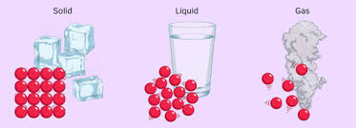
particles
All matter is made up of particles.
The particles is a very small part of something.
Most particles are very small so we cannot see.

Slide 9
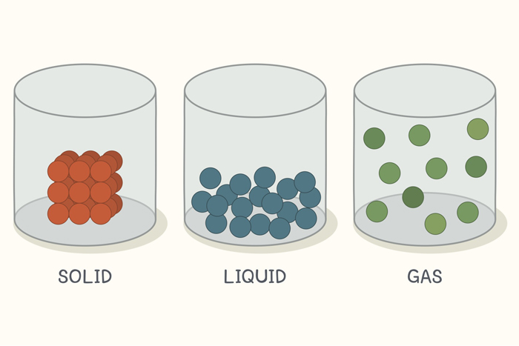
The particle model of matter.
The amount of movement of the particles decides whether the substance is a solid, liquid or gas.

Slide 10
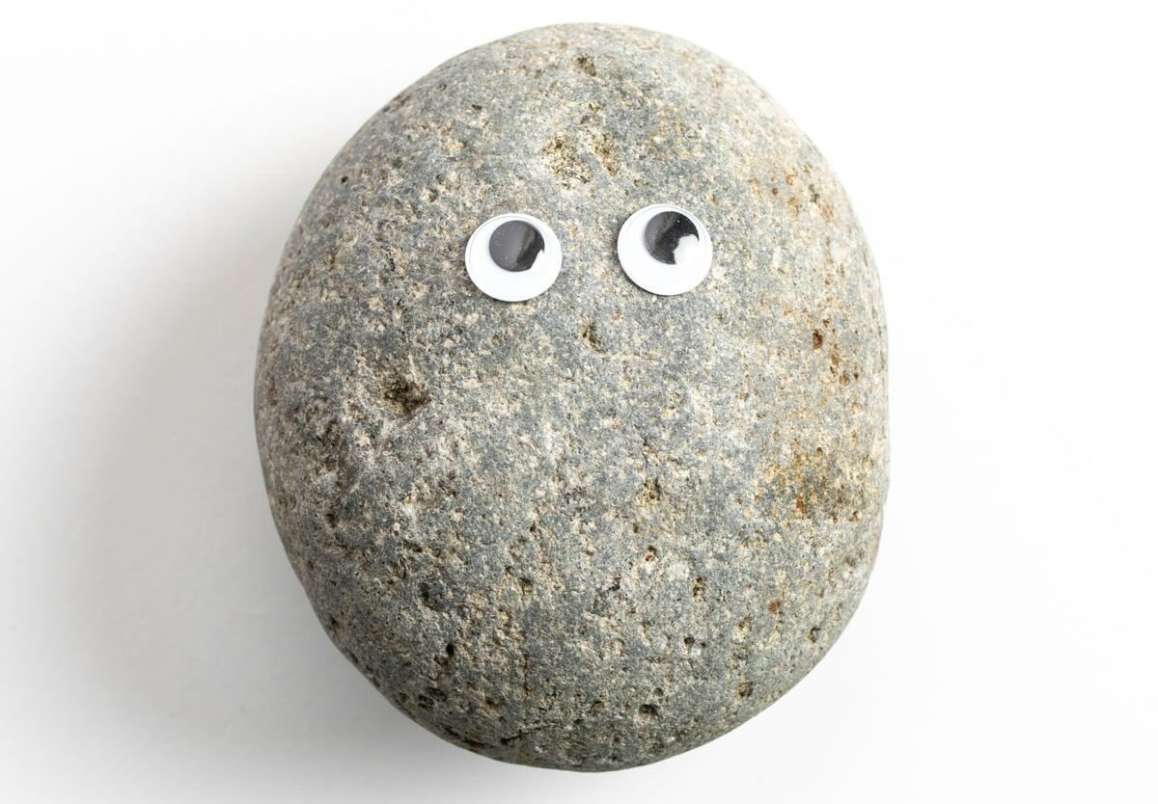
Solid
Solids have fixed shapes and volumes (like a rock),

Slide 11
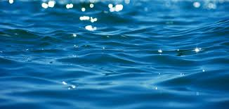
Liquid
liquids have fixed volumes but take container shapes (like water),

Slide 12
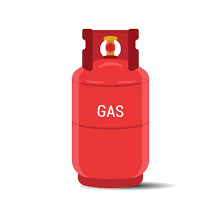
Gas
The steam (gas) disappeared into the air".

Slide 13
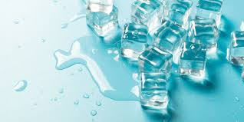
Melting
Melting is the physical process where a substance changes from a solid to a liquid, usually by adding heat, causing its particles to gain energy, break bonds, and move more freely at a specific melting point

Slide 14
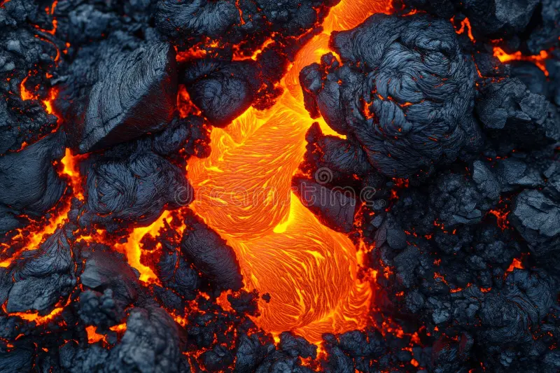
Solidifying
Solidifying means turning from a liquid/gas to a solid (like water freezing to ice or lava cooling)

Slide 15
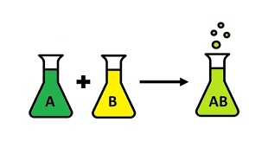
Chemical reactions
chemical reactions are when you mix things and a new substance is made, different from the start, like baking a cake

Slide 16
Thank you for listening.
Done by muhammad

