Slide 1
Materials

Slide 2

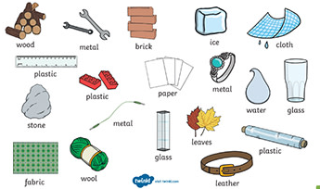
Materials
All materials are made of matter.
Objects can be made of different types of materials.
A material is a certain type of matter.
Example:
plastic
wood

Slide 3
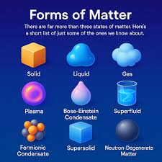
Matter
Matter is everything around us.
There are three forms of matter.
Solid.
Liquid.
Gas.

Slide 4
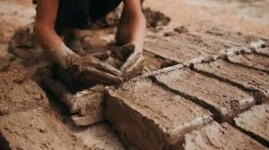
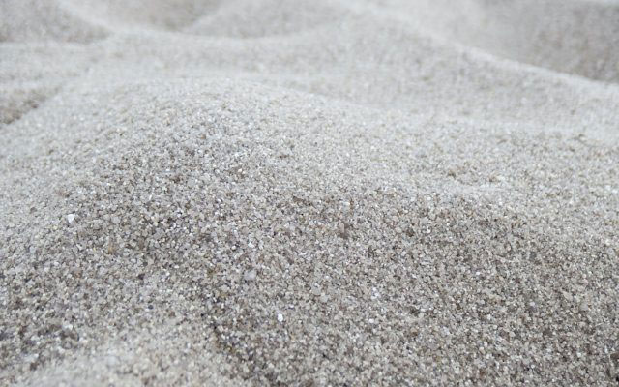
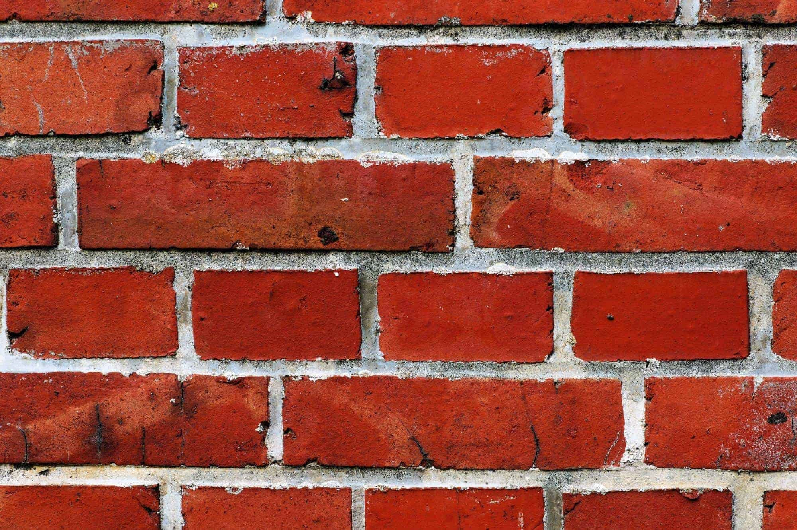
Substances
Most materials are mixture of different substances.
A substance is a pure type of solid ,liquid or gas.
clay
silica
bricks
Substances

Slide 5
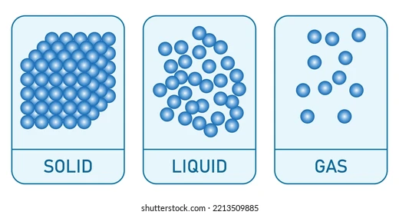
Particles
All matter is made up of particles.
A particle is a very small part or bit of something.
In solids, the particles are packed tightly together in a regular pattern.
The spaces between the particles are very small.
Particles can’t move around very much.
In liquids, the particles are also close together , but they are not packed in a regular pattern.
The spaces between the particles are bigger .
Particles can change places.

Slide 6
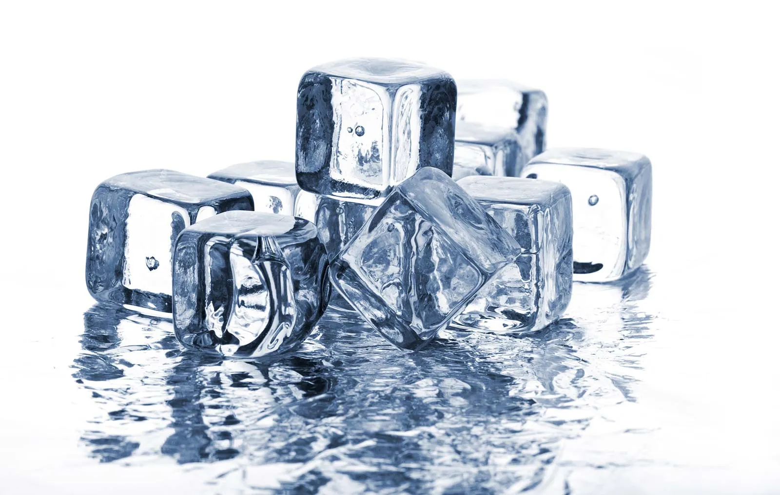
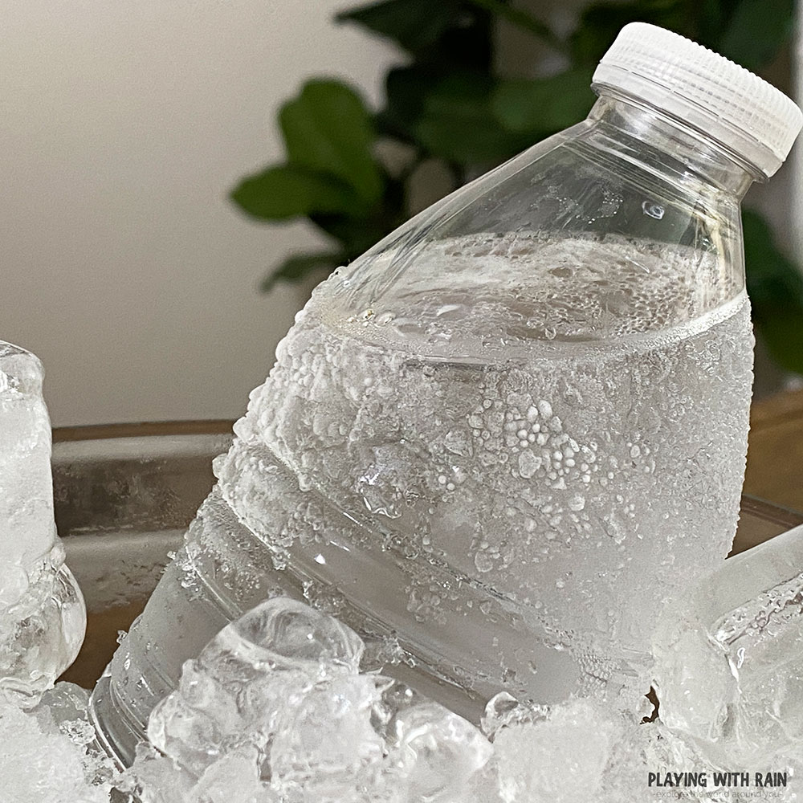
Change of state
Most materials and substances can change from one form to another when they are heated or cooled.
solidifying
melting
liquid
solid
solid
cooling
heating
liquid

Slide 7
By Balqees Hadaddin.
Grade 3B.

