Slide 1
Materials:
What is materials

Slide 2
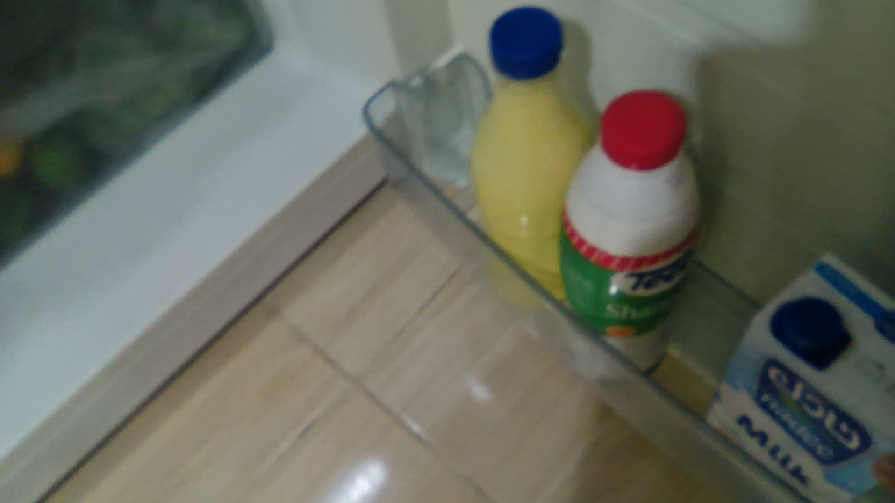
Explain :
Everything around us can be matter.

Slide 3
The particle model of matter:
Because most particles of matter are very small, scientists use a model to explain how the particles form substances the particle model describe the difference between substances that are solids liquids and gases. scientists have found out some important things about the particles that make solids ,liquids and gases
The particles have spaces between them when the space is between them the particles are small the particles or hills closed together
The particles are always moving even so if we can see them move the amount of movements of the particles decides whether the substances is so that’s liquids or gas.

Slide 4
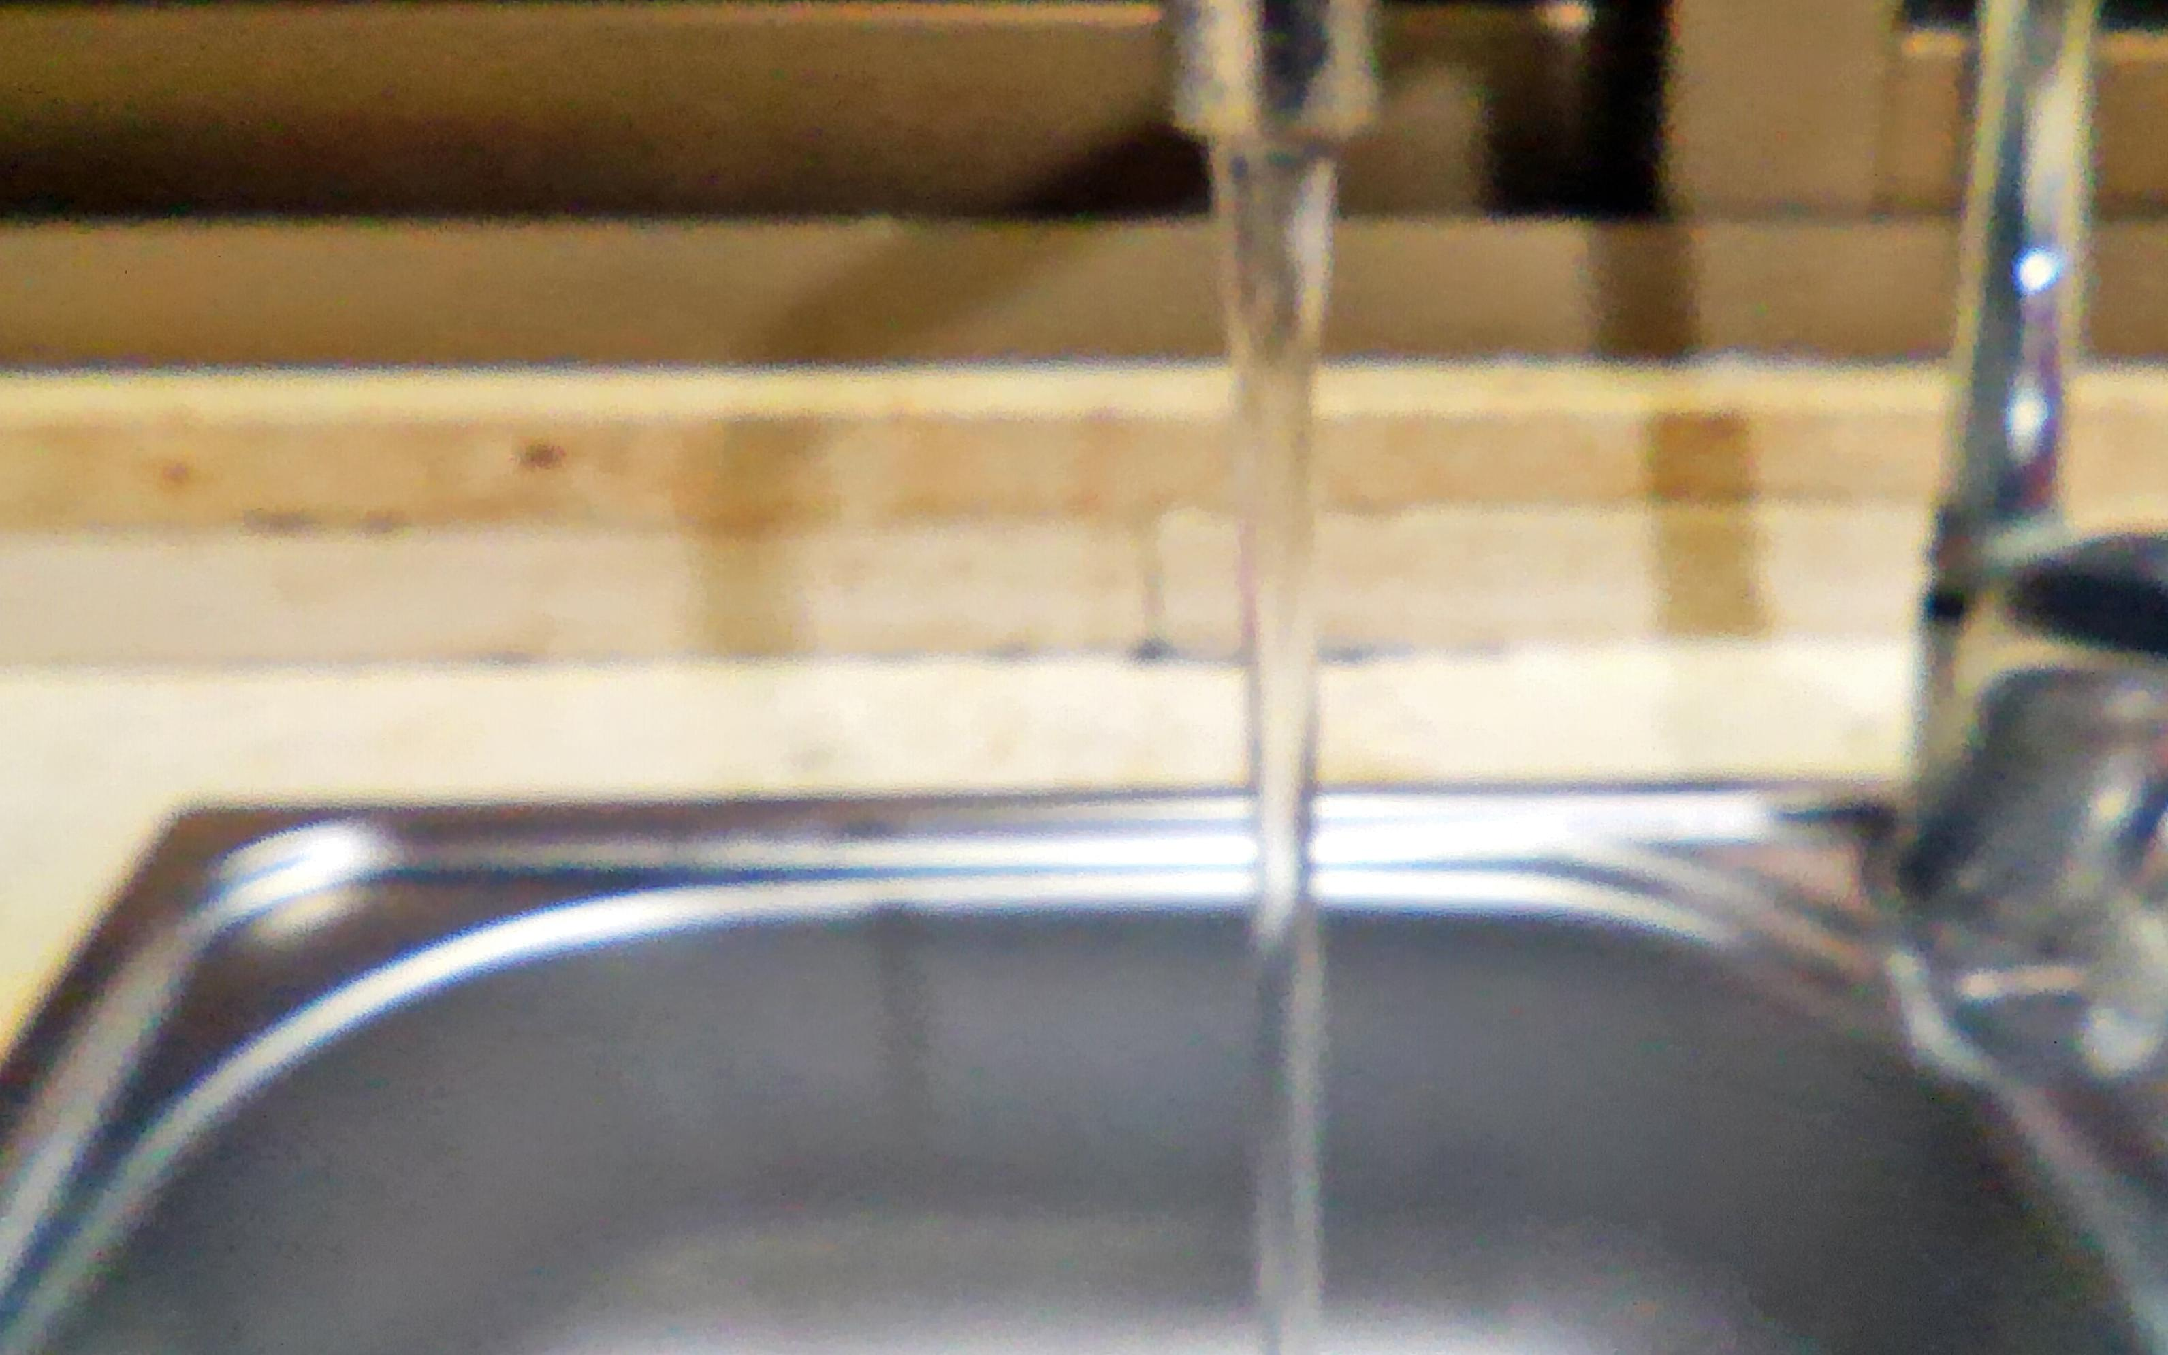
Properties of solids and liquids:
A property describe what a substance or material is like or how it’s behaves we can make sure see or feel that properties of a substance or material so is our liquids have different properties.

Slide 5
Solids:
Try to squeeze your desk chair or pencil can you make it a different shape so let’s keep their shape a list of force is exerted on them the shape of a solid does not change on its own we can make change if we squeeze or push on them hard enough remember the particle model particles in a solids that closely together there is no space for the particles to take on a different shape.

Slide 6
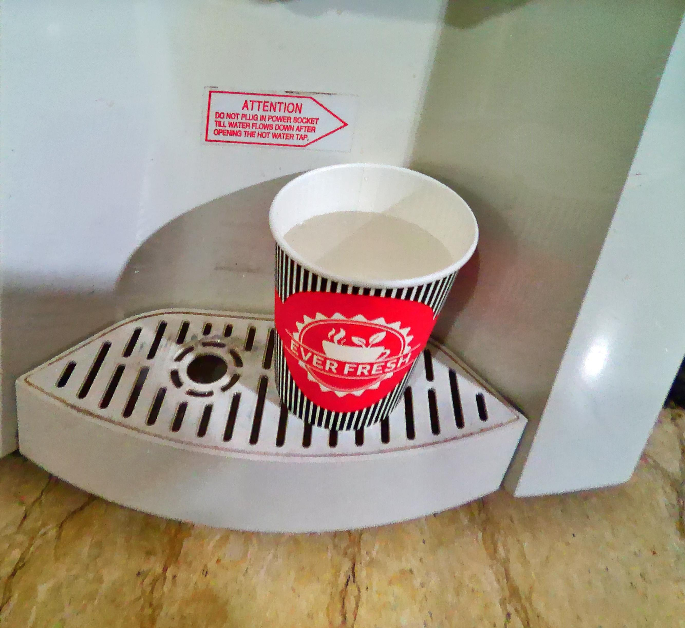
Liquids:
So, let’s give their shape what about liquids what shape is a liquid inside a drinking glass please what will happen when you pour some water onto a flat surf liquid particles are farther apart than solid particles is less than move around more easily since the particles can move the liquid I can flow and take the shape of its container.

Slide 7
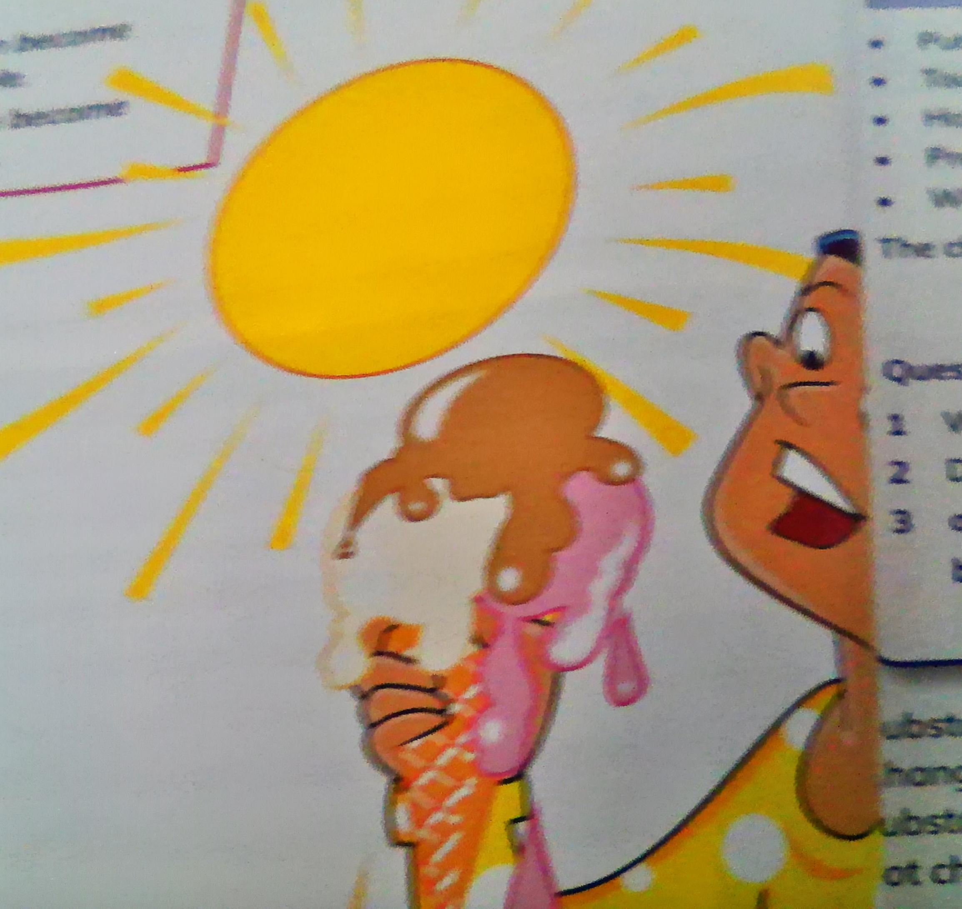
Change of state:
Most material and substances can change from one warm to another when they are heated or cooled . This is called CHANGE Of STATE . Solids liquids and gases are different states of matter.

Slide 8
Goodbye
Goodbye everyone see you

