Slide 1


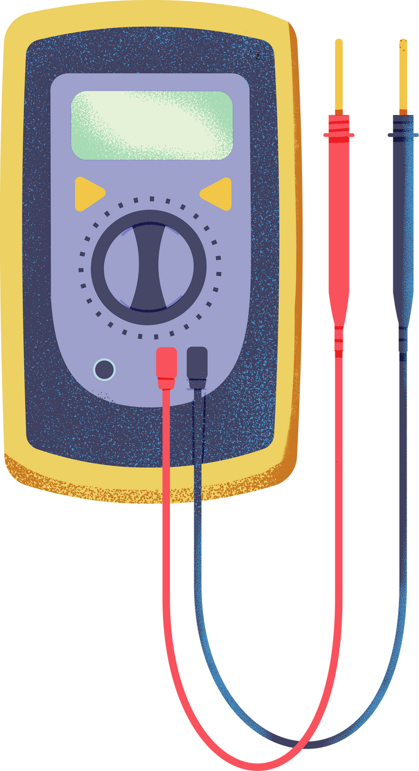



SCIENCE
UNDERSTANDING ELECTRICITY

Slide 2

WHAT IS ELECTRICITY?
Electricity is the flow of electrons (negatively charged particles) through a conductor.
Two main types:
  Static Electricity (stationary charge, e.g., balloon sticking to hair)
  Current Electricity (flowing charge, e.g., battery powering a bulb)

Slide 3


KEY CONCEPTS:
  Electrons
  Voltage (V)
  Current (I)
  Resistance (R)
move from negative (–) to positive (+) terminals.
pushes electrons (like water pressure in a pipe).
is the flow rate of electrons (measured in Amperes, A).
opposes electron flow (measured in Ohms, Ω).

Slide 4
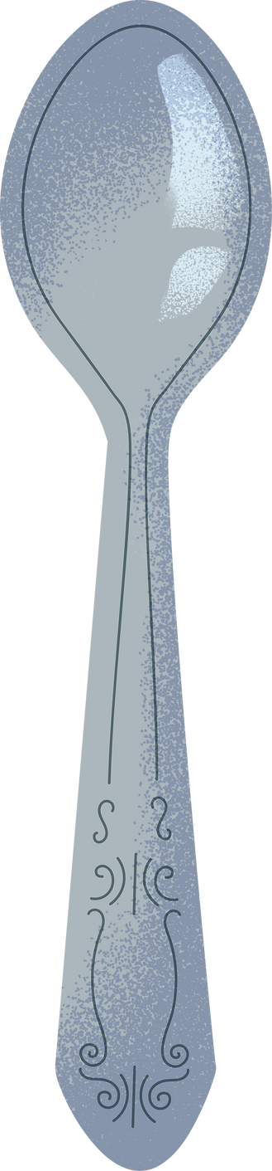


CONDUCTORS
Materials that allow electric charges (electrons) to flow easily.
Examples:
  Copper
  Gold
  Steel
  Aluminum
  Silver
(best conductor, used in wires)
(used in high-end electronics)
(used in power lines)
(used in power lines)
(used in satellites)

Slide 5




INSULATORS
Materials that block the flow of electric current.
Examples:
  Rubber
  Plastic
  Glass
  Ceramic
  Dry Wood
(Used in wire coatings, gloves)
(Outlet casings, bottle material)
(High-voltage insulators)
(Fuse boxes, spark plugs)
(Non-conductive when dry)

Slide 6



HOW ELECTRIC CIRCUITS WORK
Open Circuit
Closed Circuit

Slide 7
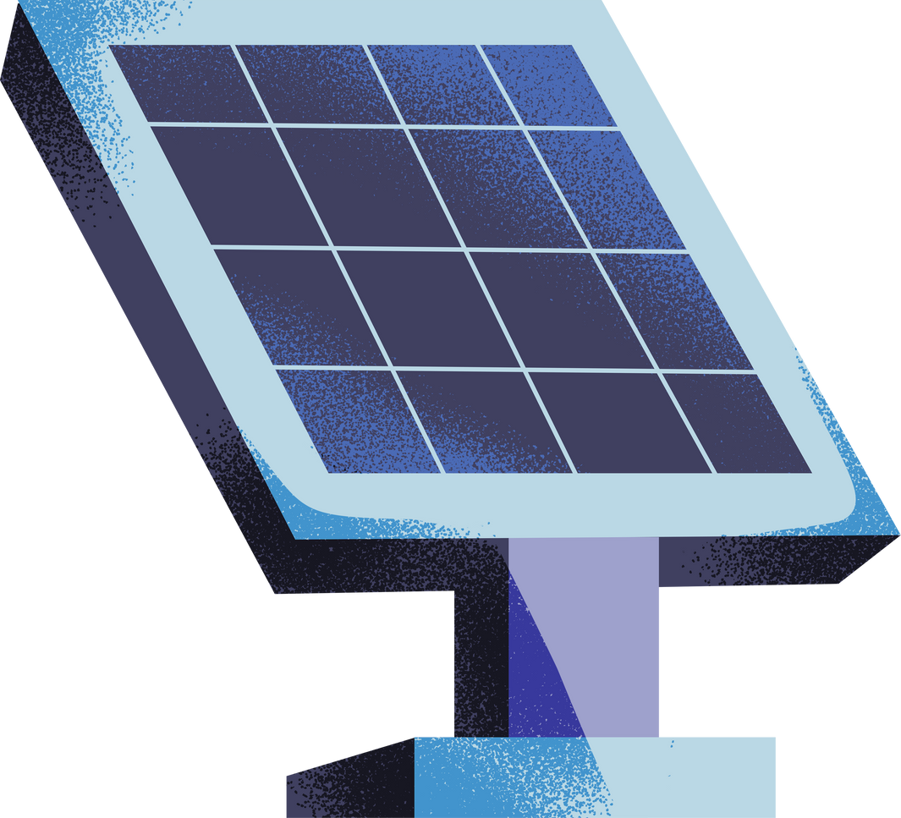

HOW ELECTRIC CIRCUITS WORK
Power Source
Conductors
Load
Switch

Slide 8
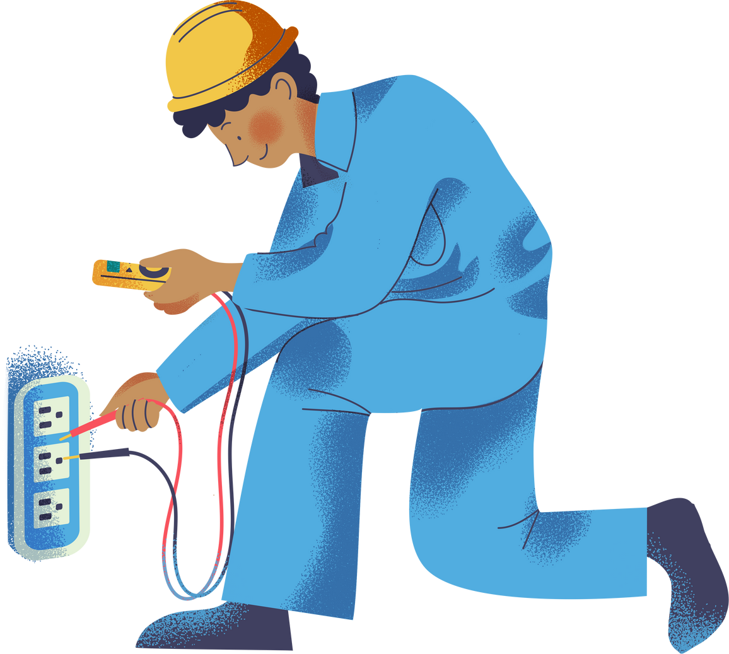
MEASURING ELECTRICITY
Voltage (V)
  "Electrical pressure" (measured with a voltmeter).
  Example: AA battery = 1.5V, Car battery = 12V.
Current (I)
  Flow rate of electrons (measured with an ammeter).
  Example: LED uses ~20mA (0.02A).
Resistance (R)
  Opposition to electron flow (measured with an ohmmeter).
  Example: A resistor limits current to protect an LED.

Slide 9
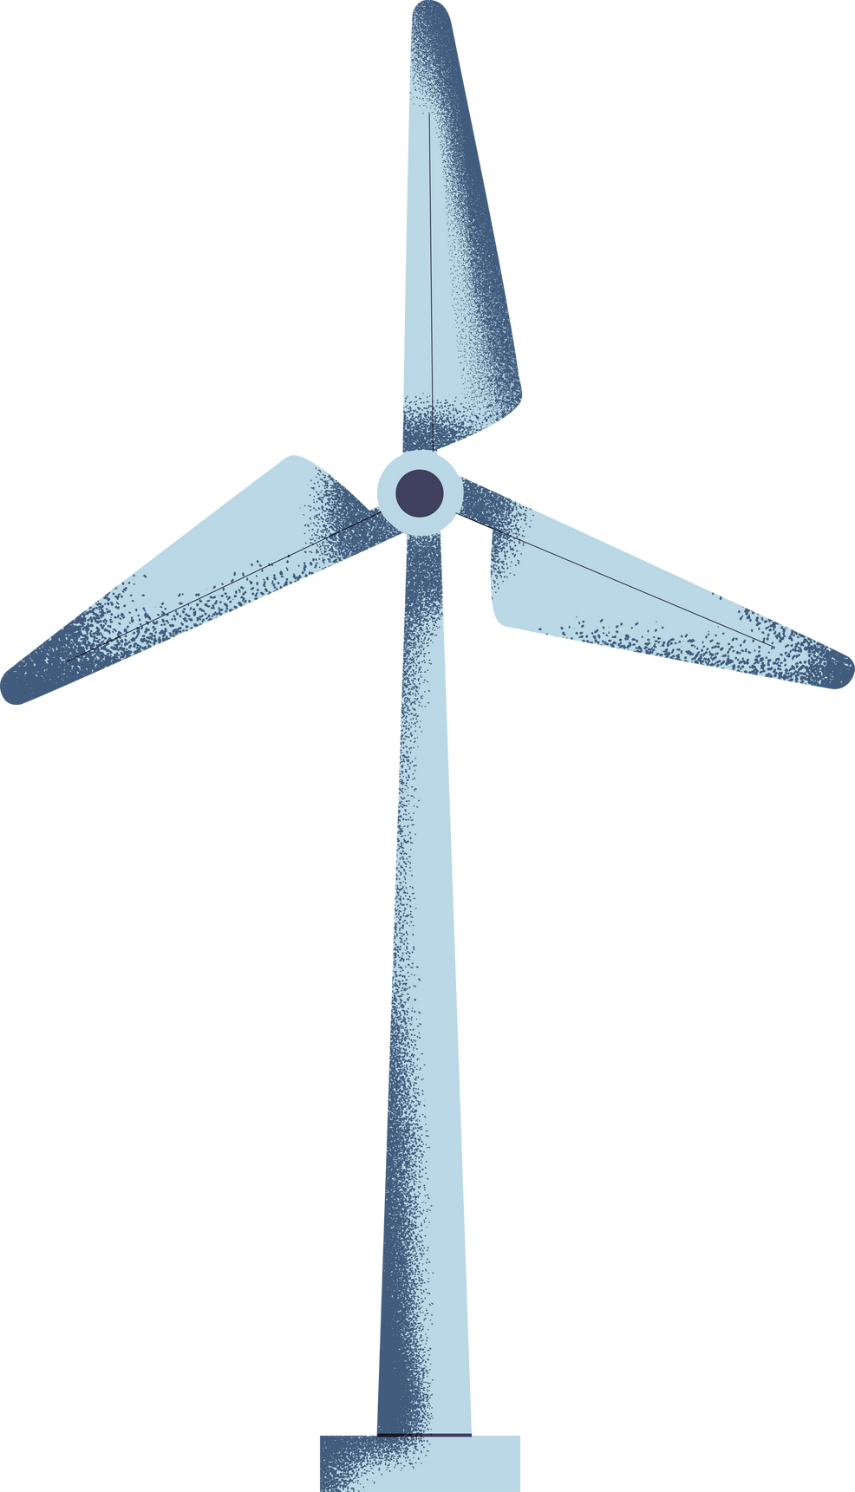
HOW ELECTRICITY IS GENERATED
Renewable Sources
  Solar Panels (sunlight → electricity)
  Wind Turbines (wind → kinetic → electrical energy)
Non-Renewable Sources
  Fossil Fuels (coal, gas)
  Nuclear (uranium fission → heat → steam → electricity)

Slide 10
