Slide 1


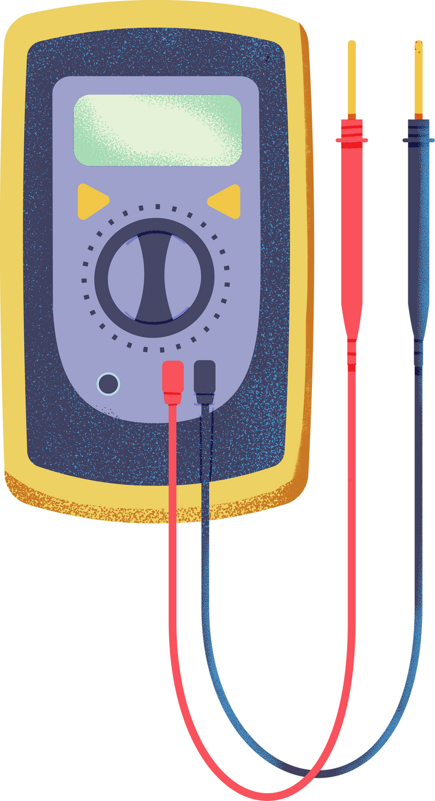



SCIENCE
UNDERSTANDING ELECTRICITY

Slide 2

WHAT IS ELECTRICITY?
Electricity is the flow of electrons (negatively charged particles) through a conductor.
Two main types:
  Static Electricity (stationary charge, e.g., balloon sticking to hair)
  Current Electricity (flowing charge, e.g., battery powering a bulb)

Slide 3


KEY CONCEPTS:
  CONDUCTRS
  INSULATORS

Slide 4
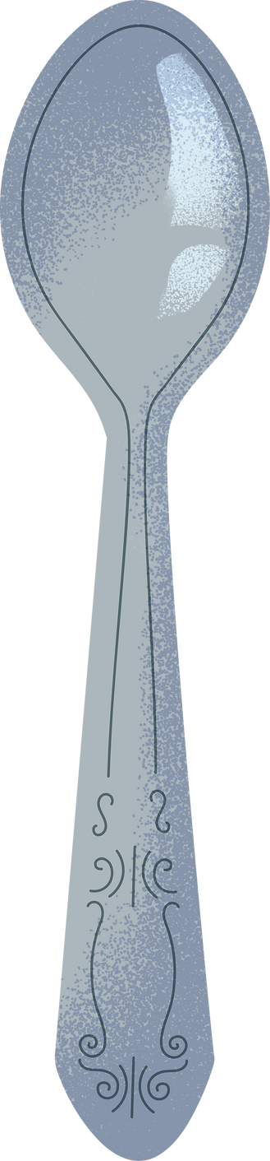


CONDUCTORS
Materials that allow (electric charges) (electrirc current) (electrons) to flow easily.
Examples:
  Copper
  Gold
  Steel
  Aluminum
  Silver
(best conductor, used in wires)
(used in high-end electronics)
(used in power lines)
(used in power lines)
(used in satellites)

Slide 5



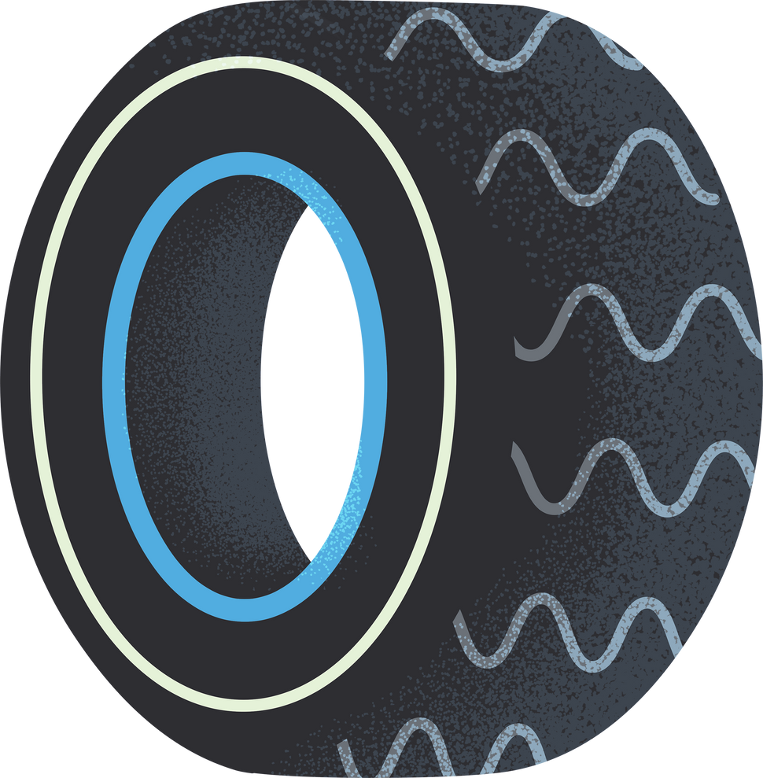
INSULATORS
Materials that block the flow of (electric current) (electric charge) (electrons)
Examples:
  Rubber
  Plastic
  Glass
  Ceramic
  Dry Wood
(Used in wire coatings, gloves)
(Outlet casings, bottle material)
(High-voltage insulators)
(Fuse boxes, spark plugs)
(Non-conductive when dry)

Slide 6
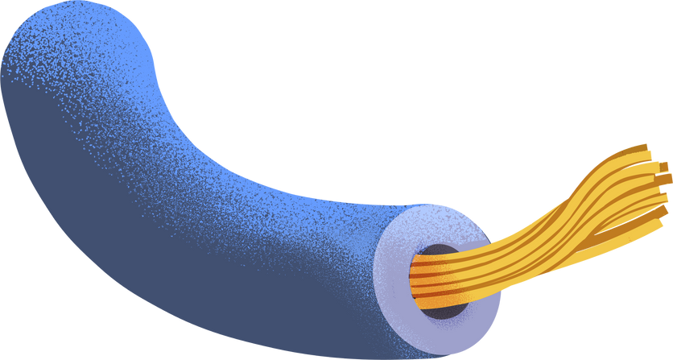
ELECTRIC CIRCUIT COMPONENTS
Power Source
Conductors
Load
Switch

Slide 7



Components Of
Electric Circuits divided into two parts
Conductors Components Of Electric Circuits | Insulators Components Of Electric Circuits
Wires | Wire Cover
Metal Parts Inside Bulb | Outer Body Of Battery
Battery Terminals | Switch Casing
Open Circuit
Closed Circuit

Slide 8
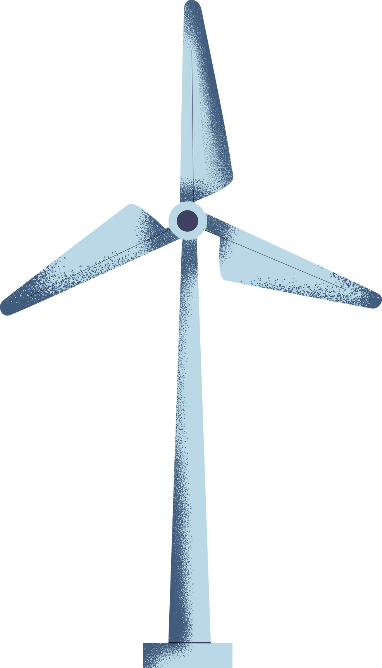
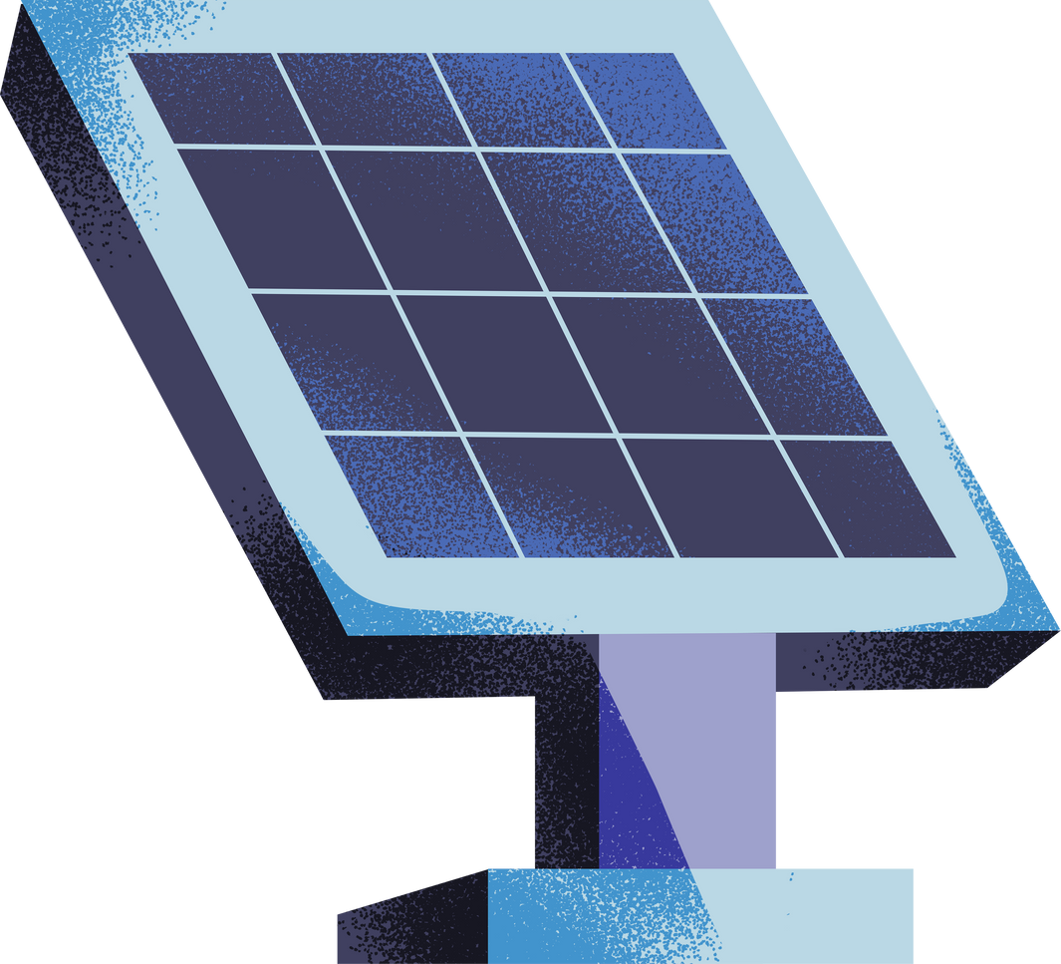
HOW ELECTRICITY IS GENERATED
Renewable Sources
  Solar Panels (sunlight → electricity)
  Wind Turbines (wind → kinetic → electrical energy)
Non-Renewable Sources
  Fossil Fuels (coal, gas)
  Nuclear (uranium fission → heat → steam → electricity)

Slide 9
