Slide 1









The Amazing Journey of Food in Our Body!
By: Maher Khzouz
Grade 4
"Today I want to take you on a little adventure inside our bodies!"

Slide 2

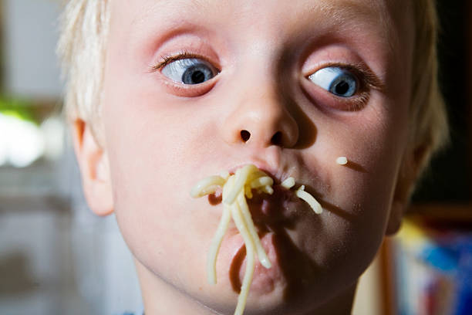










The Adventure Begins: The Mouth
💧
💧
💧
💧
🦷
🦷
🦷
🦷
🦷
💧
💧
💧
💧
💧
💧
💧
💧
💧
💧
💧
Teeth
Saliva
Chop food into small pieces
Makes food soft and easy to swallow
This is where digestion begins!

Slide 3
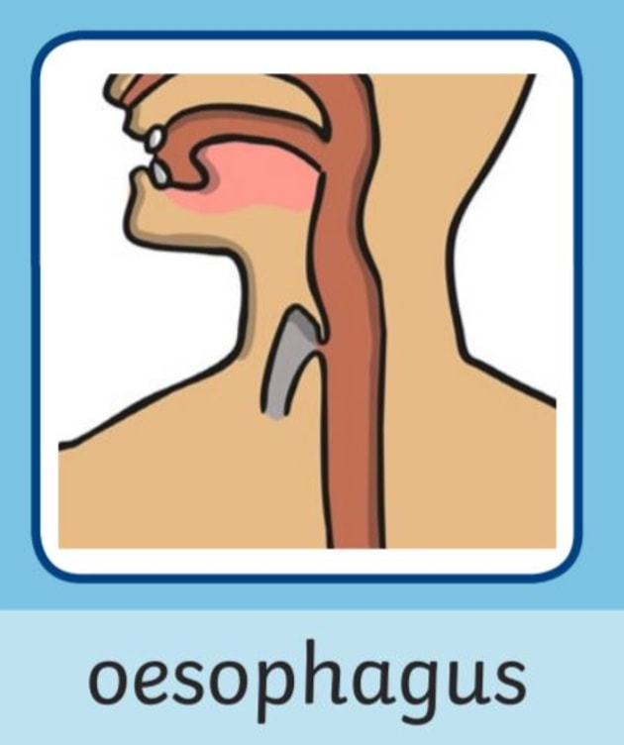




Slide Down the Stomach
Food slides down the Esophagus like a water slide, pushing food straight
To the Stomach!

Slide 4

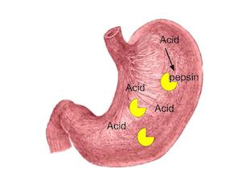

























Stomach: The Food Mixer
Stomach Acids
Soft Liquid
Mix with food to break it down
Turns food into a liquid mixture
The stomach is like a strong blender!

Slide 5
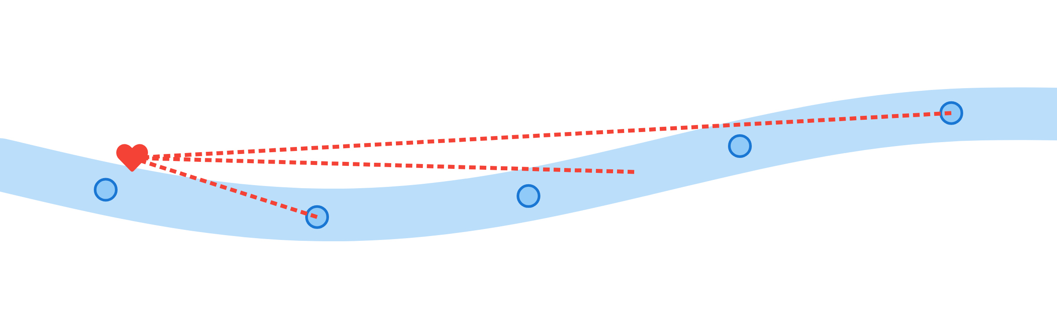






Small Intestine: The Super Absorber
🍎
🍗
🥦
🥛
🍞
Energy
Growth
Repair
Nutrients provide energy for play and activities
Helps build stronger muscles and bones
Fixes cuts and helps heal when we get hurt
The small intestine absorbs nutrients into our blood for our body's needs!

Slide 6
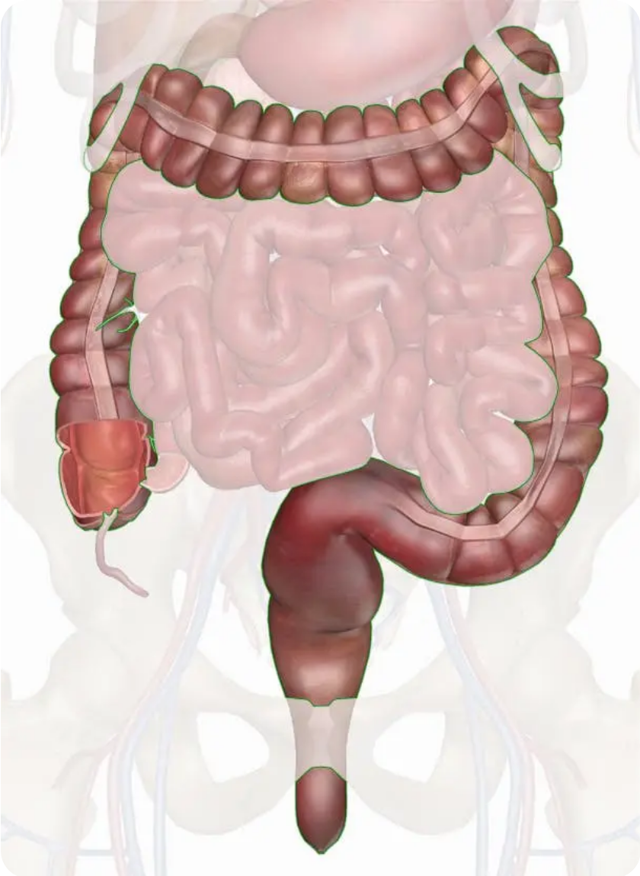









Large Intestine: Time to Clean Up
What happens here?
Unused food becomes waste
Waste Removal
Body gets rid of waste outside our body
The end of the journey!

Slide 7
















The 4 Steps of Digestion
1
2
3
4
Eating
Breaking Down
Absorbing
Disposing
We eat food and it enters our body
Food gets chopped and mixed with juices
Nutrients go into our blood for energy
Waste is removed from our body
These steps happen one after another to help our body get energy and stay healthy!

Slide 8






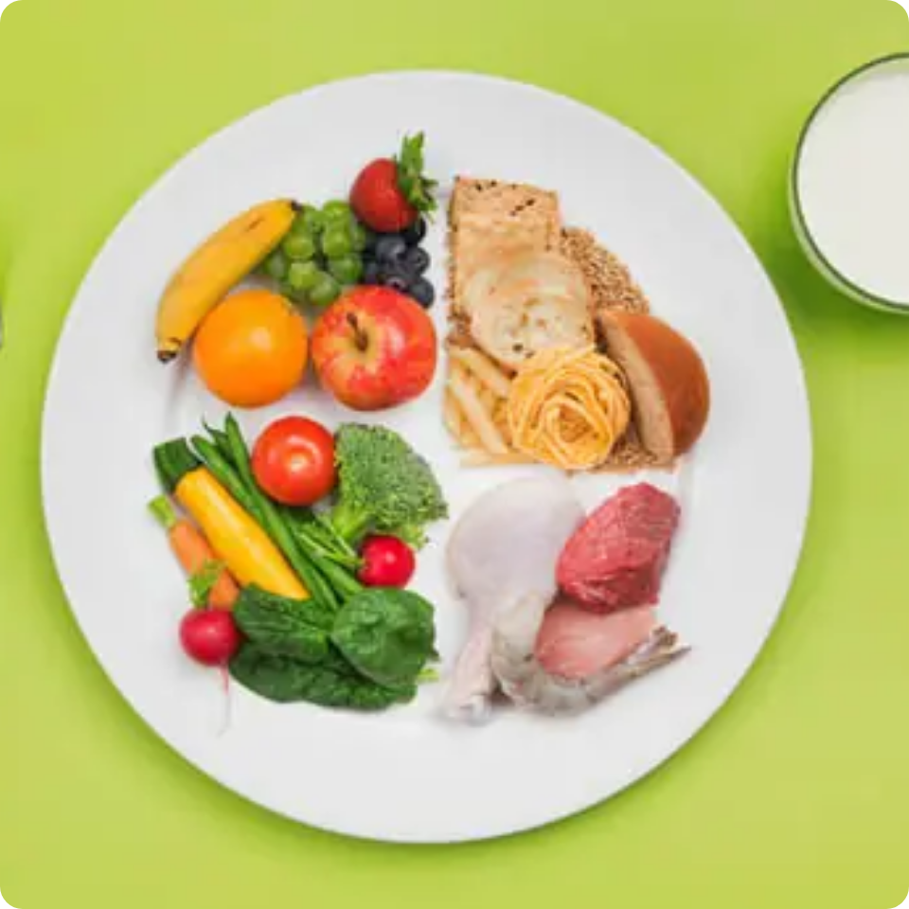







Keeping Our Digestive System Healthy
A Balanced Diet
A Balanced Plate
Eating the right foods helps your digestive system work well!
Fruits
Vegetables
Vitamins & Fiber
Nutrients & Fiber
Proteins
Carbs
Muscle Growth
Energy
Watch Sugar!
Too much sugar harms teeth and can make you sick.
A balanced meal
A healthy digestive system helps us grow and stay strong!

Slide 9








Final Message
Thank you for joining me!
Our digestive system is amazing!
Organs work together to keep us healthy
Eat well to keep your digestive system healthy
Thanks for learning about our amazing digestive system!

