Slide 1
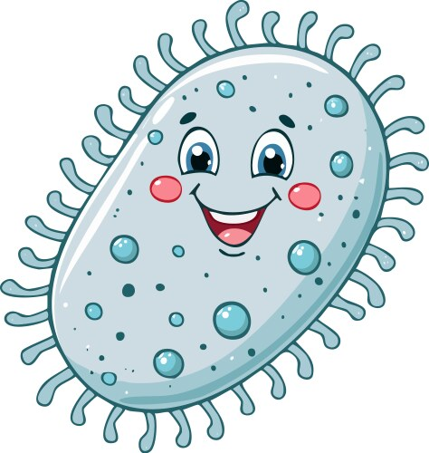
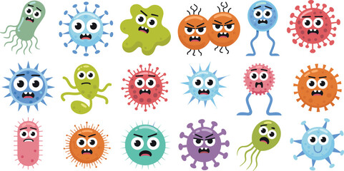
Rashed bajjali Bacteria
Viruses and Bacteria
acteria

Slide 2
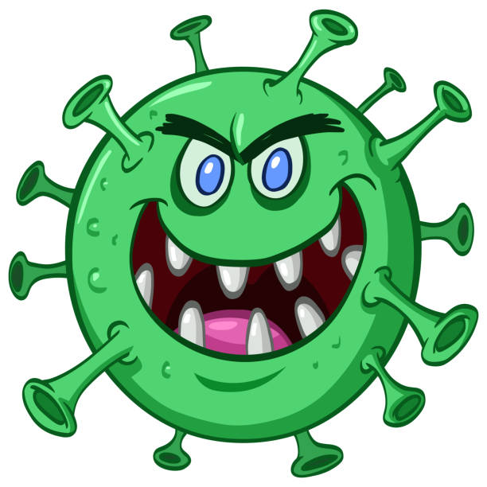
Viruses and Bacteria
Introduction
• What are viruses?
• What are bacteria?
viruses
bacteria

Slide 3
What Are Viruses?
• Very tiny particles
• Cannot live alone – need a host
• Cause diseases like flu, cold, measles

Slide 4
What Are Bacteria?
• Single‑celled organisms
• Some are good (help digestion)
• Some cause infections

Slide 5
Bacteria vs Viruses
• Viruses: need a host
• Bacteria: can live anywhere
• Viruses: smaller
• Bacteria: some helpful, some harmful

Slide 6
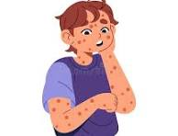
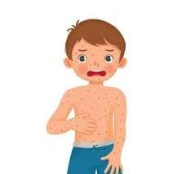
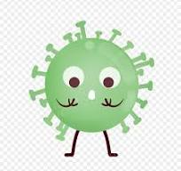

Types of Viruses
• Influenza Virus (Flu)
• Coronavirus (COVID‑19)
• Measles Virus
• Chickenpox Virus

Slide 7
How Viruses Spread
• Touching contaminated surfaces
• Sneezing and coughing
• Sharing food or drinks
• Not washing hands

Slide 8
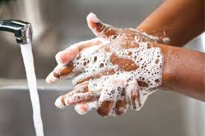
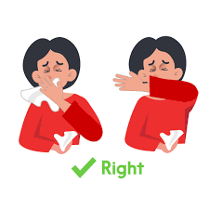

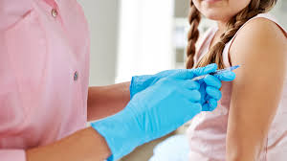
How to Protect Ourselves
• Wash hands with soap
• Use tissues when sneezing
• Avoid touching face
• Stay home if sick
• Vaccinations help protect

Slide 9
Stay Healthy!
• Eat healthy food
• Sleep well
• Exercise
• Keep clean

