Slide 1
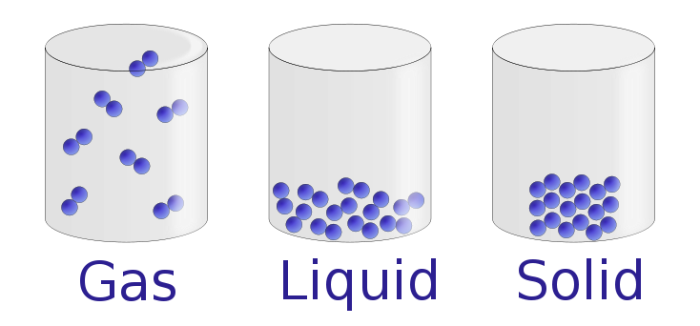
States of Matter
Rakan Sawalha grade 4 A

Slide 2
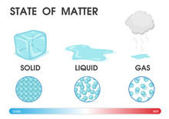
What are the three states of matter.
They are ( Solid, Liquid and Gas )

Slide 3
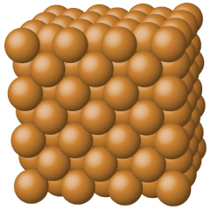
Solid
Solid particles are packed tightly together they stay in fixed position.
The particles vibrate in their postion.

Slide 4
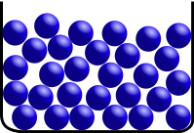
Liquid
Liquid particles are closer together than gas, but not as close as in solid.
Liquid don’t have a fixed shape, they can flow and take the shape of the container.

Slide 5
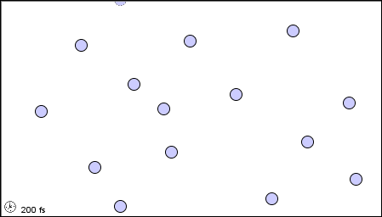
Gas
Gas particles are not close together they move in different directions.
Gas fills the container.

Slide 6

Greeting
Thank you for listen
Please like and subscribe. ☺

