Slide 1
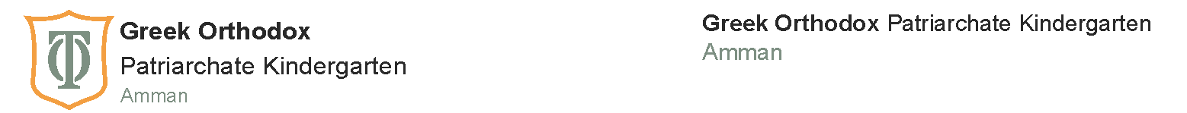
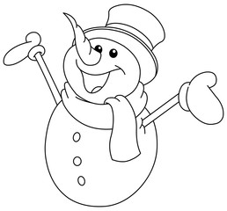
Winter Break Revision Booklet
Math
KG2
Name: ______________

Slide 2
Match each number with the correct number word.
1
three
2
four
3
one
4
two
5
five
6
seven
7
nine
8
eight
9
six
10
ten

Slide 3
Add the following.
4
+
1
=
3
+
2
=
2
+
2
=
1
+
2
=
3
+
1
=

Slide 4
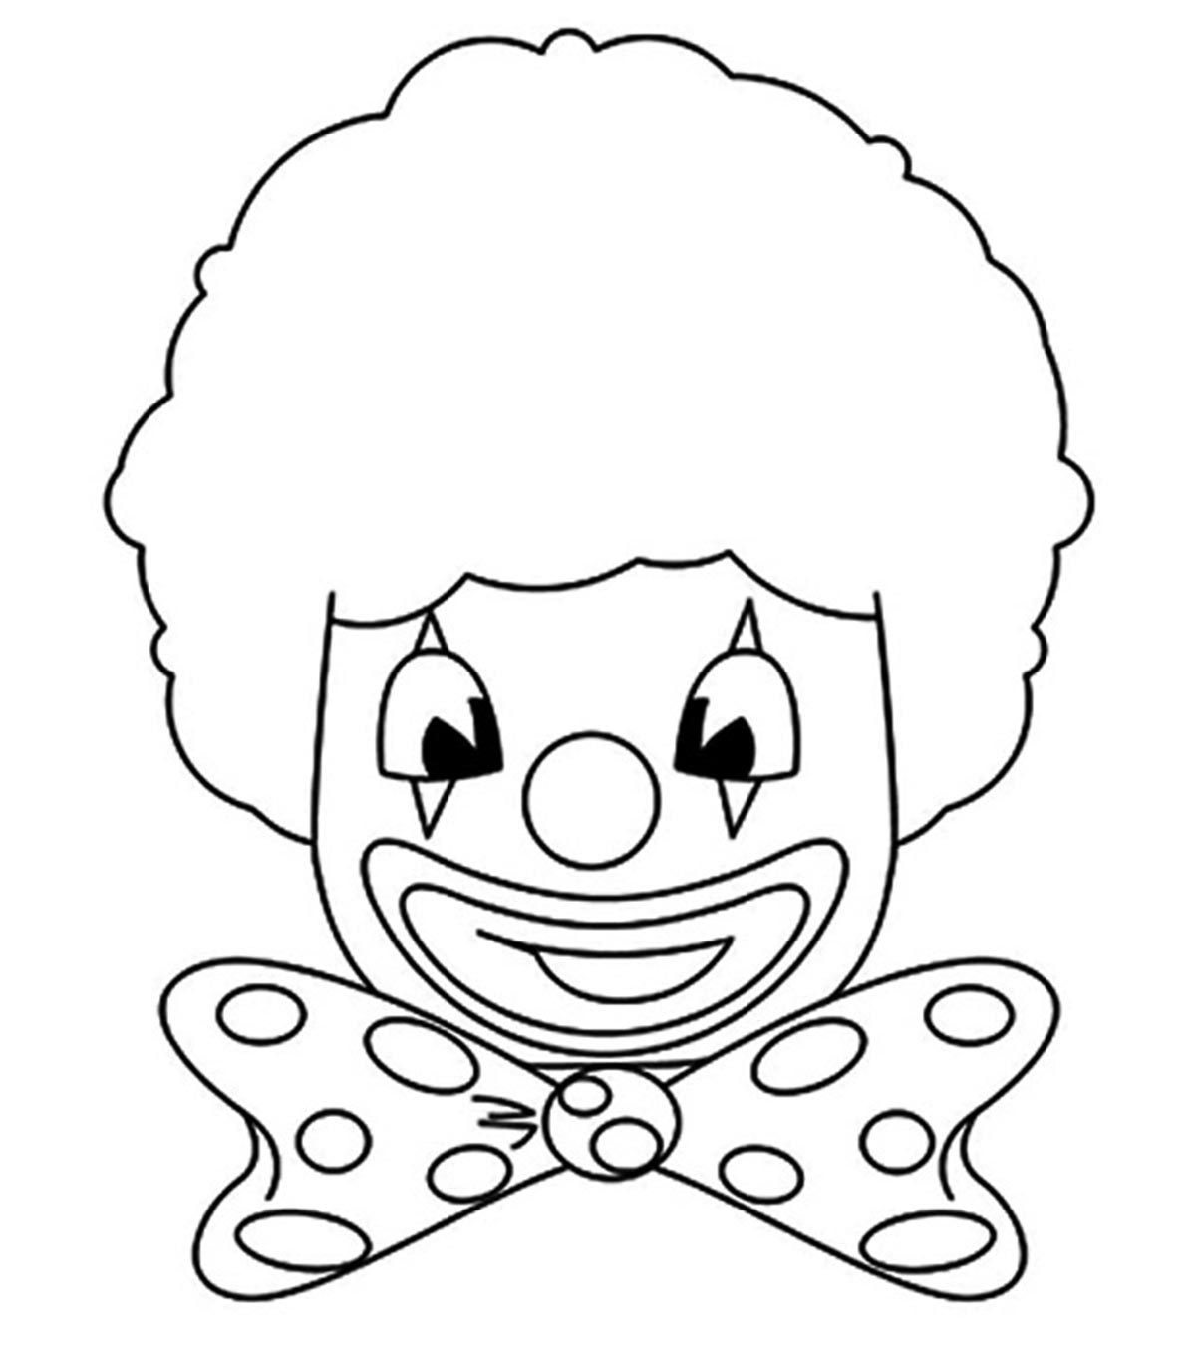


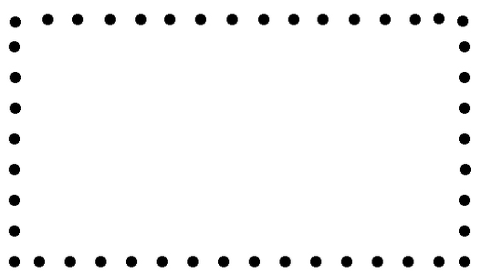

Read the color words, then colour.
yellow
red
red
green
yellow
green
yellow
Trace the shapes.
circle
rectangle
square
star

Slide 5
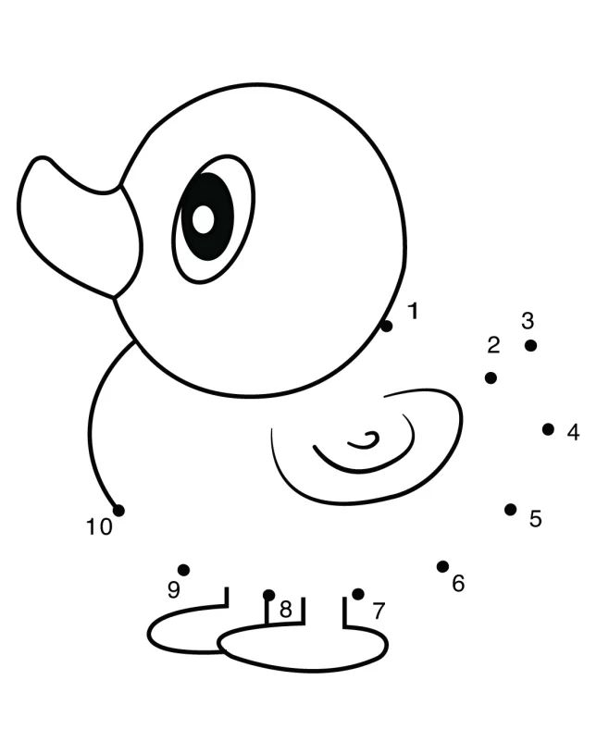
Connect the numbers 1 to 10 to finish the picture, then colour.
Write the numbers 1 to 10 in order.
3
7

Slide 6


