Slide 1
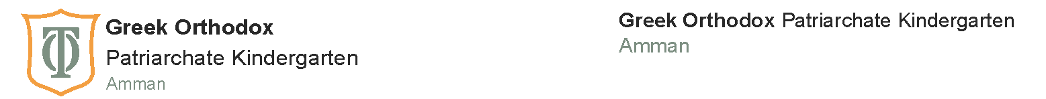
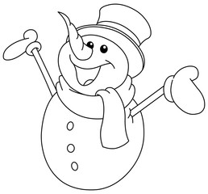
Winter Break Revision Booklet
English Language
KG2
Name: ______________

Slide 2
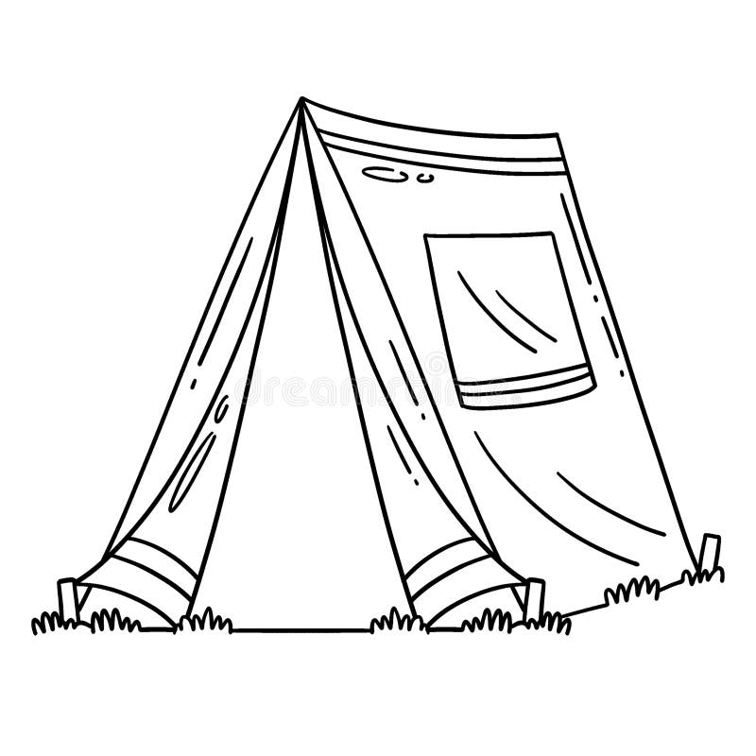

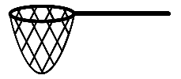
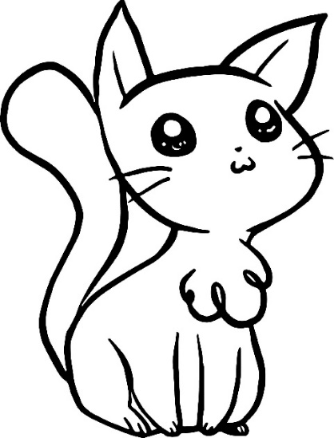

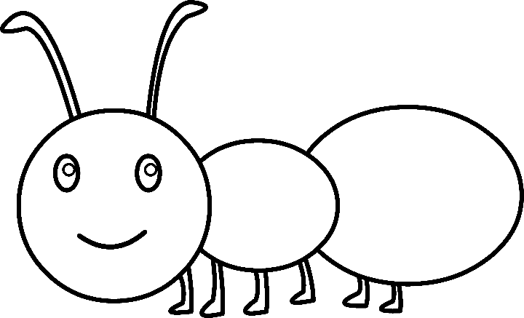
Read the words below and write the correct word under each picture, then colour.
tent ant sun
ink cat net

Slide 3
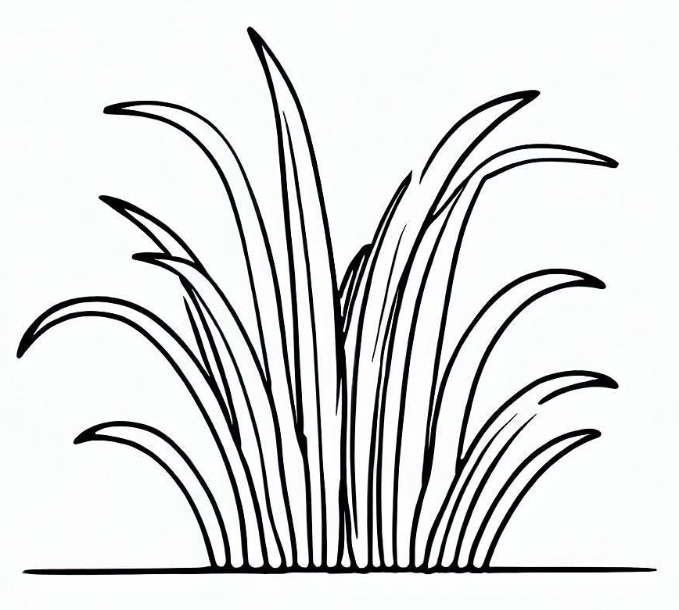
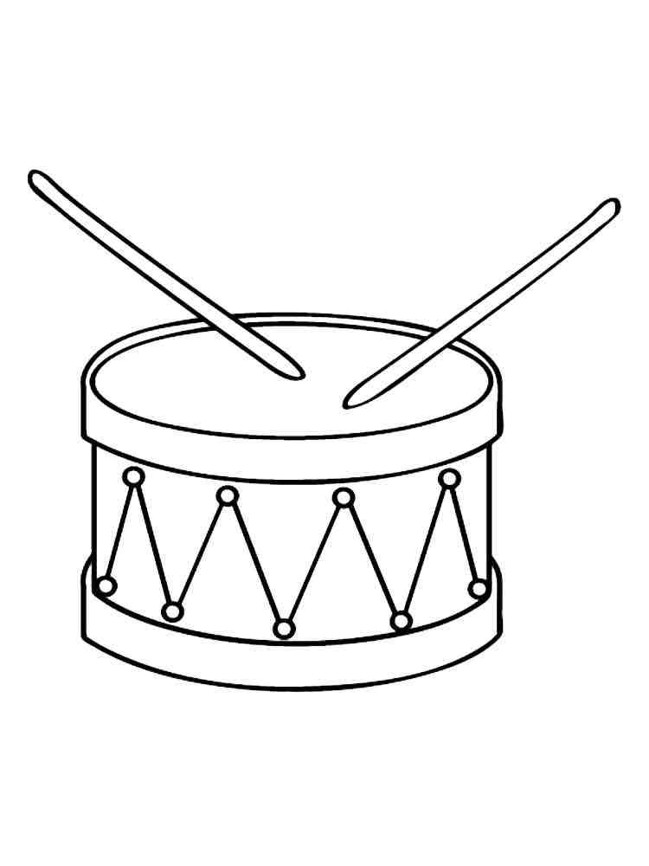

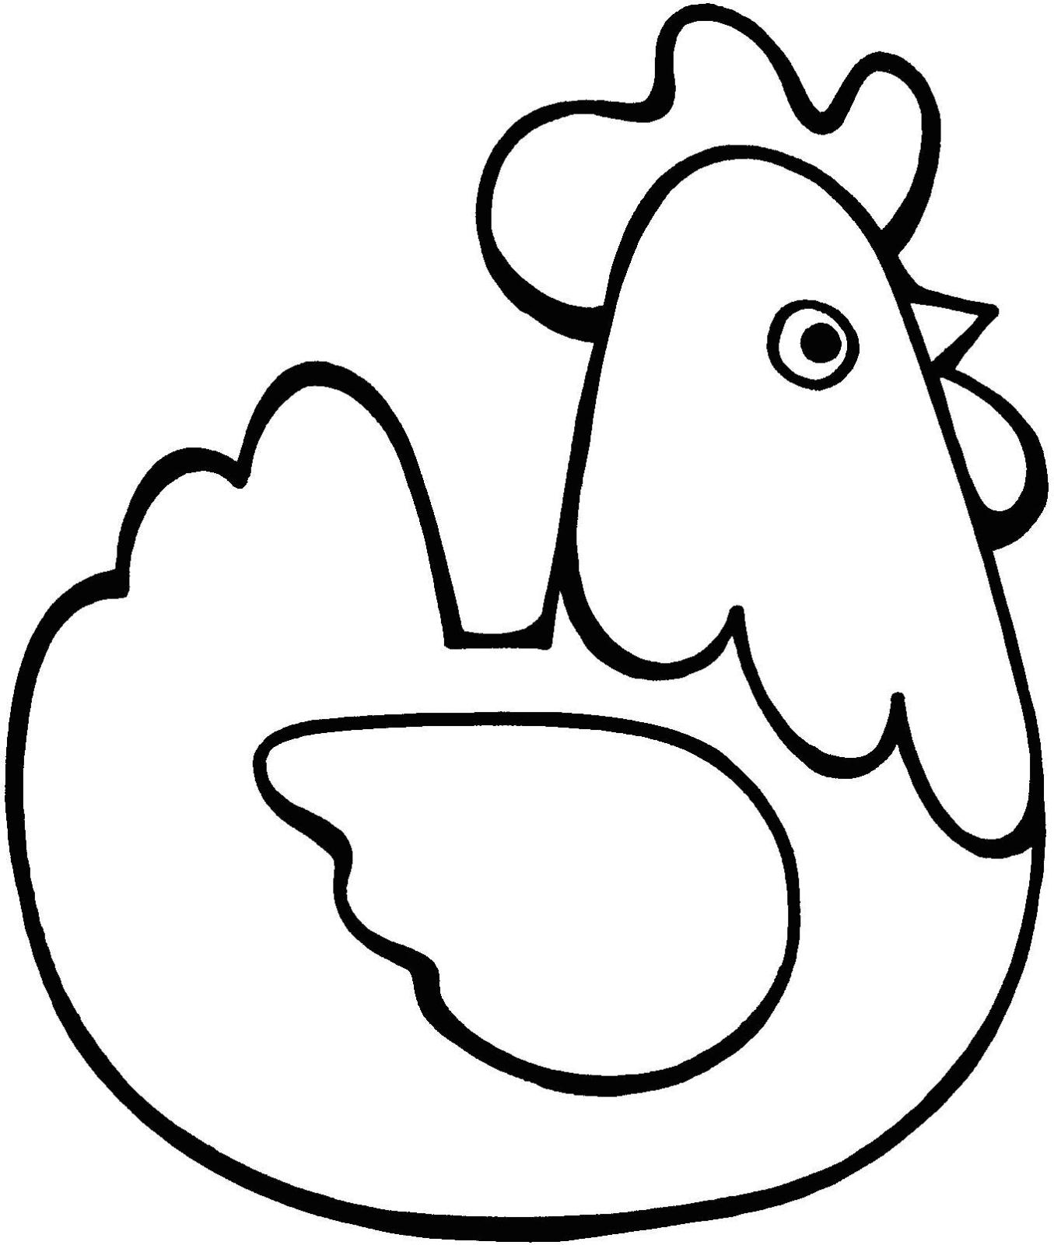
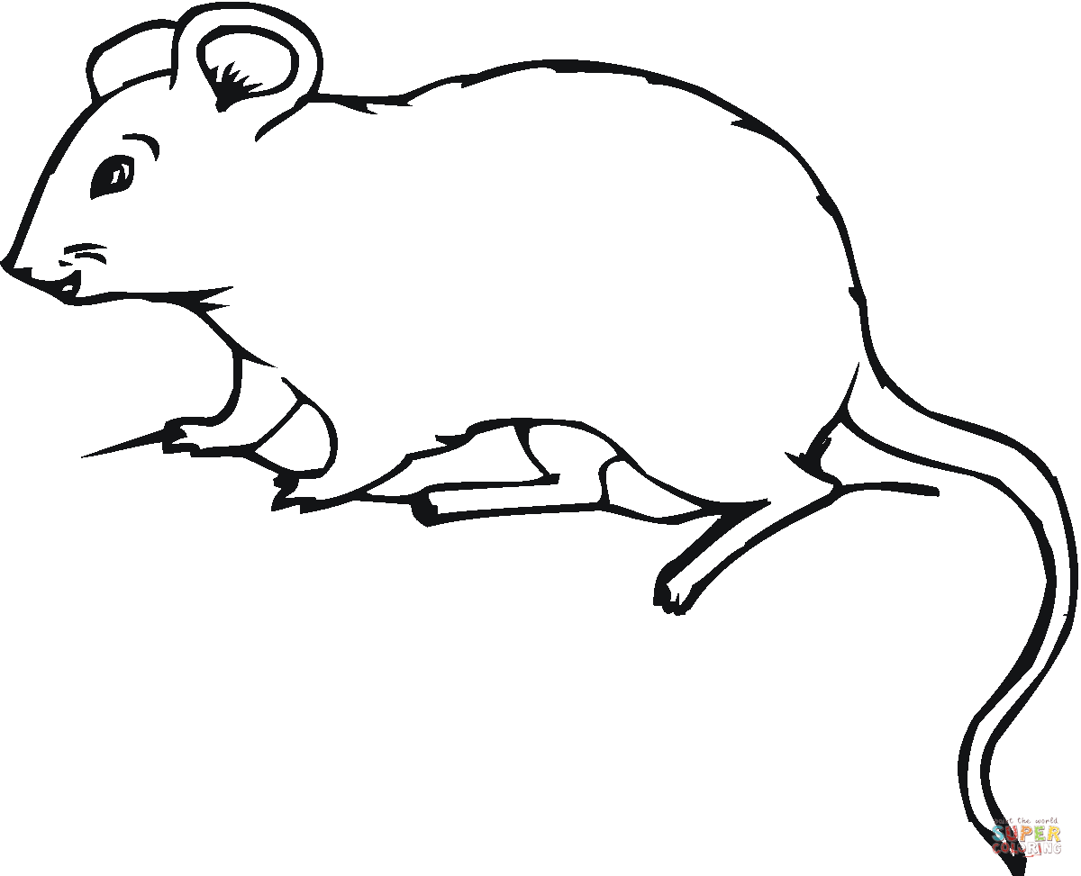
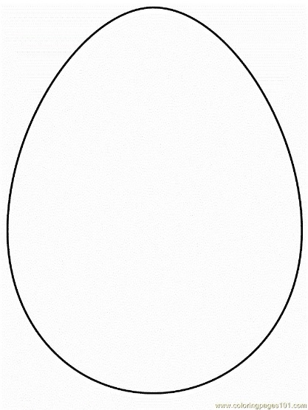
Read the words below and write the correct word under each picture, then colour.
cup drum grass
rat hen egg

Slide 4
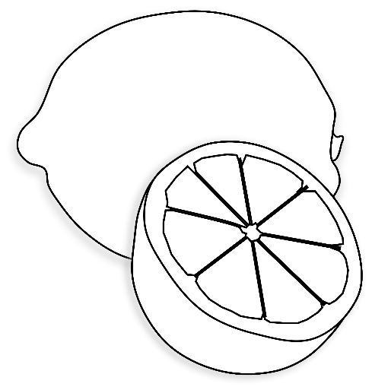
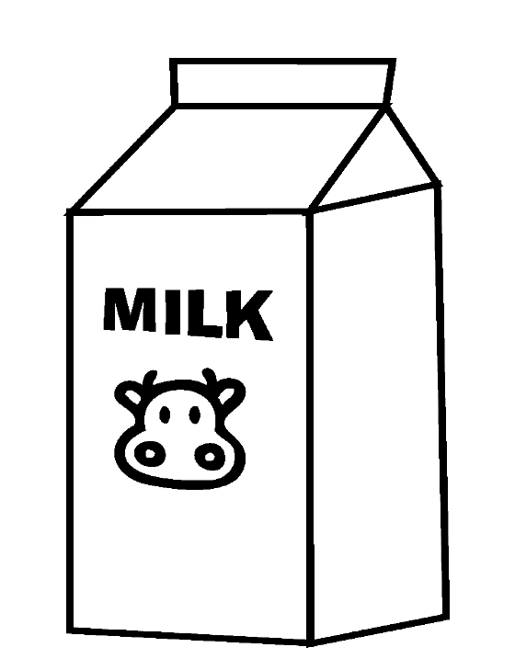


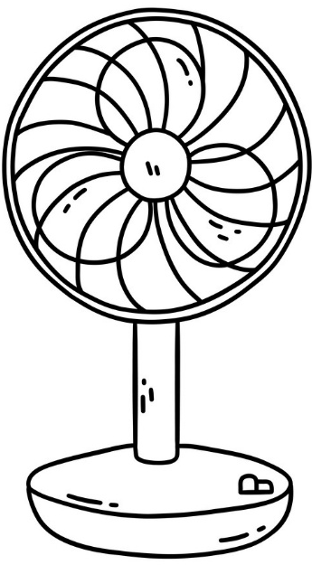
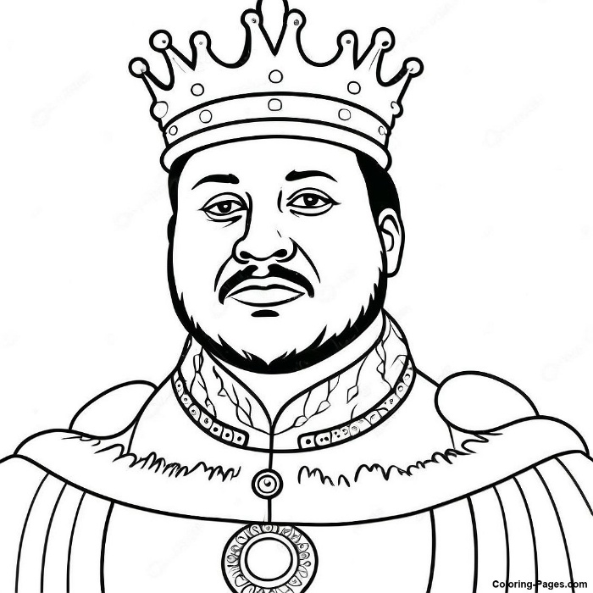
Read the words below and write the correct word under each picture, then colour.
lemon milk bag
pot fan king

Slide 5
Read the tricky word in each row and circle the similar one.
the
do
I
the
do
do
she
all
she
me
she
he
all
do
she
all
I
me
was
I
he
we
he
he
me
me
she
me
we
we
she
all
was
me
was
was
be
be
she
me
are
are
she
are
to
do
she
to

Slide 6
Read the tricky word in each row and circle the similar one.
you
come
you
said
your
your
you
here
come
come
some
here
some
said
my
some
said
there
said
here
there
there
you
go
here
no
here
said
they
there
here
they
go
no
go
your
no
my
no
come
so
said
go
so
my
here
my
some

Slide 7
Read and write.
rat
hat
fan
sit
kit
bin
men
bed
pet
log
dog
cut

Slide 8
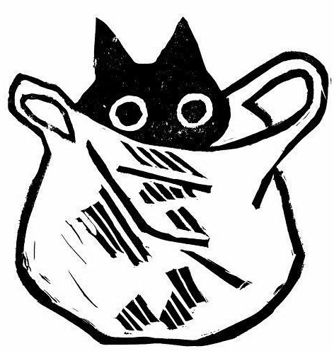
Practice reading the story then colour.
Sam and Mat
Sam had a fat cat.
He had a big black bag.
Sam lost the fat cat, Mat.
Mat, the fat cat,
was in the big black bag!
Enjoy your winter break!

